Slide 1
Smart Cities – a Matter of Communication
From T-City to the Smart City Vision
Jörg Heuer, Research & Innovation Director;
Joachim Schonowski, Smart City topic responsible

Slide 2
Telekom Innovation Laboratories

Slide 3
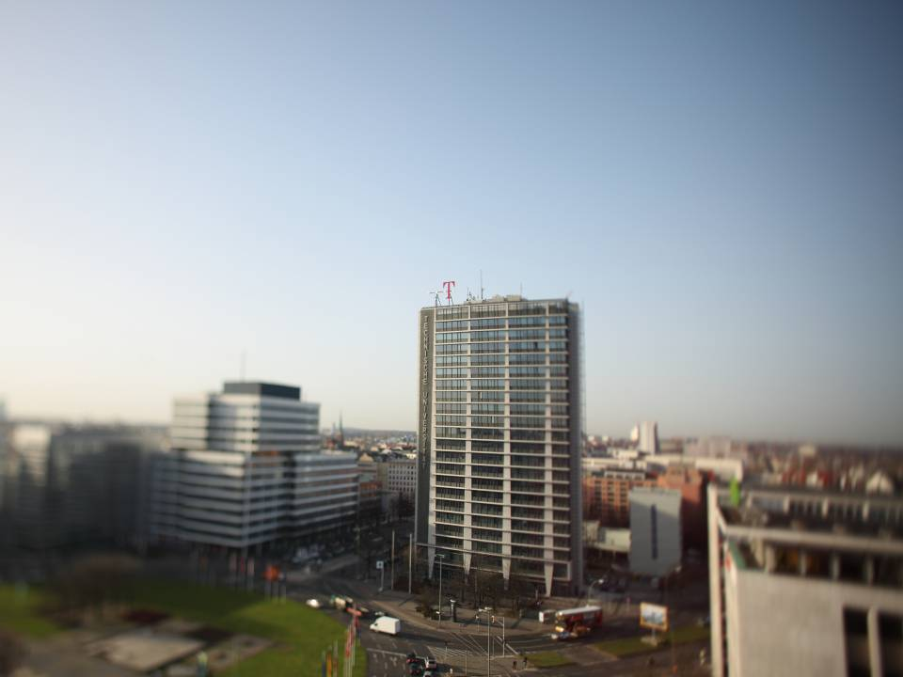
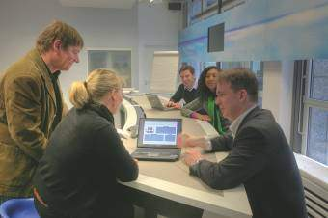
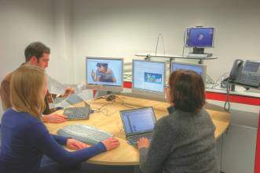
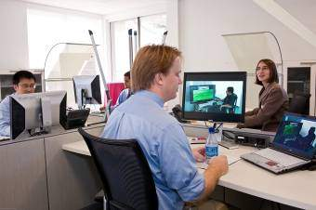
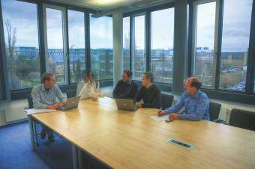
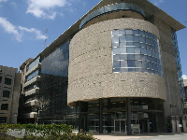
LOCATE T-LABS
SILICON ALLEE, SILICON WADI, SILICON VALLEY
Berlin 1
Mountain View
Berlin 2
Bonn
Tel Aviv
Darmstadt
Beer Sheva
Notes:
darmstadt

Slide 4
T-LABS – OPEN INNOVATION
A LONG-TERM SUCCESS FOR DEUTSCHE TELEKOM
Strategic Research
Innovation Development
Focus on scientific research
  Six professorships in universities in Berlin
  More than 150 high-potentials from around the globe
Leading edge competence:
  250 publications per year, 1 patent per week
  One award per month, e.g. Scientific
  Leibnitz Award in 2011
Focus on 7 key topics
  180 Telekom experts
  Competences all across the Telco value chain
Impact orientation:
    Gravity core for Telekom innovations in the double digit billions
      Close cooperation with all business units of Deutsche Telekom
Push results of the Open Innovation ideas
  Worldwide joint innovation with SAP,
  Bell Labs, Ericsson, BMW, etc.
  Start-up network (Berlin, Silicon Valley, Israel)
Track record of new ventures – Trust2Core, SureNow
QiSec, Zimory, Youchoose, Spotlight , etc.
Start-ups & Industry partners
Network of international partnerships with top research institutes, universities, industrial partners and start-ups.

Slide 5
THE EU Notion
AND
AN ICT View

Slide 6
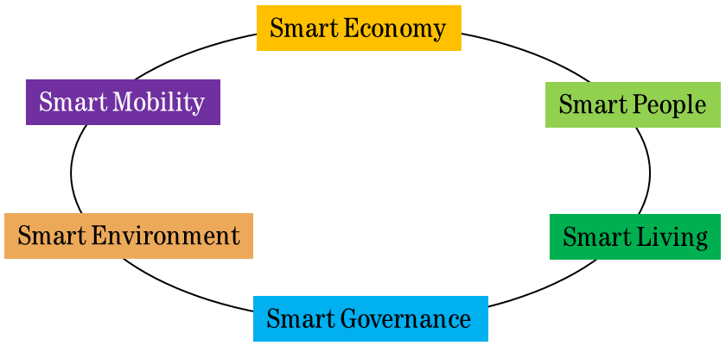
perspectives on a Smart Sustainable City
Holistic motivation
Operator excellence
  Cities require a high degree of Information and communication technology to run their infrastructures – in a sustainable way. Cities are full of people and businesses with a need for modern ICT provided by operators:
  Connectivity
  Cloud IT and services
  Trustworthy business processes
  The German IT Summit has created an extended notion of Intelligent Networks which conveys the necessary means also towards Smart Cities.
European smart cities model
  A Smart City is a city well performing in six characteristics, built on the ‘smart’ combination of endowments and activities of self-decisive, independent and aware citizens.
* http://smart-cities.eu/model.html

Slide 7
ICT provides the Intelligent Network
Classification and overview
Illustration as discussed in 2012
  Intelligent networks are technically and in their application related to further current innovation fields.
  The concept of intelligent networks must be considered in the context of manifold dynamic developments and various actors.
  In this sense, the theoretical and scientific basis needs to be fostered and coordinated to improve the technology-neutral build-up of intelligent networks across the industries.
Parallel developments in the context of intelligent networks
Smart Home
Smart Buildings
Smart Mobility
eLearn-ing
further Innovation Fields
Internet
of Things
Traffic
Education
Smart Cities
Cloud Computing
Intelligent Networks
IPv6
Broadband Networking
Health
M2M
eHealth
Administration
eGov
Energy
Industry 4.0
Cyber Physical Systems
Smart Grid

Slide 8
T-Labs’ Research and Telekom Innovation towards
Smart Cities

Slide 9
T-LABS PROJECTS MAPPED TO SIX EU TOPICS
Smart
Economy
Smart
People
Smart Governance
Smart
Mobility
Smart Environment
Smart
Living
Internet & Services + Interactive Media
Indoor analytics
& aviation,
Customer analytics
Ubi Markets
Geo marketing & profiling,
Location & augmented reality based ad-hoc social networks
Ad-hoc collaboration &
E-Polling for urban planning*
Soundtrack
High quality video communication & conferencing
3D communi-
cation
Cross Domain Middleware
Smart microgrid, Smart Security - Cybersecurity
Wearables –
urban navigation,
Wearables & augmented reality
Business Web: Smart Port Logistics at Hamburger Hafen
Smart microgrid, Earthquake warning „Droidshake“
Smart senior & Ambient Assisted Living, Connected Living – Connected Home, Trust 2 core integration in smart metering und home gateway (Quivicon)
IT & Cloud
Data science support: Hadoop as infrastructure
Mobile wallet, Personal identity
Trust provider, Cyber security
Smart object identity
Connected
Networks &
Infrastructure
M2M standardization,
Smart devices & sensors,
Intelligent IP
traffic mgmt
Home network profiling (Lola)
Communicate green + Green DSL + Smart Office- efficient networks as reference for smart grids, Desi, Green IT@T-Labs
Universal broadband access

Slide 10







Selected Running Activities in more Detail
Organizations, Products and Initiatives
Smart Living /Home
Smart Living / Senior
4th Industrial Revolution
Provisioning of a certified connected device steering platform + SDK for 3rd parties for a smart home.
Modular service offerings enabling the elderly to continue living in their own homes, based on Home Gateway for Ambient Assisted Living (AAL) - Quivicon
Project support of Industry 4.0 projects with industry partners.
Smart Economy
EU - Future Internet
Smart Government
Smart port logistics – port Hamburg M2M market places for enhanced logistics
Development of a pan-European common Internet platform providing a generic infrastructure to foster open innovation.
Develop future sustainable services towards Horizon 2020.
Smart Energy - DESI
Creating Citizen Centric Cities (CCC)
to enhance the participation of the citizens
Aligning and adapting energy provisioning with real traffic loads opens up a huge carbon decrease potential.

Slide 11
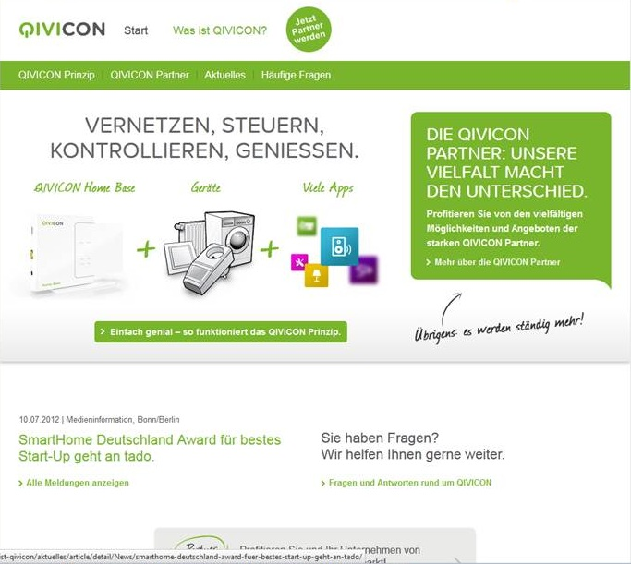
QiVICON for Smart Living
From the Labs to the Product
Service overview
Energy and Living
QIVICON is an Internet based home-automation platform for future home, supporting multiple scenarios to connect and safe energy and life and provide technically enhanced convenience for their inhabitants, especially supporting the silver generation at home. Partners, e.g.: EON, EnBW, Miele, Samsung, WinkelSolar eQ-3.
The small box „QIVICON Home-Base“ provides an Internet-platform using powerline and an appstore. The system can communicate over the air with all Qivicon certified electronic devices at home and is steered by any Internet connected device.
Examples: Developed by partners, Apps provide tasks like: activate a washing machine, once enough solar power is available or power tariffs are cheap. .

Slide 12



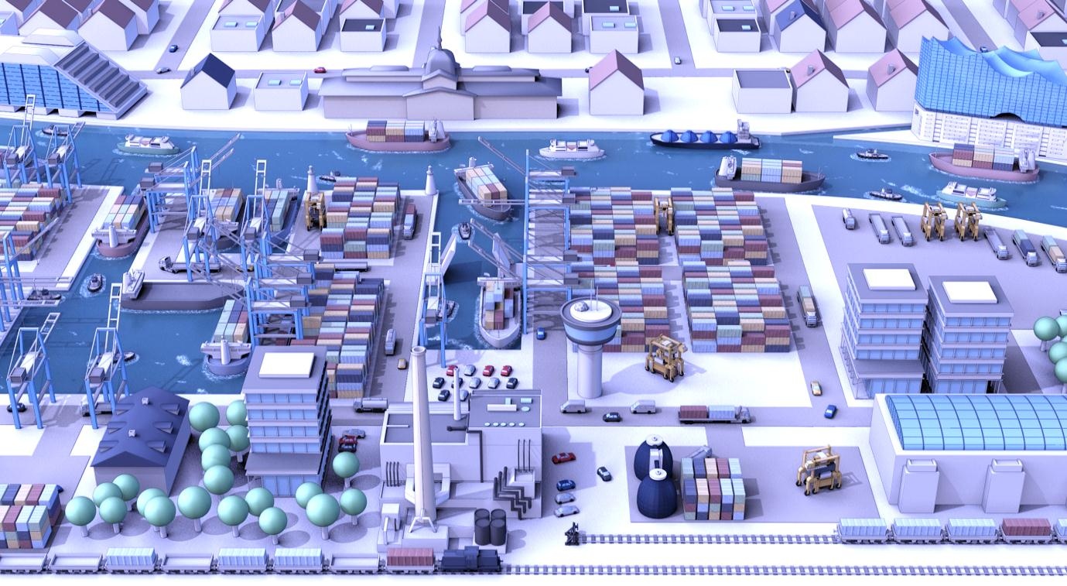


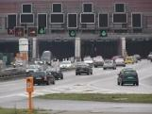





SMART PORT LOGISTICS
COOPERATION BETWEEN
Logistics Infrastructure Service
Traffic/ infrastructure status information
Expedition
Truck & trailer status information
Parking Space Rental
Service/ status information
Mobile Business Cloud
Cloud services for Hamburg port logistics ecosystem
Telematic
One
NetWeaver
Cloud

Slide 13
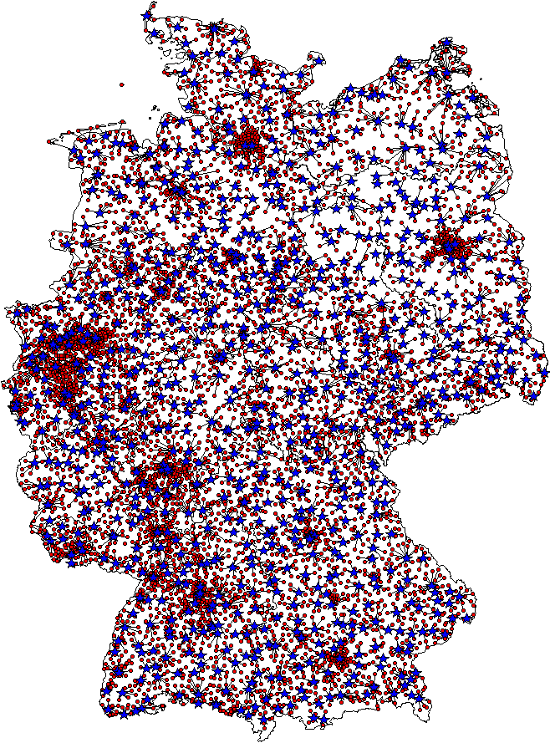
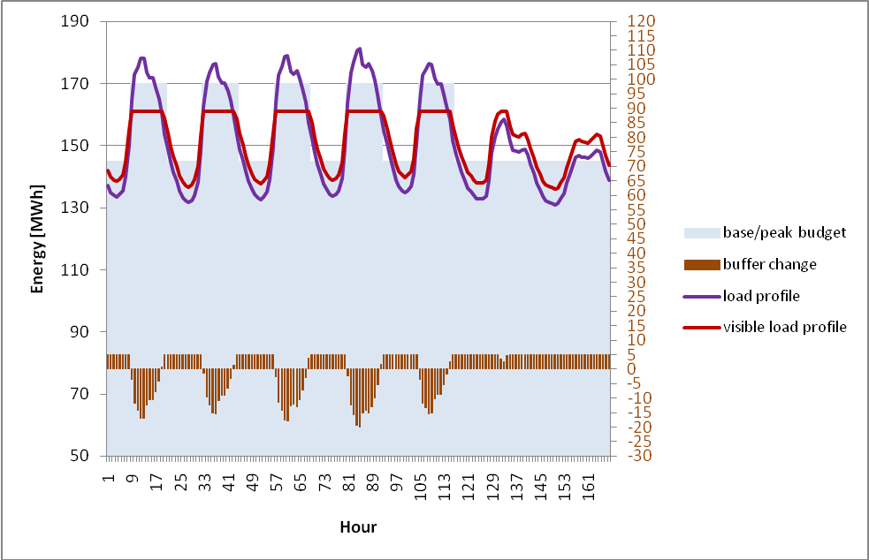
SMART ENERGY degrees of freedom in the Telco network
Two system-wide network structures
* http://www.cs.ucy.ac.cy/CIT2011
  Telco and power are parallel network-based maintenance structures with system-wide presence.
  Energy elements of the Telco network may, thus, be sensibly integrated into the future ‘Smart Grid’:
  ca. 65,000 power consumer sites
  ca. 18,500 battery parks with
  ca. 22 MAh capacity and
  ca. 2,700 emergency generators.
  The energy provisioning of a system-wide load-adaptive Telco network is ideally positioned to mediate between the challenges of variable load and Smart Grid operation (e.g. volatility).

Slide 14
The T-City Experience

Slide 15
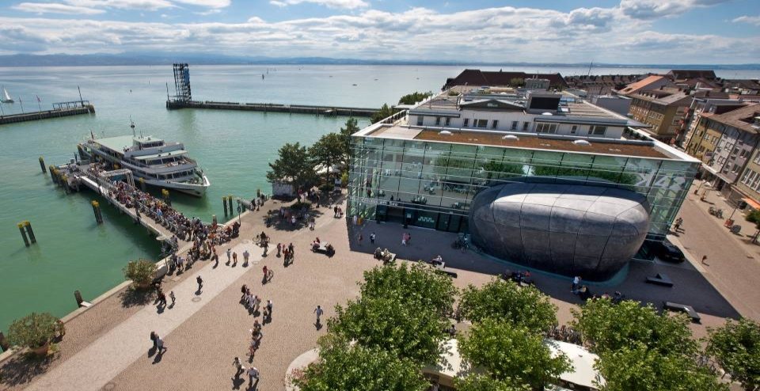
T-CITY OBJECTIVES
Experience since 2007
Increase quality of life with ICT
Connect city and
citizens
Reputation and
image
Innovation

Slide 16
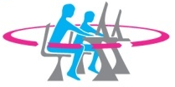





FIRST PHASE OF T-CITY 2007 – 2012
MORE THAN 40 PROJECTS WERE COMPLETED
Education
Edunex
EduKey
Health
Self-determined
living
BIGKidsCoach
derBUTLER
BodyTel
Remote patient care
T-Mobile emergency number
Tumor conference
Diagnosis portal
Citizens &
Government
Request management
Authorities’ number 115
De-Mail
Online kindergarten
EU Service Directive
Tourism &
Culture
Interactive hiking
Suche.mobi (Search.mobi)
Multimedia terminals for the deaf
Tourism portal
Multimedia terminals
Media hotel
Schwäbische.de @ Entertain
Digital picture frame
CityInfo
Business &
Energy
Smart metering
Home Network 2.0
Smart grid
Ddesk
G/On
Mobile Worker Bundle
Mobility
flinc
KatCard
GPS emergency call

Slide 17
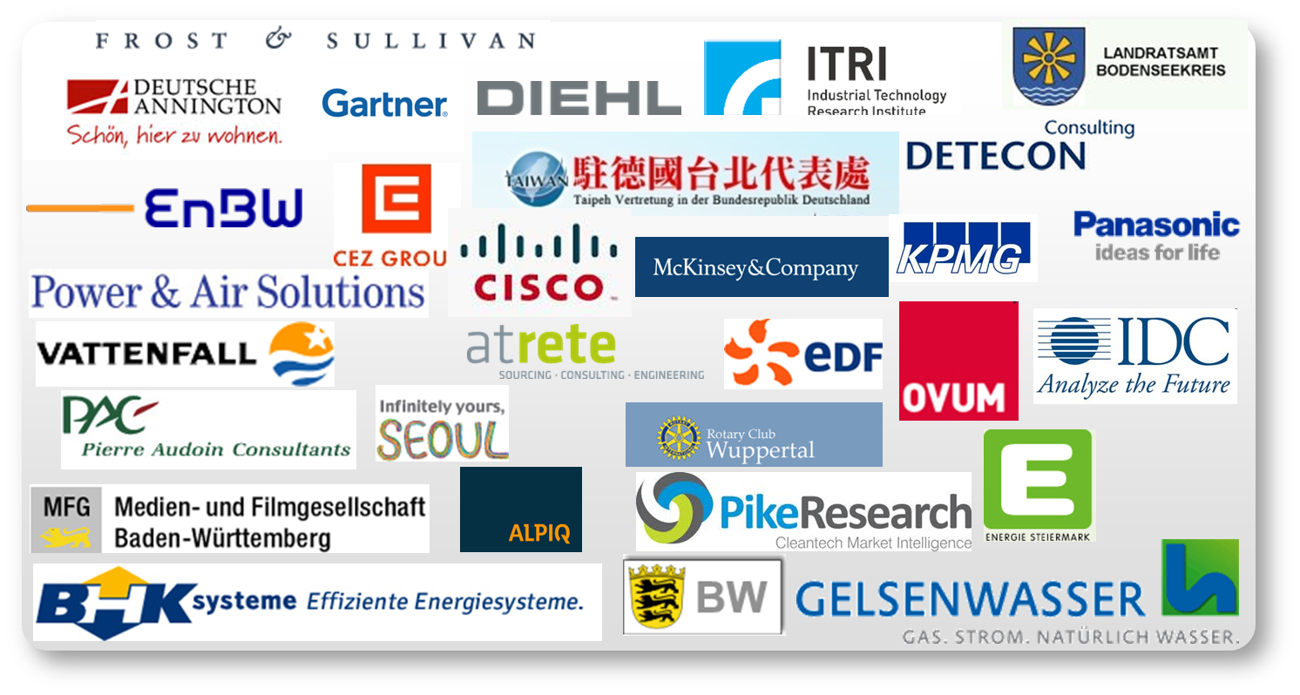
T-City turned into Telekom-City
A successful experience Continued
    T-City…
    attracted a lot of attention:
    (just a few of the visitor groups)
    Feedback has been great
    Experience collected went into products and fuels the Smart City work at DT
    Telekom-City
    The experiment has been turned into ‘normal’ operation through T-Systems
    Collaboration with local authorities is continuing
    Three model ‚futurists‘ households are kept up
    ‚Futurist‘ companies are in focus now

Slide 18
Conclusion

Slide 19
Conclusion
Smart Cities and Telecommunications Providers
    High-performance access and transport networks are a prerequisite for Smart Cities
    The network layer alone might not be enough: the ‚Intelligent Network‘ approach matches many requirements of Smart Cities
    Industry verticals need specific support: health, traffic, energy, administration, education, entertainment, production
    User‘s need to be provided with communications means, and the power to control their communication and data flow: mobility, security, identity

Slide 20
THANK YOU!

Slide 21
Backup
T-City Project Examples

Slide 22
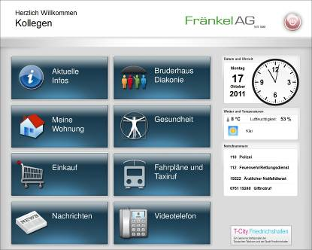
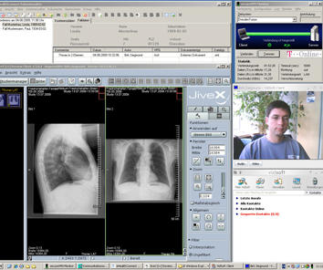
Project Examples
Support for elderly for long-term living in their own home
Housekeeper services, food or medicine delivery services, food on wheels, public transport information
Video telephony for social contacts
Overview of electricity, water and gas consumption
Telemedicine
(diabetes, high blood pressure, etc.)
Self-determined
Living
Cancer physicians from Konstanz and Friedrichshafen consult with each other online
Software simulates procedures of weekly on-site tumor conferences
Video conference with integrated electronic patient files including BSI-certified data security
Authentication through certificates and digital signature
High resolution presentation of x-ray images
Treatment plan is created simultaneously
Better treatment through working together more effectively
Tumor
Conference

Slide 23


Project Examples.
Online Kindergarten portal for all kindergartens in Friedrichshafen for parents and administration
Makes searching easier for parents and saves time
View all kindergartens in the Internet
Specify desired kindergarten at a mouse click
Administration obtains transparency on actual place requirements
Simplifies the administration organization
www.kindergarten.friedrichshafen.de
Online
Kindergarten
Binding and confidential electronic communication
Saves postage, printing & paper
As easy as e-mail
Encryption protects against access
Prevents spam
Can be used 24/7 all over the world
Telekom certified by BSI as a secure De-Mail provider
T-City as first pilot location
Product launched in 2012
DeMail

Slide 24
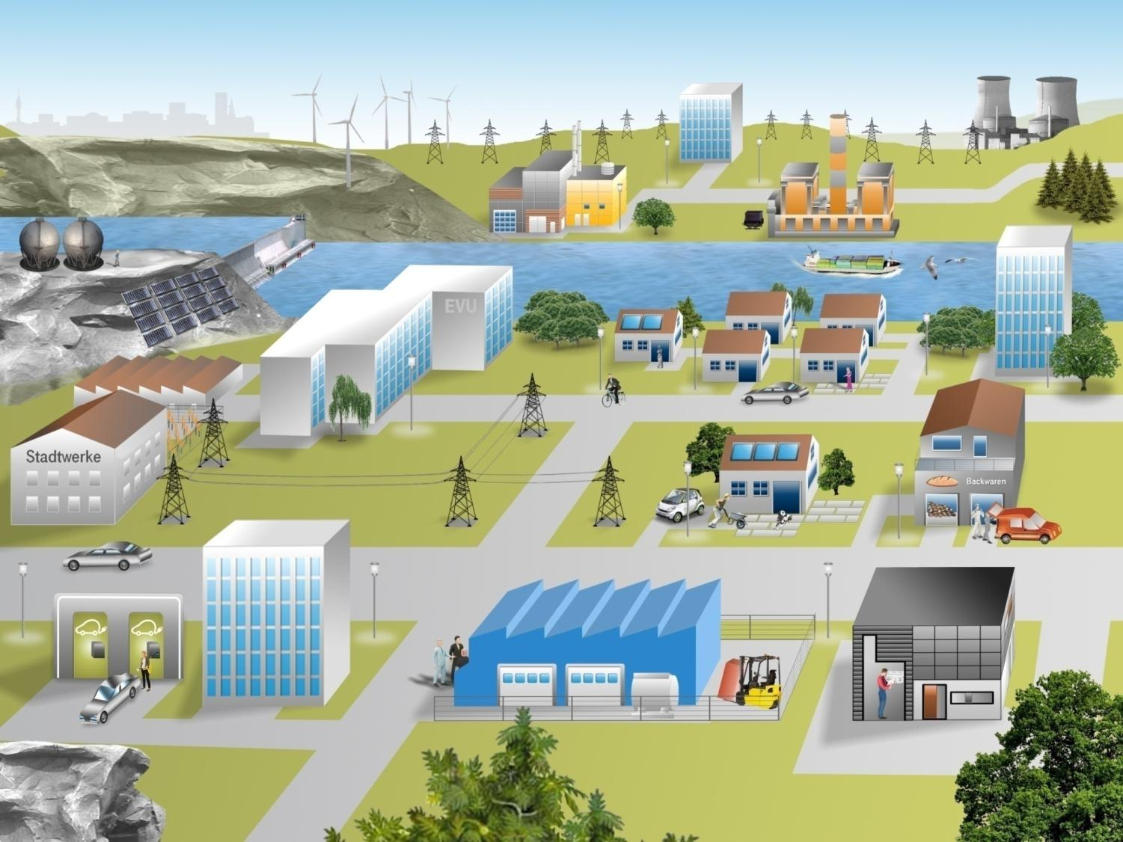
Spotlight on Energy Projects
Transition to Smart Grids in Practice
Energy @ T-City
Objectives
Test secure ICT infrastructure for new energy world
Generate benefits for utility and
end-users
Enable energy efficiency: transparency and control
Integrate prosumers to manage loads and optimize procurement
Project examples:
Smart metering as base
Home networking
Smart grid to the home
(PV, mCHP, heat pumps)
Virtual power plants
Energy efficiency for SME and MNC
Portals for different stakeholders
Connected eMobility
Home automation
Virtual power plants
Energy portals
Peak load balancing
Smart metering
Procurement
Local energy generation
Connected eMobility
Energy efficiency

Slide 25
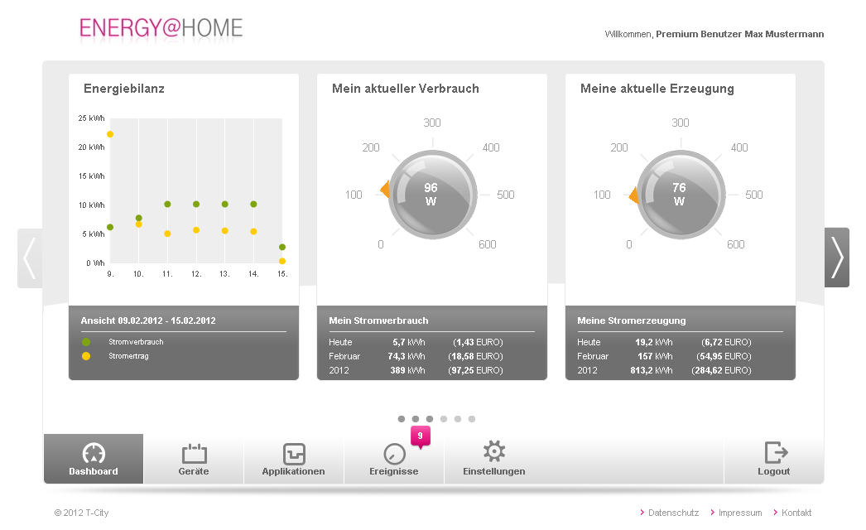
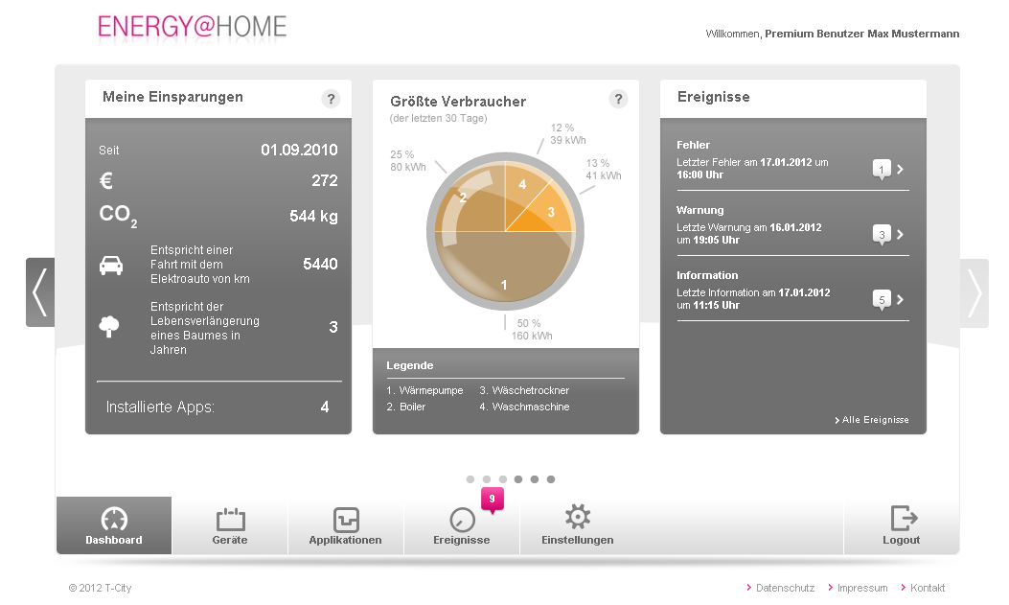
Project Example – Smart Grid to the Home
Integrating renewables into home and grid
Summary.
Connection of photovoltaic systems, combined heat & power plants and heat pumps in buildings as local producers and consumers
Visualization of own energy generation and consumption
Optimization of energy consumption
Automated energy saving tips
Identification of largest consumers in the household
Cost control, alerts and warnings
Access for end-users, installers, utilities and system operators on the relevant data
Integration into back-end systems via
Virtual Power Plant & Load Management System

Slide 26
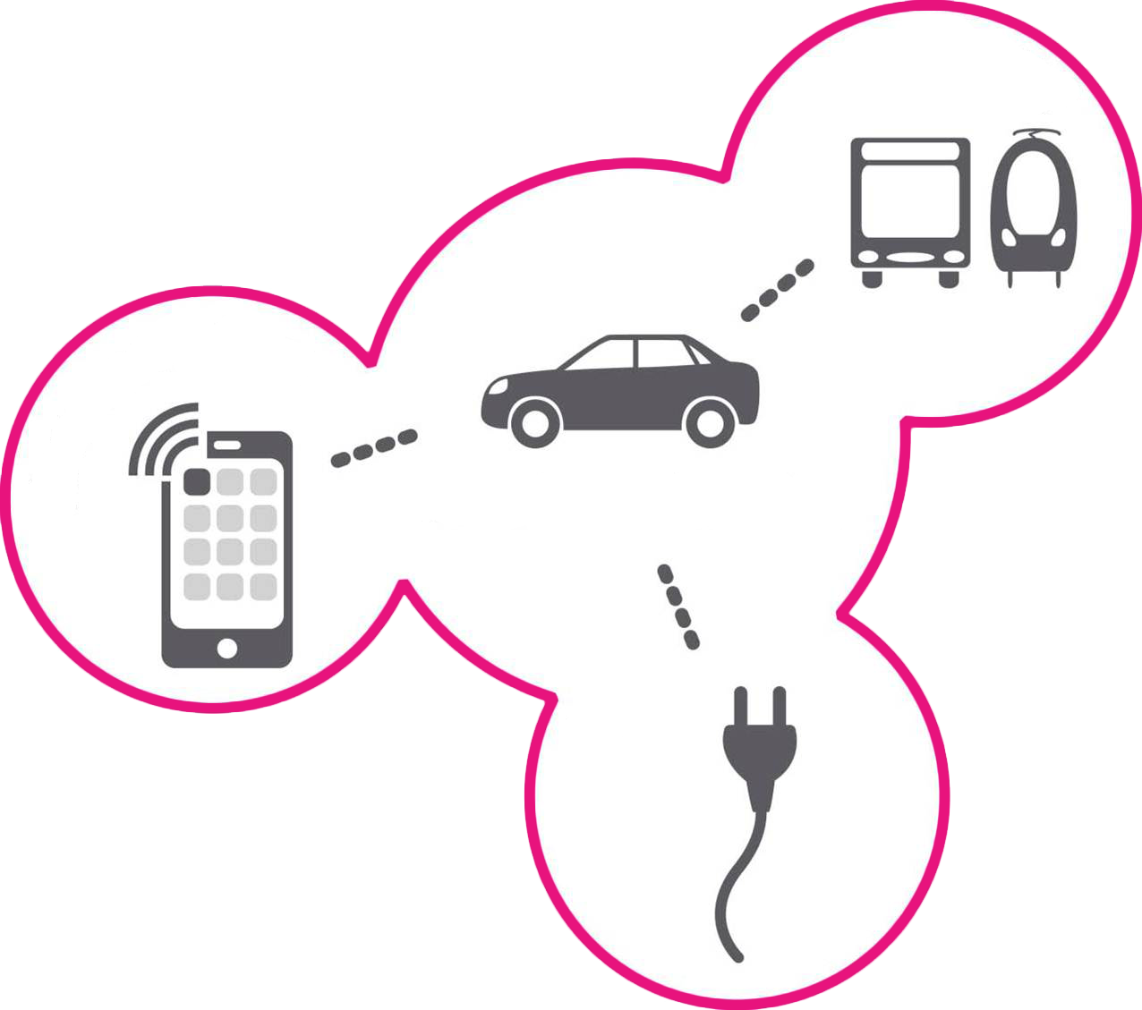



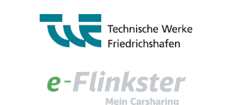
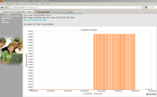


Connected Mobility
A showcase for „triple play“ – the future of mobility
Transportation
Network public and private transportation – one tariff & one booking process
Communications
Real-time data exchange
(e.g. to / from car) and
smooth change of
transportation modes
Connected Mobility
Energy
Smart Grid for efficient charging, V2G, metering
& payment
Notes:
Rural area
Trade fair
Tourism
Industry
Connected to DB – inter-modal transportation
26

