Slide 1
Germany: Digitalization and the Future of Work ICT as an Enabler for Intelligent City Development: Perspectives from Germany and China September 12, 2013
Arnold Picot
Research Center for Information, Organization and Management, Ludwig-Maximilians-University Munich
Münchner Kreis – Non-profit supra-national association dedicated to communications research
Notes:
Abstract:
Over the past decades the rapid development of information and communication technologies has transformed the world in which we live and work. As a result industrial working structures increasingly dissolve and the organization of work is becoming more flexible. Due to smarter mobile devices, online collaboration tools and faster network access work can be performed almost anywhere and anytime. Future work will consequently be more decentralized, leading to new requirements in connectivity, working facilities and modes of transportation. These requirements need to be reflected on and will partly determine the future development of intelligent cities.

Slide 2
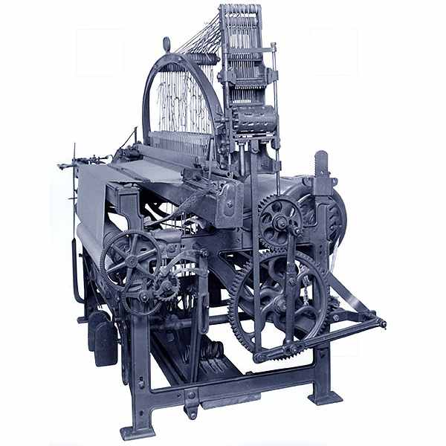
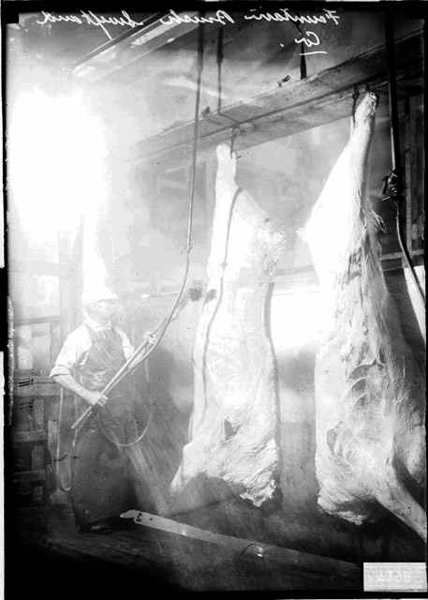
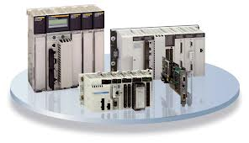
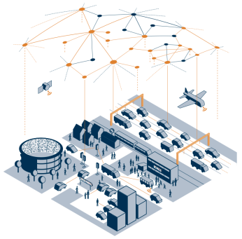
Stages of technological progress
end of 18th c.
early 20th c.
1970s
today
1. Industrial Revolution
2. Industrial Revolution
3. Industrial Revolution
4. Industrial Revolution
Introduction of mechanical production facilities driven by water and steam power
First mechanical loom 1784
Introduction of mass production through division of labor and the use of electrical energy
First conveyer belt in Cincinnati slaugtherhouse 1870
Use of electronics and IT to further automate production
First programmable logic controller (PLC) Modicon 1969
Outlook: Cyber-physical systems and the Internet of things
Figure based on Forschungsunion (2012)
Notes:
Industrialization began with the introduction of mechanical manufacturing equipment at the end of the 18th century, when machines like the mechanical loom revolutionised the way goods were made. This first industrial revolution was followed by a second one that began around the turn of the 20th century and involved electrically-powered mass production of goods based on the division of labor. This was in turn superseded by the third industrial revolution that started during the early 1970s and has continued right up to the present day. This third revolution employed electronics and information technology (IT) to achieve increased automation of manufacturing processes, as machines took over not only a substantial proportion of the “manual labour” but also some of the “brainwork”.
Over the past 30 years or so, the IT revolution has brought about a radical transformation of the world in which we live and work, with an impact comparable to that of mechanisation and electricity in the first and second Industrial Revolutions. The evolution of PCs into smart devices has been accompanied by a trend for more and more IT infrastructure and services to be provided through smart networks (cloud computing). In conjunction with ever greater miniaturisation and the unstoppable march of the Internet, this trend is ushering in a world where ubiquitous computing is becoming a reality. Powerful, autonomous microcomputers (embedded systems) are increasingly being wirelessly networked with each other and with the Internet. This is resulting in the convergence of the physical world and the virtual world (cyberspace) in the form of Cyber-Physical Systems (CPS). Following the introduction of the new Internet protocol IPv62 in 2012, there are now sufficient addresses available to enable universal direct networking of smart objects via the Internet. This means that for the first time ever it is now possible to network resources, information, objects and people to create the Internet of Things and Services.
(source: http://www.acatech.de/fileadmin/user_upload/Baumstruktur_nach_Website/Acatech/root/de/Material_fuer_Sonderseiten/Industrie_4.0/Final_report__Industrie_4.0_accessible.pdf)

Slide 3
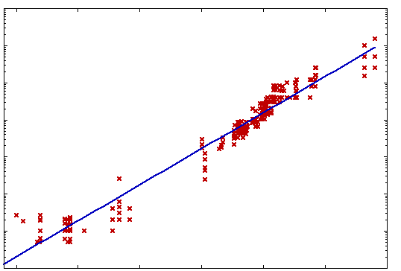
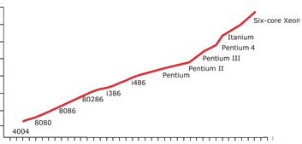
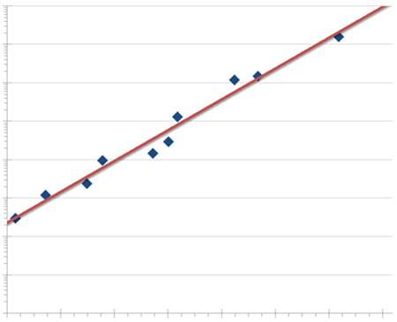
Exponential performance improvements…
Performance improvements of computers
Increase in storage capacity
10000
10¹⁰
1000
10⁹
10⁸
100
10⁷
10
Number of circuits
„Moore‘s Law“
„Kryder‘s Law“
10⁶
Capacity (GB)
10⁵
1
10⁴
0,1
10³
0,01
1970
1975
1980
1985
1990
1995
2000
2005
2010
0,001
year
1980
1985
1990
1995
2000
2005
2010
year
Increase of bandwidth
100,000,000
10,000,000
1,000,000
100,000
Internet connectivity (bits per second)
„Nielsen‘s Law“
10,000
1,000
100
10
1
1983
1987
1991
1995
1999
2003
2007
2011
year
Notes:
Moore’s Law: Number of circuits refers to the CPU
Kryder’s Law: Increase in storage capacity per “square inch” (ca. 2,54 cm x 2,54 cm)

Slide 4
...and exponential price reductions.
Prices for computing power
Prices for storage capacity
Computing power
Storage capacity
Prices in $ per GFLOPS
Prices in € per MB
year
year
Prices for bandwidth
Prices in $ per MBps
Broadband
year
Notes:
Broadband: Prices in $ per MBps refers to US “Internet Transit Prices” per month. This equals the monthly price for consumer broadband access. Explanation on Wikipedia: http://en.wikipedia.org/wiki/Internet_transit
GFLOPS: GigaFLOPS = Giga Floating Point Operations Per Second (Gleitkommaoperationen pro Sekunde)
Source for Computing Power: http://en.wikipedia.org/wiki/FLOPS
Source for Storage Capacity: http://www.winhistory.de/more/386/altepreise.htm
Source for Broadband: http://drpeering.net/white-papers/Internet-Transit-Pricing-Historical-And-Projected.php

Slide 5
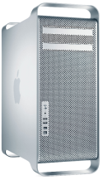
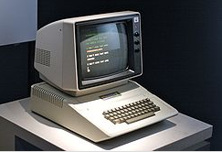
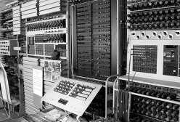
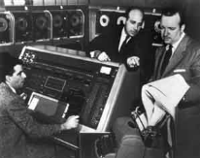
From evolution to revolution – Implications of exponential technological growth
Performance (calculations per second per $1000)
surpasses “brainpower“ of mankind in 2045
10²⁶
10²⁰
surpasses “brainpower“ of a human in 2023
10¹⁵
surpasses “brainpower“ of a mouse in 2015
Mac Pro
10.000.000.000
Power Mac G4
Apple II
IBM PC
100.000
Colossus
UNIVAC I
1
IBM Tabulator
0.00001
time
1900
1920
1940
1960
1980
2000
2012
2020
2045
Agricultural revolution
8000 years
120 years
90 years
22 years
9 years
Accelerating change
Indust. Rev.
Light bulb
Moon landing
World Wide Web
Decoding of human genome
Figure based on Times Magazin (2011)
Notes:
So where are we in the history of business use of computers? Are we in the second half of the chessboard yet?
This is an impossible question to answer precisely, of course, but a reasonable estimate yields an intriguing conclusion. The U.S. Bureau of Economic Analysis added “Information Technology” as a category of business investment in 1958, so let’s use that as our starting year. And let’s take the standard 18 months as the Moore’s Law doubling period. Thirty-two doublings then take us to 2006 and to the second half of the chessboard. Advances like the Google autonomous car, Watson the Jeopardy! champion supercomputer, and high-quality instantaneous machine translation, then, can be seen as the first examples of the kinds of digital innovations we’ll see as we move further into the second half—into the phase where exponential growth yields jaw-dropping results.
Computers and networks bring an ever-expanding set of opportunities to companies, Digitization, in other words, is not a single project providing one-time benefits. Instead, it’s an ongoing process of creative destruction.
Vergleich 1940 – 1970 zu 1970 – 2012 → Entwicklung neuer Möglichkeiten hat deutlich zugenommen (analog dazu landwirtschaftl. Rev. vs. industrielle Rev.)
→ Mit der Erreichung der zweiten Seite des Schachbretts sind eine Vielzahl an Innovationen zu erwarten. Erste Bsp. IBM Watson Jeopardy!, Google Car, LRZ Supercomputer

Slide 6
Technological progress has ever since influenced the organization of work
At times of industrial mass production
the physical centralization of production was a prerequisite for mass production
the physical centralization of administration was required as part of the necessary coordination and communication processes
As a result industrial work and life structures emerged:
Location-bound working environments in factories and office buildings with hierarchical structures
Extensive division of labor
Separation of execution and responsibility
Specified office and information channels (model of bureaucracy)
Strict separation of work and leisure time
Employer-employee relationship as default model
…

Slide 7
Changing industrial working environment as a result of digitalization and connectivity
Merging the physical and virtual worlds
Today, about 98 percent of microprocessors are embedded, connected with the outside world through sensors and actuators.
With the help of sensors, cyber-physical systems process data from the physical world and make it available for network-based services, which in turn can have a direct effect on processes in the physical world
Opportunities through ICT and Cyber-physical systems
Real time management of dispersed value networks
Dynamic configuration of business processes allows flexible responses, optimization and execution of processes down to batch size of 1
End-to-end transparency of business processes through access to meta-information
Vision: Internet of Things
Smart environments
e.g. smart city
Cyber-physical systems
e.g. smart factory
Networked embedded systems
e.g. intelligent road junction
Embedded systems
e.g. airbag
Evolution of embedded systems into the Internet of Things
Sources: Acatech (2011), Acatech (2012), Forschungsunion (2012), Picot/Reichwald/Wigand (2008)

Slide 8
As a result industrial working structures increasingly dissolve
ICT allows for new forms of organization related to:
Place/ time
Work processes can be controlled and integrated at any time and any place
Work is predominantly shifted in the cloud
Communications media
Problem- and task-oriented use of the Internet and social media instead of office channels
Division of labor
Integration and decentralization of content
Cooperation among the value chain and integration of the customer
Project-based work and integration of individuals as freelancers
Collaboration
Problem-oriented connection and integration of worldwide expertise
Controlling
Real-time control

Slide 9
Implications for Intelligent City Development

Slide 10
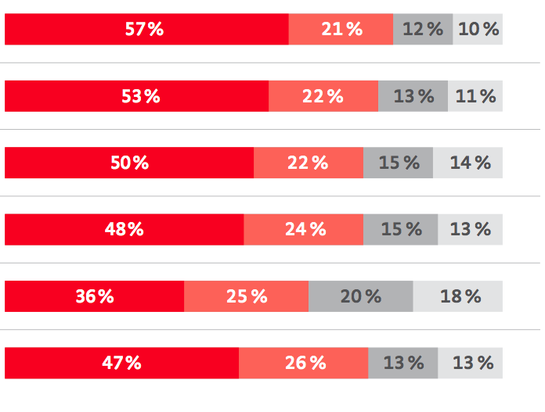
The organization of work becomes increasingly flexible and is predominantly carried out independently in project based settings
What share of your daily work do you work in...
What share of your daily work do you work...
alone
interdisciplinary teams
projects
other settings
interdisciplinary teams across companies
discipline specific teams
Germany
USA
Brazil
China
India
S. Korea
Source: Münchner Kreis „Future Study“ (2013), www.zukunft-ikt.de/studien

Slide 11
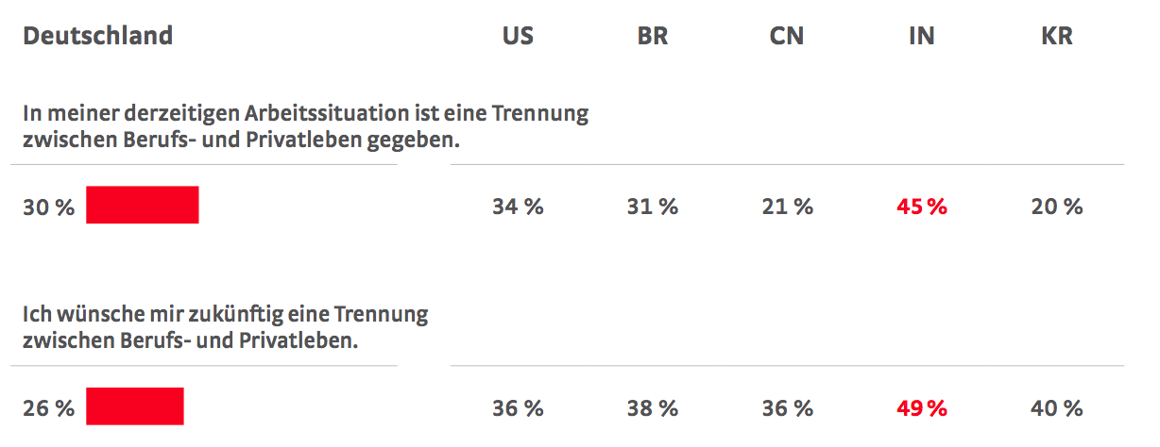
For many workers a separation of work- and personal life is not given anymore – a situation that only a minority would like to change
Germany
US
BR
CN
IN
KR
My current work setting allows for a strict separation of work- and personal life
30%
34%
31%
21%
45%
20%
In the future I would like to keep my work- and personal life separate
26%
36%
38%
36%
49%
20%
Source: Münchner Kreis „Future Study“ (2013), www.zukunft-ikt.de/studien

Slide 12
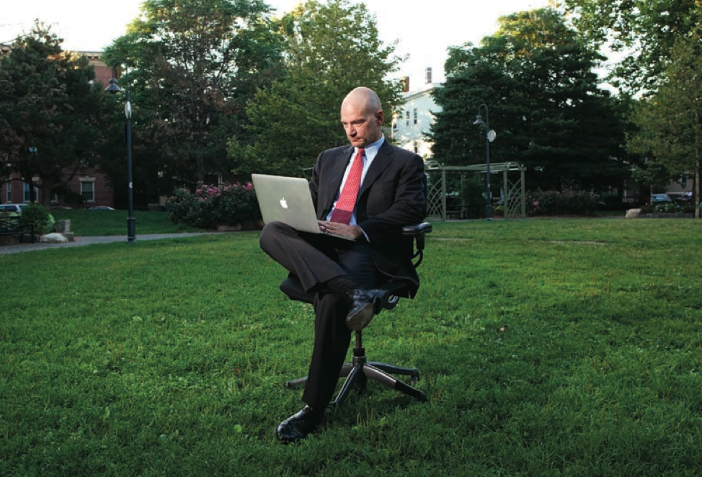
The office as a specific place for our professional lives is becoming less important, leading to a diminishing need for downtown office centers
Source: MIT Technology Review (2011)
Notes:
The idea that the office is a specific place where our professional lives happen is becoming less universal, and less important. These days many knowledge workers can be productive anywhere, thanks to smarter, more numerous mobile devices, faster network access, and a growing number of online collaboration tools.

Slide 13
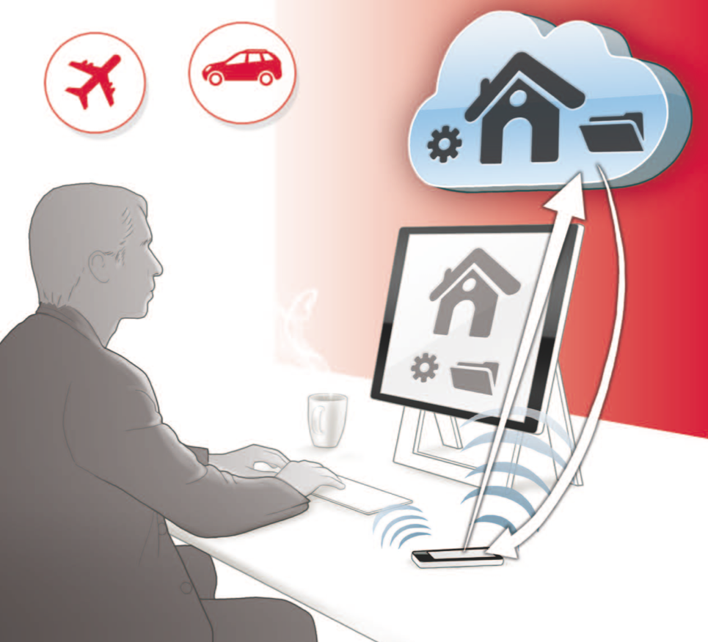
By 2024 at the latest, over 75 percent of office workers in Germany will regularly use a home or mobile office
Source: Münchner Kreis „Future Study“ (2011), www.zukunft-ikt.de/studien
Notes:
The ‘anywhere’ desk creates a new communication infrastructure that enables me to work anywhere (at home, at the office, in meeting rooms, stores, and on trains, planes and automobiles), without needing a PC or laptop, and to have convenient access to all my personal data and programs – with * against unauthorized access – through the communication networks.
Due to rapidly dropping prices, monitors and entry panels will soon become part of the basic infrastructure in private and public spaces. They will be available on walls, on tables or other furniture, on the backs of seats (in planes, trains and buses), in display windows, at info terminals – simply every- where. My mobile telephone uses near field communication to establish a secure wireless link between these input/out- put devices and my private data store on the Internet – al- lowing me to use my data and programs conveniently nearly anywhere. No one can eavesdrop on my data, nor are any traces of my use visible. The advantage is that I no longer need a computer. I just need a screen, a keyboard, my cell phone and the service of the ‘anywhere’ desk.

Slide 14
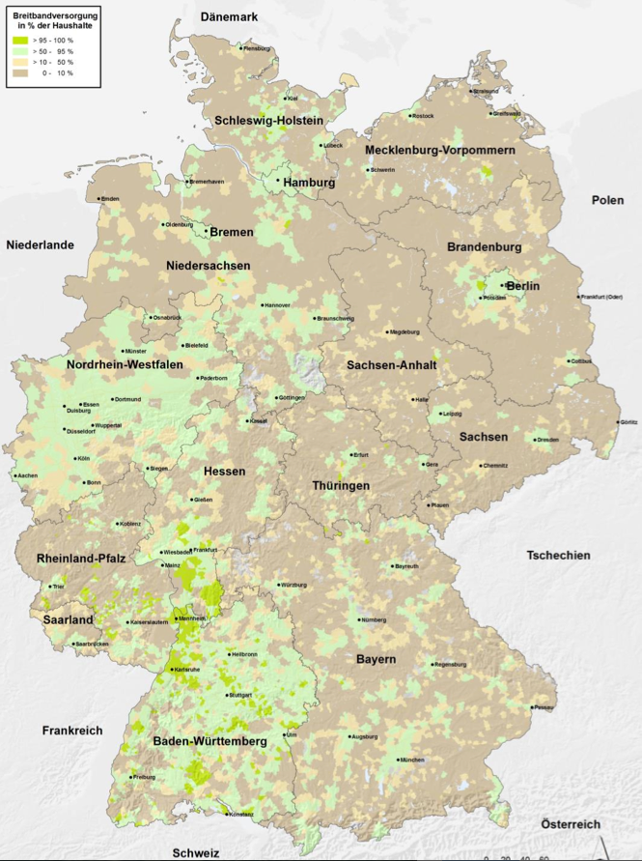
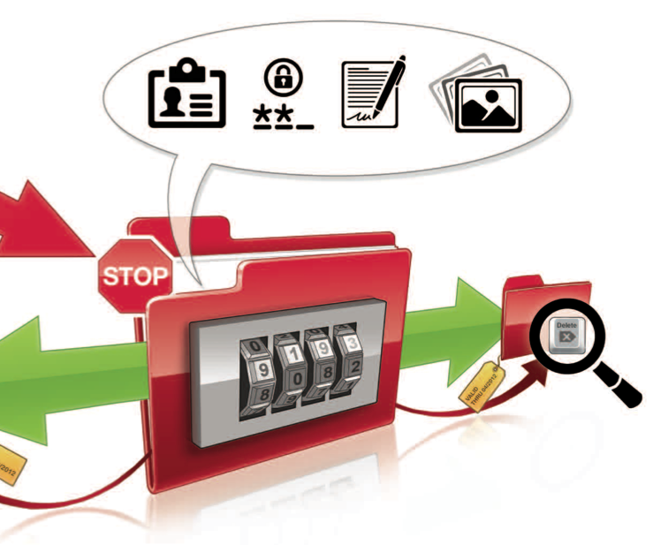
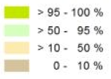
Pervasive demand for secure remote data access – the prerequisite of high performance broadband connectivity still underdeveloped
Household Broadband connectivity (> 50mbit/s) in %
Online Data Manager
Sources: Münchner Kreis „Future Study“ (2011), www.zukunft-ikt.de/studien,
http://www.zukunft-breitband.de/DE/Service/publikationen,did=559116.html (2012)
Notes:
The online data manager is a software solution on the Internet which manages ‘data as an article of exchange’ between the user and the provider of Internet services, enables access to the user’s personal data on re- quest or for a certain period, blocks him or her for individual providers if so required, gives users an overview of their access permissions whenever they need it, and requests account deletion when the user considers it necessary. This service should be free of charge for the user and can be financed, if necessary, through a usage charge to be paid by the service provider.
In the countries surveyed, opinions about when the online data manager should ideally be available vary tremendously. The most frequent response in Germany, Brazil and Korea is “Immediately,” an answer that is quoted by 26, 28 and 22 percent of respondents respectively. Respondents in China would like this scenario to be available in around 2015, but the largest group of respondents in Sweden and the USA hope that it will never be available (25 and 26 percent)
A major reason, why many respondents reject the online data manager are concerns in regards to data privacy and security – those aspects will be crucial for the acceptance of data cloud services.
Deploying high-speed broadband (> 50mbit/s) across Germany still remains challenging (Map, 2012). However fast (mobile) broadband will be the prerequisite for future forms of work.

Slide 15
Besides internet access ubiquitous workplaces face several challenges
Source: Münchner Kreis „Future Study“ (2011), www.zukunft-ikt.de/studien
Notes:
Innovation minded participants:
This study reports on the results from all participants; however, answers from “innovation-minded” participants are also provided in many cases. Innovation-minded participants are people who are particularly open to new ideas in the technology area and who actively represent and help disseminate them. The group of total participants always includes the data from the innovation-minded participants as well. A comparison of the two groups reveals significant differences in socio-demographic characteristics, as well as in attitudes and behaviors. This background information makes it easier to interpret the respective results of the two groups for the 16 pictures of the future.

Slide 16
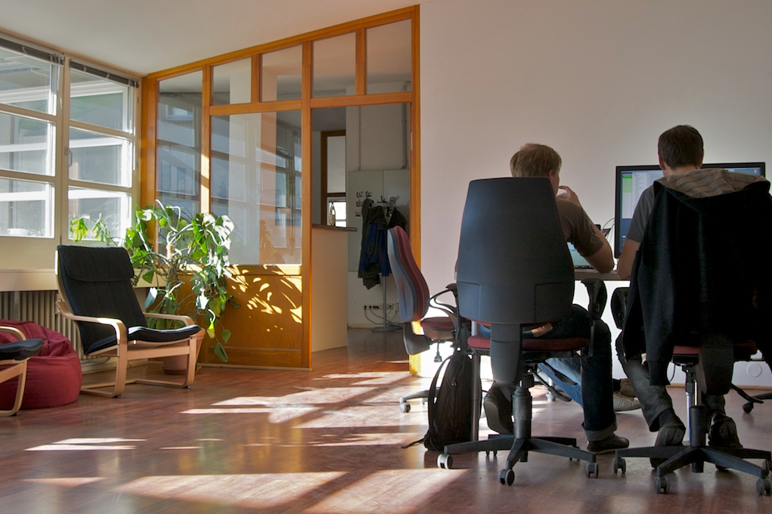
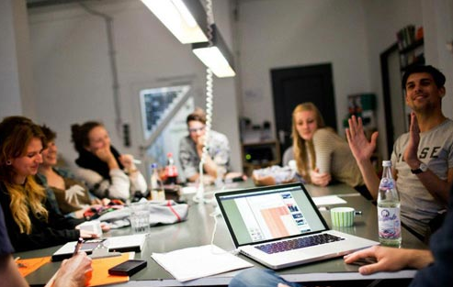
Since gathering places will remain important in business, smart working centers will be crucial for future office work in cities and rural areas
Co.Up Coworking Space in Berlin
Edelstall Coworking Space in Hannover
Sources: http://co-up.de/about.html, http://edelstall.de
Notes:
Statistics for Germany (2011):
Number of coworking spaces: 72 Number of desks: 1850
(http://www.deskmag.com/en/coworking-spaces-in-germany-219)
Goals of Smart Working centers:
Cities create public spaces near residential neighborhoods, where people can work, meet, and use shared services such as secure wireless Internet access, telepresence, collaboration tools, and business services, including reception, catering, and day care.
Employers can use these spaces to offer flexible 21st-century work options, including teleworking and coworking (independent workers sharing a facility).
Giving people a place to work and meet near home reduces commute time, greenhouse gas emissions, and traffic congestion.
An open workspace creates opportunities for new social and business connections for entrepreneurs, professional mobile workers, knowledge workers, company employees, community groups, youth groups, and senior citizens.
Source: http://www.cisco.com/web/strategy/docs/scc/smart_work_center_solution_overview_us_0725.pdf

Slide 17
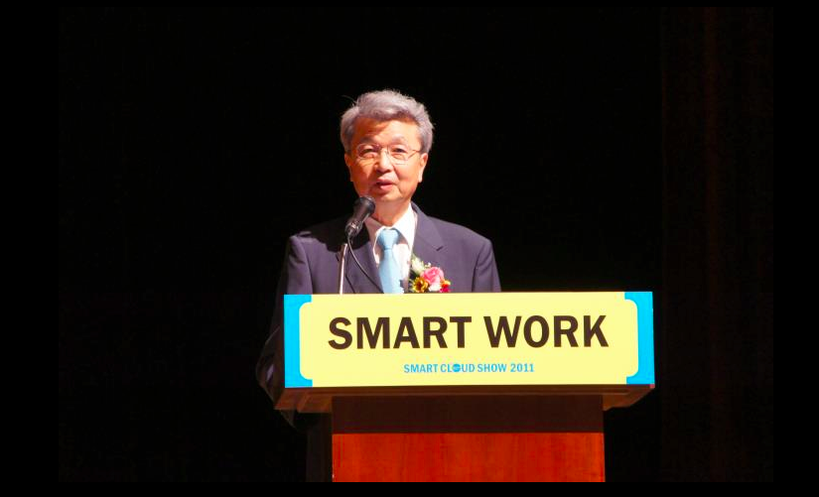
In 2011 South Korea even launched a national “Smart Working” initiative to enable employees to work from home or in smart working centers
Source: http://www.meconomy.me/blog/smartworkinginkorea/
Notes:
Korea initiative goal: the government’s plan is to enable at least one third of all employees in the public sector to work from home (or so called „Smart Working Centers“) by 2015. The private sector then is to follow
In 2012 only two Smart Working Centers were realized in South Korea with 12 public and 50 private centers to follow in 2012. Until 2015 the goal was set to 50 public and 450 private centers (http://www.brandeins.de/archiv/2012/relevanz/arbeit-ohne-stau.html)
Other countries followup with similar initiatives: Netherlands with a countrywide network of smart working centers (http://www.euractiv.com/de/informationsgesellschaft/smart-work-koennte-fuer-gruenes-news-502550); Estonia with “Smart Work Centres in Non-Metropolitan Areas 2012-2014” (http://www.abikeskused.ee/eng/study-visit-estonia-smart-work-centres)

Slide 18
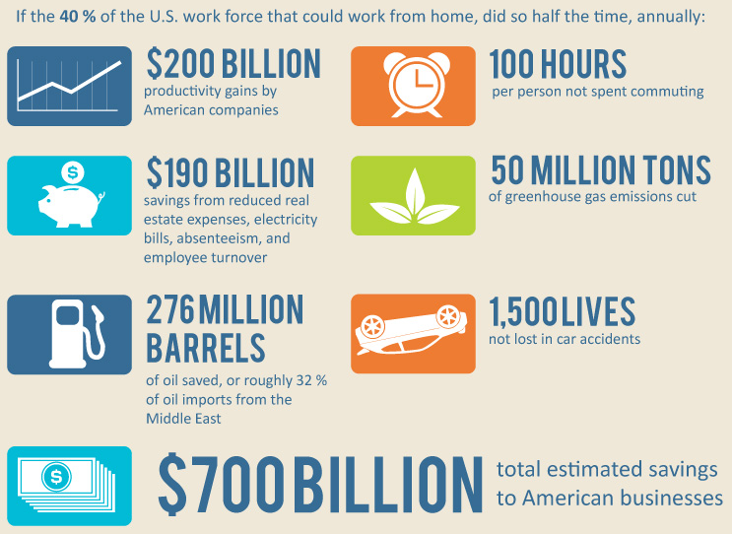
The benefits of telecommuting are manifold (US statistics)
Source: Business2businesscommunity.com (2012)

Slide 19
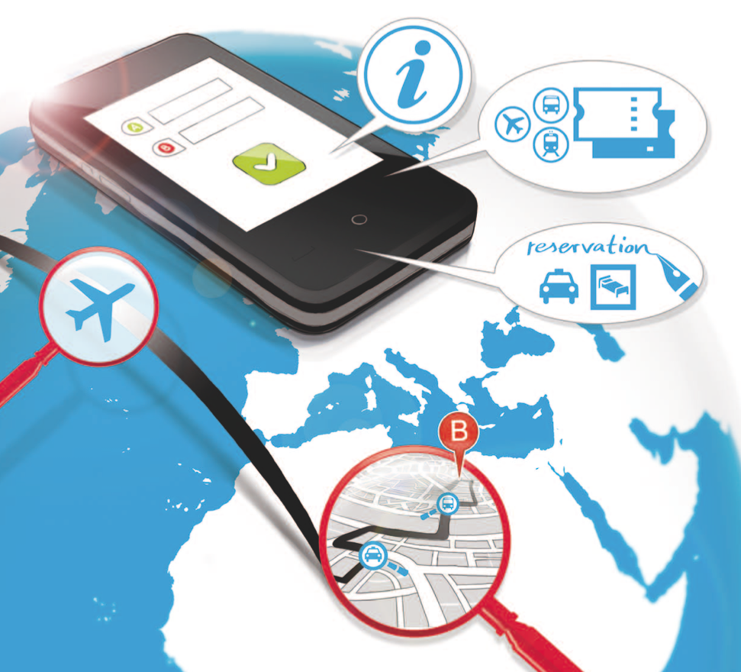
However, workers will still have to commute occasionally – when they do, they expect a seamless experience
Source: Münchner Kreis „Future Study“ (2011), www.zukunft-ikt.de/studien
Notes:
There are many mobility services and online route planners. The timetables of practically all modes of public transport are now available on the Internet, as well as flight plans and current traffic information. Some private transport operators can also be booked online. But what is missing is the possibility of Internet-based, integrated trip planning, which takes into account all available transport operators to allow optimum planning of the trip tailored to the user’s needs, makes the reservations, and books all the tickets automatically. In addition, an ideal travel planning system would offer users the option of saving their personal preferences and support them in the specific course of their journey. For example, the system should navigate users through unfamiliar surroundings, inform them of delays or other obstructions and, where appropriate, suggest plan changes and rebookings and then automatically make them.

Slide 20
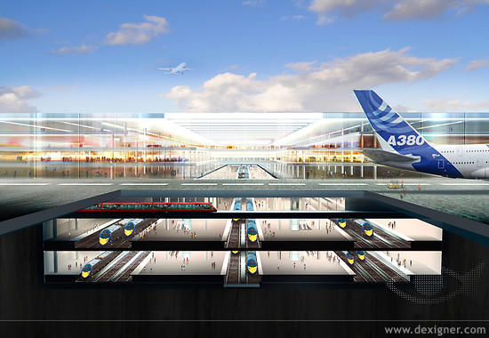
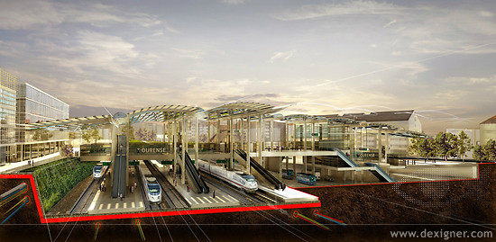
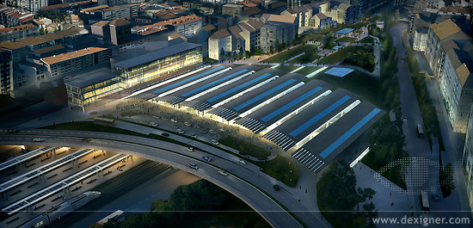
Intermodal transportation hubs will be required to connect different public transport modes
Source: http://www.dexigner.com/directory/detail/5919.html

Slide 21
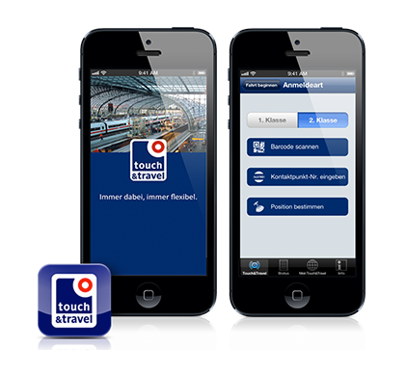
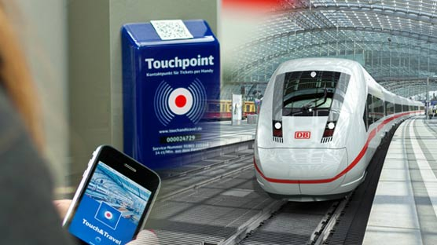
Intermodal booking, route planners and integrated transportation services are prerequisites for seamless mobility
Deutsche Bahn – Touch & Travel Initiative
Sources: http://media5.rsh.de/binaries/asset/image/2204343/wlm_full_image/0/2389867/Touch-und-Travel-Der-Fahrkartenkauf.jpg,
http://www.bahn.de/p/view/buchung/mobil/touch-and-travel.shtml
Notes:
Touch&Travel was piloted on long distance routes between Berlin, Frankfurt, Köln and Hannover, as well as in regional transportation in Potsdam and Berlin. Mid December 2008 the second pilot launced, with 500 of 2500 customers using Touch&Travel as designated ticket. Therefore the customer uses his cellphone as a touchpoint to transmit data via Near Field Communication (NFC) to validate his route when getting on and leaving the train (source: http://de.wikipedia.org/wiki/Mobile_Ticketing)
→ Existing systems in Germany are still highly proprietary (just for one mode of transportation & vendor) and often too complicated to use

Slide 22
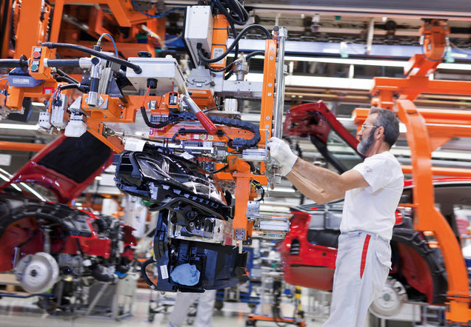
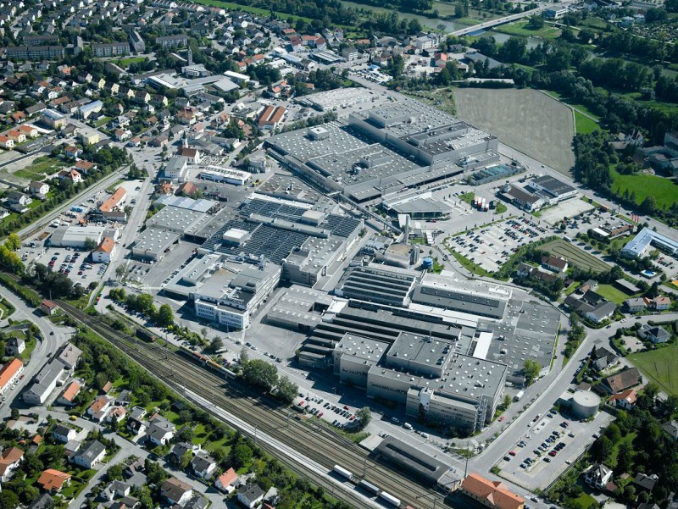
In contrast to office work, industrial mass production will be highly centralized in industry parks and economic development zones
Partly automated assembly line at Audi Ingolstadt
BMW Dingolfing manufacturing plant
Sources: http://portal.radioiasi.ro/public/photos/large/2/sediul-bmw-din-dingolfing_80938880.jpg, http://www.bloomberg.com/image/ica9wx5pS9O0.jpg

Slide 23
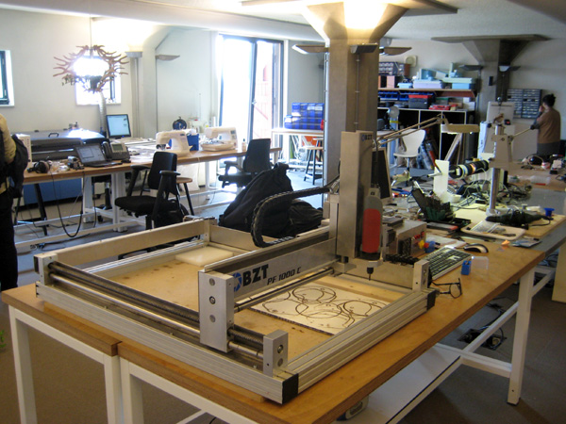
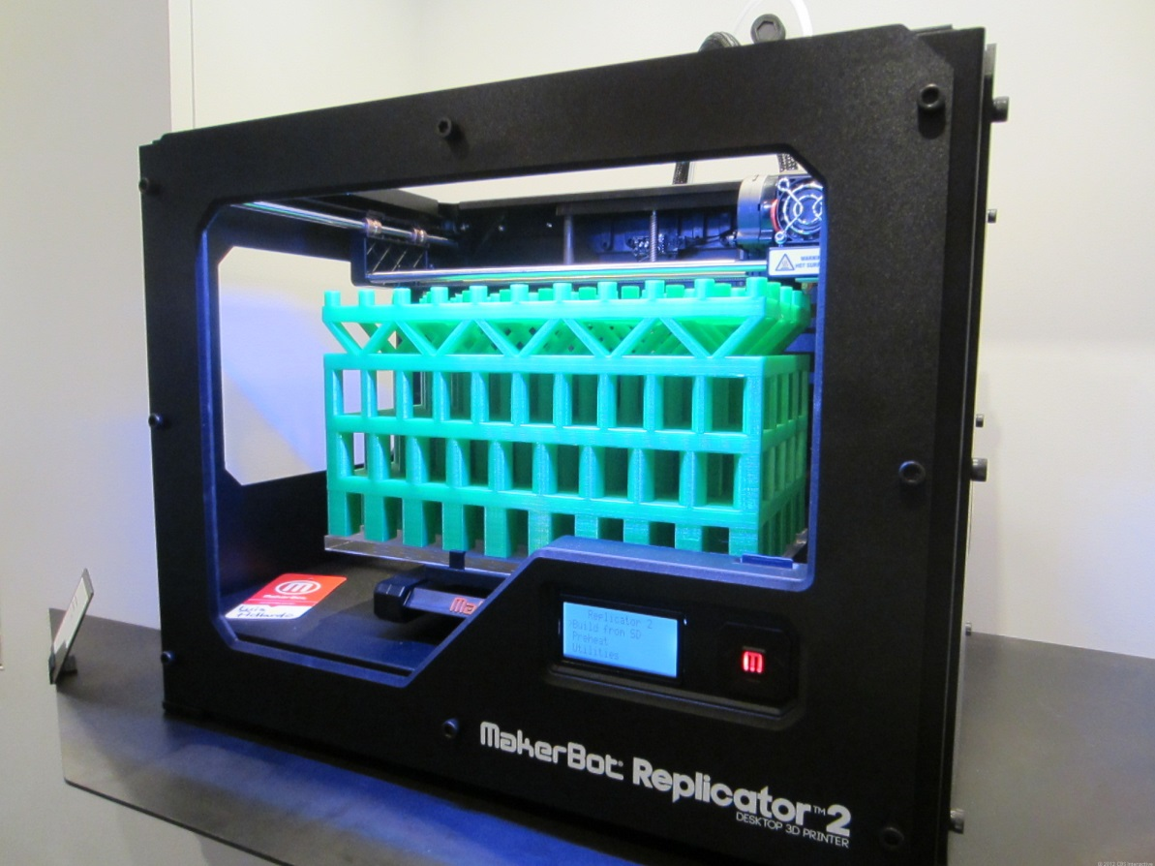
The rise of 3D printing and fablabs are nevertheless first indicators of small scale decentralized production
Amsterdam Fab Lab at The Waag Society
3D Printer: MakerBot Replicator 2
Sources: http://en.wikipedia.org/wiki/Fab_lab, http://cloudtimes.org/wp-content/uploads/2013/03/makerbot-3d-printing.jpg
Notes:
Fab Lab: A fab lab (fabrication laboratory) is a small-scale workshop offering (personal) digital fabrication.[1][2]
A fab lab is generally equipped with an array of flexible computer controlled tools that cover several different length scales and various materials, with the aim to make "almost anything".[3] This includes technology-enabled products generally perceived as limited to mass production.
While fab labs have yet to compete with mass production and its associated economies of scale in fabricating widely distributed products, they have already shown the potential to empower individuals to create smart devices for themselves. These devices can be tailored to local or personal needs in ways that are not practical or economical using mass production. (Source: http://en.wikipedia.org/wiki/Fab_lab)
3D Printer (Makerbot Replicator 2, Pricepoint: about $2000): Additive manufacturing's earliest applications have been on the toolroom end of the manufacturing spectrum. For example, rapid prototyping was one of the earliest additive variants, and its mission was to reduce the lead time and cost of developing prototypes of new parts and devices, which was earlier only done with subtractive toolroom methods (typically slowly and expensively).[35] With technological advances in additive manufacturing, however, and the dissemination of those advances into the business world, additive methods are moving ever further into the production end of manufacturing in creative and sometimes unexpected ways.[35] Parts that were formerly the sole province of subtractive methods can now in some cases be made more profitably via additive ones.
Standard applications include design visualization, prototyping/CAD, metal casting, architecture, education, geospatial, healthcare, and entertainment/retail. (Source: http://en.wikipedia.org/wiki/3D_printing)

Slide 24
Key takeways

Slide 25
Lessons for the development of intelligent cities
Connectivity
Provide pervasive high performing connectivity (mobile and fixed networks) as a necessary infrastructure for future digital work
De- centralization
Envisage a shift from central downtown offices to decentral (home) offices and decentral production facilities
Changing spheres
The increasing reintegration of work into the private sphere must be reflected in the future design of urban quarters and homes
Smart working centers
Envisage a rise of smart working centers as technical platform and face-to-face meeting facilities next to residential quarters
Transportation
Provide flexible, seamless and well coordinated intermodal transportation means and logistic services
Manufacturing
Care for expanding plant locations (highly automated large scale manufacturing) outside of city centers

Slide 26
Thank you for your attention!

Slide 27
„The future of work in a digital world“
MÜNCHNER KREIS conference
October 10th, 2013, Hilton City Hotel in Munich
Registration and program via: www.muenchner-kreis.de

