Slide 1
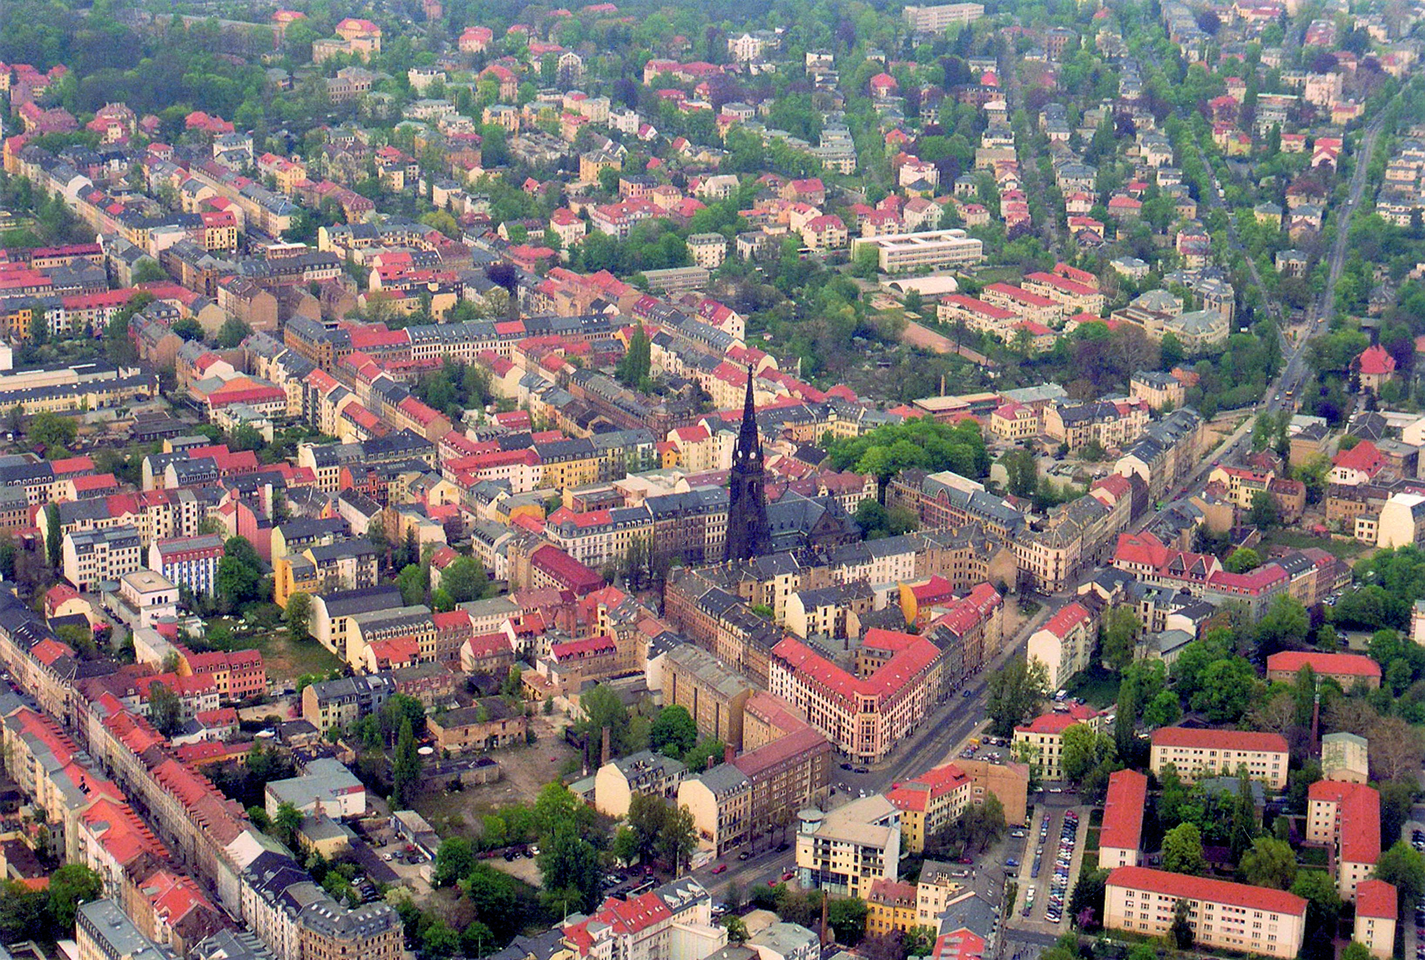
Smart as the New Green?
Reflections on the International Debate
about Eco-Cities
Bernhard Müller
Leibniz Institute of Ecological Urban and Regional Development, Dresden, and
Technische Universität Dresden, Germany
ICT as an Enabler for Intelligent City Development:
Perspectives from Germany and China
Session 6: The Broader Implications
for Societies in Intelligent Cities
September 12, 2013
München

Slide 2
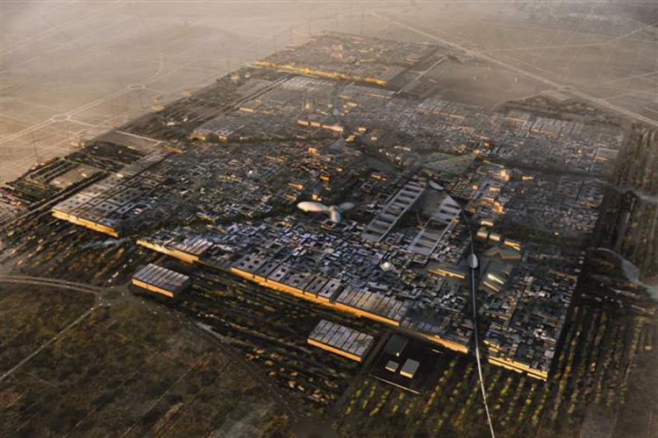
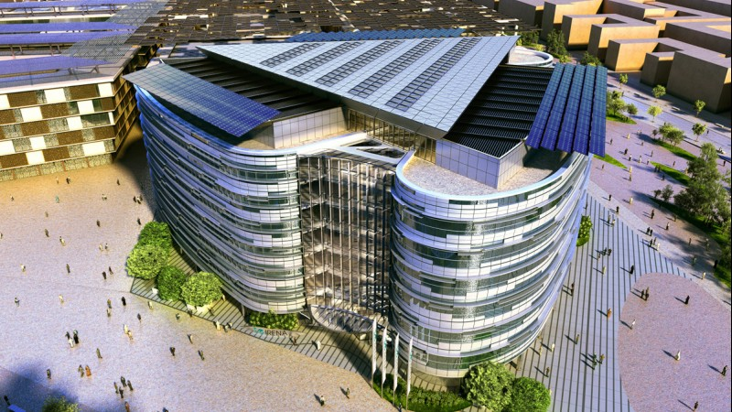
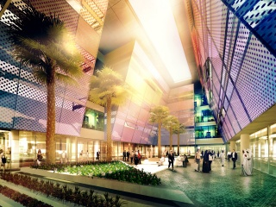
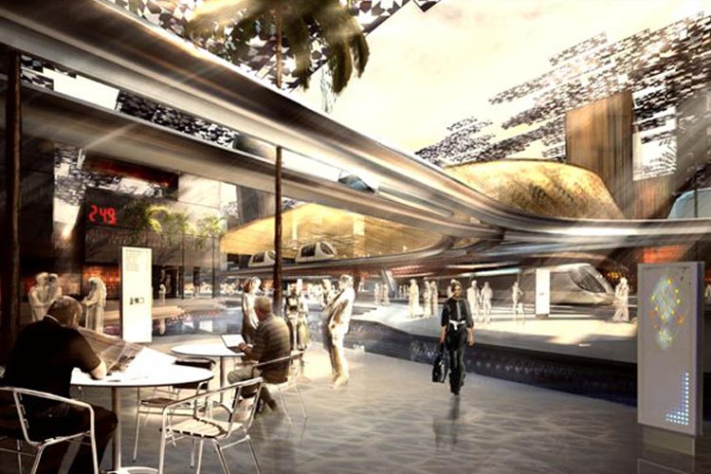
Masdar City, Abu Dhabi
Lord Norman Foster
Zero carbon – zero waste
Total site area: 700 hectares
3.7 million sqm Gross Floor Area (GFA)
Residential: 52%, Commercial: 38%
Retail: 2%, Community: 8%
Projected resident population: 40,000
Projected commuters: 50,000
Source: http://www.masdarcity.a

Slide 3
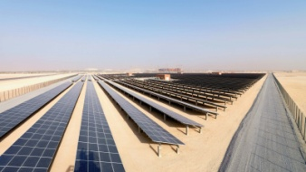
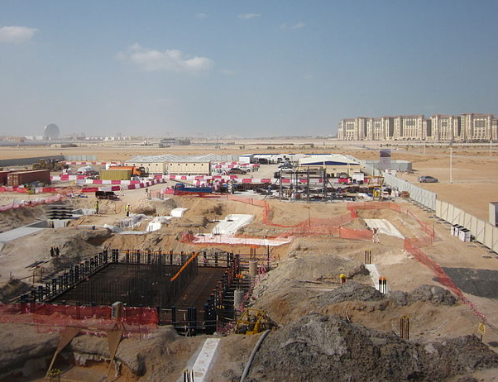
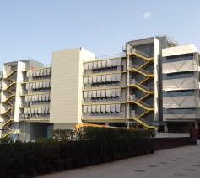
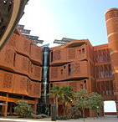
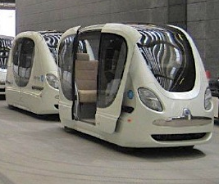
Masdar City, Abu Dhabi
Eco-city in the making
Initial cost estimate: 24 bn US$
Initial time frame: 2016; now: 2025
Initial transport concept:
Personal Rapid Transit (PRT)-Net
Research and education: Masdar
Institute of Science and Technology
Source: http://www.masdarcity.a

Slide 4
Urban laboratories – eco-cities flourishing worldwide
Tianjin
Dongtan
Nanjing
Yinggehai
Caofeidian
Chengdu
Chongqing
Sejoing
Songdo
Freiburg
Portland
Seattle
Vancouver
Toronto
Linz
Graz
Masdar
Changodar
Dahej
Manesar Bawal
Shendra
Curitiba
Kopenhagen
Oslo
Gothenburg

Slide 5
Urban laboratories
Eco-City

Slide 6
Urban laboratories
Eco-Region
Eco-City
Eco-District

Slide 7
Urban laboratories
Nature /
Urban Green
Eco-Region
Eco-City
Techno-logy /
ICT
Eco-District

Slide 8
Urban laboratories
Nature /
Urban Green
Eco-Region
Sustain-able
City
Eco-City
Techno-logy /
ICT
Eco-District

Slide 9
What do I want to talk about?
Ambiguity of the eco-city

Slide 10
What do I want to talk about?
Ambiguity of the eco-city
Eco-city and sustainability

Slide 11
What do I want to talk about?
Ambiguity of the eco-city
Eco-city and sustainability
The broader view:
eco-city certification schemes

Slide 12
What do I want to talk about?
Ambiguity of the eco-city
Eco-city and sustainability
The broader view:
eco-city certification schemes
Perspectives - outlook

Slide 13
What do I want to talk about?
Ambiguity of the eco-city
Eco-city and sustainability
The broader view:
eco-city certification schemes
Perspectives - outlook

Slide 14
Ambiguity - What is an eco-city?
“The term Eco City is relatively new, but it is based upon concepts that have existed for a long time”
(Roseland 1997)

Slide 15
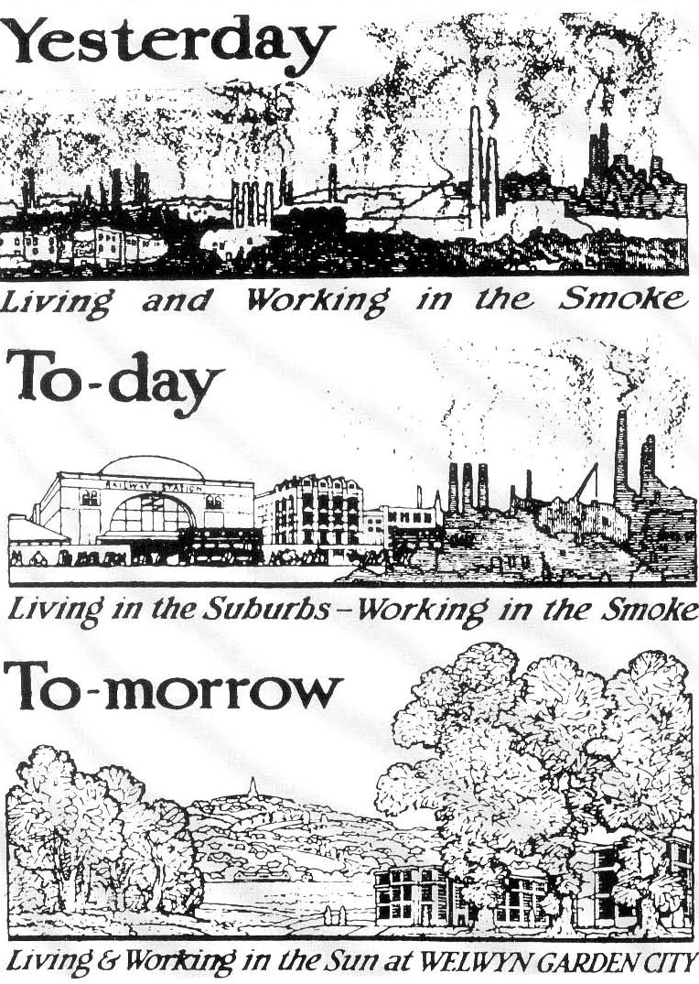
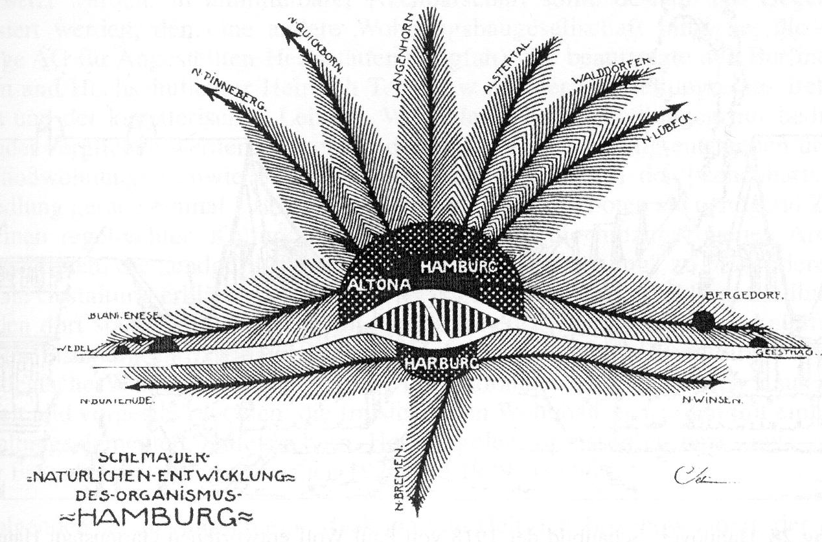
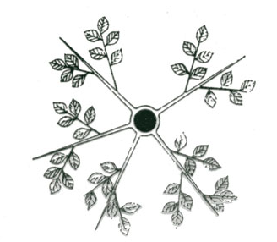
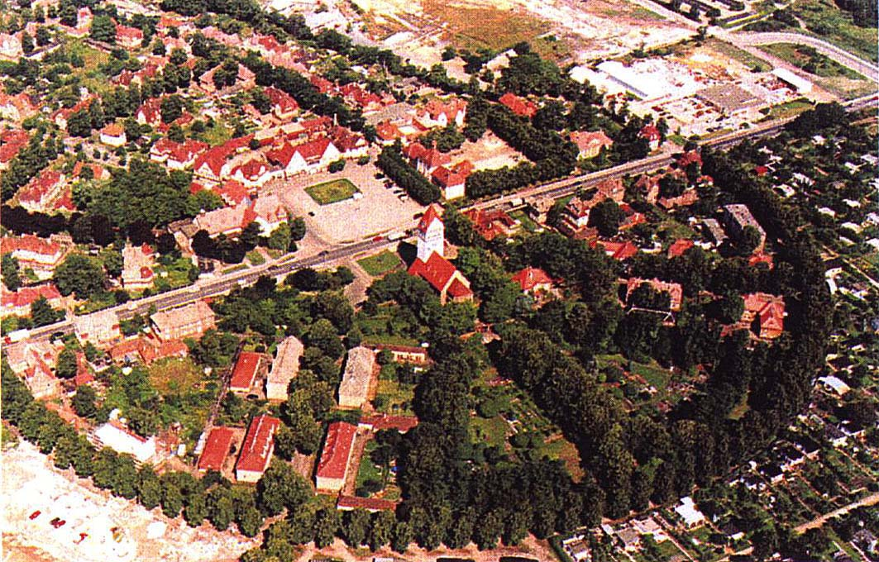
Fritz Schumacher
1898
Gardencity of Marga
Wilhelm Seidensticker

Slide 16
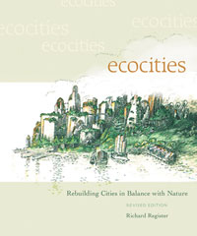
Fritz Schumacher
Richard Register
(2006)
1898
Gardencity of Marga
Wilhelm Seidensticker

Slide 17
Ambiguity - What is an eco-city?
“The term Eco City is relatively new, but it is based upon concepts that have existed for a long time”
(Roseland 1997)
“Eco-Cities have moved from a relatively loosely defined concept with only few, mainly experimental pilots, to a multitude of concrete, practice led initiatives” (Joss 2010)

Slide 18
The global rise of eco-cities as urban laboratories
number
NB: launch dates approximate in some cases
Early Pioneers
2000s+
Post-Rio
Source: Joss 2013

Slide 19
Ambiguity of the eco-city - Historical perspective
1975 NGO Urban Ecology Berkeley: “rebuild cities in balance with nature” – in part: reaction to urban sprawl
1987 Richard Register “Eco City Berkeley”: rebuilding city ecologically
1990 I Eco City World Summit (Berkeley): shaping cities based on ecological principles
1992 United Nations “Earth Summit” (AGENDA 21)
1992 David Engwicht “Towards an Eco-City – calming the traffic”
1997 NGO Urban Ecology Berkeley:
“its mission is to create ecological cities following 10 principles …”
2000s Peak oil, energy, climate change
2008 Masdar City – start of construction
2013 X Eco City World Summit (Nantes)

Slide 20
Principles for creating eco-cities
Revise land use priorities to create compact, diverse, green and vital mixed communities near transportation facilities
Revise transportation priorities to favour bicycle and foot over autos
Restore damaged urban environments (creeks, wetlands)
Create affordable, safe, convenient and racially and economically mixed housing
Nurture social justice and create improved opportunities for women, people of colour and disabled
Support local agriculture, urban greening projects and community gardening
Promote recycling, innovative appropriate technology and resource conservation while reducing pollution and hazardous waste
Work with business to support ecologically conscious economic activity
Promote voluntary simplicity and discourage excessive consumption of material goods
Increase awareness of the local environment and bioregion through activist and educational projects
Source: Urban Ecology 1996

Slide 21
Principles for creating eco-cities
Revise land use priorities to create compact, diverse, green and vital mixed communities near transportation facilities
Revise transportation priorities to favour bicycle and foot over autos
Restore damaged urban environments (creeks, wetlands)
Create affordable, safe, convenient and racially and economically mixed housing
Nurture social justice and create improved opportunities for women, people of colour and disabled
Support local agriculture, urban greening projects and community gardening
Promote recycling, innovative appropriate technology and resource conservation while reducing pollution and hazardous waste
Work with business to support ecologically conscious economic activity
Promote voluntary simplicity and discourage excessive consumption of material goods
Increase awareness of the local environment and bioregion through activist and educational projects
Technology?
Source: Urban Ecology 1996

Slide 22
Movements influencing eco-cities
Appropriate technology
Community development
Social ecology
Green movement
Bioregionalism
Sustainable development
Source: Roseland 1997

Slide 23
What do I want to talk about?
Ambiguity of the eco-city
Eco-city and sustainability
The broader view:
eco-city certification schemes
Perspectives - outlook

Slide 24
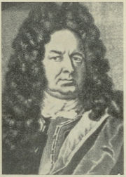
Sustainability Frameworks
1713 – 300 years of sustainability discussion

Slide 25
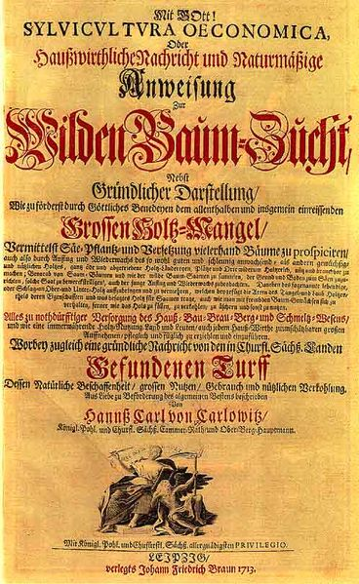
Sustainability Frameworks
1713 – 300 years of sustainability discussion
Hans von Carlowitz (1713)
Since 1711 Chief Mining Officer
responsible for forestry in Saxony
Sustained supply of wood
for mining

Slide 26

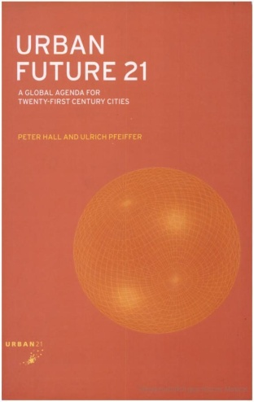
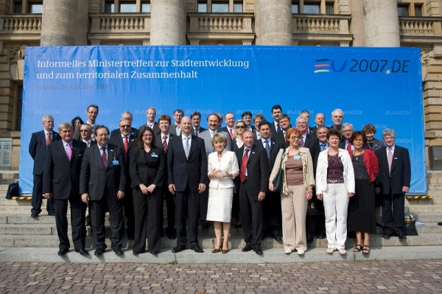

Sustainability Frameworks
1713 – 300 years of sustainability discussion
1992 – Rio Conference
1994 – Aalborg Charter
1994 – German Constitution / Basic Law
1998 – Building and Spatial Planning Laws
2000 – Urban 21
2007 – Leipzig Charter
(Source: Agentur für Stadtentwicklung 2007)

Slide 27
Leipzig Charter on
Sustainable European Cities (2007)
I. Making greater use of integrated
urban development policy approaches
Implementation oriented participatory
integrated urban development programs
Strategies for action:
Creating high quality public spaces
Modernizing infrastructure networks
Improving energy efficiency
Proactive innovation and educational policies
Notes:
27

Slide 28
Leipzig Charter on
Sustainable European Cities (2007)
II. Special attention to deprived neighborhoods
Social cohesion and integration as a goal
Strategies for action:
Pursuing strategies for upgrading the physical environment
Strengthening the local economy and local labor market
Proactive education and training policies for children and young people
Promotion of efficient and affordable housing
Notes:
28

Slide 29
Leipzig Charter on
Sustainable European Cities (2007)
II. Special attention to deprived neighborhoods
Social cohesion and integration as a goal
Strategies for action:
Pursuing strategies for upgrading the physical environment
Strengthening the local economy and local labor market
Proactive education and training policies for children and young people
Promotion of efficient and affordable housing
Technology?
Notes:
29

Slide 30
Sustainability Frameworks
1713 – 300 years of sustainability discussion
1992 – Rio Conference
1994 – Aalborg Charter
1994 – German Constitution / Basic Law
1998 – Building and Spatial Planning Laws
2000 – Urban 21
2007 – Leipzig Charter
(Source: Agentur für Stadtentwicklung 2007)

Slide 31
National Council for
Sustainable Development
(since 2001, 15 members)

Slide 32
National Council for
Sustainable Development
(since 2001, 15 members)
Potentials of elderly
in development
New ways of energy provision
Resources efficient construction
Reduction of “consumption” of
space for urban development
and transportation
…
National Sustainability
Strategy (since 2002;
latest update 2012)
Assessment Reports
(“Indicator Reports”,
since 2006,
every 2 years)

Slide 33
Germany: Competition for sustainability
Opening the debate in the 1990s: „Cities of the future“
(in 4 model cities, 7 reference cities, tests in 50 further cities)
Notes:
33

Slide 34
Germany: Competition for sustainability
Opening the debate in the 1990s: „Cities of the future“
(in 4 model cities, 7 reference cities, tests in 50 further cities)
Five dimensions related to urban planning / development:
Land management
Mobility
Environment
Housing
Economy
Notes:
34

Slide 35
Germany: Competition for sustainability
Opening the debate in the 1990s: „Cities of the future“
(in 4 model cities, 7 reference cities, tests in 50 further cities)
Five dimensions related to urban planning / development:
Land management
Mobility
Environment
Housing
Economy
Characteristics
Oriented towards integrated urban planning / development
“Top-down”: Assessment of local sustainability
Government driven
Notes:
35

Slide 36
12 Standard indicators (relatively easily accessible) | 12 Additional indicators (relatively difficult to collect)
Land management Area for settlements and transport purposes Intensity of land use Protected area Re-use of derelict/waste land | Land management Relation of urban development area within/outside of existing built-up area Mobilisation of new development areas within existing built-up area
Mobility Kilometers driven by buses and trains/trams Car density | Mobility Length of bikeways network Modal split: use of cars in the city Settlement area accessible by public transport Safety / victims of accidents
Environment Non-recycled garbage Consumption of drinking water | Environment CO2 emissions Energy consumption
Housing Relocation from suburbia Financial support of individuals for housing | Housing Basic supply Burglary / housebreaking
Economy Unemployment rate Number of commuters | Economy “Consumption” of space to provide employment Structure of local economy

Slide 37
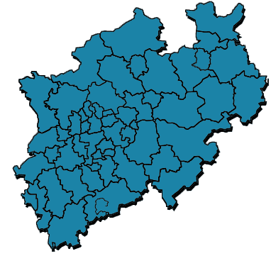
Sets of Indicators and Evaluation Tools for Cities
In Germany (selection)
„Cities of the Future“ („Städte der Zukunft“, Federal Gvt. initiative)
North Rhine–Westphalia: Indicators for Sustainable Development (regional comparison of cities)
„Zukunftsfähige Kommune“ (DUH)
(Future oriented municipality)
(Source: Energieagentur NRW 2006)

Slide 38
North Rhine–Westphalia: Indicators for Sustainable Development
Categories
Indicators
Material Flow
passive houses
solar-powered supplies of warm water
Energy
decentralized combined heat and power plant
energy-focused building refurbishment
Social Life
decentralized combined heat and power plant using biomass
electricity consumption
Urban Development & Resources
electricity generation from renewable energy sources
(Source: Energie Agentur 2006)

Slide 39
Application of NRW-Indicators
City | Indicators | City | Indicators
Aachen | none | Lippstadt | none
Ahlen | none | Löhne | none
Arnsberg | none | Mettmann | none
Bielefeld | municipal environmental budgeting | Münster | synthesis of 3 different indicator systems
Bonn | DUH- Indicators | Minden | none
Dorsten | none | Neunkirchen-Seelscheid | none
Dortmund | none | Oer-Erkenschwick | none
Düren | synthesis of 3 different indicator systems | Remscheid | none
Gelsenkirchen | none | Rheinisch-Bergischer Kreis | none
Gütersloh | indicator set developed by municipality | Schwelm | none
Herdecke | none | Sendenhorst | none
Ladbergen | none | Siegen | none
Lemgo | none
Comparability!
(Source: Plappert 2012)

Slide 40
DUH-Indicators „Zukunftsfähige Kommune“
Categories
Aspects
Indicators
Welfare
Trees on Settlement Area
Installed capacity of wind power*
Installed capacity of photovoltaic*
Presence of House Martins (Delichon urbica)
Installed capacity of water power*
Area of solar-thermal plants*
Environmental and Resource-Saving Energy Production
Environment and Resource Effenciency
Energy production of CHP plants (electricity)*
Installed capacity of biomass (heat)*
Installed capacity of biomass (electricity)*
Choice of Means of Transport
Social Justice
Usage of Drinking Water
Waste
Energy production of CHP plants (heat)*
Land Use Designation
Protected Nature
Low energy input
Energy consumption of municipal properties*
* per inhabitant
(Source: DUH 2004)
Economic Effenciency
Quality of Rivers
Economical Land Consumption
Private electricity consumption*

Slide 41
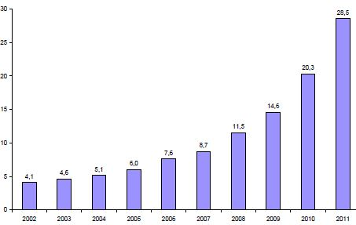
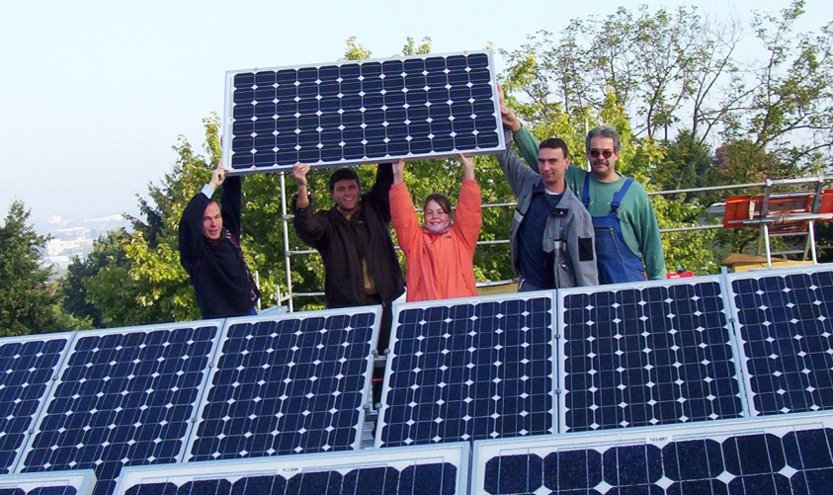

Monitoring with DUH-Indicators
City of Bonn, Germany
Objective: making sustainable development measurable
4 guiding categories
  welfare
  social justice
  environment and resource efficiency
  economic efficiency
Monitoring since 2002
Solar Energy (PV)
Definition: Installed power kWh per 1,000 inhabitants
(Source: City of Bonn 2012)
(Source: ECS 2012)

Slide 42
Rather isolated contests for sustainability and competitiveness
Urban / regional issues
Cities of the future
Socially integrative city
Urban transformation East/West
…
Innovation / technology
Bioregio
Innoregio
Health regions of the future
Energy efficient city
…

Slide 43
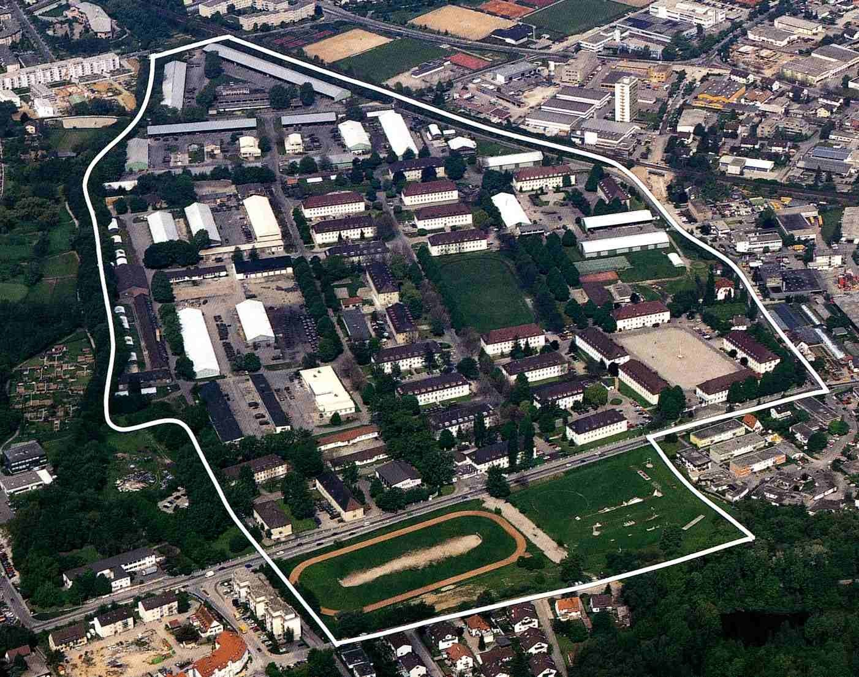
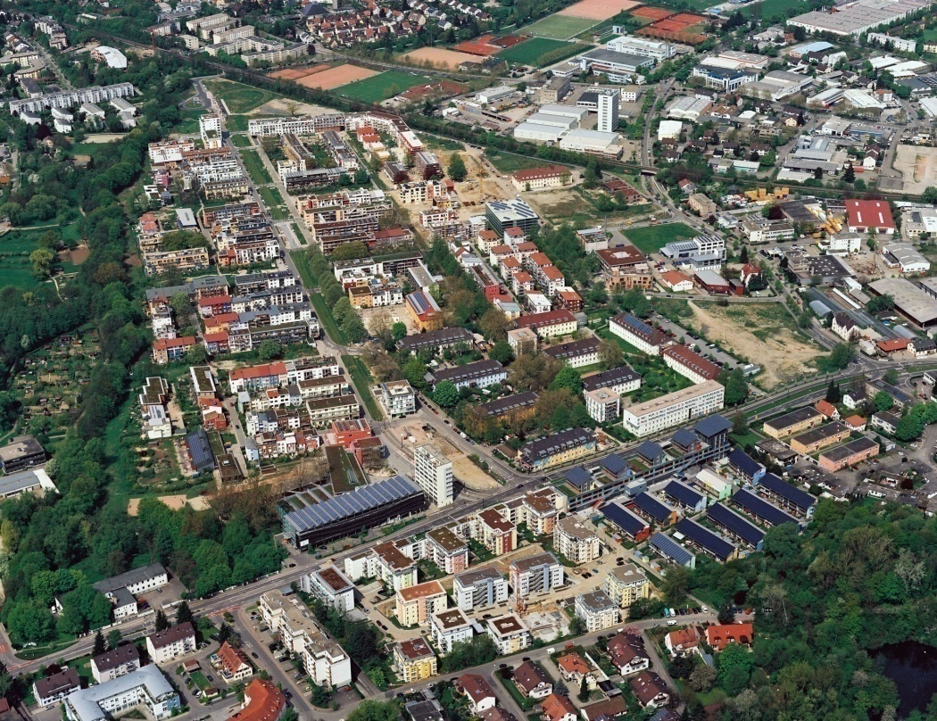
However, …
Freiburg-Vauban 1992
Freiburg-Vauban 2006

Slide 44
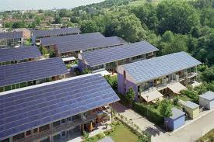
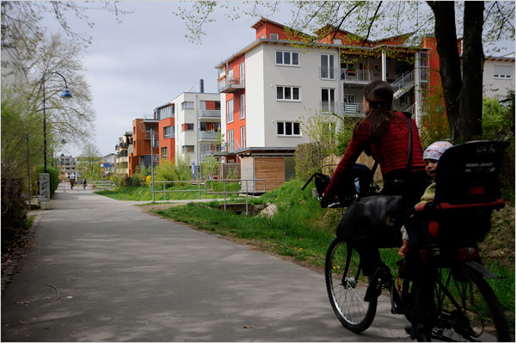
Example of a Bottom-Up Process:
Vauban, Freiburg, Germany
Area formerly in military use
1990 initiative founded by citizens
1992 – 1999 transition phase
Emphasis on:
a strongly car reduced mobility concept
the creation of a neighbourhood of short distances
installation of local heat
social integration
priority of private and cooperative groups over investors
(Source: Vauban 2012)

Slide 45
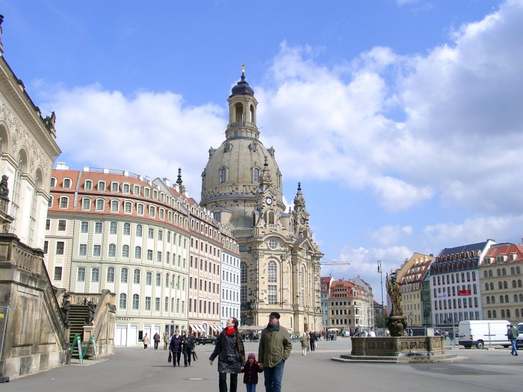
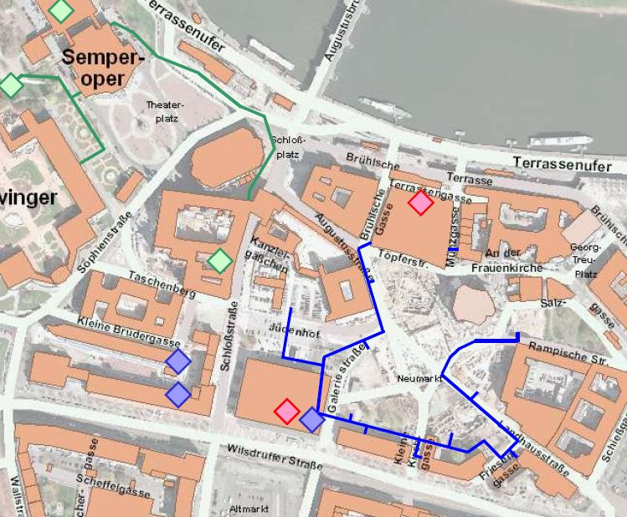
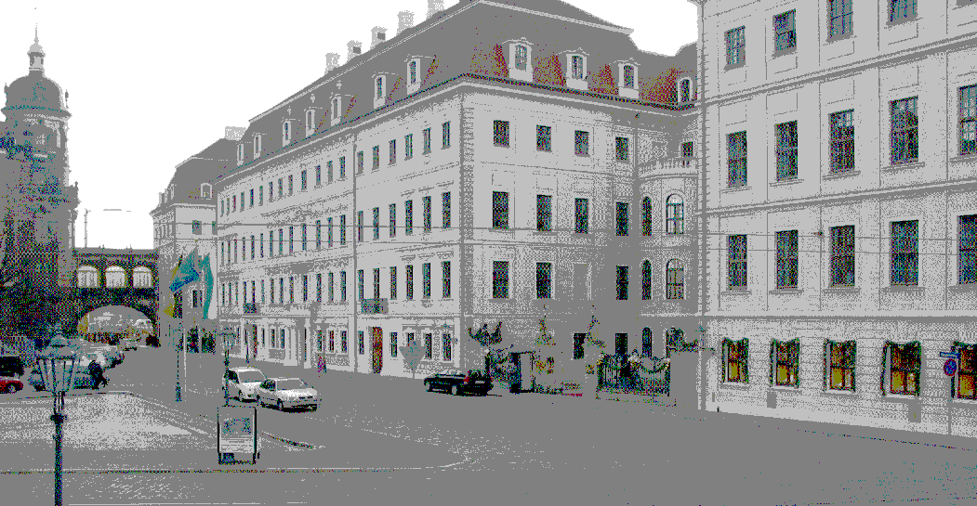
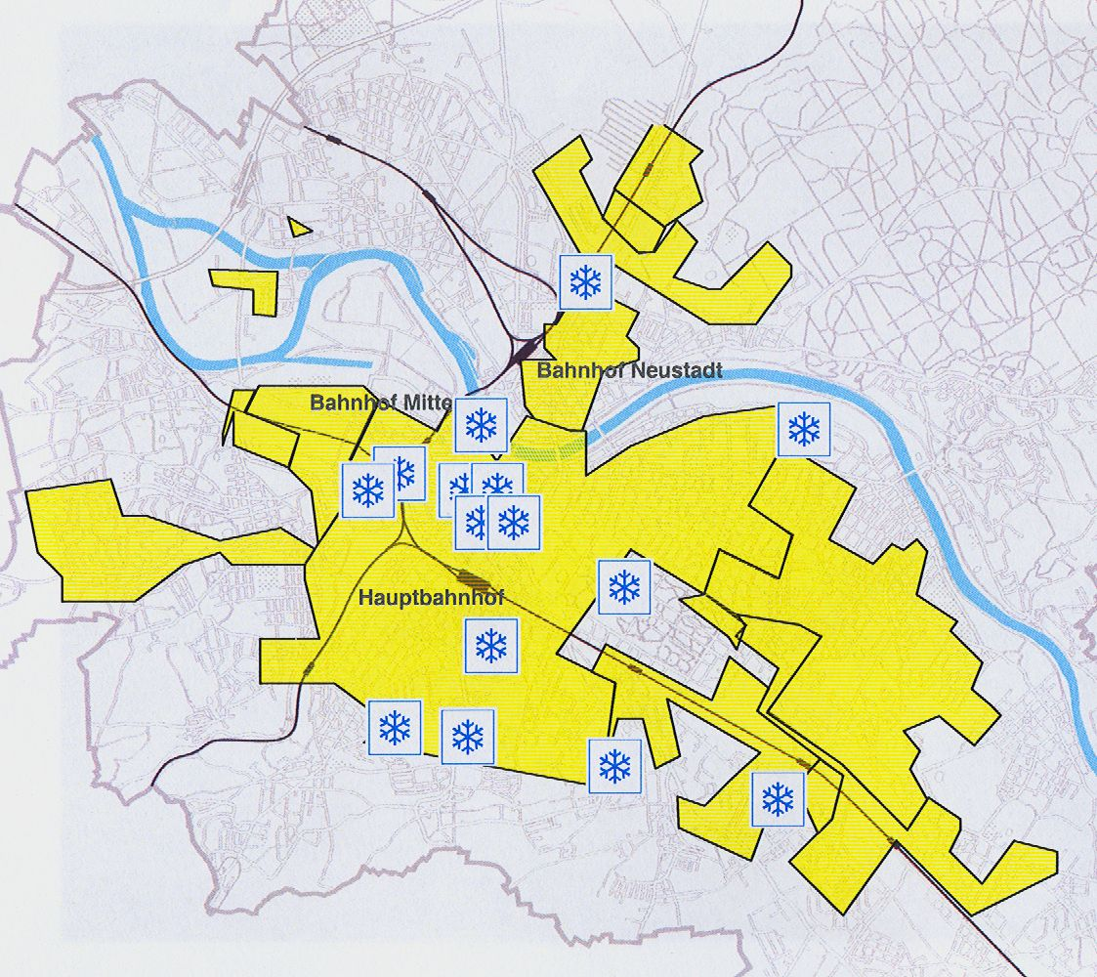
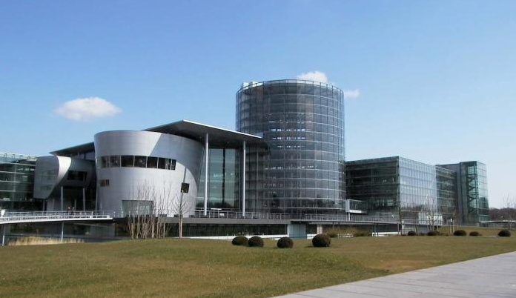
New technological
solutions almost
everywhere
Dresden:
Energy concept,
district cooling,
groundwater

Slide 46
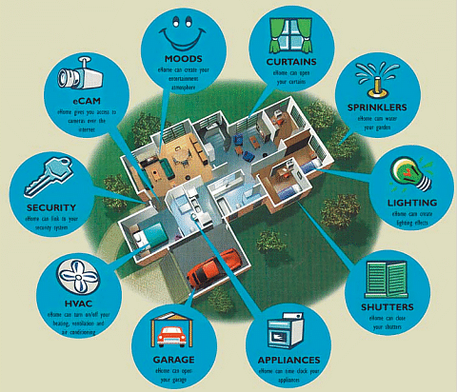
Demographic change:
Ambient assisted living

Slide 47
Demographic change:
Ambient assisted living
Energy
Life style
…
Health care
Mobility
Accessibility
of open spaces

Slide 48
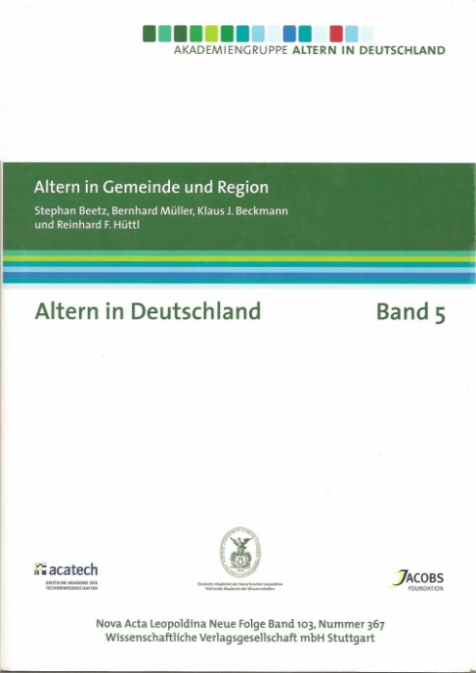
Demographic change:
Ambient assisted living
Energy
Life style
…
Health care
Mobility
Accessibility
of open spaces
Ageing sensitive urban development

Slide 49
What do I want to talk about?
Ambiguity of the eco-city
Eco-city and sustainability
The broader view:
eco-city certification schemes
Perspectives - outlook

Slide 50
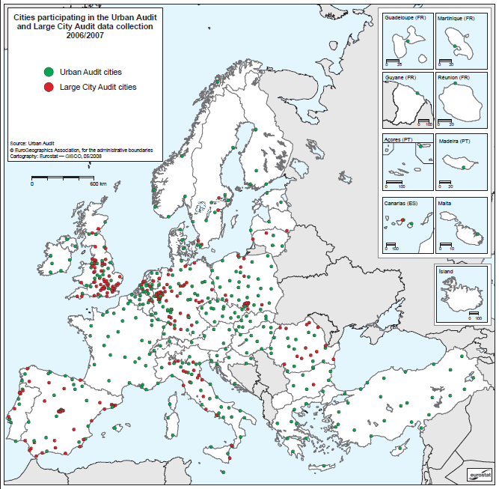
Sets of Indicators and Evaluation Tools for Cities
In the EU (selection)
URBAN AUDIT (Eurostat –
comparing 321+36 cities,
more than 250 indicators
in 9 domains)

Slide 51
Sets of Indicators and Evaluation Tools for Cities
In the EU (selection)
URBAN AUDIT (Eurostat –
comparing 321+36 cities,
more than 250 indicators
in 9 domains)
European Common
Indicator Initiative
(GD Environment,
since 1999)

Slide 52
European Common Indicators Initiative (GD Environment)
10 Indicators
Products promoting sustainability
CO₂ emissions
due to local energy consumption
Children´s journeys from and to school
Local contribution to global climate change
Availability of local public open areas and services
Citizens‘ satisfaction with the local community
CH₄ emissions
due to local waste management activities
Noise pollution
Quality of local ambient air
Sustainable land use
Local mobility and passenger transportation
Sustainable management of the local authorities and local businesses
(Source: European Commission 2002)

Slide 53

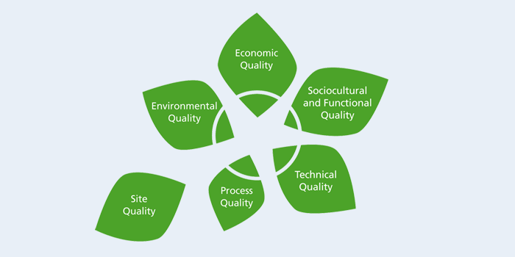
Initiated in 2007 by a small group
of stakeholders from real estate
and building sectors
Membership 2012: 1050
“Unique knowledge platform”
Certification system for
new development areas

Slide 54
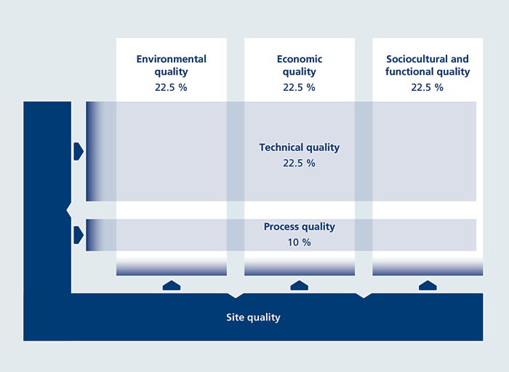

Slide 55
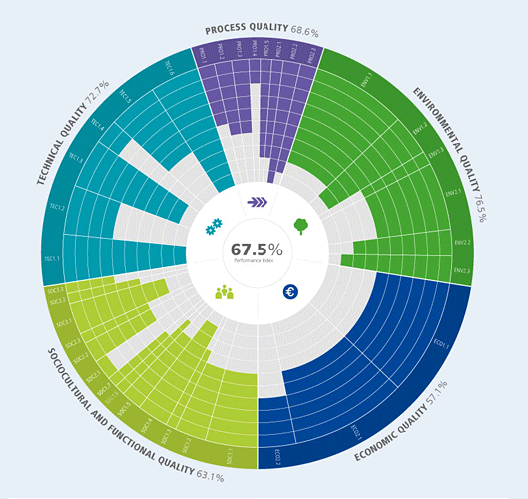
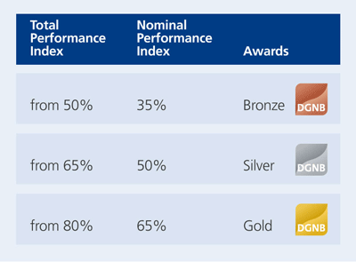

Slide 56
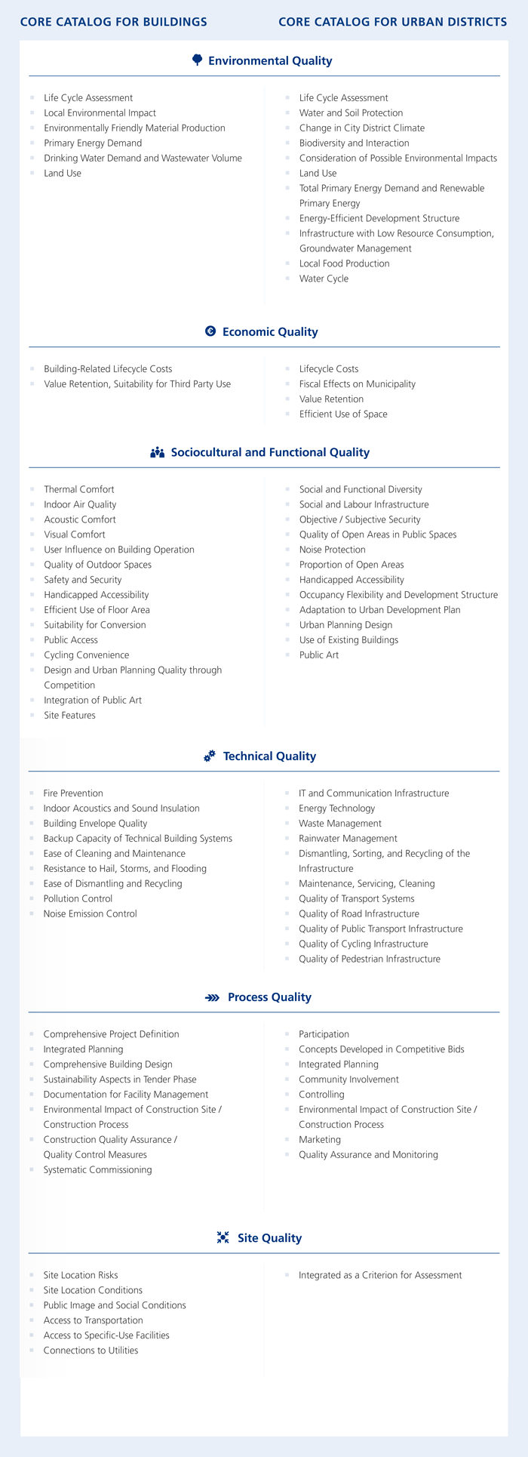

Slide 61
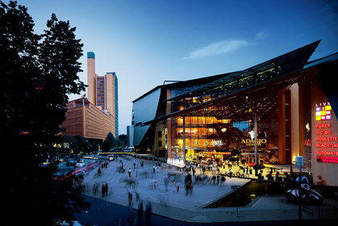
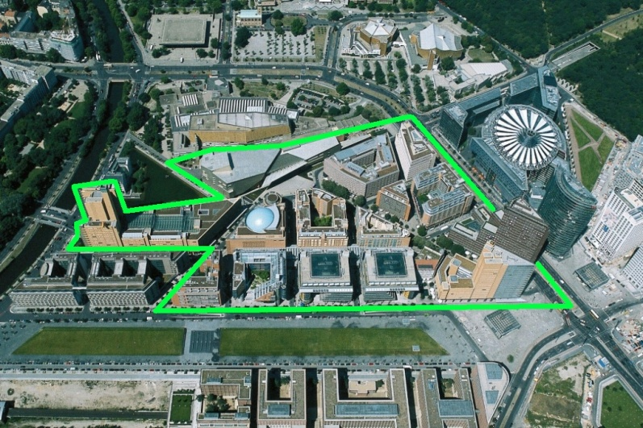
Example of a DGBN-Urban Area:
Potsdamer Platz, Berlin, Germany
Regeneration project of a brownfield into a mixed use development (1993 – 1998)
Area: 68,000 sqm
400 companies, 10,000 jobs and 370 residential units
Residential 9%
Entertainment 15%
Offices 46%
Hotels 12%
(Source: greenIMMO 2011)
(Source: SEB 2011)
Sustainable energy and environmental concept:
healthy and environmentally suitable building materials
low energy consumption (e.g. ventilation systems instead of air conditioning)
minimized pollutant emission
rainwater management (e.g. 50,000 sq m green roofs, rainwater is reused in toilets)
(Source: Drees & Sommer 2011)

Slide 62
Example of a DGBN-Urban Area:
Potsdamer Platz, Berlin, Germany
Regeneration project of a brownfield into a mixed use development (1993 – 1998)
Area: 68,000 sqm
400 companies, 10,000 jobs and 370 residential units
Residential 9%
Entertainment 15%
Offices 46%
Hotels 12%
SILVER!
(Source: greenIMMO 2011)
(Source: SEB 2011)
Sustainable energy and environmental concept:
healthy and environmentally suitable building materials
low energy consumption (e.g. ventilation systems instead of air conditioning)
minimized pollutant emission
rainwater management (e.g. 50,000 sq m green roofs, rainwater is reused in toilets)
(Source: Drees & Sommer 2011)

Slide 63
Private sector involvement as a strength

Slide 64
Private sector involvement as a strength
Broadly based system, technology as criteria
Key sustainability aspects covered

Slide 65
Private sector involvement as a strength
Broadly based system, technology as criteria
Key sustainability aspects covered
Owners / users and their interests play
an important role
Problem of scales taken into consideration
Life cycles taken into consideration
Assessment of processes

Slide 66
Private sector involvement as a strength
Broadly based system, technology as criteria
Key sustainability aspects covered
Owners / users and their interests play
an important role
Problem of scales taken into consideration
Life cycles taken into consideration
Assessment of processes
However:
Too early to judge – international orientation
Orientation of new urban areas – what about existing ones? What about retrofitting?

Slide 67
What do I want to talk about?
Ambiguity of the eco-city
Eco-city and sustainability
The broader view:
eco-city certification schemes
Perspectives - outlook

Slide 68
Perspectives - Outlook
There are many new challenges which urge technological change in cities in order to achieve sustainability, e.g. climate change, demographic change

Slide 69
Perspectives - Outlook
There are many new challenges which urge technological change in cities in order to achieve sustainability, e.g. climate change, demographic change
Smart/intelligent cities and eco-cities are not the same but there is a large overlap, and there are even more potentials – the eco-city is “more” than the smart city

Slide 70
Urban laboratories
Nature /
Urban Green
Eco-Region
Sustain-able
City
Eco-City
Techno-logy /
ICT
Eco-District

Slide 71
Urban laboratories
Nature /
Urban Green
Eco-Region
Sustain-able
City
Eco-City
Techno-logy /
ICT
Eco-District
Inclusiveness with balance

Slide 72
Perspectives - Outlook
There are many new challenges which urge technological change in cities in order to achieve sustainability, e.g. climate change, demographic change
Smart/intelligent cities and eco-cities are not the same but there is a large overlap, and there are even more potentials – the eco-city is “more” than the smart city
Eco-cities are prominent and suitable laboratories for smart technologies

Slide 73
Perspectives - Outlook
There are many new challenges which urge technological change in cities in order to achieve sustainability, e.g. climate change, demographic change
Smart/intelligent cities and eco-cities are not the same but there is a large overlap, and there are even more potentials – the eco-city is “more” than the smart city
Eco-cities are prominent and suitable laboratories for smart technologies
There are large market opportunities

Slide 74
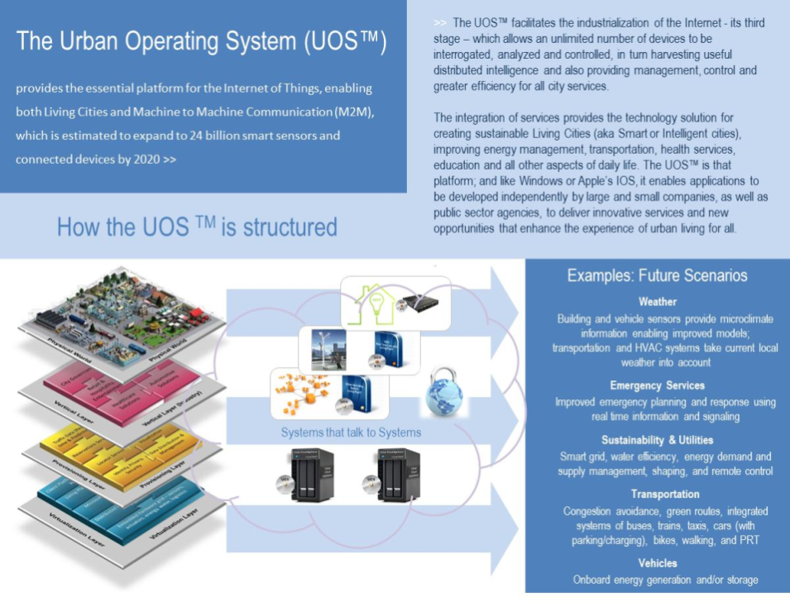
 | “The development of smart cities in future is a crucial commercial opportunity.” "We are entering a phase when everything becomes connected, from healthcare to transportation," Steve Lewis, LivingPlan IT, BBC, 4 May 2012
-> Need to bring ‘eco-tech-city’ into question & develop alternative discourses
Source: Joss 2013
Notes:
Summary – findings so far
recent eco-city initiatives = a rapidly growing, global phenomenon
these initiatives represent a ‘mainstreaming’ of urban sustainability in last 10 years – from theoretical concepts and pilots, to broad policy uptake (local, national and international programmes) and practical implementation
among the diversity of approaches, we can identify several significant commonalities and differences, relating to
type of development – with a majority taking place in existing urban environments
phase of development – with a majority currently under way, and mainly retrofit projects completed
implementation mode – with a majority focusing on technological innovation, mainly addressing CO2/GHG emission reduction targets
this suggests that global climate change is a main factor driving these developments
however, we wanted to probe this in more detailed, and uncovered some interesting information – [next slide]
74

Slide 75
Perspectives - Outlook
There are many new challenges which urge technological change in cities in order to achieve sustainability, e.g. climate change, demographic change
Smart/intelligent cities and eco-cities are not the same but there is a large overlap, and there are even more potentials – the eco-city is “more” than the smart city
Eco-cities are prominent and suitable laboratories for smart technologies
There are large market opportunities
Industrie 4.0 is a big chance and challenge for
urban development

Slide 77
Perspectives - Outlook
There are many new challenges which urge technological change in cities in order to achieve sustainability, e.g. climate change, demographic change
Smart/intelligent cities and eco-cities are not the same but there is a large overlap, and there are even more potentials – the eco-city is “more” than the smart city
Eco-cities are prominent and suitable laboratories for smart technologies
There are large market opportunities
Industrie 4.0 is a big chance and challenge for
urban development
We need a closer link between urban development policies and smart technologies policies

Slide 78
Perspectives - Outlook
Aspects to consider:

Slide 79
Perspectives - Outlook
Aspects to consider:
New urban districts versus retrofitting cities?

Slide 80
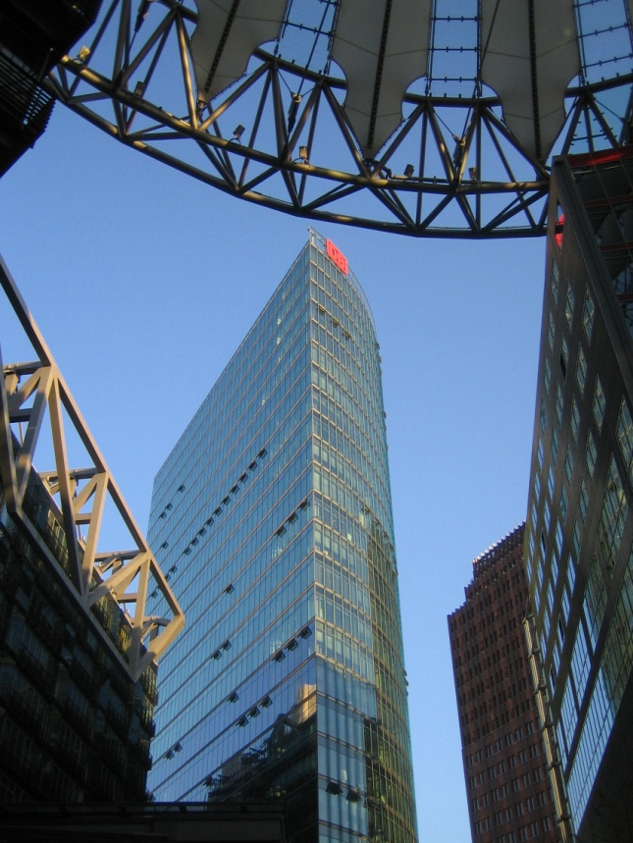
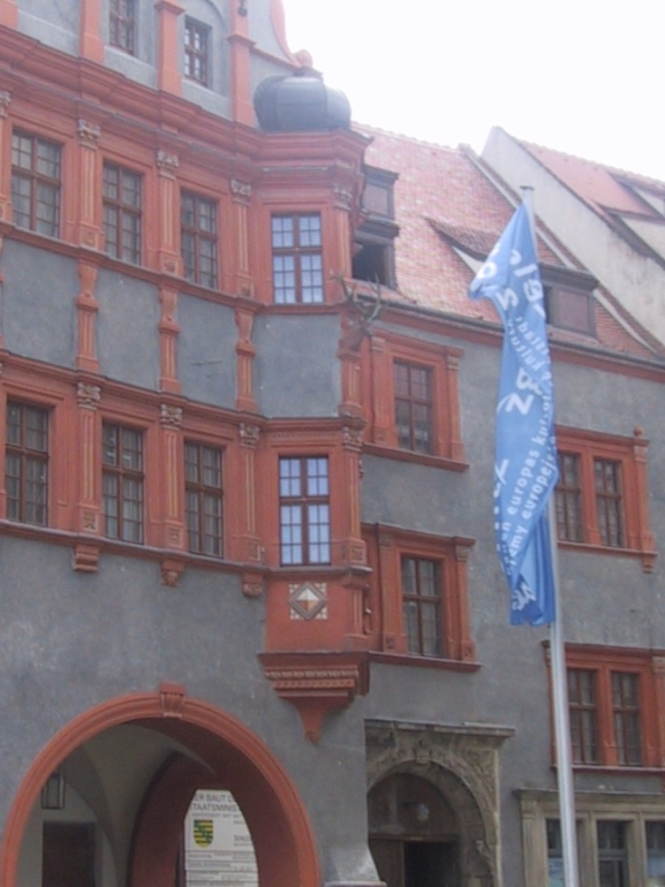
We are strong: sustainability schemes regarding new developments
We are weak: sustainability approaches regarding the existing cities
Berlin
Görlitz

Slide 81
Perspectives - Outlook
Aspects to consider:
New urban districts versus retrofitting cities?
Eco-islands versus integrated urban
and regional development?

Slide 82
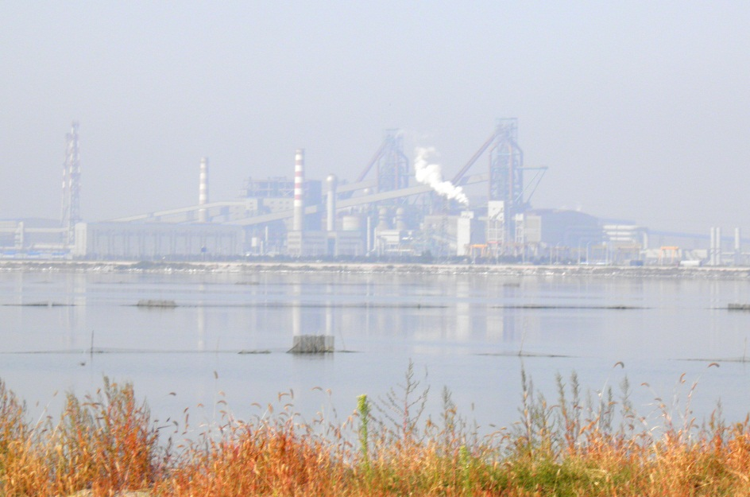
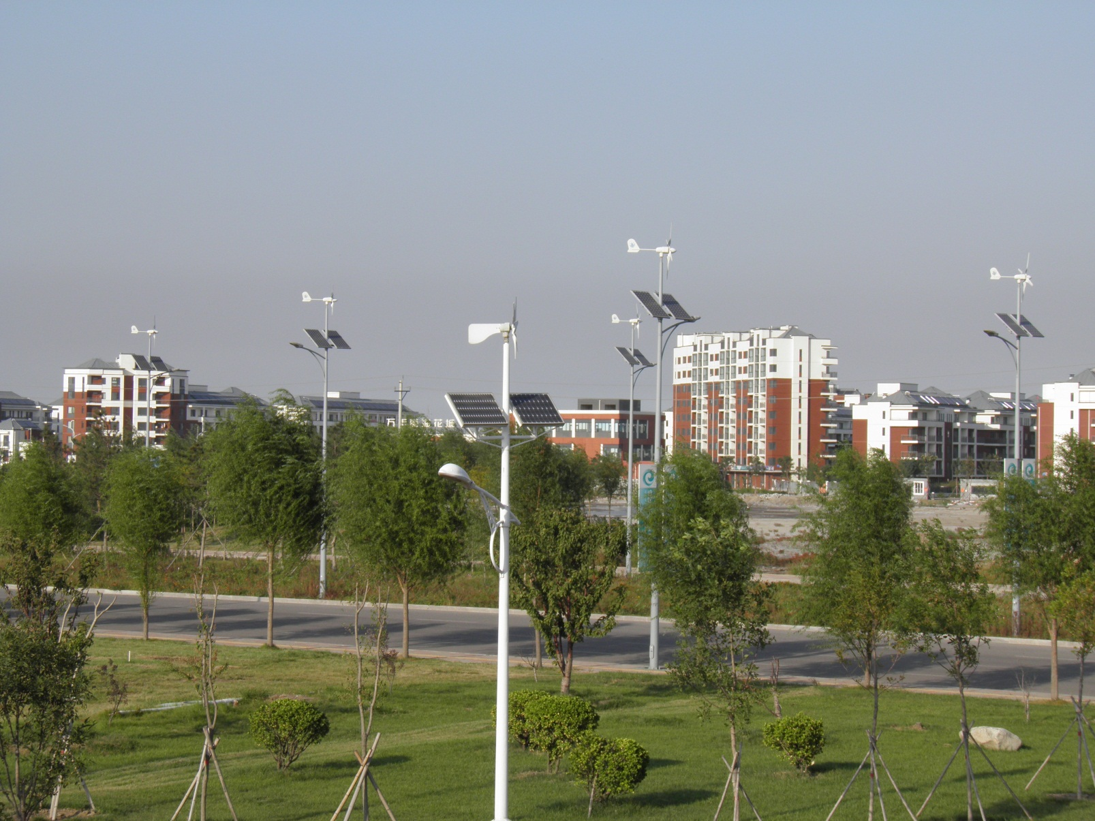
The eco-city …
… and polluting industries
in the hinterland

Slide 83
Perspectives - Outlook
Aspects to consider:
New urban districts versus retrofitting cities?
Eco-islands versus integrated urban
and regional development?
How do we link the intelligent parts of cities with the less intelligent ones? -> Competition? -> Segregation?

Slide 84
Perspectives - Outlook
Aspects to consider:
New urban districts versus retrofitting cities?
Eco-islands versus integrated urban
and regional development?
How do we link the intelligent parts of cities with the less intelligent ones? -> Competition? -> Segregation?
Production of showcases versus “mass production”:
Cost effectiveness and repeatability of solutions?

Slide 85
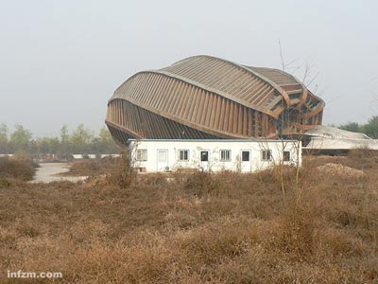
… may turn into
ruins of tomorrow
Dreams of today …

Slide 86
Perspectives - Outlook
Aspects to consider:
New urban districts versus retrofitting cities?
Eco-islands versus integrated urban
and regional development?
How do we link the intelligent parts of cities with the less intelligent ones? -> Competition? -> Segregation?
Production of showcases versus “mass production”:
Cost effectiveness and repeatability of solutions?
Adaptability and robustness: Will the innovation cheetahs of the present turn into the technological dinosaurs of tomorrow?

Slide 87
Perspectives - Outlook
Aspects to consider:
New urban districts versus retrofitting cities?
Eco-islands versus integrated urban
and regional development?
How do we link the intelligent parts of cities with the less intelligent ones? -> Competition? -> Segregation?
Production of showcases versus “mass production”:
Cost effectiveness and repeatability of solutions?
Adaptability and robustness: Will the innovation cheetahs of the present turn into the technological dinosaurs of tomorrow?
Human dimension: Size, acceptance, governance, participation, willingness to participate?

Slide 88
Perspectives - Outlook
Aspects to consider:
New urban districts versus retrofitting cities?
Eco-islands versus integrated urban
and regional development?
How do we link the intelligent parts of cities with the less intelligent ones? -> Competition? -> Segregation?
Production of showcases versus “mass production”:
Cost effectiveness and repeatability of solutions?
Adaptability and robustness: Will the innovation cheetahs of the present turn into the technological dinosaurs of tomorrow?
Human dimension: Size, acceptance, governance, participation, willingness to participate?
The role of urban planning in the future?

Slide 89
Philipp Rode (London School of Economics):
"What exactly is sustainable ecological urban development? … Does it refer to futuristic visions based solely on advanced technology—or is it more like ‘back to nature,’ where you live without electricity and artificial light? For me, sustainable ecological urban development means balancing proven elements with modern technology ….“
Source: http://www.masdarcity.a

Slide 90
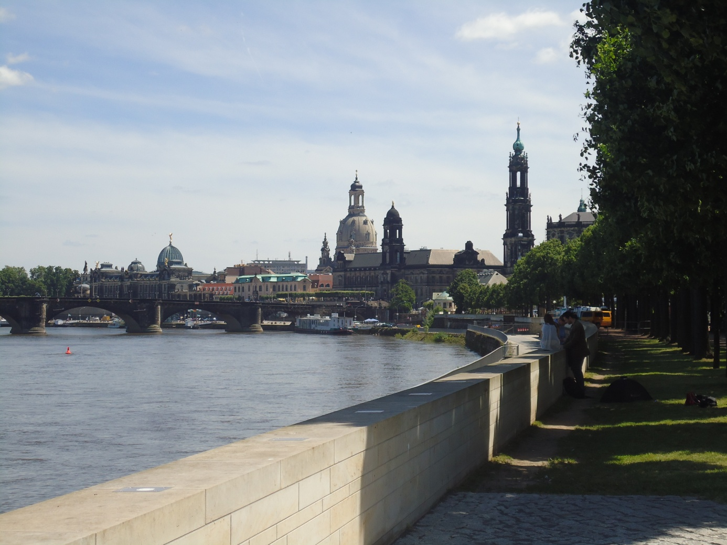
Philipp Rode (London School of Economics):
"What exactly is sustainable ecological urban development? … Does it refer to futuristic visions based solely on advanced technology—or is it more like ‘back to nature,’ where you live without electricity and artificial light? For me, sustainable ecological urban development means balancing proven elements with modern technology ….“
In city development,
smart is not the new green –
but it can be an important element of it!
Source: http://www.masdarcity.a

Slide 91
Philipp Rode (London School of Economics):
"What exactly is sustainable ecological urban development? … Does it refer to futuristic visions based solely on advanced technology—or is it more like ‘back to nature,’ where you live without electricity and artificial light? For me, sustainable ecological urban development means balancing proven elements with modern technology ….“
Thank you very much for your attention!
Bernhard Müller
www.ioer.de
b.mueller@ioer.de
Source: http://www.masdarcity.a

