Slide 1

Smart Cities &
Communities
Colette Maloney
Head of Unit, Smart Cities & Sustainability
DG CONNECT – European Commission

Slide 2
Outline
  Concept: What makes a city smart and green?
  Addressing the challenge:
    Connecting and enabling European cities
    Moving beyond the silos
European Innovation Partnership on Smart Cities and Communities
H2020
Cooperation with China
Notes:
2

Slide 3

A city becomes ‘smart’ and ‘green’ through strategic deployment of ICT infrastructure and services to achieve sustainability policy objectives.
Energy and Resource Efficiency
ICT deployed to increase energy efficiency in buildings and beyond, including urban planning; ICT-optimised water and waste management; …
Carbon Neutrality
ICT deployed to decrease carbon footprint of private and public real estate, to feed distributed renewables into the grid, to optimise traffic management; …
Smart and Green through ICT
Cost-Effectiveness
ICT deployed to realise savings through reduced peak energy demand, to turn consumers into prosumers, to optimise logistics; …
?
ICT deployed to enable achieving further public policy objectives
Notes:
3

Slide 4
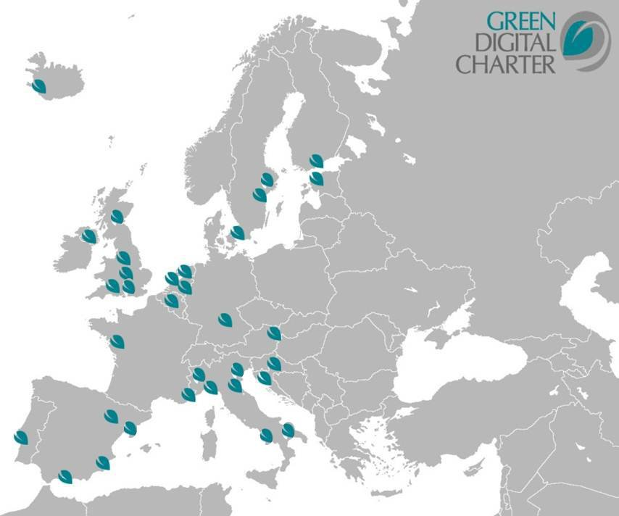
Connecting and enabling European cities:
The Green Digital Charter means political commitment and specific actions towards ICT-enabled sustainability targets and greening ICT itself.
Overall Objectives
Since November 2009, to encourage cities to:
reduce the carbon footprint of their ICT and
roll-out ICT solutions leading to more energy and resource efficiency, carbon neutrality and further public policy goals
Signatory Mayors’ Commitments
Closely cooperate on ICT deployment towards public policy goals
Deploy 5 large scale ICT projects within 5 years
Decrease ICT’s direct carbon footprint by 30% within 10 years
Notes:
4
This initiative set up by Eurocities and the city of Manchester has put the EU’s energy and climate targets at the centre of its activities.
It is hooked into the bigger and broader Covenant of Mayors Initiative, but:
- It focuses specifically on the use of ICT to help achieve these targets (will say some more about this later when we come to address energy efficiency. ).
- It also focuses on reducing the footprint of ICT in cities (through consolidation of large data-centres for example).

Slide 5

Connecting and enabling European cities:
‘NiCE – Networking intelligent Cities for Energy Efficiency’ is the EC’s support action to promote and advance the Green Digital Charter.
Key Objectives
Objectives: establishing an ICT footprint Reporting Tool drawing on existing international standards to measure, compare and report ICT’s direct carbon footprint at city level
Supporting the Green Digital Charter in moving from political commitment to action:
Define a set of monitoring and reporting tools
Deliver practical support to the signatory cities
Knowledge exchange
beyond GDC
    Cooperation
    with China
Notes:
5
As part of the Green Digital Charter, cities have made ambitious commitments.
Nice should help stimulate action and make progress visible. It should enable cities to interact and share ideas, approaches,…
.

Slide 6

EIP on Smart Cities - Moving beyond the silo:
The European Commission will focus its efforts on smart cities across portfolios to optimise outputs and ensure public policy coherence.
EU Smart Cities and Communities Initiative
Mobility and Transport
ICT
Energy
6
Notes:
6

Slide 7
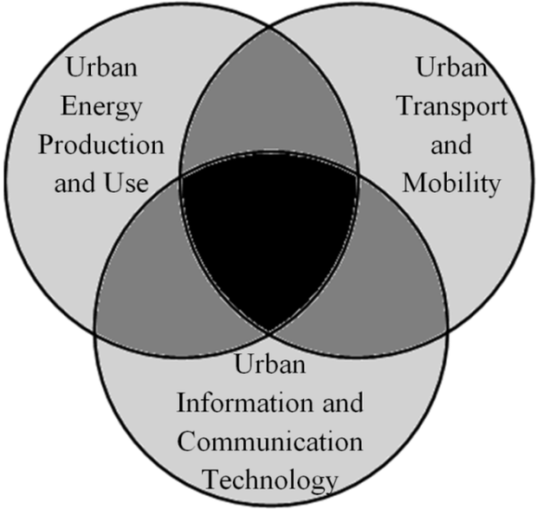
Smart Cities European Innovation Partnership :
Energy, ICT, Transport
20/20/20 goals for 2020
2. Integrated approach
  Energy, Transport and ICT
3. Focus on the intersection
4. ICT both as enabler and as consumer
5. Key role for industries and cities

Slide 8
Implementation
  Supply side:
  Large-scale demo projects
  ('lighthouse projects')
  Demand side:
  Business models
  Public procurement
  Horizontal actions (e.g. regulatory measures, standards, common measurement frameworks)
8

Slide 9
Innovation process and financing
Horizontal Actions to inform the SCC
feed into research programmes and address market barriers
R&D and validations of vital SCC components
Initial demonstrations of SCC concepts in city environments
Large-scale demonstrations of SCC concepts in city environments
Commercial roll-out in city environments
The Innovation Process
Horizon 2020 and other funding
sources
Technical assistance,
structural funds, risk-sharing
facilities etc.
R&D funding, e.g. FP7 & Horizon 2020
9

Slide 10

Governance
  High Level Group
  guide Strategic Implementation Plan (SIP)
  steer implementation SIP
  take commitments, lead by example
  Supported by a "Sherpas" Group
  Stakeholder Platform
  provide input to SIP
  exchange of knowledge
  create partnerships
10

Slide 11
Horizon 2020
A European Research & Innovation funding programme (2014-20) with a considerable size (77 billion Euro)
Part of proposals for next EU budget, complementing Structural Funds, education, etc.
A core part of Europe 2020, Innovation Union & European Research Area:
  Responding to the economic crisis to invest in future jobs and growth
  Addressing peoples’ concerns about their livelihoods, safety and environment
  Strengthening the EU’s global position in research, innovation and technology
11

Slide 12

Europe 2020 priorities
International cooperation
European Research Area
Shared objectives and principles
Tackling Societal Challenges
  Health, demographic change and wellbeing
  Food security, sustainable agriculture and
  the bio-based economy
  Secure, clean and efficient energy
  Smart, green and integrated transport
  Climate action, resource efficiency and raw
  materials
  Inclusive, innovative and reflective societies
  Secure Societies
ICT
Creating Industrial Leadership and Competitive Frameworks
Leadership in enabling and industrial technologies
  ICT
  Nanotech., Materials, Manuf. and Processing
  Biotechnology
  Space
Access to risk finance
Innovation in SMEs
ICT
ICT
ICT
ICT
ICT
ICT
EIT
JRC
Excellence in the Science Base
Frontier research (ERC)
Future and Emerging Technologies (FET)
Skills and career development (Marie Curie)
Research infrastructures
ICT
ICT
Simplified access
Dissemination & knowledge tranfer
Common rules, toolkit of funding schemes
12

Slide 13
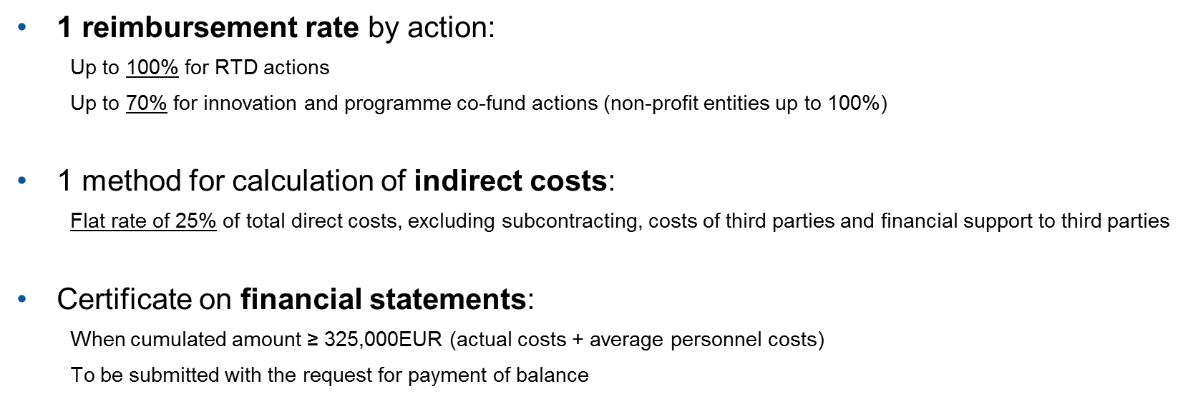
Horizon 2020 – Funding Models
13

Slide 14
Horizon 2020 – Next Steps
September-October: Consultations with national experts
October-November: Finalisations of WP2014-15
November 6-8: ICT 2013 in Vilnius
December 10: WP adoption
December 11: Publication of first calls
Spring 2014: closing of first call
14

Slide 15
Cooperation with China
1. EU-China ICT Policy Dialogue
  2013
  China-EU Green Smart Cities Cooperation launched May this year
  Expert Group established
  15 pilot cities in each side selected
  Link with the EU-China Urbanisation Partnership
  Event in Beijing 20-24 November this year
  2014
  Exchange of visits between China and EU pilot cities
  Preparation of Reports on China-EU Smart Cities Dialogue
15

Slide 16
Cooperation with China
2.- Reinforce co-operation with NICE:
The Green Digital Charter in fast growing countries; contribution to the toolset.
3.- Involvement in the EIP through the Stakeholders Platform
4.- Continue technical and research oriented cooperation via
H2020.
16

Slide 17

Thank you!
17

