Slide 1
I&C technologies in vertical applications – smart cities
Siemens Corporate Technology | September 2013

Slide 2
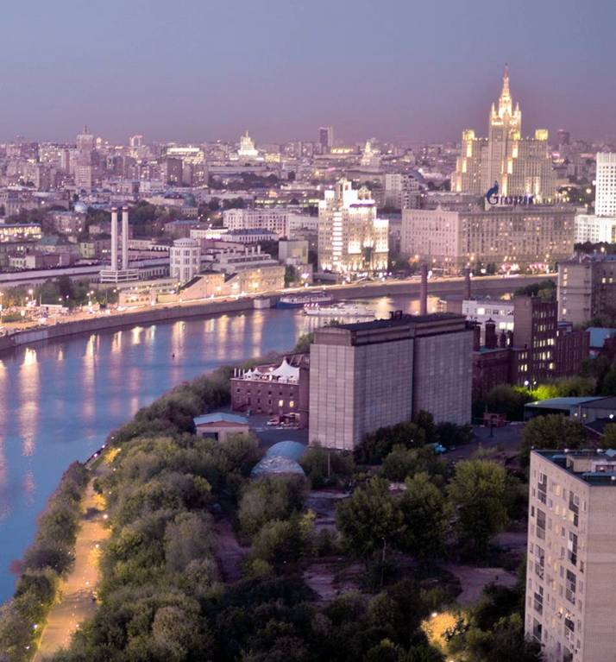
We are in the "urban millennium"
Facts about cities
Population
2009: 50% of the world's population lives in cities
2030: urban population will grow from 3.5 billion to 4.7 billion
Economy
51% of global GDP is produced in 600 cities
By 2025, middle-weight cities in emerging markets will generate 40% of GDP growth
Environment
Cities consume two-thirds of the world's energy, and 60% of its drinking water
Cities generate up to 70% of its CO₂ emissions

Slide 3
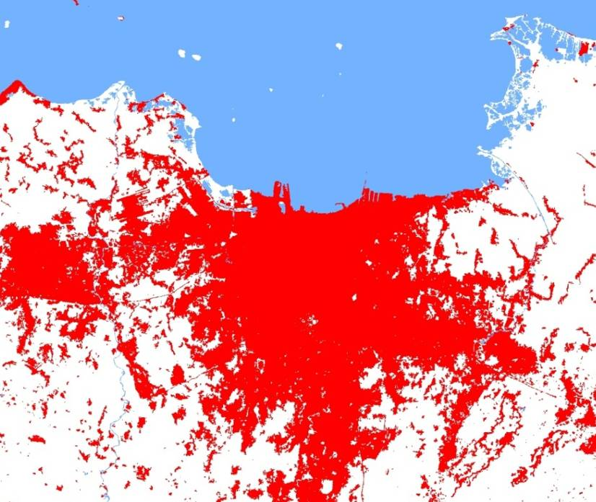
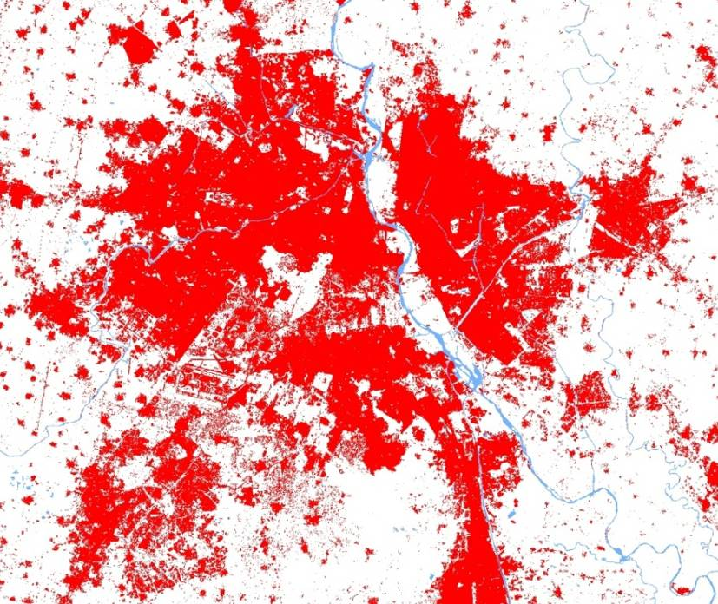
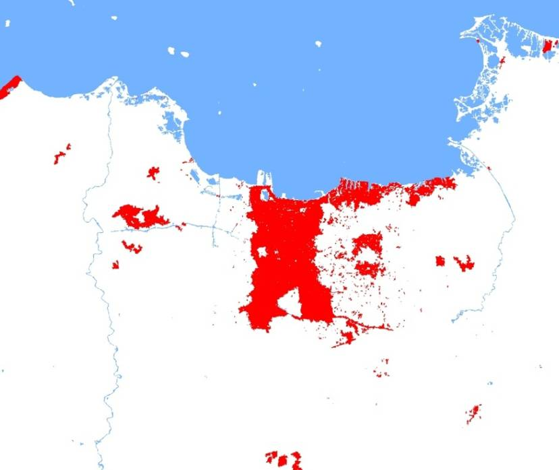
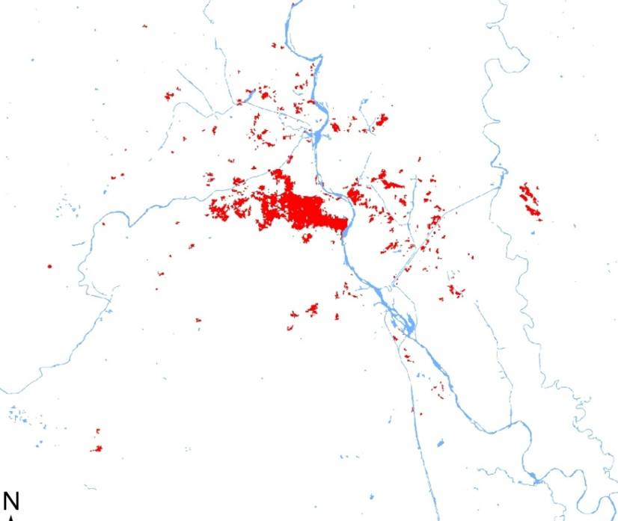
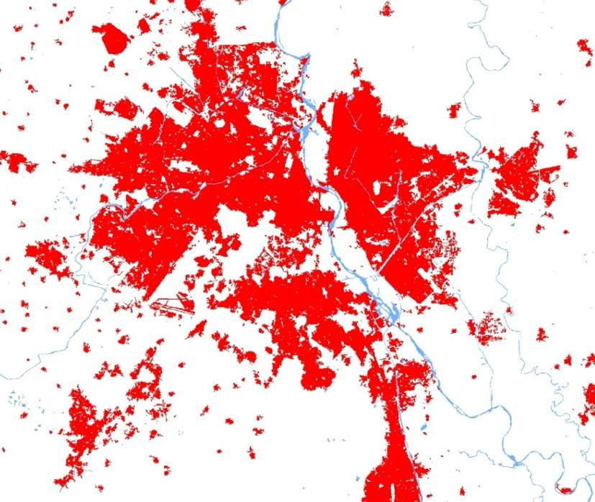
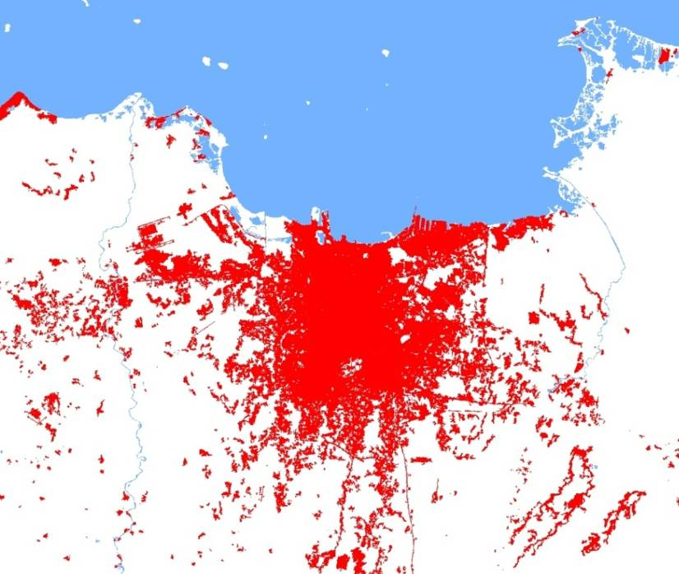
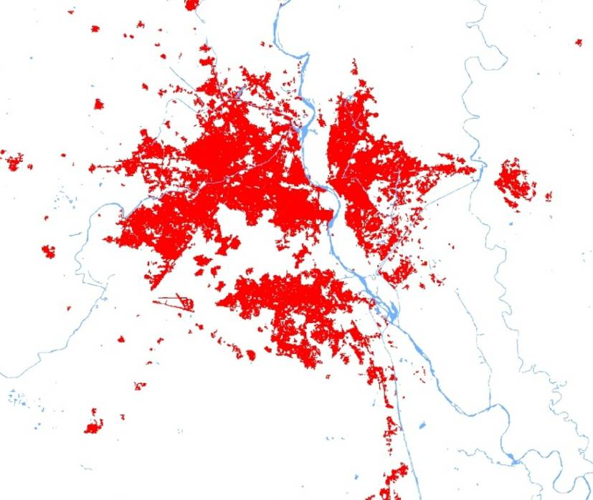
Population: City population grows by 2 inhabitants per second
Illustration of city population growth: Jakarta and Delhi
Delhi 2000—16 Mio
Greater Delhi 2010—22 Mio
Greater Jakarta 2000—21 Mio
Greater Delhi 1972—4 Mio
Greater Jakarta 2010—28 Mio
Greater Jakarta 1975—12 Mio
Jakarta 1975—4.8 Mio
Delhi 1972—4,4 Mio
Greater Jakarta 1990—17 Mio
Greater Delhi 1988—10 Mio
Source: Deutsches Zentrum für Luft- und Raumfahrt, UN World Urbanization Prospects: The 2009 Revision
Notes:
Weltbevölkerung wächst um 2.5 Bürger pro Sekunde, 2 davon in Städten
In Indien ziehen jede Minute 30 Einwohner in Städte. Das klingt nicht viel, ist aber
30 je Minute
1.800 je Stunde
43.200 je Tag
15.768.000 je Jahr
Bayern hat 12,5 Mio Einwohner. So viele ziehen in Indien in nicht einmal 10 Monaten in Städte
15 Mio pro Jahr entspricht der Einwohnerzahl der 21 größten deutschen Städte zusammen:
Berlin 3461
Hamburg 1786
München 1353
Köln 1007
Frankfurt 680
Stuttgart 607
Düsseldorf 589
Dortmund 580
Essen 575
Bremen 547
Dresden 523
Leipzig 523
Hannover 523
Nürnberg 506
Duisburg 490
Bochum 375
Wuppertal 350
Bonn 325
Bielefeld 323
Mannheim 313
Karlsruhe 295
3

Slide 4
Economy: Emerging markets middleweight cities play a crucial role in future growth
GDP per city size – today and tomorrow
Today: Tier 1 cities¹⁾ → 51% of global GDP
2025: Rise of emerging mid-weight cities
6”6
55,000″
100%
100%
Rural
Developed Economies
77%
Other urban
9%
Megacities²⁾
16%
~1400 Tier 2 cities¹⁾
10%
Large³⁾
Mid- weight cities: ~40%
14%
Mid-
Sized⁴⁾
Emerging Economies
77%
15%
Small⁵⁾
15%
51%
~600 Tier 1 cities¹⁾
22%
29%
Rural areas
Population
GDP (USD)
Contribution to global GDP growth 2007-2025
1) Tier categorization based on population, economic development and political importance of the respective cities 2) Megacities: >10 million inhabitants; 3) Large mid-weights: >5 million; 4) Mid-size mid-weights: >2 million 5) Small mid-weights: >0,15 million; Source: McKinsey

Slide 5
Environment: Impact of cities on energy consumption and environment will grow even further
Example: Building energy consumption of an Asian mega city, 2008 to 2020, in million tons SCE
16,30
Resulting growth rate
Growth rates
Cooling
Residential
Cooling 20% p.a.
Lighting 14% p.a.
Appliances 8% p.a.
Hot Water and Cooking 8% p.a.
Commercial
Cooling 12% p.a.
Lighting 10% p.a.
Appliances 7% p.a.
Hot Water and Cooking 10% p.a.
7,86
Lighting
+13% p.a.
40% of total city energy consumption
Appliances
Hot Water and Cooking
2,36
Cooling
4,49
1,68
Lighting
+10% p.a.
0,45
0,15
8,44
0,81
Appliances
1,86
0,62
3,59
Hot Water and Cooking
2,63
0,37
0,55
1,09
2008
2020
Residential
Commercial
Source: Siemens project team

Slide 6
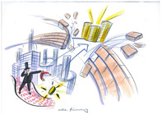
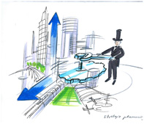
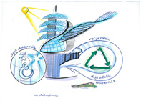
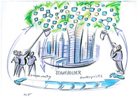
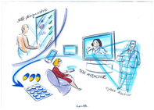
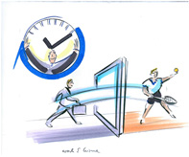
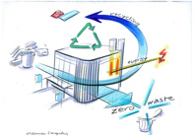
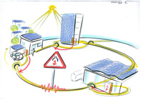
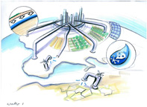
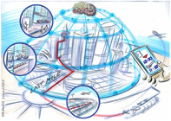
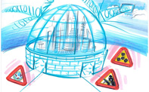
Cities mayors are facing a diverse playing field – Vertical IT is both a challenge and an enabler
Trends and challenges faced by cities
Admin., financing, participation
E-governance
New business models and stakeholders
Co-determination
Strategic planning & Identity
Urbanization, demand for new living spaces
Land scarcity
Decentralized city structures
Architecture, urban planning & mgmt.
Zero-emission building standards
Decentralized, multi-purpose infrastructure and building clusters
ICT / Digitization
Increasing
Penetration of IT
Digitalization
Sensor pervasion
Digital natives
Healthcare & well-being
Aging society
E-health, location-in-dependent diagnosis
Health-oriented building design
Work & Leisure
Remote work places
Virtual technologies 24/7 working life driving up stress levels
Resources & Recycling
Clean environment as competitive edge
Closed-loop recycling
Urban farming
Energy
Renewable energy
Decentralized power generation by "prosumers"
Resilient grids
1
Water
Global water stress
Decentralized water management
Almost-closed water loops
1
Transport & Logistics
New mobility con-cepts, less individual traffic
Integrated, smart, intermodal mobility
2
Safety / Security
Cyber war & crime
Reestablishment of city gates
Ubiquitous sensor networks
2
Social Structures
Increasing migration
Rising middle classes
Down-ageing
Individualization / flexibility
Vertical IT for utilities
Vertical IT for city applications
Source: Siemens Pictures of the Future “Cities”

Slide 7
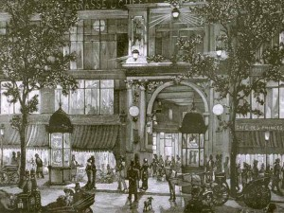
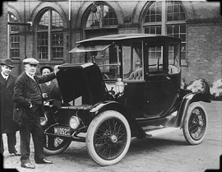
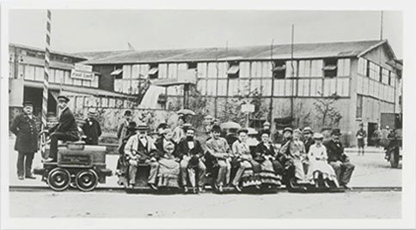
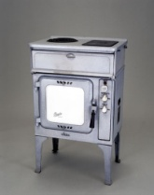
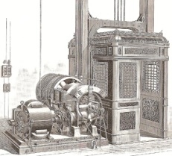
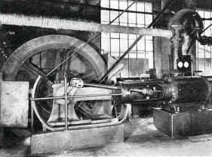
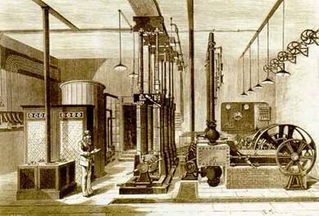
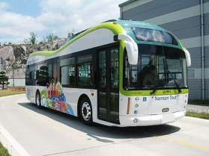
Electricity – the lifeblood of a city
Milestones in city electrification
1844: 1st electric street light (Paris)
~1890-1920: Electric cars flourishing in Europe and the US
1879: 1st electric train (Siemens, Berlin)
From ~1930: Electric ovens
1880: 1st electric elevator (Siemens, Berlin)
1938: 1st deployment of heat pumps (Zurich)
1882-1885: First power plants in Germany (Stuttgart, Berlin)
2008: 1st modern electric car in serial production (Tesla Roadster)
1885: 1st public utility in Germany (AG Städtische Elektrizitätswerke, Berlin)
2010: 1st all-electric regular bus service (Seoul)

Slide 8
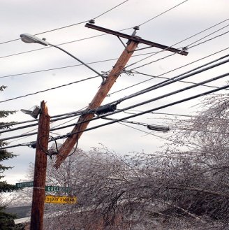
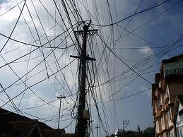
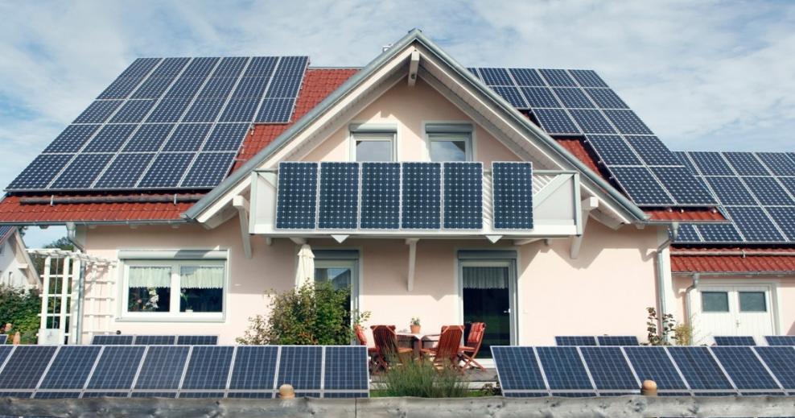
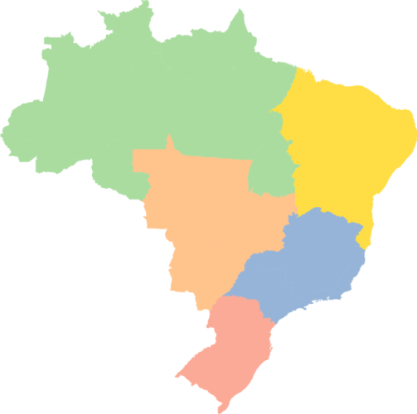
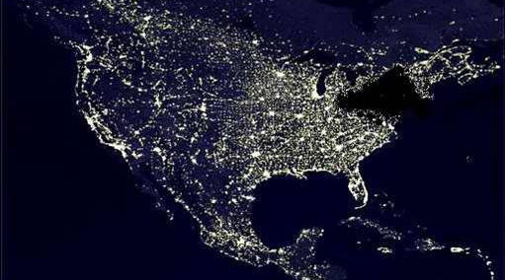
Modern day challenges: Resilient energy supply against a rising number of threats
Modern-day grid challenges (examples)
Outdated infrastructure
Rise of the “prosumer“
„Non-technical losses“
Capacity problems with potentially disastrous impact
22%
20%
21%
9%
E.g. Brazil:
NTL: 23 TWh p.a. (5.8% of total)
Economic loss of 1“ EUR p.a.
18%
5%
Distribution losses
21%
10%
12%
3%
Non-technical losses

Slide 9
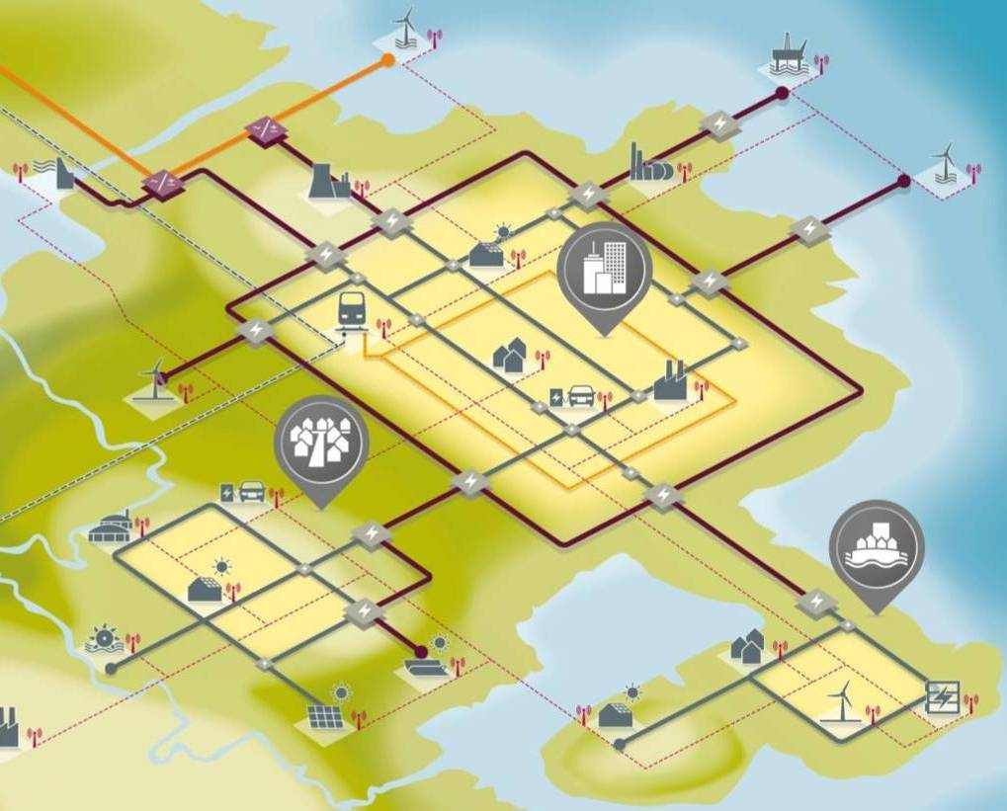
IT-driven smart grid applications are increasingly vital to keep the lifeblood flowing
Smart grid solutions
Challenges in changing energy systems
Smart Grid Solutions
Renewable and distributed generation
✓
Balancing generation & demand, new business models
✓
✓
✓
Limited generation and grid capacity
✓
✓
✓
Load management & peak avoidance
✓
✓
✓
✓
✓
✓
✓
Aging and/or weak infrastructure
✓
✓
Reliability through automatic outage prevention and restoration
✓
✓
✓
Cost and emissions of energy supply
✓
Efficient generation, transmission, distribution & consumption
✓
✓
✓
✓
✓
Revenue losses, e.g. non-technical losses
✓
✓
✓
Full transparency on distribution level and automated loss prevention
✓
✓
✓

Slide 10
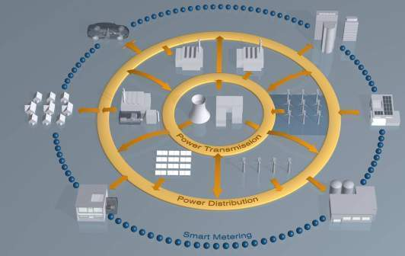
Step-wise development towards multi-modal energy grids
Intelligent energy grids: Development steps
Power grid
Power grid + building
Multi-modal energy systems
Integration of renewable energy (in-feed, storage and trade)
Microgrids
Example: Project IRENE ¹⁾ (Siemens, Hochschule Kemp-ten, Allgäuer Überlandwerke)
Integration of intelligent residential, commercial and industrial premises (private power generation, intelligent consumptions)
Island grid, nano grid
Example: Project “Seestadt Wien / Aspern”
Integration of all energy carriers and converters (district heating and cooling, heat pumps, boilers, etc.)
Heat
Water pump
Water
Climate
1) Integration of renewable energy sources and electric vehicles
Exchange of energy and data
Notes:
Memo 10

Slide 11
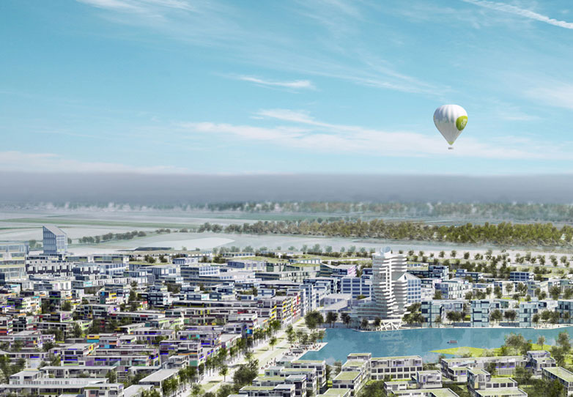
Tianjin Eco-City and Seestadt Wien Aspern – unique chances to research on live infrastructures
Projects “Tianjin Eco-City” (TEC) and “Seestadt Wien-Aspern”
SEIT: Research JV between SSTEC¹⁾ and Siemens Limited China
Goal: Development of need-based innovation solutions in connection with new eco-technologies
Research topics:
Smart green buildings
Intelligent renewable energy systems
Etc.
Research JV between Siemens AG and Vienna city
Goal: Sustainable greenfield development of Aspern (20,000 apartments, 20,000 work places)
Research topics:
Data analytics of grid data
Intelligent building management, optimization of building vs. grid mgmt.
Sensor-supported energy distribution management
End user information systems
1) Sino Singapore Tianjin Eco-City Investment & Development Co. Ltd
Notes:
11

Slide 12
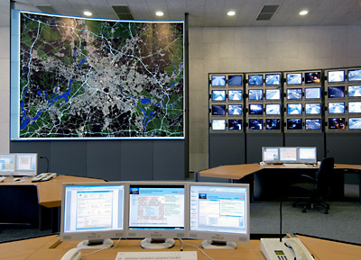
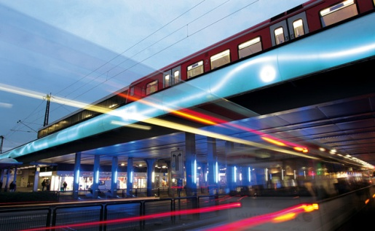
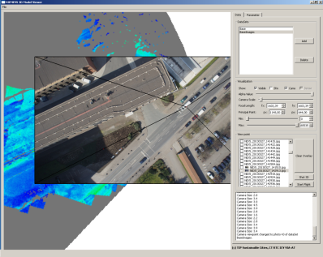
City applications break down into different use cases, and usually aim for improved quality of life
City applications: Use cases (overview)
Monitor and Control
Integrate and facilitate
Analyze and optimize
Seamless optimization, e.g.
Safety and security management
Traffic management
City administration portal
Integrated public transportation platform
Minimized use of central grid (and costs)
Utility tariff design
Image-based loss analysis
Underlying trends
Internet of things – pervasive deployment and availability of sensors and computing power
Advanced analytics of increasing amounts of data
“Digitally native” population

Slide 13
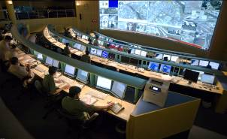
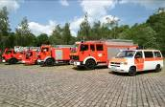
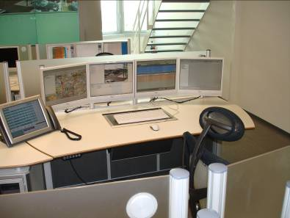
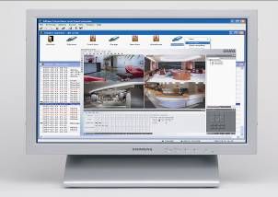
Use case “Monitor and Control” – example city security (Siemens Sieveillance)
Example “Siemens Sieveillance”
Intervention forces
Integrated command and control solution to coordinate and dispatch emergency forces
Critical Infrastructure
Intelligent management systems to ensure critical infrastructures remain secure and run smoothly
Corporate
Sophisticated control system to meet corporate security challenges
Buildings
An extensive range of inter-operable field devices create the basis of our security solution

Slide 14
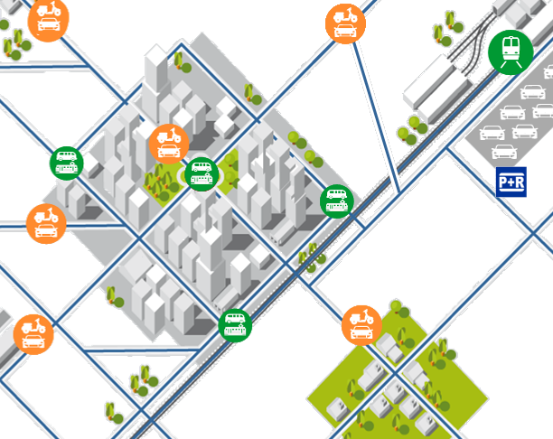
Use case “Integrate & Facilitate” – example intermodal traffic management
Example “Integrated Mobility Platform”
End users / passengers
Transportation apps, e.g.
Unified ticketing
Trip scheduling
Integrated Mobility Platform
Transportation services, e.g.
Public transport
Taxi, car & bike sharing

Slide 15
The next step – an integrated city operating system?
“City operating system”: Idea sketch
From a collection of vertical IT solutions …
… to an integrated city operating system?
Individual, stand-alone IT solutions
Operated by different city departments
Addressing the obvious needs of citizens and city administrations
“Eco-system” of city-related platforms and applications from city and 3rd parties
Cloud-based storage of openly accessible, interoperable data
Cross-domain views (city cockpit, simulation)
Power, water
Traffic
Trans- port
City admin
Etc.
Power, water
Traffic
Trans- port
City admin
Etc.
Unified data model and communication standards
3rd party app.
3rd party app.
3rd party app.
3rd party app.
Etc.

Slide 16
Key takeaways
Cities are growing all around the globe – especially middleweight cities in emerging markets will play a crucial role in future growth
The impact of cities on energy consumption and environment will grow even further
Cities mayors are facing a diverse playing field, with multiple challenges e.g. in the areas of energy, water, transport & logistics, security & safety – many of which can be addressed with vertical IT solutions
Vertical IT for utilities is increasingly essential to assure even the most basic services
City IT applications – which break down into different use cases – mostly aim for improving quality of life
Siemens already works on and provides a variety of vertical IT solutions for intelligent urban environments
The next step in the evolution towards smart cities might be the development of city operating systems, which integrate standalone vertical IT solutions
Notes:
16

