Slide 1
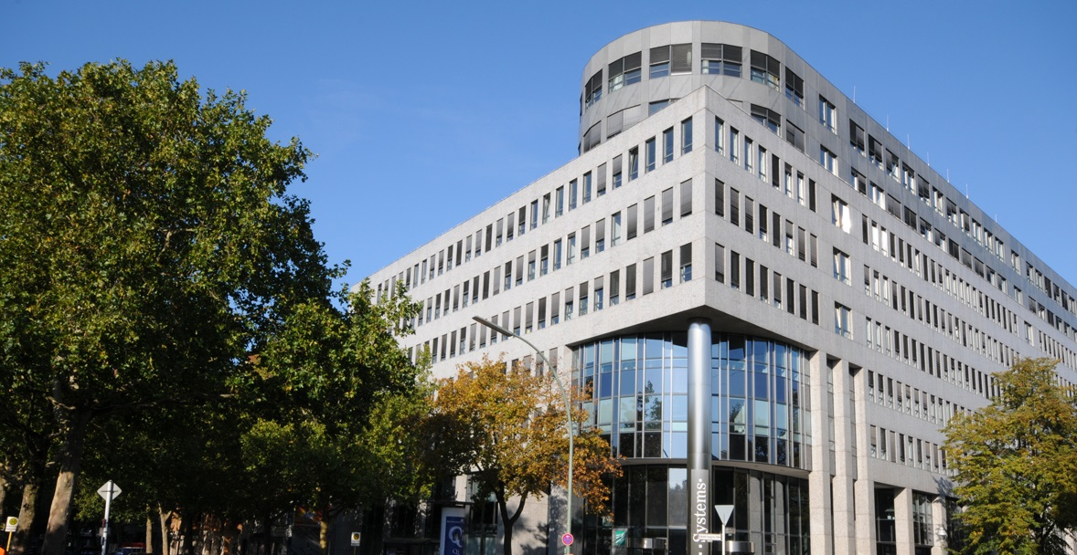
No Smart City without Smart Government
Dr.-Ing. Matthias Flügge
Fraunhofer Institute for Open Communication Systems (FOKUS), Berlin
ICT as an Enabler for Intelligent City Development | September 12, 2013 | Munich

Slide 2

Smart City
Fields of activity
Environment
Mobility
Energy
Health
Education
Safety
…and more

Slide 3
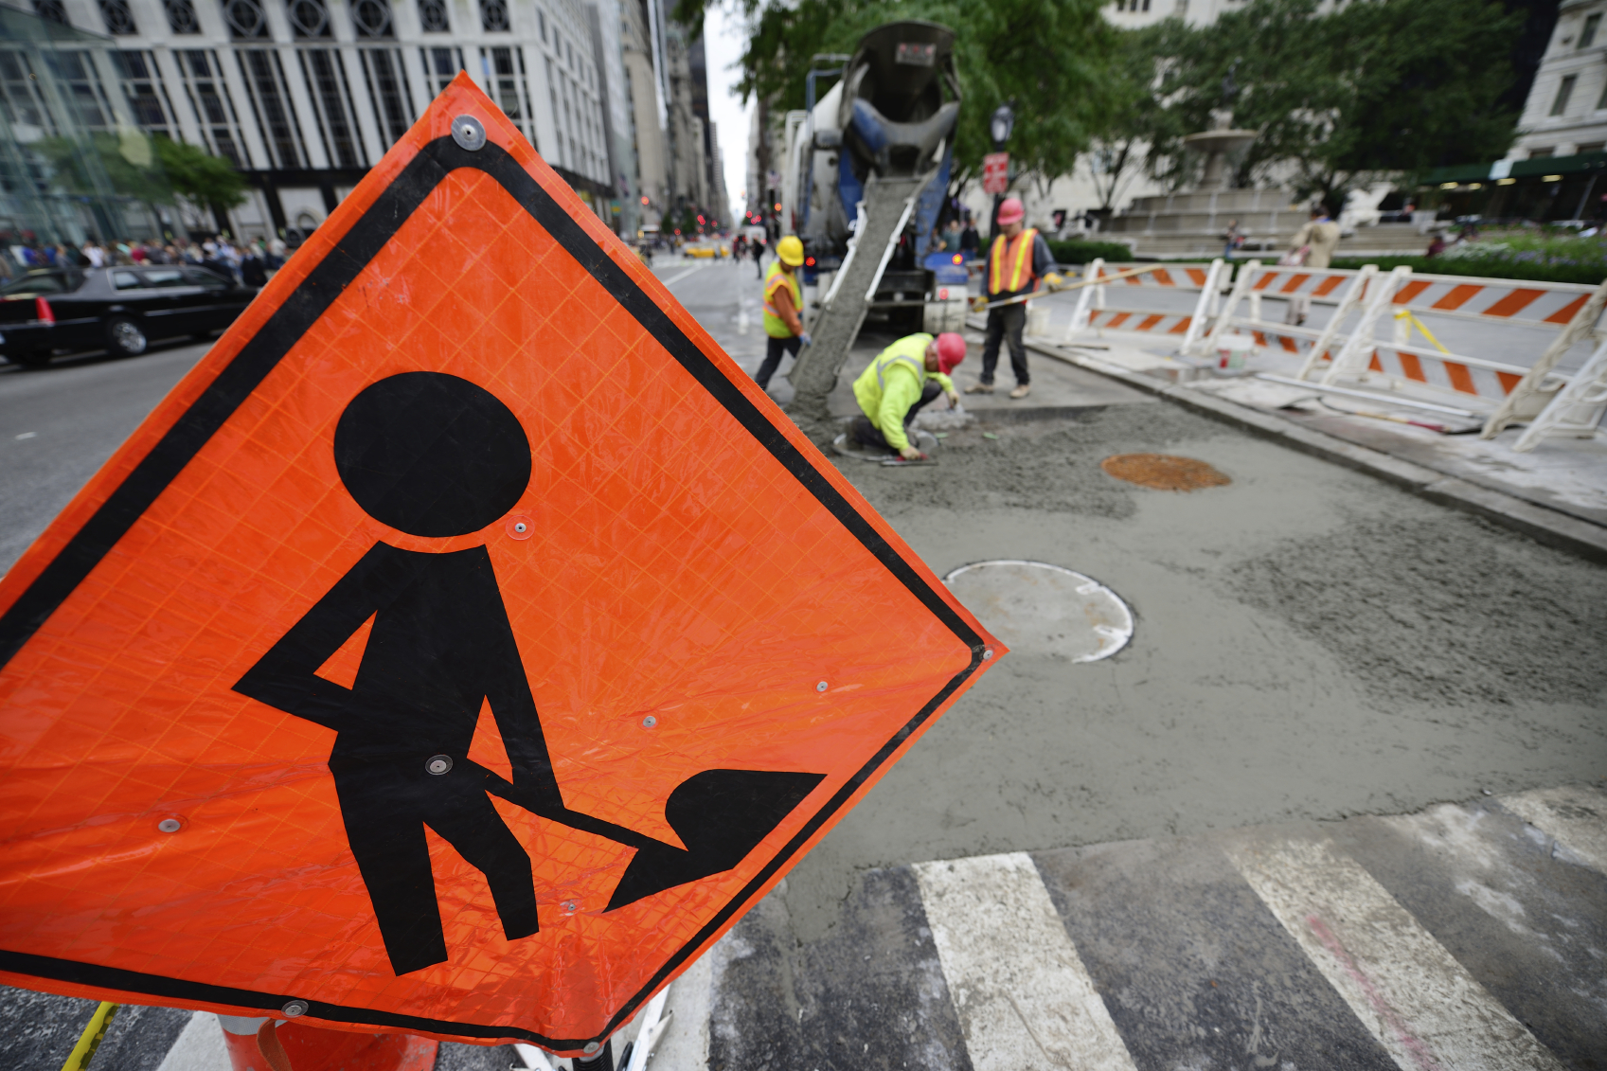
Taking A Walk Through The City
Road works ahead!

Slide 4
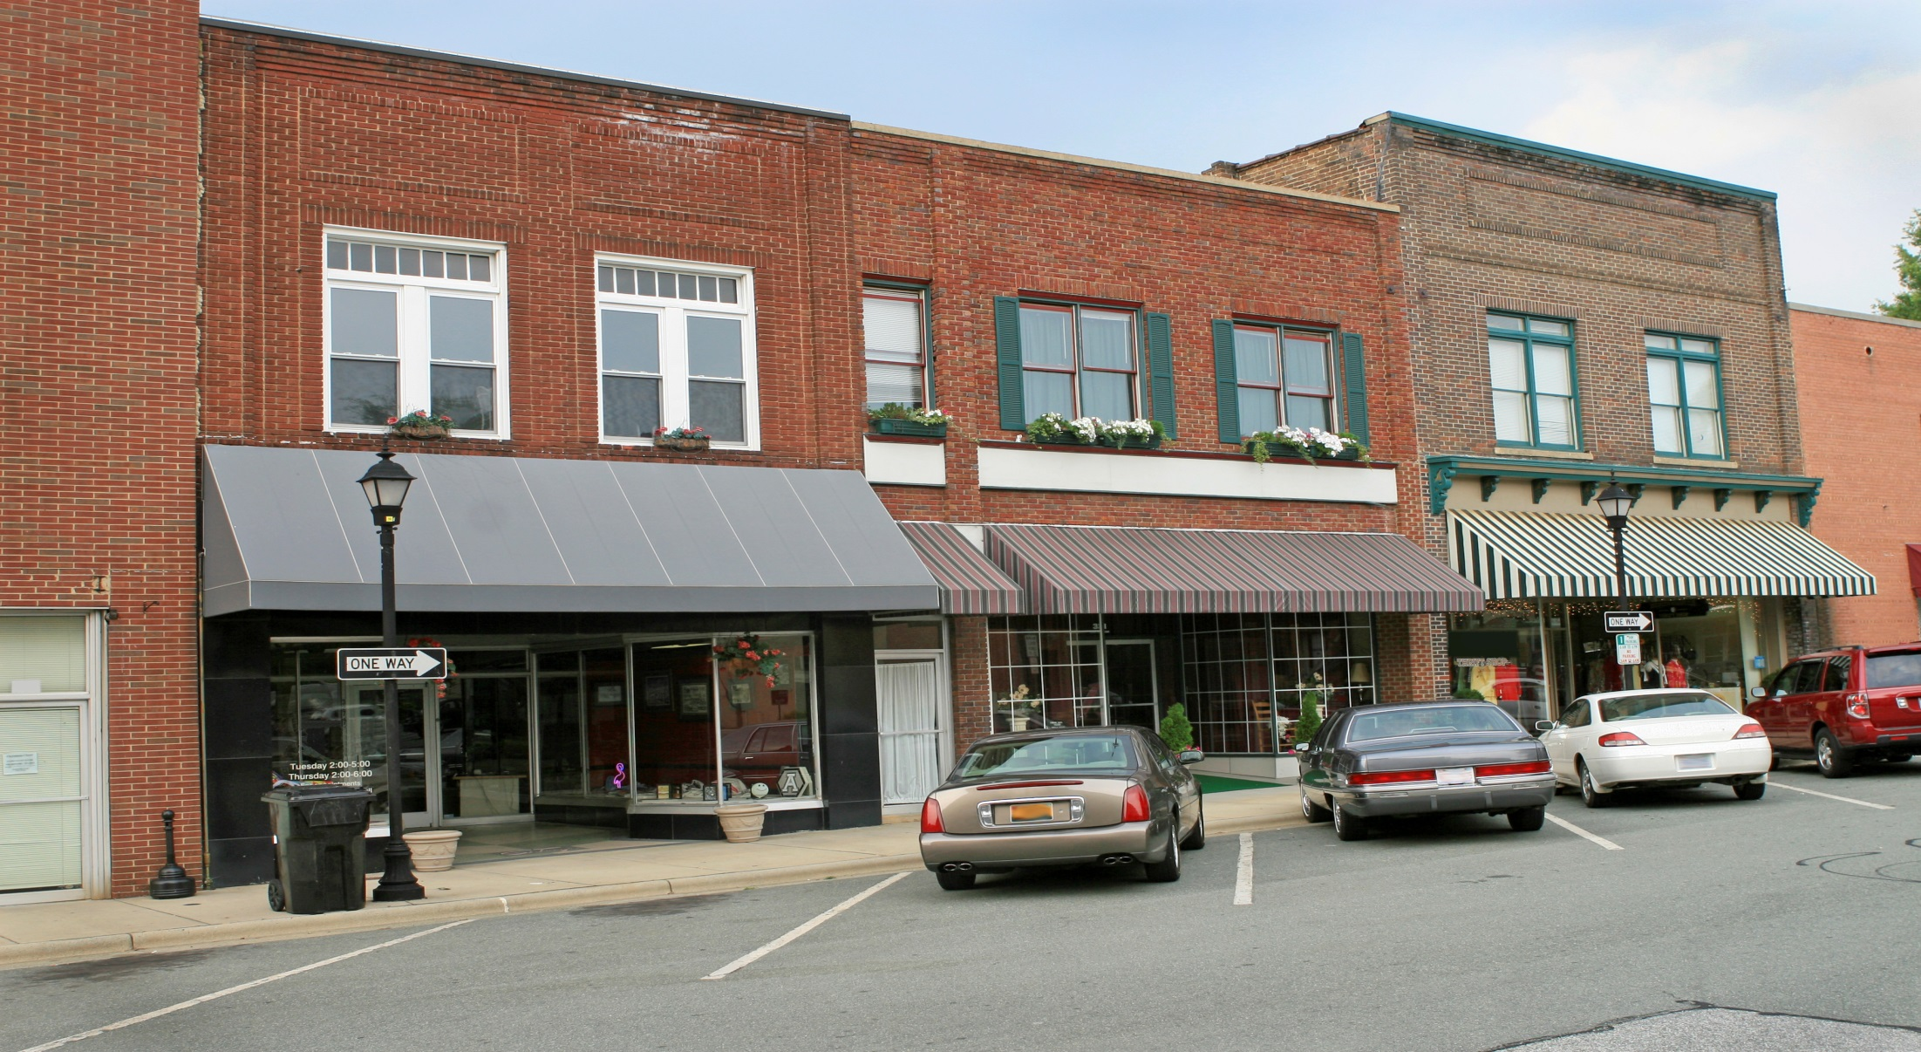
Taking A Walk Through The City
Clean and tidy sidewalks

Slide 5
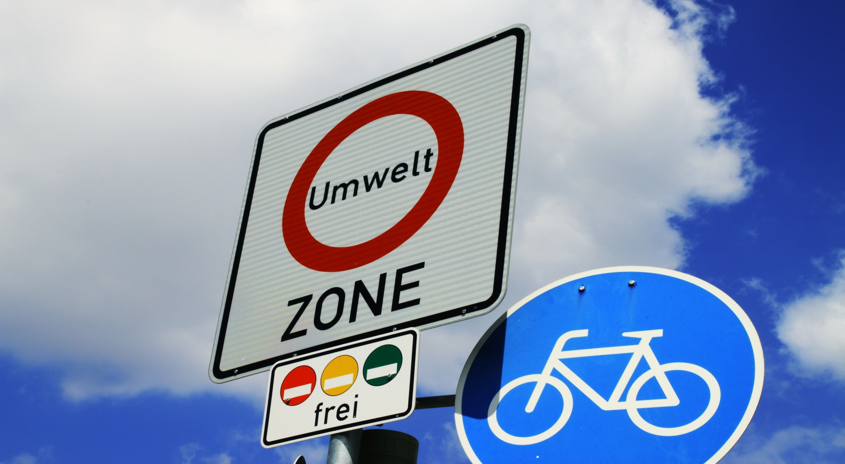
Taking A Walk Through The City
Mission: no emissions

Slide 6
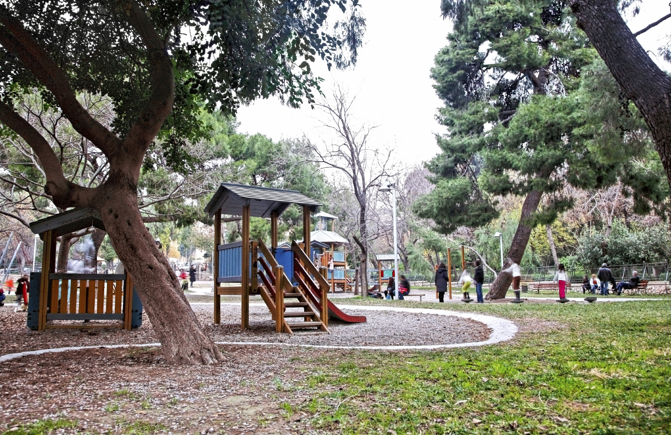
Taking A Walk Through The City
Enough for today - relax

Slide 7
No Smart City…
…without smart government
Mobility
Energy
Government /Public Administration
Health
Environment
Education
Safety
…and more

Slide 8
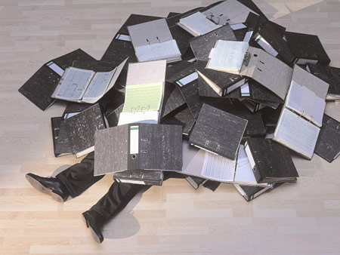

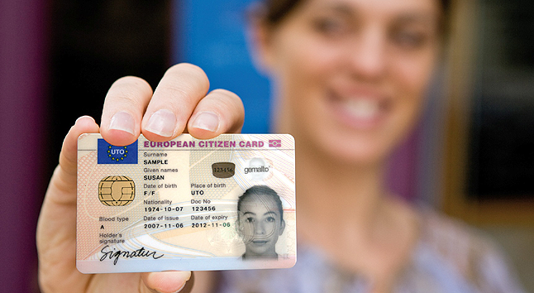
Government and Public Administration
Obstacle or enabler for smart cities?
Permissions, Applications,
Records, Waiting Time…
Promotion of Economic Development,
New Infrastructures, Citizen Participation…

Slide 9




ICT for Modern Government
National initiatives
eGovernment: Use of Information and communication technologies (ICT), and particularly the Internet, as a tool to achieve better government
All federal
public administration
services ready for
online delivery by 2005
Better cooperation
between federal
Government,
Federal States
and local authorities
Electronic collaboration
between public administration
and business community,
electronic identities, secure
communication infrastructures
Strategy defined by actors on federal, state and municipal level, goal: leading eGovernment position in Europe by 2015
Nationale
eGovernment
Strategie

Slide 10
eGovernment
Technological development stages
eGovernment 3.0 –
Smart Government?
eGovernment 2.0
eGovernment 1.0

Slide 11
eGovernment
Technological development stages
eGovernment 3.0 –
Smart Government?
eGovernment 2.0
eGovernment 1.0

Slide 12


eGovernment 1.0
ICT systems for special administrative procedures
Help!
Support of administration internal procedures
  processing of building applications, child benefit claims, management of budget funds, citizen registration information…
Provision of information for citizens and business
  e.g. simple web sites with office opening hours, contact persons…

Slide 13
eGovernment
Technological development stages
eGovernment 3.0 –
Smart Government?
eGovernment 2.0
eGovernment 1.0

Slide 14


eGovernment 2.0
Process-oriented eGovernment
From task-oriented to process-oriented administration
Cross-organizational workflows between public
agencies, businesses and citizens
End-to-end online transactions
One stop government
Multi-channel access
Technical implications
  Service oriented Architectures
  (“From software to services”)
  Open standards
  Secure electronic identities

Slide 15

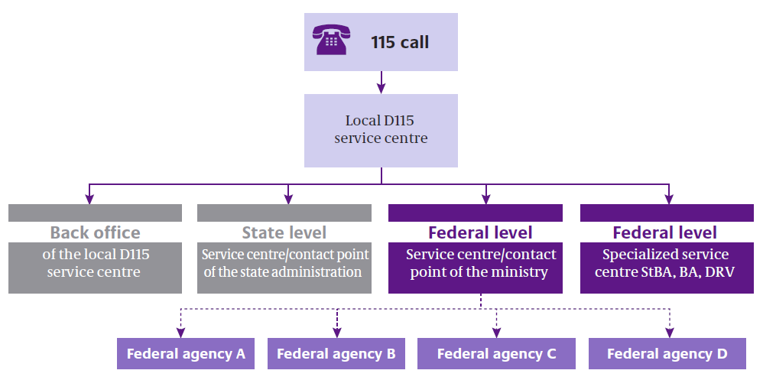
eGov 2.0 – Single Point of Access
Flagship project D115
Central telephone number (115) to give businesses and
private individuals a direct line to public administration
Fixed service quality: availability, response time, call quality…
Challenges
  No central service center,
  network of hundreds
  of service centers on federal,
  state and local level
  Highly heterogeneous
  knowledge bases and
  case management systems
Standards (XML) for
caller enquiries (tickets)
and for describing the most frequently requested services

Slide 16

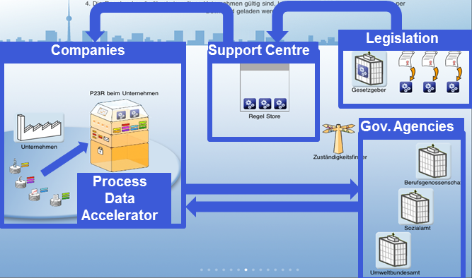
eGov 2.0 – Cross-organizational workflows
Flagship Project „Process Data Accelerator“
More than 10,000 reporting duties, bureaucracy costs 40 Billion Euro p.a.
  e.g. report working hours of employees and wages to statistical offices
  e.g. report social insurance contribution to health insurance organizations
Different recipients, different reporting forms, different timelines
Solution:
Process Data Accelerator
13 partners from government,
business and research
Pilot with BASF, Datev
and public agencies
(employment reports and
environmental reports)

Slide 17

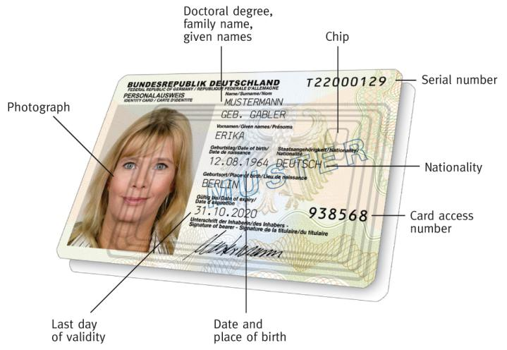
eGov 2.0 – End-to-End Online Transactions
German eID card
Secure and media break free online transactions require trustworthy
electronic identites
New German eID card issued since Nov 2010
  Online electronic authentication (PIN)
  Electronic signature
  Sovereign function
    Digital photograph + fingerprints
    Access only for qualified
    authorities
> 18 Mio. cards are already issued,
60 Mio by 2020
70.000 public authorities equipped with hard and software

Slide 18
eGovernment
Technological development stages
eGovernment 3.0 –
Smart Government?
eGovernment 2.0
eGovernment 1.0

Slide 19
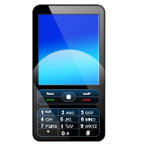




Smart (City) Government
Strong involvement of third parties (business, citizens, civil society)
Government and public administration will develop from service providers to platform providers
Third Party
Applications
New Ways of
Cooperation
Open Interfaces,
Public Data
Participation and
Collaboration Tools
Government Agencies

Slide 20

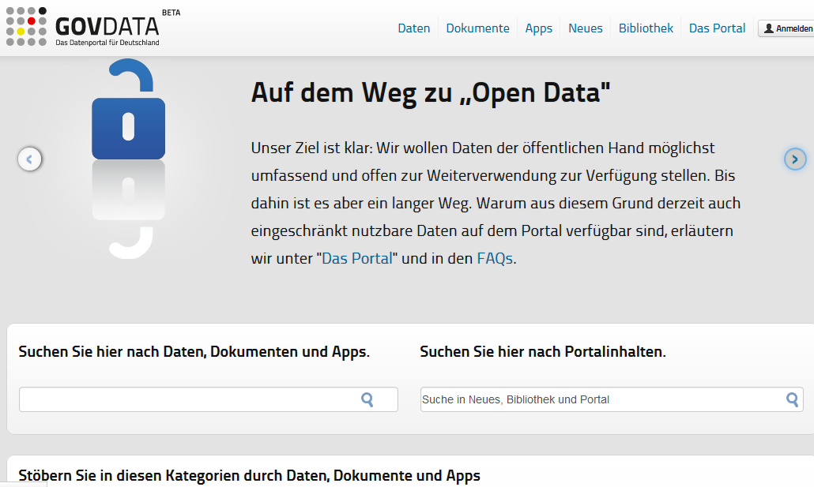
Smart (City) Government
Megatrend Open Government Data
Make government data treasures available and reusable for everybody!
  More transparency, better traceability
  Commercial (re-)use
Paradigm shift: „All data is public except for privacy sensitive data“
Backed by EU and national legislation
Open Data principles
  machine processable,
  non-proprietary formats,
  free license…
Growing number of Open Data portals
More and more Open Data apps
developed by third parties

Slide 21

Smart (City) Government
Open service platform „goBerlin“
Marketplace for trusted e-services from public administration and business
App developers combine public and private services to new citizen apps
Key benefits
  More online transactions → reduced processing costs
  New business opportunities (esp. for SMEs)
  Innovative services for citizens
Portal with Trusted Apps for Citizens
Marketplace for Public and Commercial Services
Service Provider
(Public and
Private Sector)
App Developers
(Civil Society and Business)
Cloud Computing Infrastructure

Slide 22
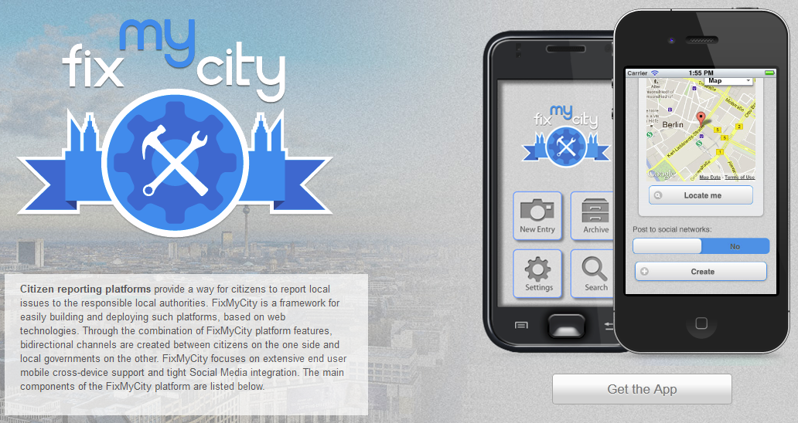
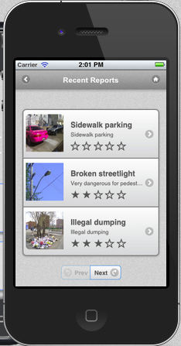
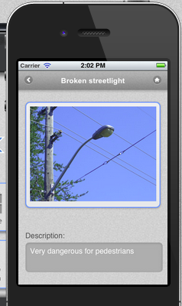
Smart (City) Government
Citizen issue management
Citizens report local issues
to the responsible local authorities
  Mobile reporting app for citizens
  Backend integration with
  case management systems
  at public authorities
Public administration:
Reduced inspection efforts
Citizen:
Track status of issues
City Government:
Better insight to citizen needs,
better governance

Slide 23
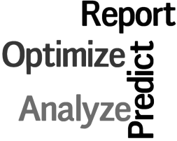

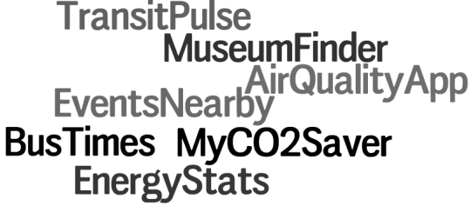
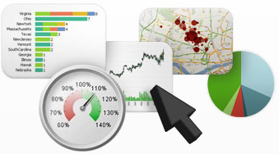

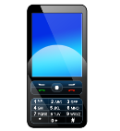





Smart (City) Government
Towards a Smart City Cloud
Development Tools
Data
Analytics
Collaboration
Tools
Open Data and Open Service Interfaces
Smart City Cloud

Slide 24
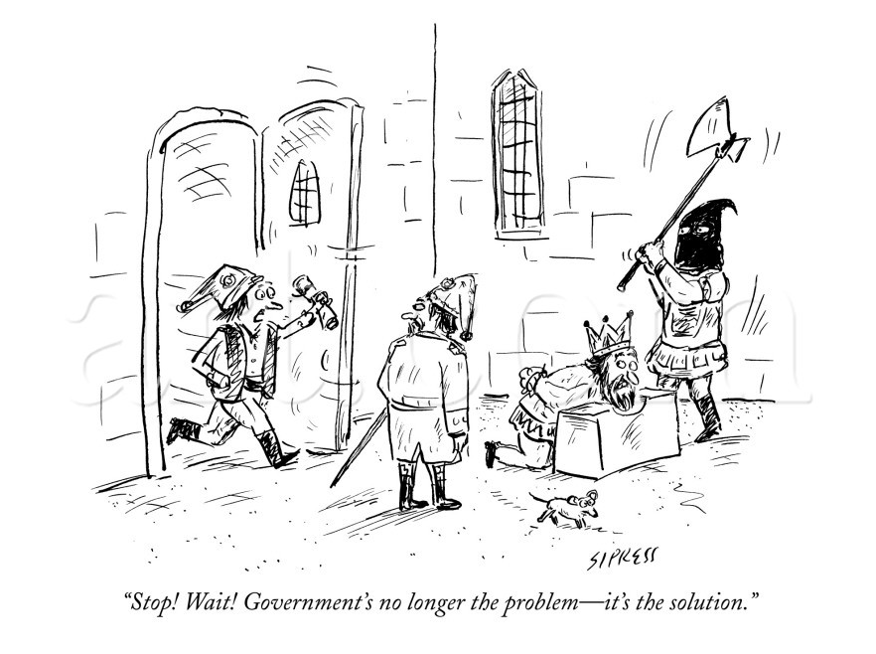
Fazit
Bla
© David Sipress

Slide 25
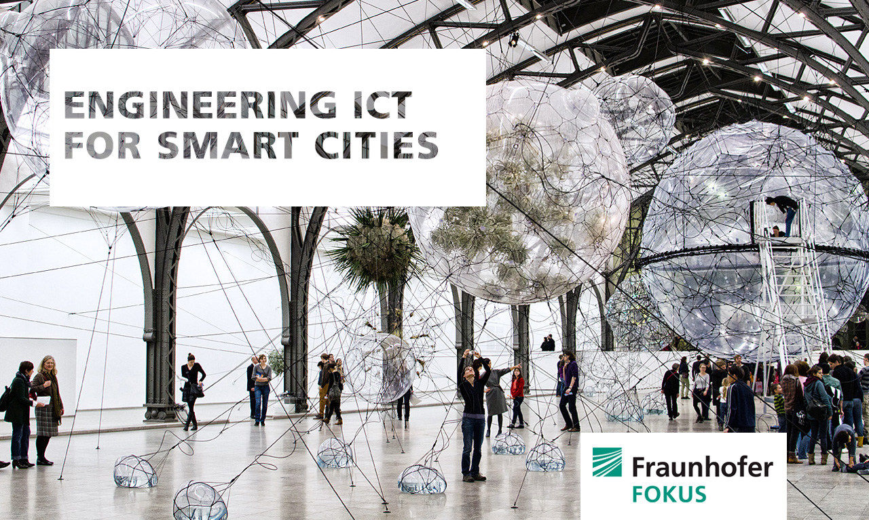
matthias.fluegge@fokus.fraunhofer.de

