Slide 1
Service Platform and Applications in Smart Cities
11
Junliang Chen
Chinese Academy of Engineering
Beijing University of Posts and Telecommunications

Slide 2
Outline
Development Trends of Smart Cities & System Architecture
Smart Cities Service Platform of BUPT
  EDSOA Based Service Development Platform
  Resource Management Platform
  Service Execution Platform
Deployed Applications

Slide 3
Development Trends of Smart Cities & System Architecture

Slide 4
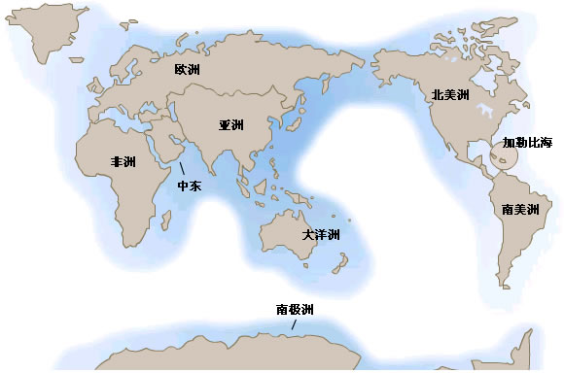
Global smart city construction in full swing
European Union:
Amsterdam started the construction of smart city in 2000.
Germany made the e-European broadband strategy i2010
“City with a Brain” is a smart city project of Spain，it monitors city energy usage through sensors.
United States:
Austin, Seattle, Atlanta, Boston, Las Vegas, Los Angeles, San Francisco, Philadelphia, Cleveland, Marion, Pittsburgh, Milwaukee are building their smart cities.
Asia:
In 2009， the Japanese government introduced“Digital Japan Creation Project” . In 2010, Japan launched pilot projects in cities including Yokohama, Toyota City, Kyoto and Kitakyushu.
In 2006, Singapore launched the “intelligent Nation 2015 Plan”
In South Korea, six cities such as Seoul, Busan and Incheon have become u-city demonstration area.

Slide 5

















National needs：
Smart city construction
Smart city is a new height of city informatization, it is the next stage of the urbanization process, the intelligent service is an important symbol.
Government hotline
Smart enforcement
Smart city management
Smart government affairs
Smart government affairs
Emergency system
Smart supervision
Safe city
Smart scenic spot
Smart City
Smart environmental protection
Smart society
Smart industry
Smart campus
Smart logistics
Smart community
Smart posts
Smart healthcare
Smart transportation
Food safety
Smart patrol

Slide 6
China’s Smart City Project of the Twelfth Five-Year Plan
“The tentative measures for the administration of pilot smart cities”
The construction of smart city is implementing the idea of CPC Central Committee and the State Council about the innovation-driven development, promoting new urbanization, comprehensive building of well-off society in an important measure.
Smart city is a brand new city form under a new generation of information technology support, knowledge society, and the next generation of innovation (innovation 2).
黑龙江
吉林
新疆
辽宁
甘肃
内蒙古
北京
宁夏
河北
青海
山西
山东
The first batch of 90 cities in the smart city pilot project
In January 29, 2013, the housing administration identified the first batch of national "smart city" pilot cities of a total of 90, of which 37 prefecture-level cities, 50 districts (counties) , 3 towns.
  first-tier cities ：Beijing, Shanghai, Tianjin.
  second-tier cities ：Taiyuan, Changzhi, Shijiazhuang, Wuxi, etc.
  3 towns：Zhangpu of Kunshan, Baijia of Liuyang, Lecong of Fuoshan.
陕西
河南
江苏
西藏
湖北
安徽
上海
四川
江西
浙江
贵州
湖南
福建
台湾
云南
广西
广东
海南

Slide 7
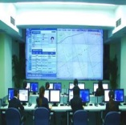






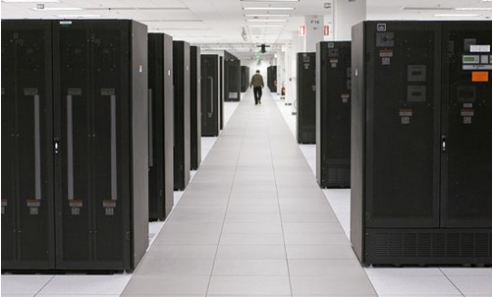




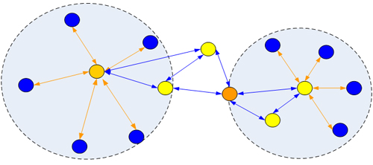






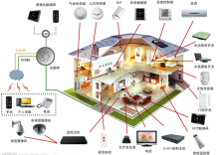

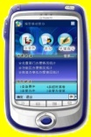



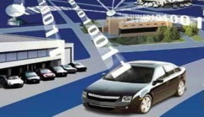
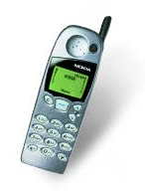
System Architecture of Smart Cities
Application
Layer
Emergency
Rescue
Safe
City
Intelligent
Agriculture
Smart
Community
Intelligent
Health
Environment
Monitoring
Intelligent
Transportation
Smart
Logistics
Platform
Layer
Middleware
Service
Platform
Communication
Service
Platform
Cloud
Computing
Platform
Data
Center
Network
Layer
PSTN
PLMN
通信网
互联网
物联网
Communication Network
Internet
Internet of Things
Terminal/
Sensing
Layer

Slide 8
The Main Problems in China’s Smart City Construction
Lack of effective planning, redundant construction
  Lack of effective plan in the overall process of informatization, causing redundant even waste construction.
Decentralized system construction，causing the problem of information islands
  Various departments and industries are implementing their informatization process; however, they could not combine their effort together to play a bigger role.
    e.g. City emergency rescue command system
  Multiple infrastructure and support system construction caused a lot of waste of resources and manpower
  It’s hard to coordinate these services dynamically cross organizations or domains.

Slide 9
Smart Cities Service Platform of BUPT

Slide 10
Smart Cities Service Platform of BUPT
Application
Layer
Emergency
Rescue
Safe
City
Intelligent
Agriculture
Smart
Community
Intelligent
Health
Environment
Monitoring
Intelligent
Transportation
Smart
Logistics
Service Execution Platform
Smart Cities Service Platform of BUPT
Service Development
Platform
Resource Management
Platform
Network
Layer
PSTN
PLMN
通信网
互联网
物联网
Communication Network
Internet
Internet of Things
Terminal/
Sensing
Layer

Slide 11
Basic Ideas of BUPT Service Platform
EDA
+
SOA
=
Event-
Driven
SOA
SOA（Service-oriented Architecture）
Distributed
Loosely Coupled
Platform-
Independent
Service Reusability
EDA (Event-driven Architecture)
Asynchronous
Interaction
Real-time
Dispatching
Dynamic
Collaboration
Efficient
Concurrence
Enabling the participants of service interactions
to decouple from time, space and control flow

Slide 12
EDSOA Based Smart Cities Service Platform

Slide 13
EDSOA Based Service Development
Relationship Analysis
of Service Processes
and Events
SOA Service
Development Tools
Event Table
(Event Output and
Input Relationship)

Slide 14
Resource Management Platform

Slide 15
  Existing IoT application modes are focus on single application and “silos” solutions. There is a tight-coupling between the devices and the applications and they are characterized by "proprietary devices for one specific application".
  The data and resources are typically locked into closed systems without cross-system sharing, reusing, and interaction.
Silo
Silo
Application
Application
Application
Application
Application
Resource Management Framework
Devices
Devices
Devices
Devices
Devices
  We propose a resource management framework to open up or break the current application silos and move to a horizontal and open application mode.

Slide 16
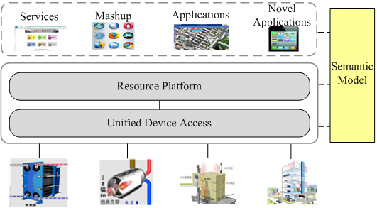
  The resource management framework provides an infrastructure for accessing heterogeneous devices, formally describing resources and entities, and publishing their output in well-understood, machine-processible formats on the Web.
  It shields the heterogeneity and technical detail of devices, and exposes them in a well-defined resource way. The resources and information are represented in a self-description and semantic manner.
  It decouples the upper applications from the underneath devices, and ensures the expandability of upper and underneath layers. It enables the cross-system sharing and reusing of resources, and interaction between applications.

Slide 17
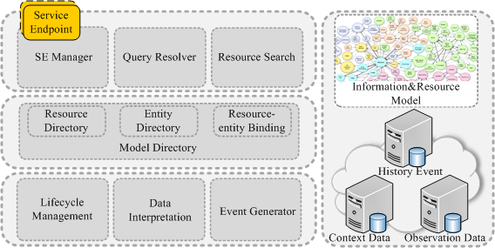
Resource Management Platform
  Expose the capabilities of resources to upper applications in the way of REST service.
  Monitor the state of resources and synchronize the information of Model Directory.
  Search required resources by Model Directory.
  Interpret the outputs of resources and generate events according to model and resource-entity binding.

Slide 18
Single Process
Service Development

Slide 19






Basic Ideas of Service Development
Presentation Layer
Service Composition Layer
C
S
C
C
S
S
S
S
Components/Services layer
C
C
C
S
S
Components
Services
Basic Network Functions
Application Functions
Resource Layer
Voice
COM
SMS
Video
COM
Email
Weather
Report
Tickets
Service

Slide 20
SOA Development Tools
BPEL Based Service Development Tool
JBPM Based Human Interaction Workflow Development Tool
Mobile Terminal Service Development Tool

Slide 21
BPEL Based Service Development Tool

Slide 22
Function & Structure Chart of
BPEL Generating Kit

Slide 23
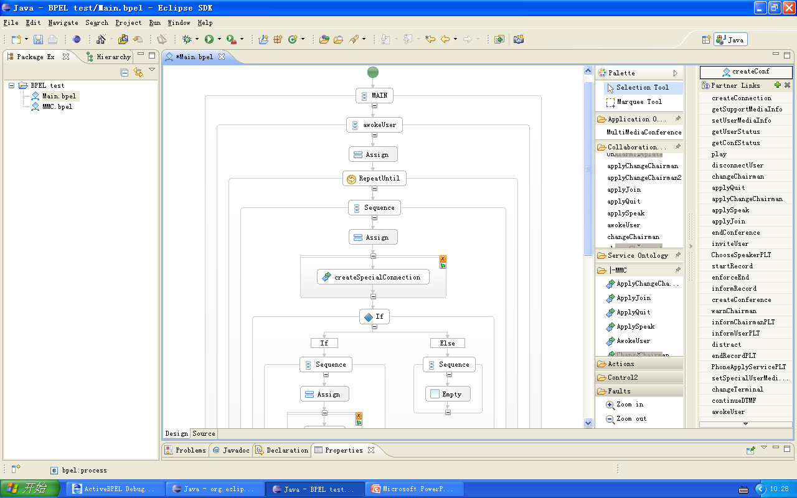
Visual Web Service Development Based on BPEL
Drag-and-drop flow designer
Service
Assets
panel

Slide 24
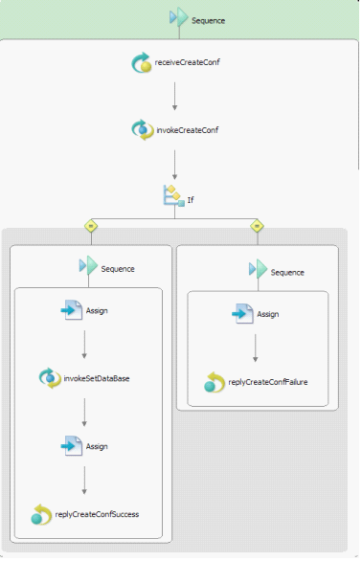
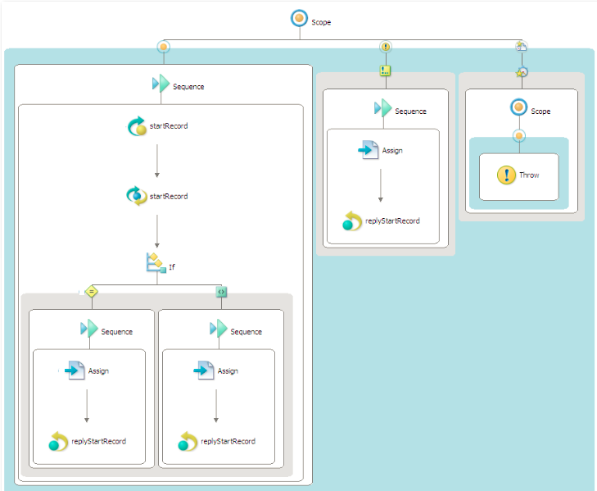
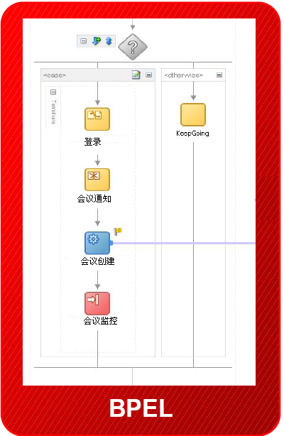
BPEL-based Multimedia Conference Process
Start recording
Create a meeting

Slide 25
JBPM Based Human Interaction Workflow Development Tool

Slide 26
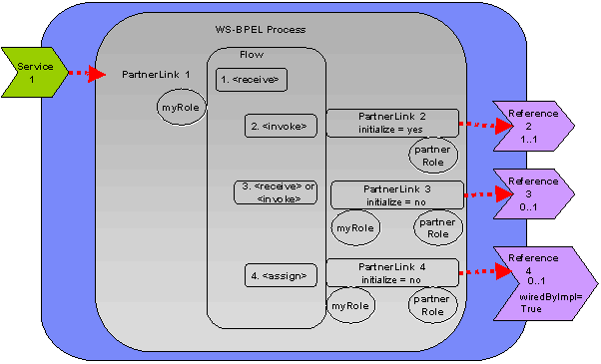
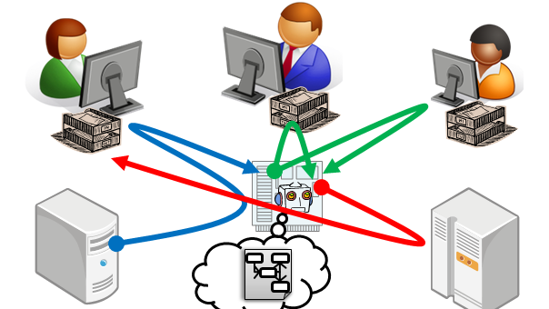
Workflow Service Development Environment Geared to Human Activities
BPEL: Lack of good support of human activities. We developed the JBPM workflow tool in order to support human activity workflow in enterprise informatization.

Slide 27
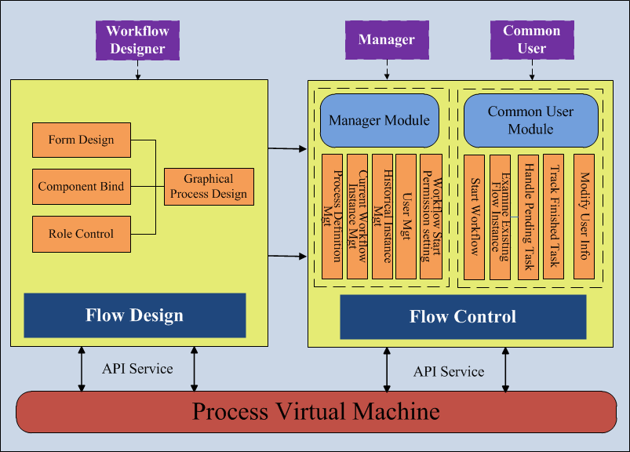
Function & Structure Chart of BUPT Workflow

Slide 28
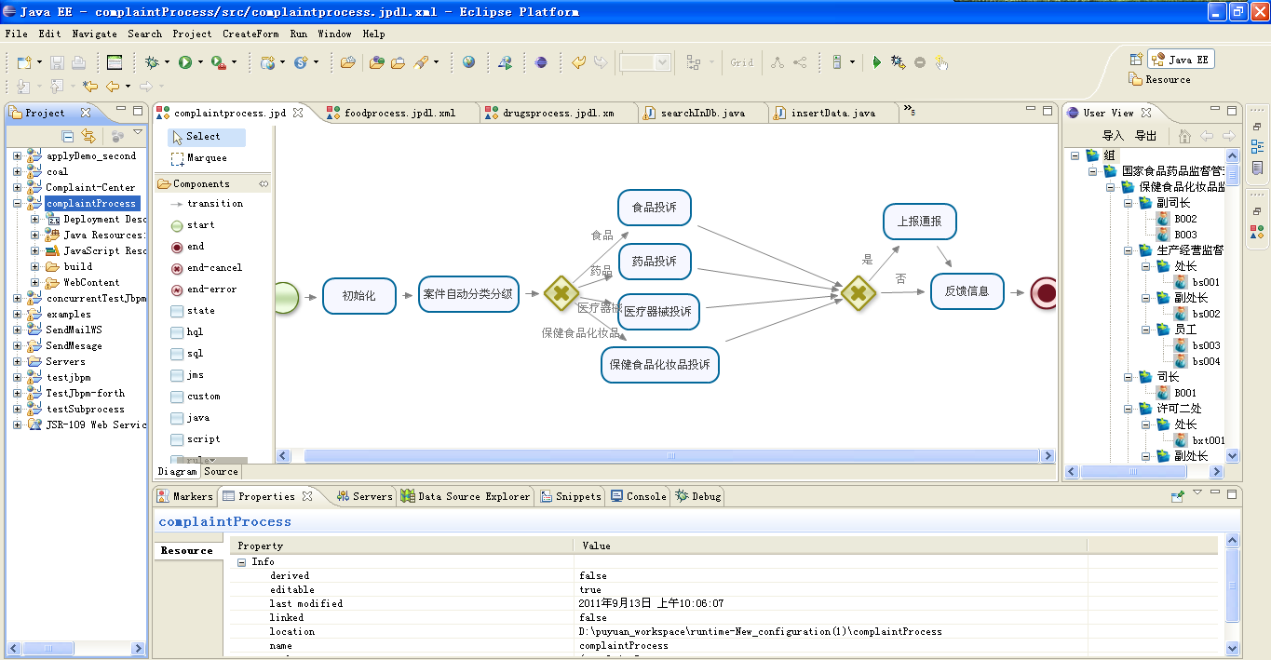
Main Interface of Workflow Development Kit
Visual Form designer
Visual flow designer
Organizational Structure model

Slide 29
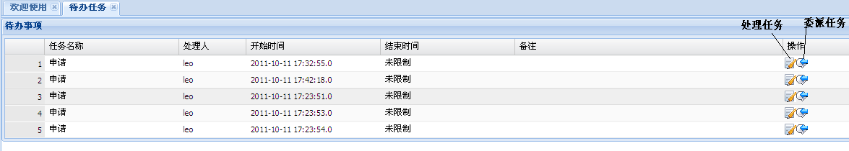
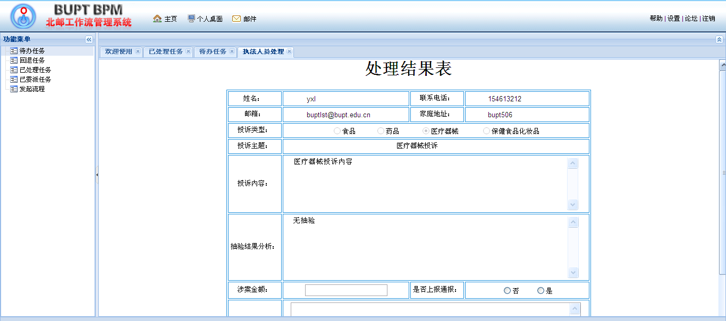
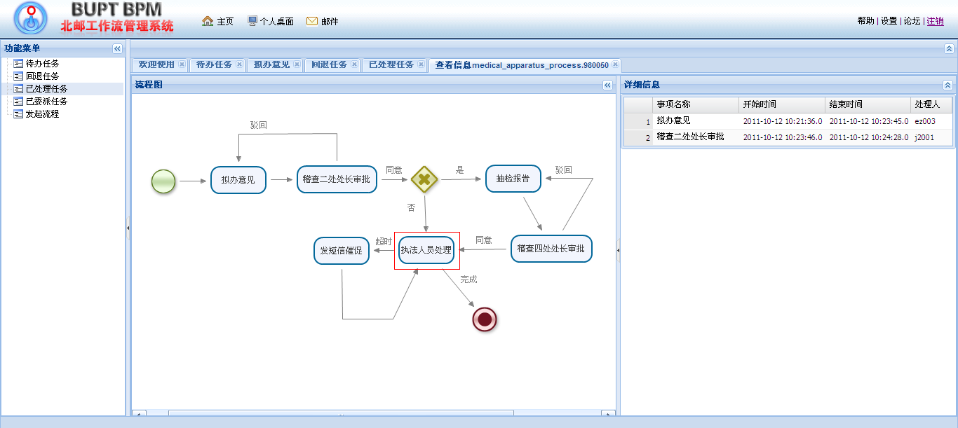
Workflow Service Runtime System
Workflow implementation and execution
Task processing
View history

Slide 30
Service Execution Platform

Slide 31

Overall Structure of IoT-oriented Intelligent Service Execution Environment
IoT Object Presence and HMI
Flow-based man-machine interface & coordination
Privacy of IoT Services
Event-driven Coordinated Service Execution
Event Scheduling, Event Execution
Unified Message Space
Event filtering, Routing, Aggregation
Resource Management & Access Layer
WSRF、CIM、Ontology

Slide 32
Unified Message Space

Slide 33
Mobile Terminal Service Development Tool

Slide 34

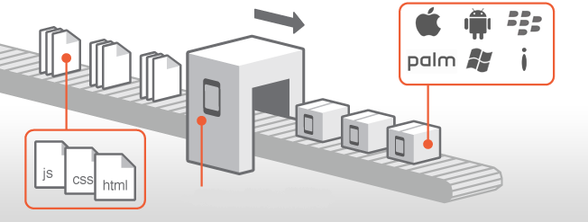
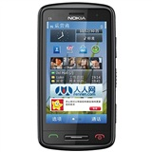
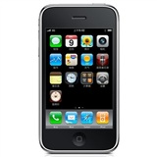

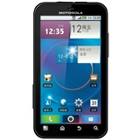

Principle of Smart Terminal Application Development Platform
①
③
① Use HTML5+CSS3+JavaScript to develop cross-platform smart mobile terminal client-side application.
②
② Generate different installation package for different mobile operating system.
③ Multi-deployment with one development process.

Slide 35

Internal Structure of Smart Terminal Application Development Platform

Slide 36
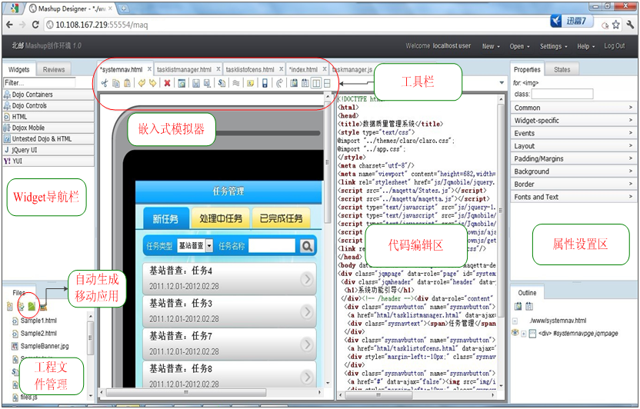
Integrated Environment of Smart Terminal Application Development Platform
Tool bar
Simulator
Widget
Navigator
Coding Edit
Property
Setup
Application
Generation
Project
management

Slide 37
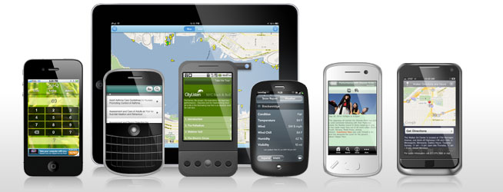
Mainstream Smartphone
Operating System Supported
Our platform supports：
Android iOS WinPhone7

Slide 38
Deployed Applications

Slide 39
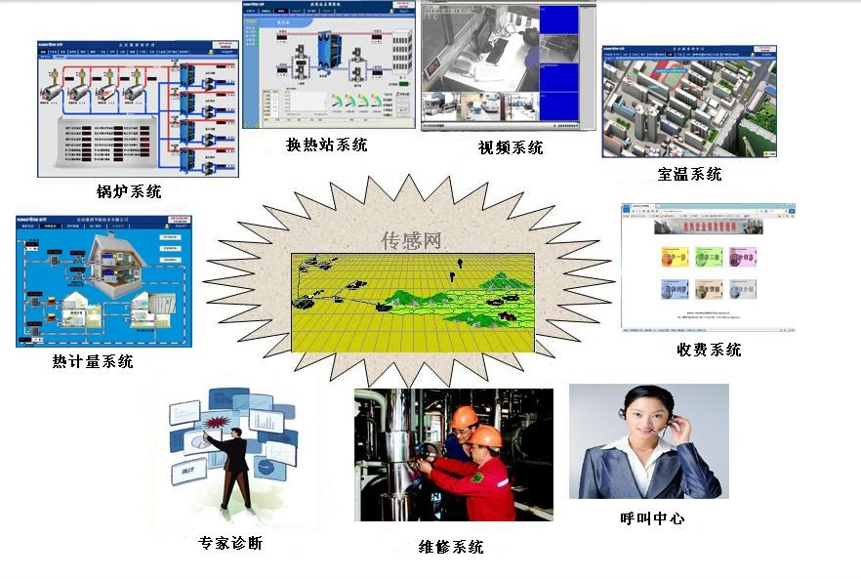
Application1： Information Monitoring Service for District Heating System
Heat Exchanger
Video System
Room Temperature Monitoring
Boiler Monitoring System
District Heating
Service System
Billing System
Heat Metering System
Data Analysis System
Call Center
Maintenance System
a complex service system based on multiple cross-domain,
heterogeneous systems

Slide 40
System Deployment Scale and Architecture
The Deployment Scale
120 District heating neighborhoods in Beijing, including
400 remote monitoring boiler rooms and heat exchanger,
150,000 heat metering users.

Slide 41
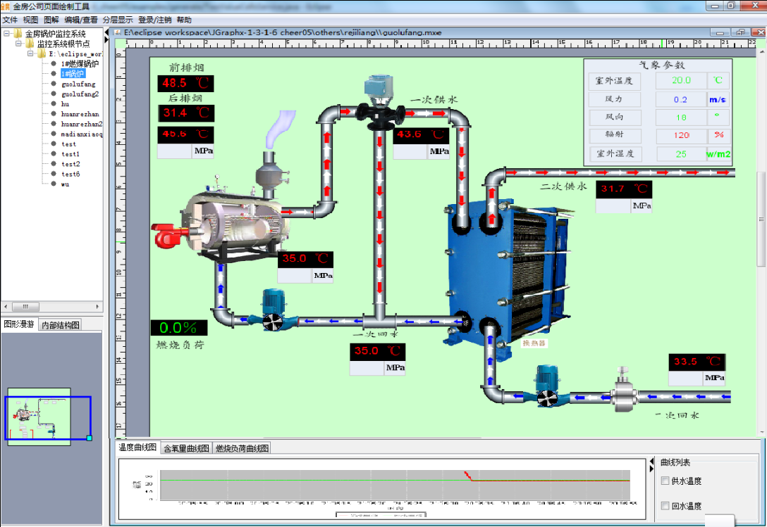
Information Monitoring Service for District Heating System-Gas Boiler Room

Slide 42
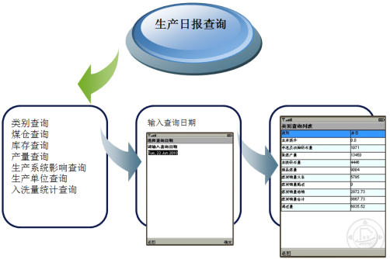
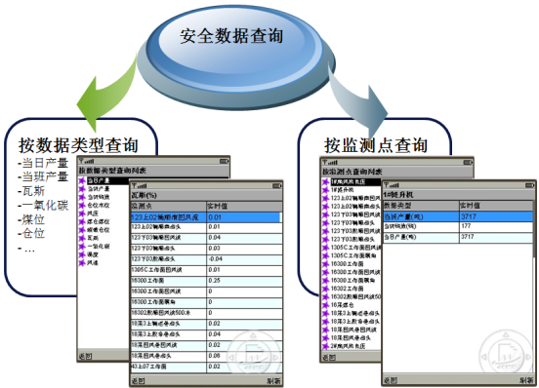
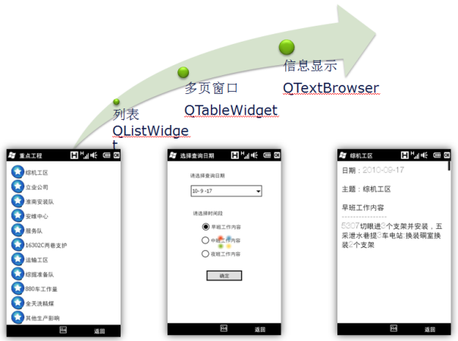
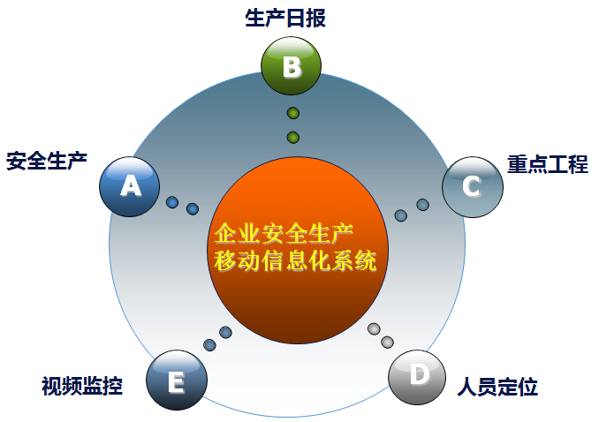
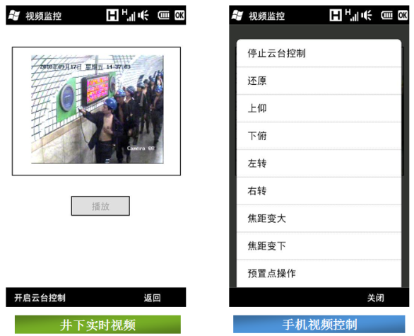
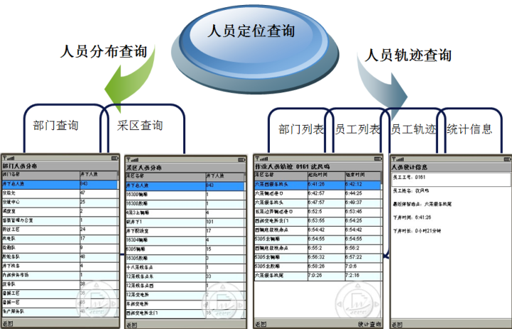
Application2：E-Mine Mobile Information System of Jining, Shandong

Slide 43
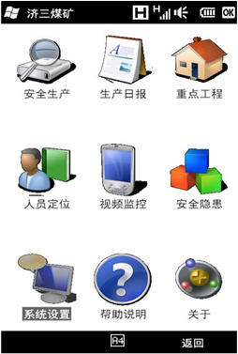
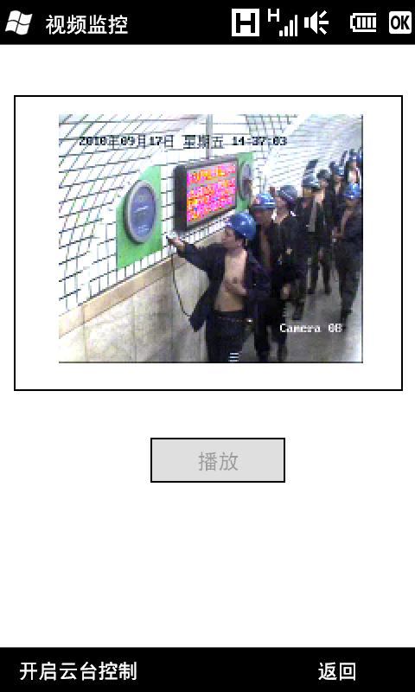
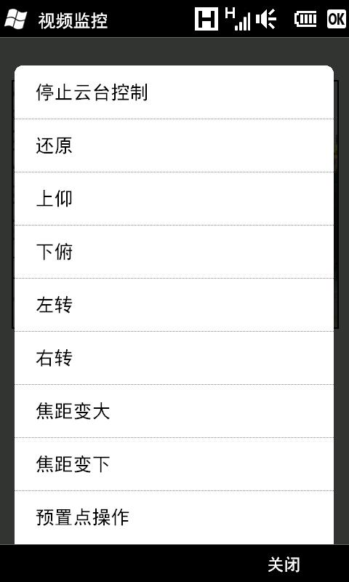
System Main Interfaces and Remote Video Monitoring
Downhole video in real time
Cell phone video control

Slide 44
Thanks！Look Forward to Cooperation!

