Slide 1
The future of work: How can we create more intelligent organizations?
Thomas W. Malone MIT Center for Collective Intelligence
Copyright © 2013 Thomas W. Malone. All rights reserved.

Slide 2
Notes:
Mention Davos (Hockfield)…
Slide 1:
Intelligence is not just something that happens inside individual brains.
It also arises in groups of individuals.
We define collective intelligence as: Groups of individuals acting collectively in ways that seem intelligent.

Slide 3
Notes:
Slide 2:
By this definition, collective intelligence has existed for a long time (e.g., Families, companies, and countries are all groups of individual people doing things that at least sometimes seem intelligent.
But in the last few years, we’ve seen some very new kinds of collective intelligence made possible by the internet.

Slide 4
Notes:
Slide 3:
Consider Google, for example: Millions of people create web pages and link those pages to each other. Then the Google algorithms “harvest” this knowledge so that when you type a question in the Google search bar, the answers you get often seem amazingly intelligent. This is a kind of intelligence that never existed on our planet before.

Slide 5
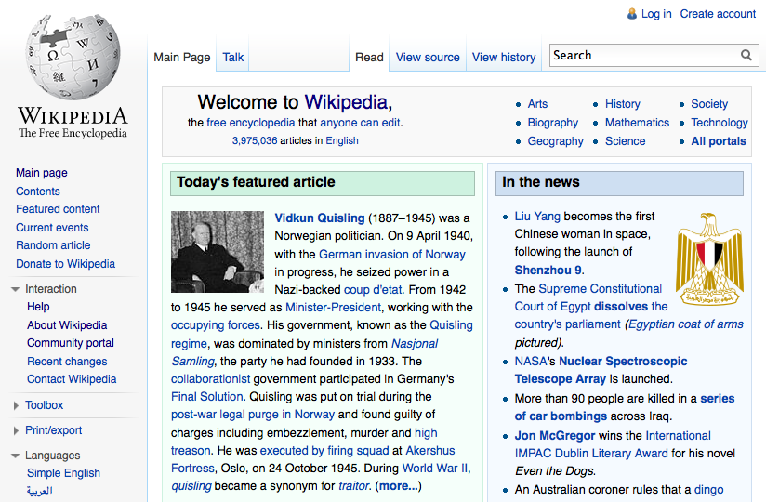

Slide 6
The Question
How can people and computers
be connected so that
—collectively—
they act more intelligently
than any person, group, or computer
has ever done before?
Notes:
Aspirational question
But lots of scientific and design questions underlie it
Today, I’d like to talk about 4 we’re working on…
For instance, one question is whether “collective intelligence” even exists in any sense other than as a simple aggregation of individual intelligences

Slide 7
Measuring collective intelligence
People who are good at one cognitive task are, on average, also good at others.
Spearman’s general cognitive ability (g)
Intelligence tests measure this general cognitive ability
First principal component in a factor analysis
Predicts school grades, job performance, life expectancy…
Does such a general cognitive ability exist for groups?
And how can we measure it?

Slide 8
Results
Yes, there is a general cognitive ability for groups.
“Collective intelligence”
Collective intelligence is only weakly correlated with the average and maximum intelligence of the individuals in the group.
Woolley, Chabris, Pentland, Hashmi, & Malone, Science, 2010.

Slide 9
Results (cont.)
Collective intelligence is correlated with
“Social perceptiveness” of group members
Equality of distribution of turn-taking
Proportion of females in group
Largely explained by “social perceptiveness”
Woolley, Chabris, Pentland, Hashmi, & Malone, Science, 2010.
Notes:
Caveats….
The way the members of a group relate to each other is very important to the overall performance of the group.
This may be even more important to the group’s performance than the individual abilities of the group members, or—even conventional leadership.

Slide 10
Results (cont.)
Collective Intelligence*
* avg std scores of all groups with specified percent female
Percent Female
Notes:
Error bars are SEM (std error of the mean):
The std deviation of the error in the sample mean relative to the true population mean
SEM = (sample-based estimate of the standard deviation of the population) / SQRT(n)

Slide 11
Questions
Can collective intelligence tests predict the performance of groups on other real-world tasks?
How can we improve collective intelligence?
Group size
Group norms for interaction
Computer support
…
Notes:
Sales team, prod dev team, top mgmt team

Slide 12
What are the basic organizational design patterns of collective intelligence?
Collected over 200 “interesting” examples of Internet-enabled collective intelligence
Identified common design patterns or “genes”
Notes:
To really answer this question well, we need to go way beyond thinking of “Collective intelligence” as just a fuzzy collection of cool examples.
Google, wikipedia, prediction markets are very different from each other.
It’s more like a set of common characteristics—or design patterns—that get recombined in different ways to produce different kinds of collective intelligence.
We can call these design patterns “genes” and what we really need to do is map them and their combinations, including examples of each gene, the conditions under which it is useful, and so forth.
You could call this mapping the genomes for superorganisms that exhibit collective intelligence.
----
If you want to *design* new examples of collaborative innovation, these are the building blocks you have to work with.

Slide 13
Types of organizational genes
Create
Decide
What
Money Glory Love
Crowd | Hierarchy
Who
Why
How
 | Crowd
 | Independent | Dependent
Create | Collection | Collaboration
Decide | Individual decisions | Group decision
Malone, Laubacher, Dellarocas, 2010.
Notes:
About 16 genes so far

Slide 14
Example: Genetic structure of Linux
Example | What |  | Who | Why | How
Linux | Create | New software modules | Crowd | Love Glory | Collaboration
 | Decide | Which modules warrant inclusion in next release | Torvalds and lieutenants | Love Glory | Hierarchy
Malone, Laubacher, Dellarocas, 2010.

Slide 15
How?
 | Crowd
 | Independent | Dependent
Create | Collection Contest | Collaboration Hyperspecialization
Decide | Individual decisions Market Social network | Group decision Voting Consensus Prediction markets
Malone, Laubacher, Dellarocas, 2010.
Notes:
Most interesting
Two key distinctions:
What is being done (Create or Decide)?
What is the relationship among the pieced (Independent or Interdependent)?

Slide 16
How?
 | Crowd
 | Independent | Dependent
Create | Collection Contest | Collaboration Hyperspecialization
Decide | Individual decisions Market Social network | Group decision Voting Consensus Prediction markets
Malone, Laubacher, Dellarocas, 2010.
Notes:
Most interesting
Two key distinctions:
What is being done (Create or Decide)?
What is the relationship among the pieced (Independent or Interdependent)?

Slide 17
Gene: Contest
A subtype of Collection where one or a few items in the collection are selected as winners
Examples
InnoCentive
TopCoder
Netflix prize
Yahoo Answers
Goldcorp challenge
Threadless
Matlab
Quirky

Slide 18
Example: Quirky
Consumer products company
Community of 285,000 inventors
1,500 product ideas / week submitted
1 or 2 selected for development
Company does detailed design with input from community
Most manufacturing in Asia
Retail sales through own website, Target, Amazon, …
Notes:
Community bets 30% of revenue for direct sales (Quirky website) and 10% of sales from retailers. 42% of this goes to the original inventor, rest to those who influence during development
One of their biggest sellers was: Pivot Power by Jake Zien, a design student, who has already received almost $500K
Line of Apple iPhone 5 accessories (cases, charger/earbuds holder) designed in 24 hours after launch. (can preorder on Fab.com for shipment in 5-6 wks)

Slide 19
Gene: Hyperspecialization
A subtype of Collaboration in which the pieces done by different people are much smaller or more specialized than today’s jobs
Examples
TopCoder
Amazon Mechanical Turk
CrowdForge
Malone, Laubacher, & Johns, 2011.
Notes:
Inspired by Wikipedia and Linux, we’ve started a new project at MIT called the Climate Collaboratorium

Slide 20
Example: TopCoder
Software development community with over 400,000 registered freelance programmers from all over the world.
Each project is divided into many small tasks (requirements specification, architectural design, user interface design, coding different modules, integration, testing).
Freelance programmers compete to do these tasks and win prize money.
Different programmers specialize in different types of tasks.
Notes:
Acuired by Appirio (Sep 2013)
based in Connecticut
Slides
Legal research
Transcribing audio
Software development firm with over 95,000 registered freelance programmers from all over the world (China, India, Romania, Poland).
Prize money: few thousand dollars for winner and runner up.
Programmers compete for money but also (often more importantly) for recognition. Online statistics—visible to others—about how many contests you’ve entered, won, and how much money you’ve made. For instance, programmers with ratings higher than than 2200 points are “red members” One said: “I was the first red [level] member from my school, and I think I was the first red member from China.”
Questions:
Do they really have a contest for each module?
Who judges winning modules? Other freelancers? Company programmers?
How much are typical (and max) prizes?
Are modules visible to others as they are being written?
Who does integration of modules (and how is it done)?

Slide 21
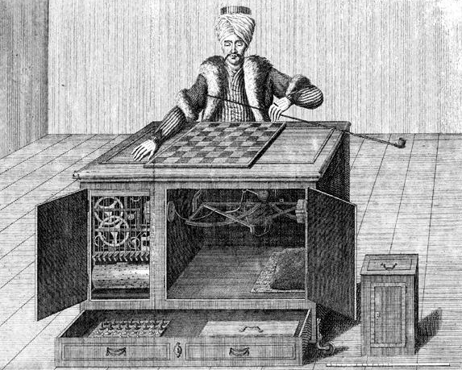
Amazon Mechanical Turk
Name comes from 18th century chess-playing “automaton” that actually had a small chess master inside

Slide 22
Amazon Mechanical Turk
On-line marketplace for work that requires human intelligence (and can’t be done by computers)
Transcribing audio
Understanding news articles
…
Many tasks are very small and pay only a few cents.

Slide 23
CrowdForge
By Kittur, Smus, & Kraut at Carnegie Mellon University
Crowds write documents (or perform other complex tasks) through microtasks done via Amazon Mechanical Turk
Examples:
Writing an encyclopedia article on New York City
Developing a product comparison table for cars

Slide 24
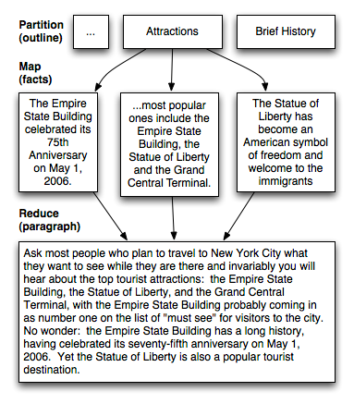
CrowdForge (cont.)

Slide 25
CrowdForge (cont.)
Independent judges rated articles written by the crowd as:
Better than similar articles written by individuals (for the same cost)
Equivalent to the Simple English Wikipedia article on the same topic

Slide 26
Gene: Voting
Reddit
IBM Jams (evaluation phase)
Schaumburg Flyers
Ebbsfleet United
Kasparov v. the World
Threadless

Slide 27
Schaumburg Flyers
Minor league baseball team near Chicago
Through Internet voting, fans decide batting order, pitching rotation, starting line-up, and which players to trade
Goal: Reality Baseball with fans all over the world visiting the web site frequently
Result: Team had disappointing season. Some people blamed voting for bad results.
Notes:
2006 season
Possible explanations:
Fans didn’t know as much and weren’t as motivated as managers and so couldn’t make decisions as well.
Maybe fans of opposing teams were intentionally voting for bad choices!
Another instructive failure! What would be needed for something like this to work in the future?

Slide 28
Ebbsfleet United
UK football (soccer) team
Shares purchased by over 30,000 members in over 80 countries
Membership fee: £50 / yr (appx. $77)
Members vote on team selection, final budgets, player trades

Slide 29
Kasparov vs. the World
Players:
Gary Kasparov (world chess champion, 1999) vs. the rest of the world (moves decided by majority vote)
Kasparov heavy favorite before play began.
Used on-line discussions, and suggestions by 5 well-known chess experts
Result: Kasparov won after 62 moves in 4 months.
He said it was the hardest game he ever played.
Notes:
The rest of the world, with on-line discussions and suggestions by 4 young chess stars and one grandmaster and moves decided by majority vote
1 move per day,
Kasparov was heavy favorite before play began
What if people voted to decide what to do?
---------
From Wikipedia: Prior to the game, Kasparov was considered a prohibitive favorite. He was reigning World Champion, he was playing with the advantage of the white pieces, and previous examples of majority Internet voting had produced mediocre competition. For example, Anatoly Karpov had taken the black pieces against the rest of the world earlier that year, and had won convincingly. Contrary to expectations, however, Kasparov's game produced a mixture of deep tactical and strategic ideas, and although Kasparov won, he admitted that he had never expended as much effort on any other game in his life, declaring it to be the "greatest game in the history of chess".
The World Team had several points in their favour, some of which were innovative for an Internet game. Firstly, four young chess stars were selected by MSN to suggest moves for the World Team. They were, in decreasing order of FIDE rating, Etienne Bacrot, Florin Felecan, Irina Krush, and Elisabeth Paehtz. Also, grandmaster Daniel King, recruited to provide a running commentary, often acted as a fifth advocate. Secondly, the moves were slowed down to a pace of one move per player every two days; that is to say, Kasparov had 24 hours to consider each of his moves, and the World Team had 24 hours to respond. Thirdly, MSN provided a bulletin board for the discussion of the team's moves. It was hoped that these advantages would collectively allow for true consultation, and raise the level of play.

Slide 30
The problem
Notes:
Many people would say that global climate change is one of the most important problems facing humanity today.
It is affected by all of our actions, and it will potentially affect every one of us.
And even those who don’t think it’s big problem would agree that we humans have to somehow decide what to do about it, even if what we decide to do is nothing.
Fortunately, at the same time that we have this potentially huge global problem, we also have the possibility of using a kind of global problem solving approach that was never possible before in human history…

Slide 31
Linux
Notes:
As examples like Wikipedia and Linux illustrate, it’s now possible to harness the collective intelligence of thousands of people around the world to work together on very big problems at a scale and with a degree of collaboration that was never possible before.
Our goal in this project is to apply this general approach to developing plans for what we humans can do about global climate change.

Slide 32
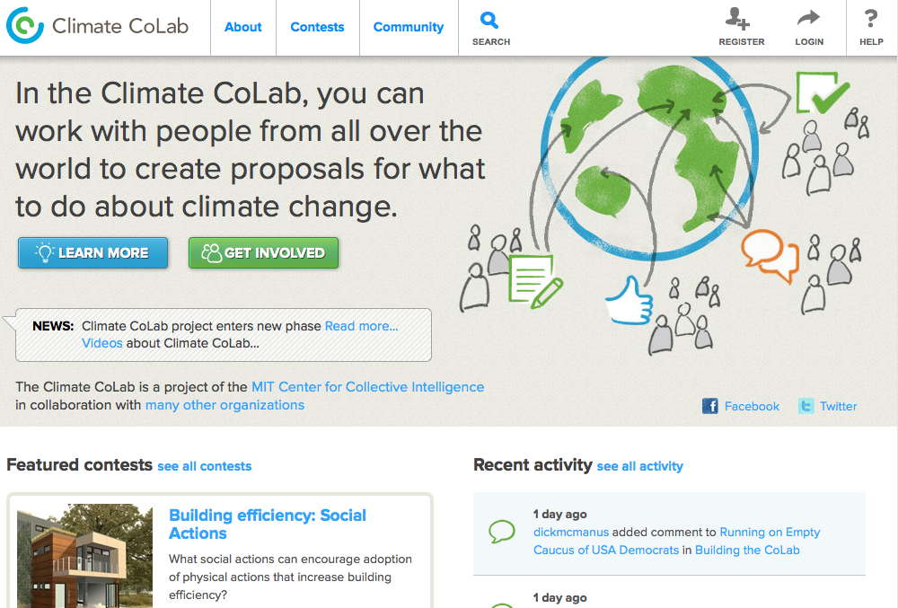
Notes:
… we’ve created a central place on the web, called the Climate CoLab, where people can not just share information about the problem, but they can also develop proposals for what we can actually do about it.

Slide 33
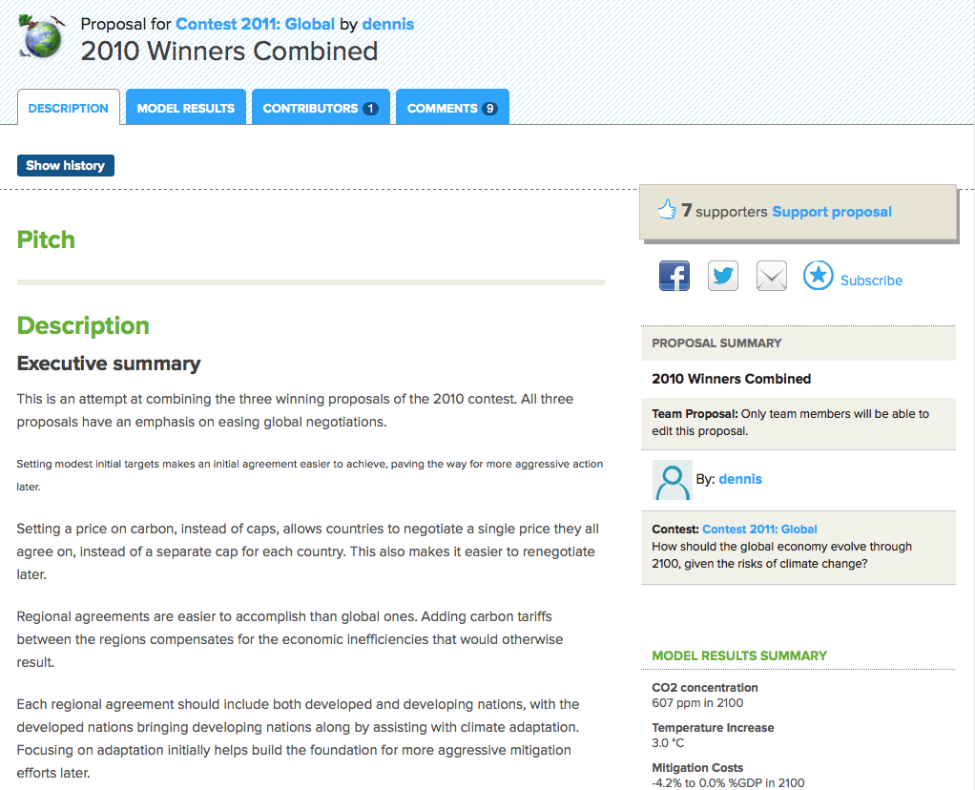
Notes:
Anyone who’s interested can use their creativity and insight to contribute to proposals for political, technological, economic, or other actions we might take…

Slide 34
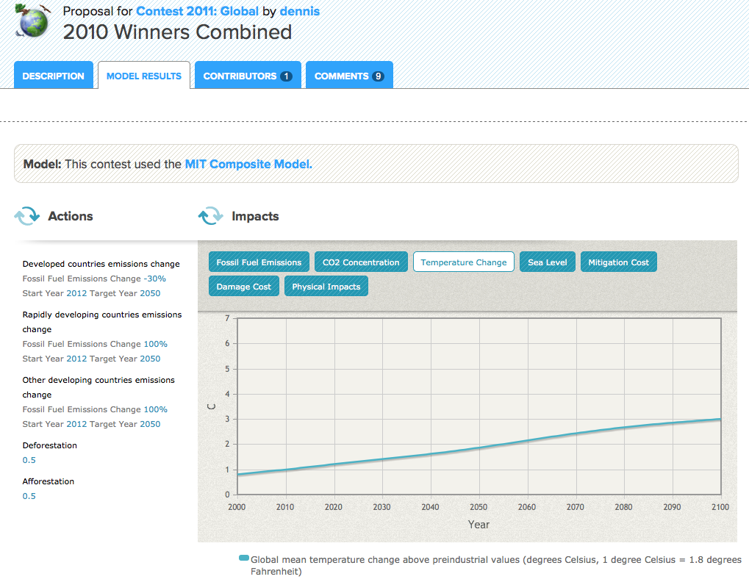
Notes:
Sterman and colleagues

Slide 35
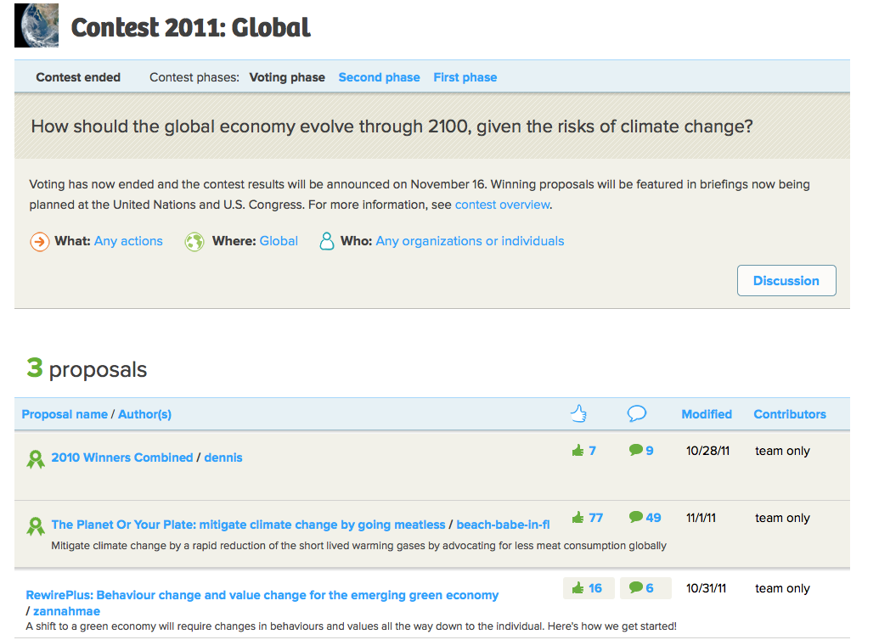

Slide 36
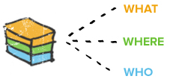
Breaking the problem into pieces
What can electric utilities do to generate electricity with lower carbon emissions?
What can city governments do to adapt to rising sea levels?
What social actions could most effectively change cultural attitudes about climate change?
Notes:
What can we do about geoengineering?

Slide 37
Putting the pieces back together
Integrated global proposals
…
Integrated regional proposals
…
…
…
US
China
Action proposals
…
…
…
Mitigation
Adaptation
Notes:
Starting next year, we expect to have other contests that bring together these proposals for parts of the problem into integrative, overall proposals for what to do at the national and global levels.
Will all this really work to help solve the problem of what to do about global climate change?
We don’t know.
But our hope is that…
The Climate CoLab will help bring together
scientists, policy makers, business people, and many others
to plan
--and gain support for--
better climate actions
than anything we would otherwise have done.

Slide 38
Notes:
Slide 14:
In the long run, as our world becomes more and more closely connected with many kinds of electronic communication, it will become increasingly useful to think of all the humans and computers on our planet as constituting a kind of “global brain.”
And perhaps our future as a species will depend on how well we’re able to use our global collective intelligence to make choices that are not just smart, but also wise.

Slide 39
References
Measuring collective intelligence
Woolley, A. W., Chabris, C. F., Pentland, A., Hashmi, N., & Malone, T. W. Evidence for a collective intelligence factor in the performance of human groups, Science, 29 October 2010, 330 (6004), 686-688; Published online 30 September 2010 [DOI: 10.1126/science.1193147] . http://www.sciencemag.org/cgi/content/abstract/science.1193147
Woolley, A., & Malone, T. Defend your research: What makes a team smarter? More women, Harvard Business Review, June 2011, 89 (6): 32-33 http://hbr.org/2011/06/defend-your-research-what-makes-a-team-smarter-more-women/ar/1
Collective intelligence genome
Malone, T. W., Laubacher, R., & Dellarocas, C. The Collective Intelligence Genome, Sloan Management Review, Spring 2010, 51, 3, 21-31 (Reprint No. 51303).http://sloanreview.mit.edu/the-magazine/articles/2010/spring/51303/the-collective-intelligence-genome/#1
Malone, T., Laubacher, R., & Johns, T. The Age of Hyperspecialization, Harvard Business Review, July-August 2011, 89(7/8): 56-65. http://hbr.org/2011/07/the-big-idea-the-age-of-hyperspecialization/ar/1

Slide 40
References (cont.)
Climate CoLab
Introne, J., Laubacher, R., Olson, G. & Malone, T. The Climate CoLab: Large Scale Model-based Collaborative Planning. Proceedings of the International Conference on Collaboration Technologies and Systems (CTS 2011), Philadelphia, PA, May 23-27, 2011 (Winner of Outstanding Paper Award). http://ieeexplore.ieee.org/xpl/login.jsp?tp=&arnumber=5928663&tag=1&url=http%3A%2F%2Fieeexplore.ieee.org%2Fxpls%2Fabs_all.jsp%3Farnumber%3D5928663%26tag%3D1
http://climatecolab.org
Global brain
Bernstein, A., Klein, M., & Malone, T. W. Programming the global brain. Communications of the ACM, May 2012, 55 (5): 41-43. http://cacm.acm.org/magazines/2012/5/148531-programming-the-global-brain/abstract
Center for Collective Intelligence
http://cci.mit.edu

