Slide 2
Gewinnerprojekte des 1st Annual Architecture & Design Competition in Second Life

Slide 3
Meylenstein (Tanja Meyle) "Living Cloud"

Slide 5
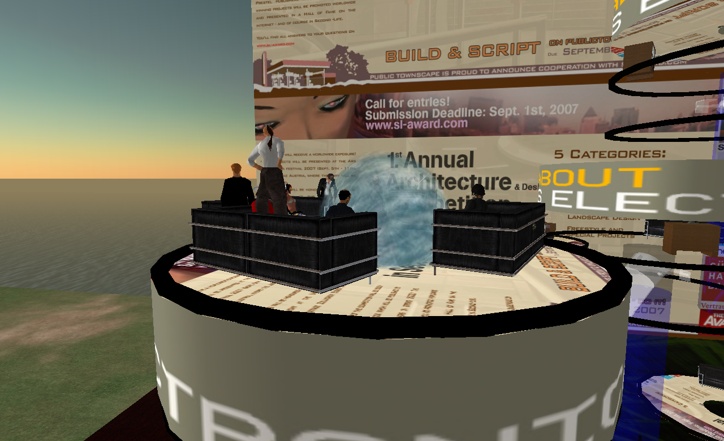

Slide 6
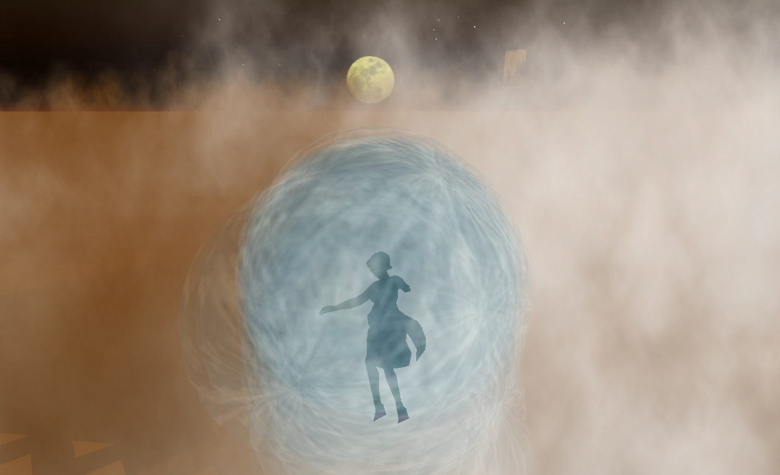

Slide 7
Max Moswitzer „Whitenoise"

Slide 9
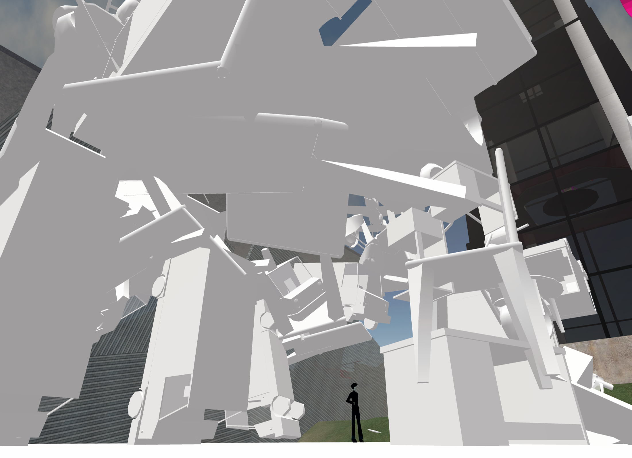

Slide 10
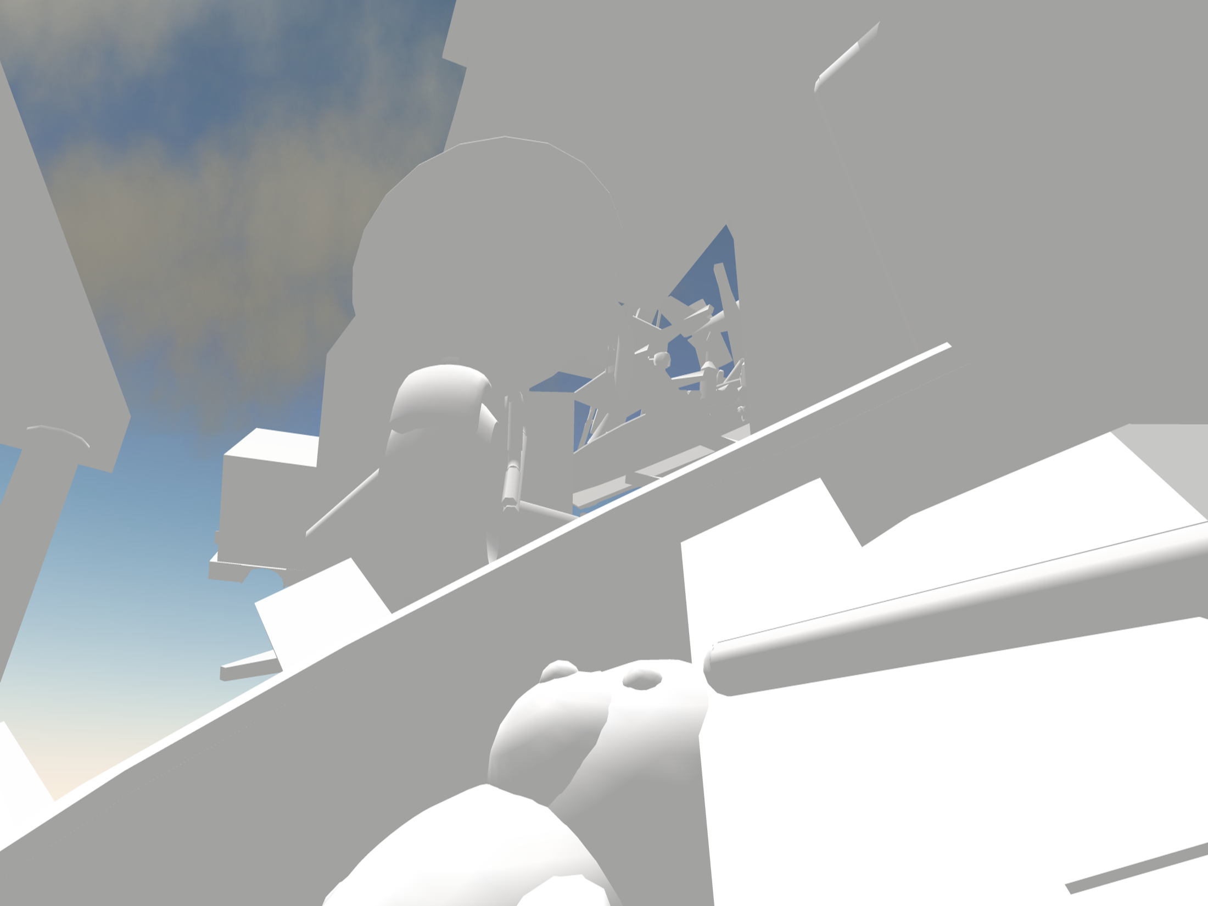

Slide 11
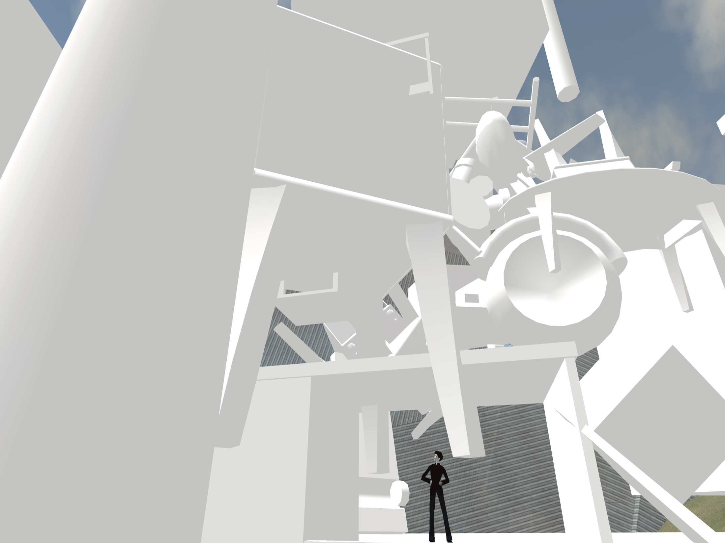

Slide 13
Adam Nash „Seventeen Unsung Songs"

Slide 14
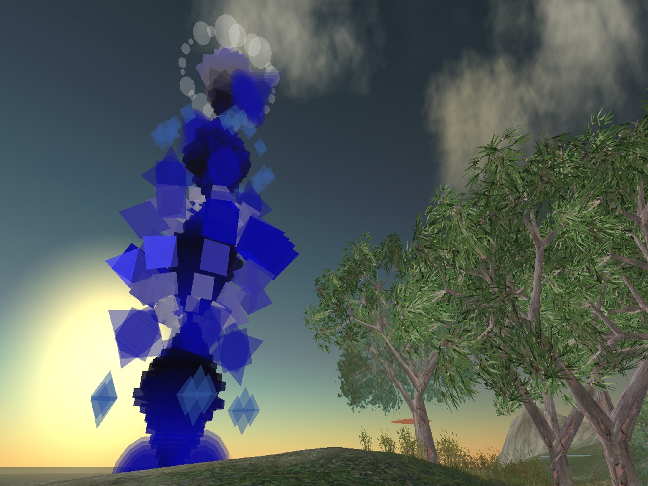

Slide 15
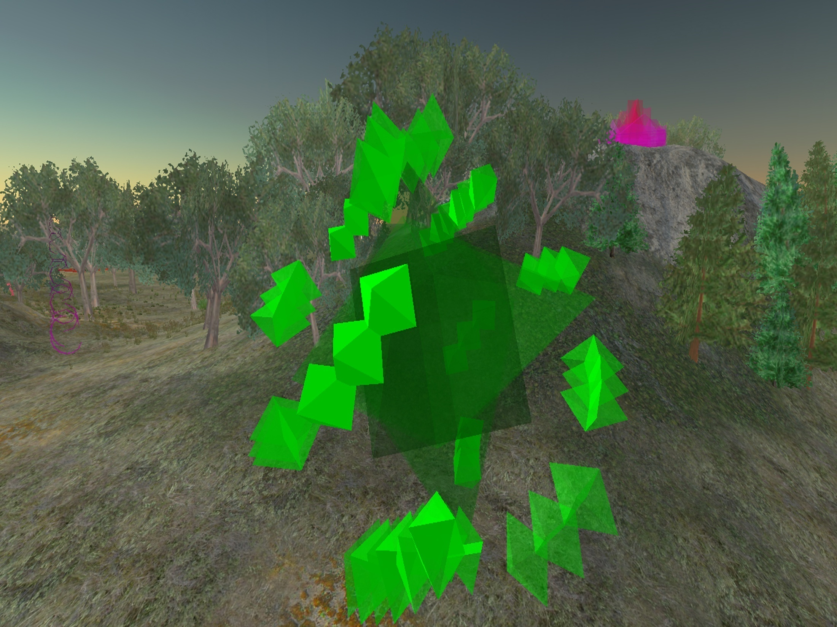

Slide 16
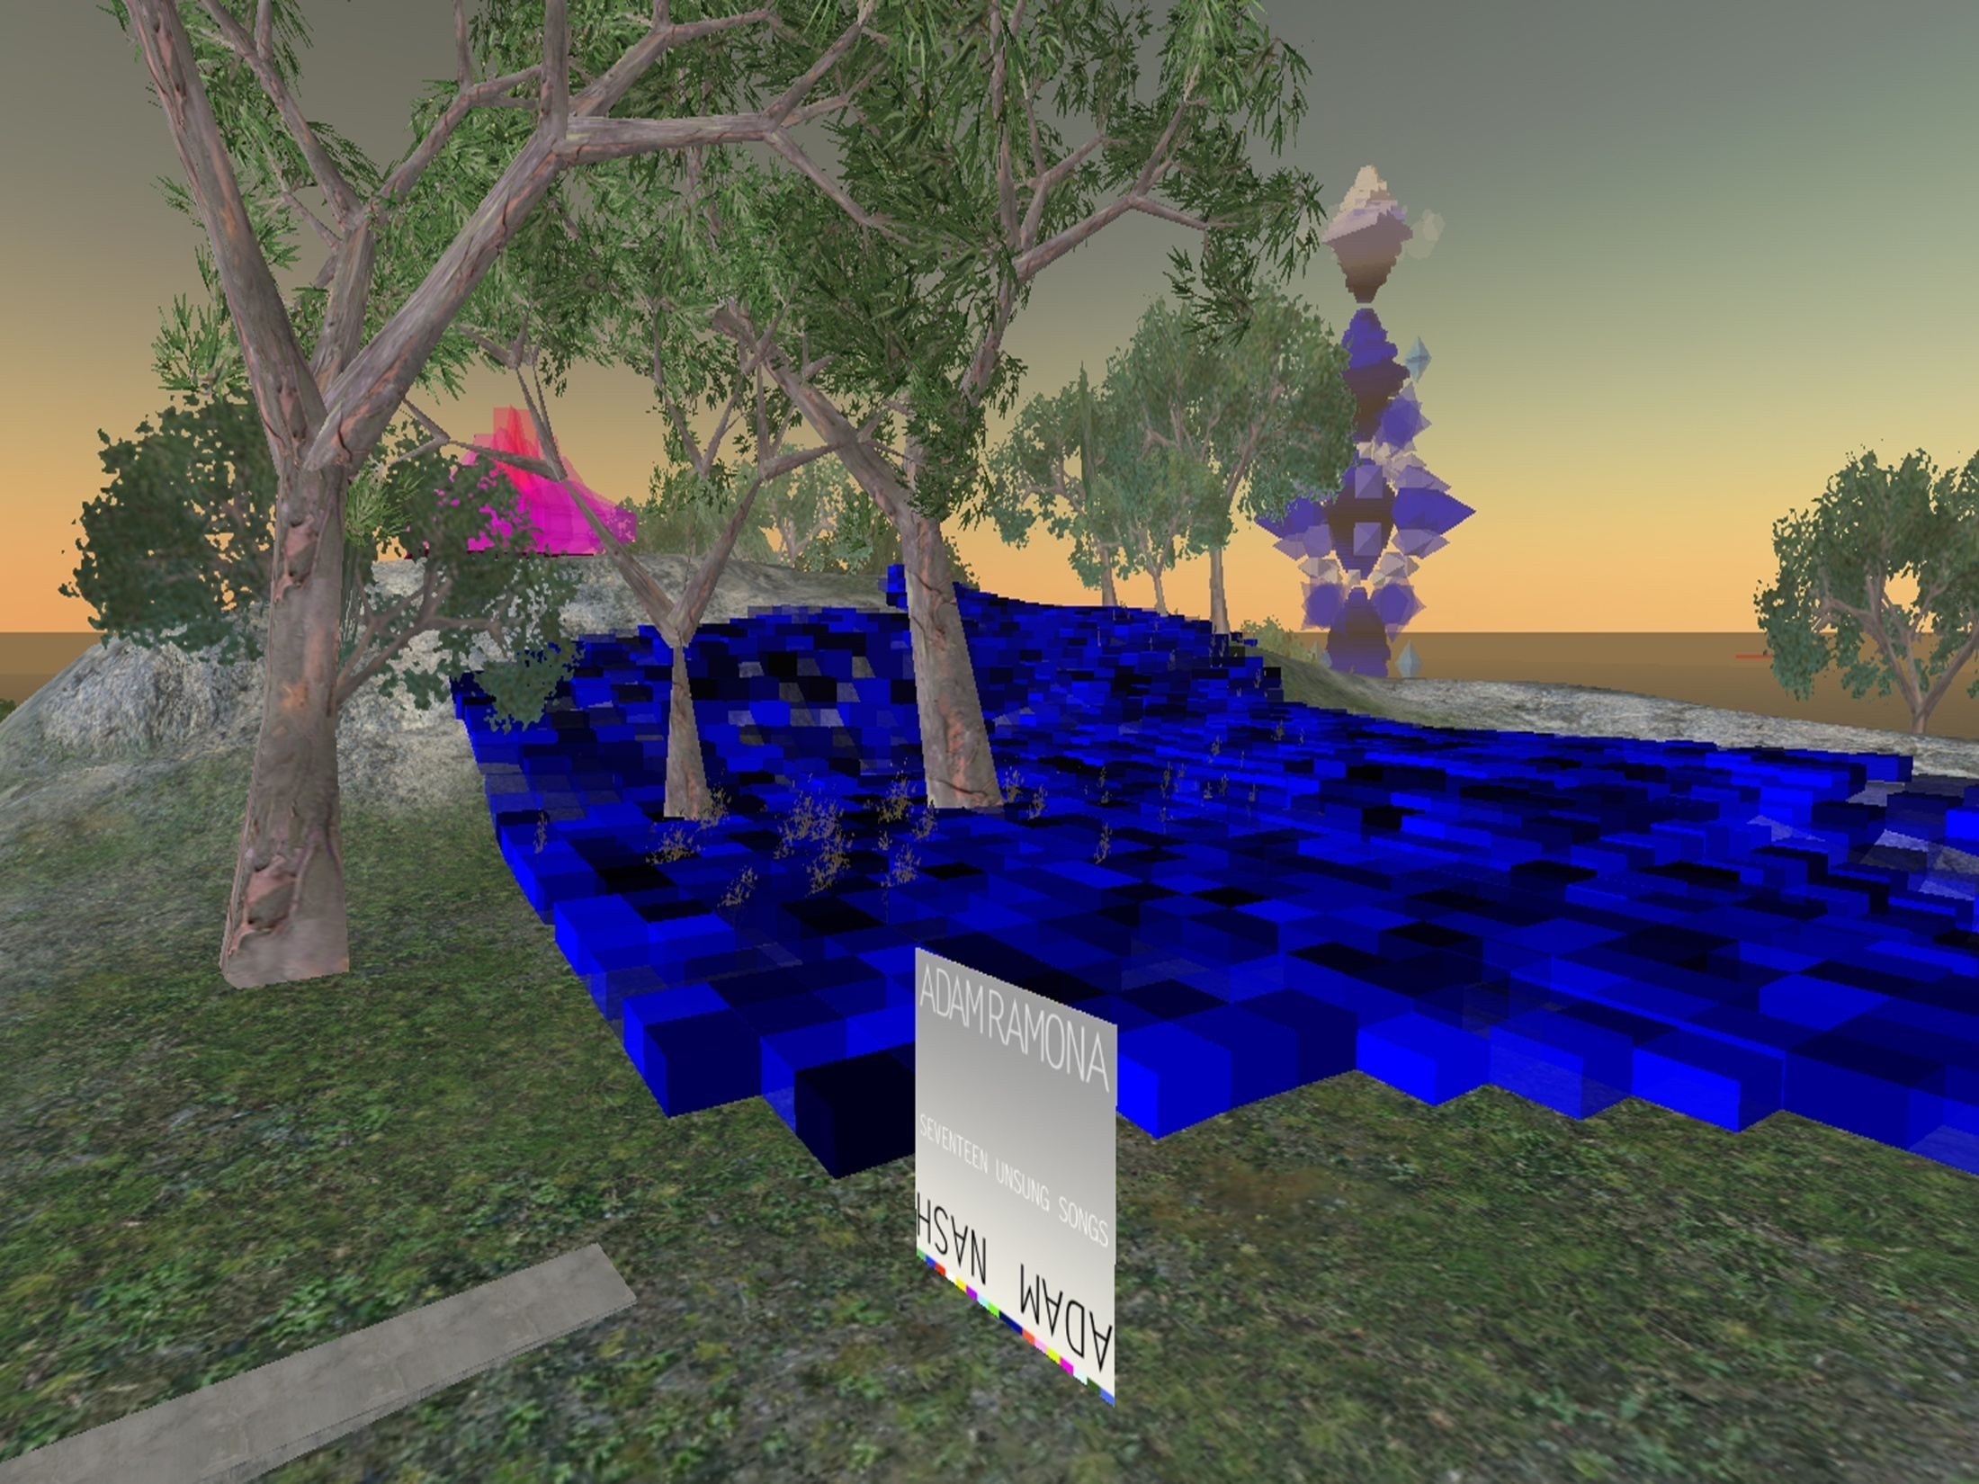

Slide 17
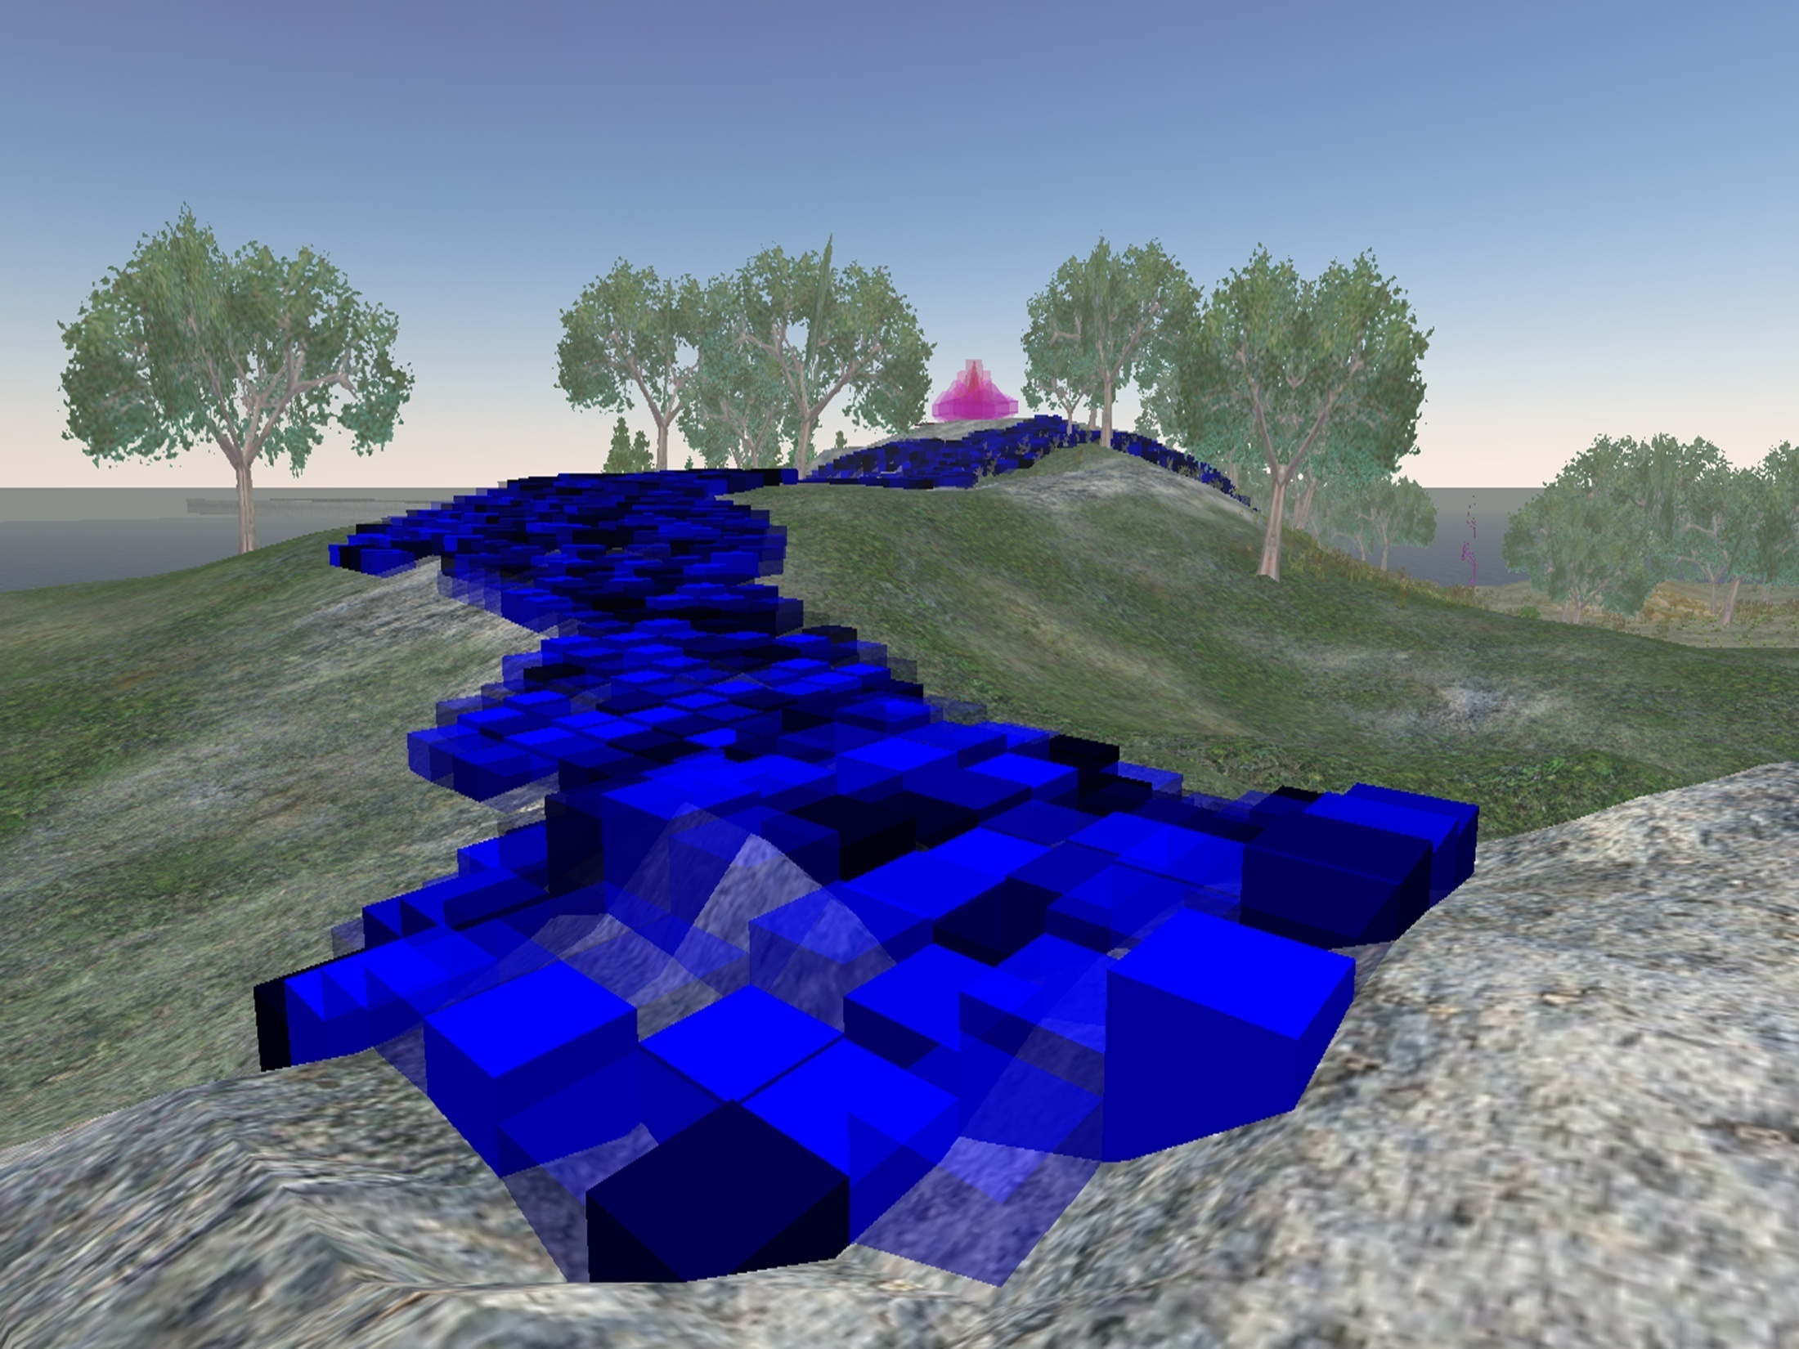

Slide 18
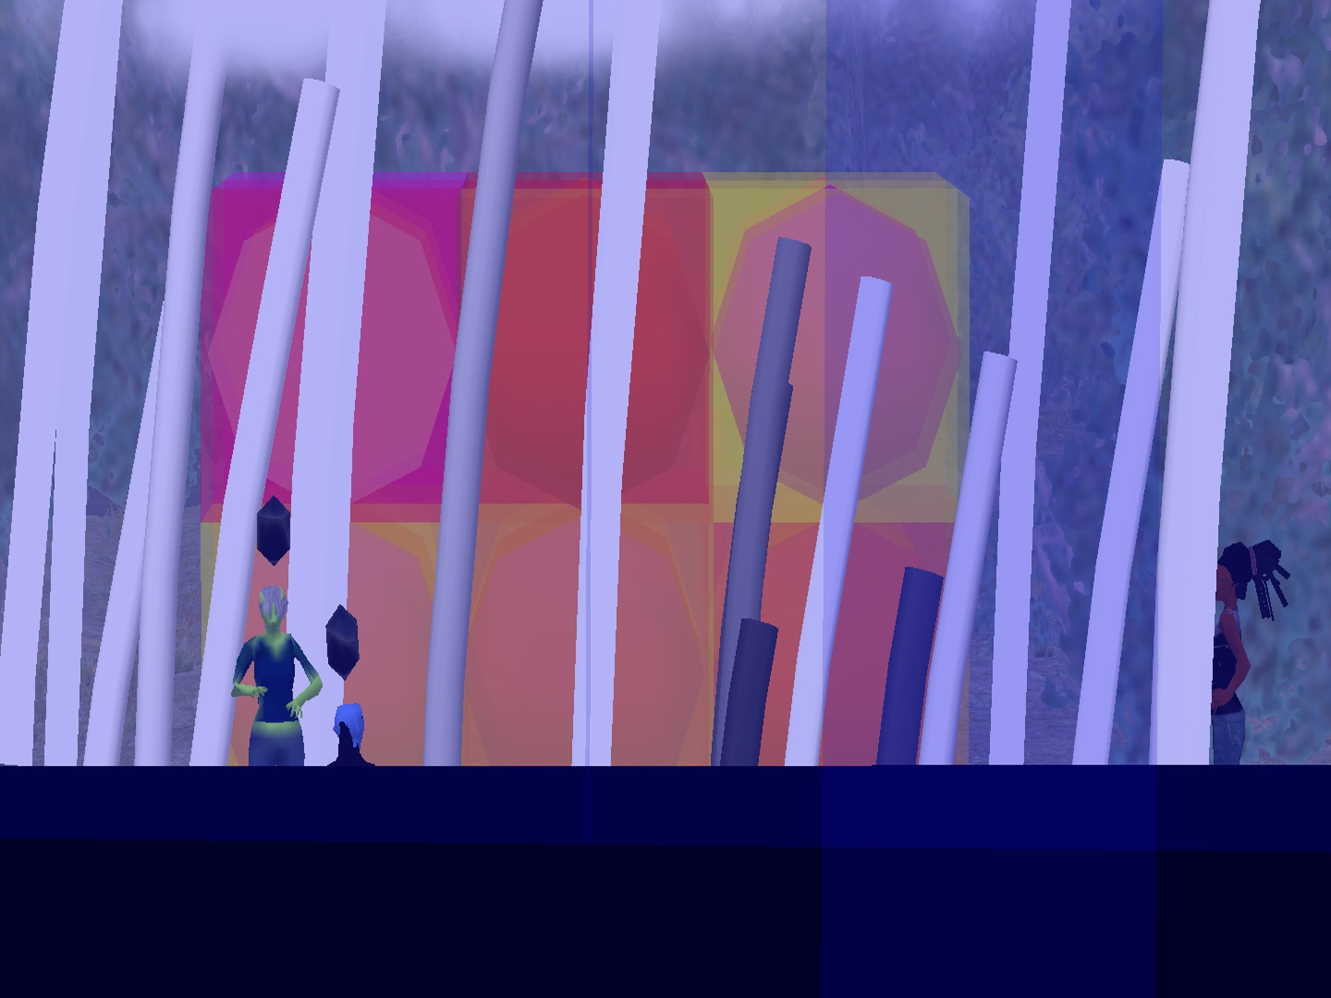

Slide 19
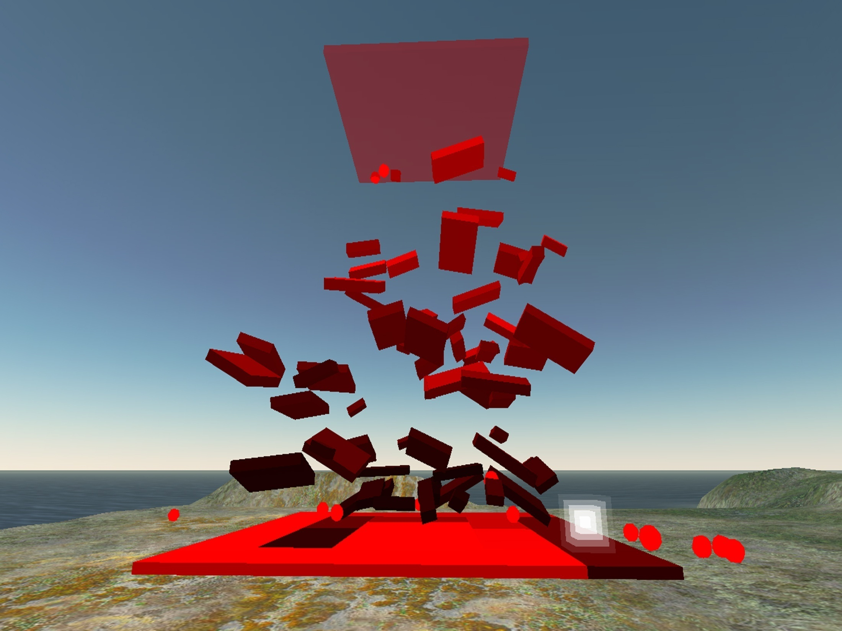

Slide 20
DC Spensley Full Immersion Hyperformalism

Slide 23
