Slide 1

Konferenz “Telemonitoring in Gesundheits- und Sozialsystemen – Eine eHealth-Lösung mit Zukunft”, München eHealth-Entwicklungen international –
Stand und Perspektiven
Reinhard Busse, Prof. Dr. med. MPH FFPH
Dept. Health Care Management, Berlin University of Technology
(WHO Collaborating Centre for Health Systems Research and Management)
&
European Observatory on Health Systems and Policies

Slide 2
$ 19 Mrd für eHealth im US-Konjunkturpaket

Slide 3
4% „full“ + 13% „basic“

Slide 4
1.5% „comprehensive“ + 7.6% „basic“

Slide 5
Physicians’ Use of Electronic Medical Records
Percent of physicians using electronic medical records
International Comparison, 2006
AUS=Australia; CAN=Canada; GER=Germany; NETH=Netherlands; NZ=New Zealand; UK=United Kingdom; US=United States.
Data: 2001 and 2006 Commonwealth Fund International Health Policy Surveys.
Source: Commonwealth Fund National Scorecard on U.S. Health System Performance, 2008

Slide 6
Primary Care Practices with Advanced Information Capacity, 2006
Percent reporting 7 or more out of 14 functions*
*Count of 14: EMR, EMR access other doctors, outside office, patient; routine use electronic ordering tests, prescriptions, access test results, access hospital records; computer for reminders, Rx alerts, prompt tests results; easy to list diagnosis, medications, patients due for care.
Source: 2006 Commonwealth Fund International Health Policy Survey of Primary Care Physicians

Slide 7
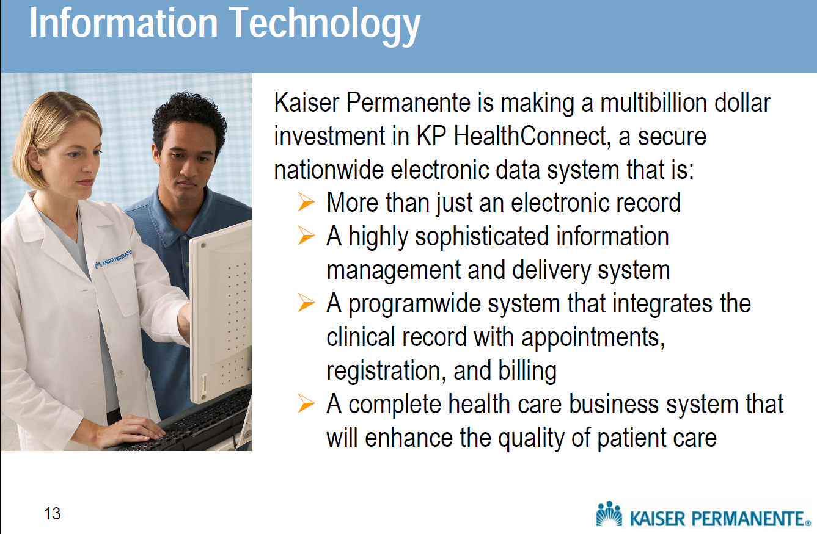
On the other hand, there are eHealth world-leaders …

Slide 8
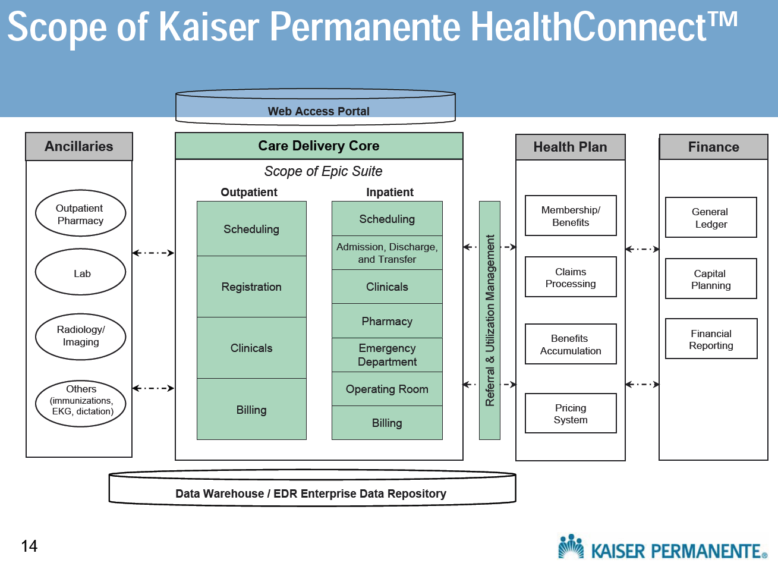

Slide 9
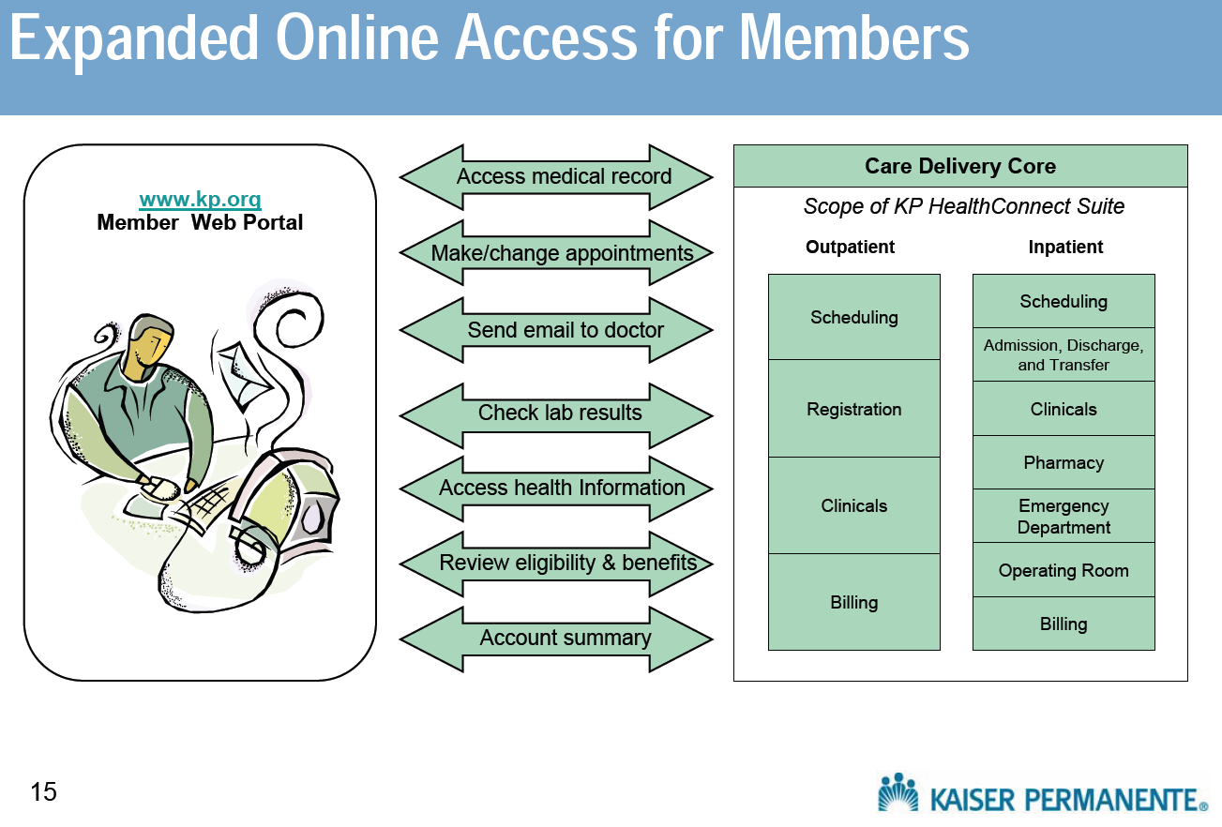

Slide 10
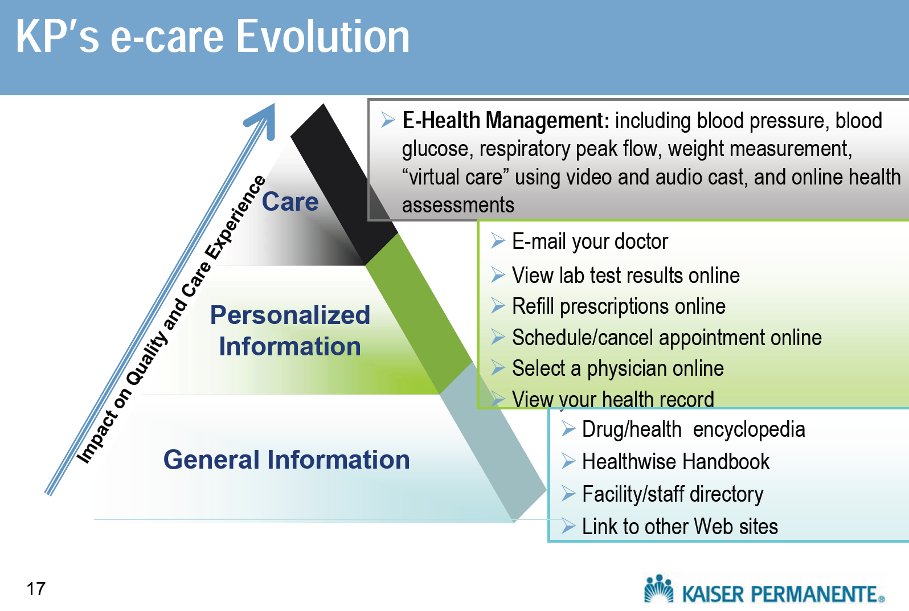

Slide 11
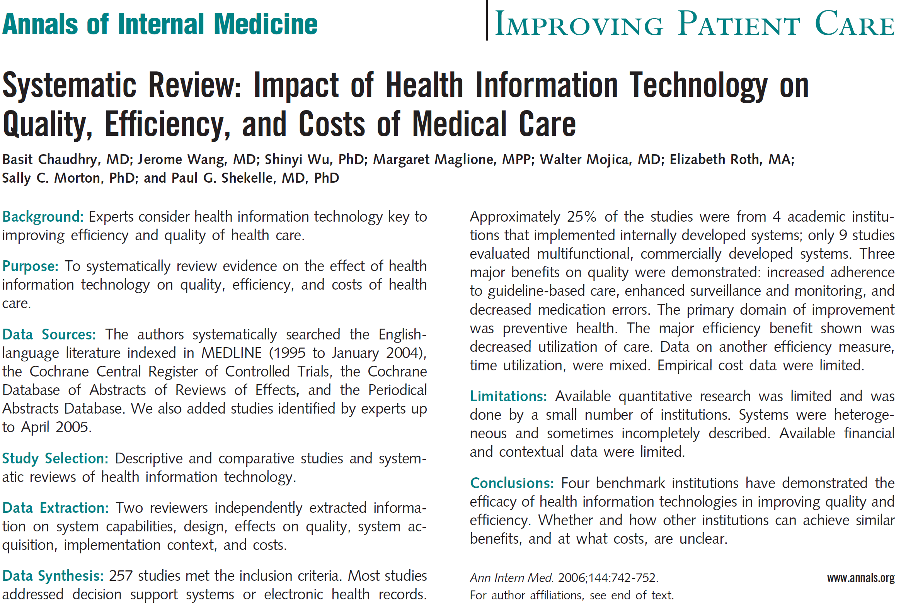

Slide 12
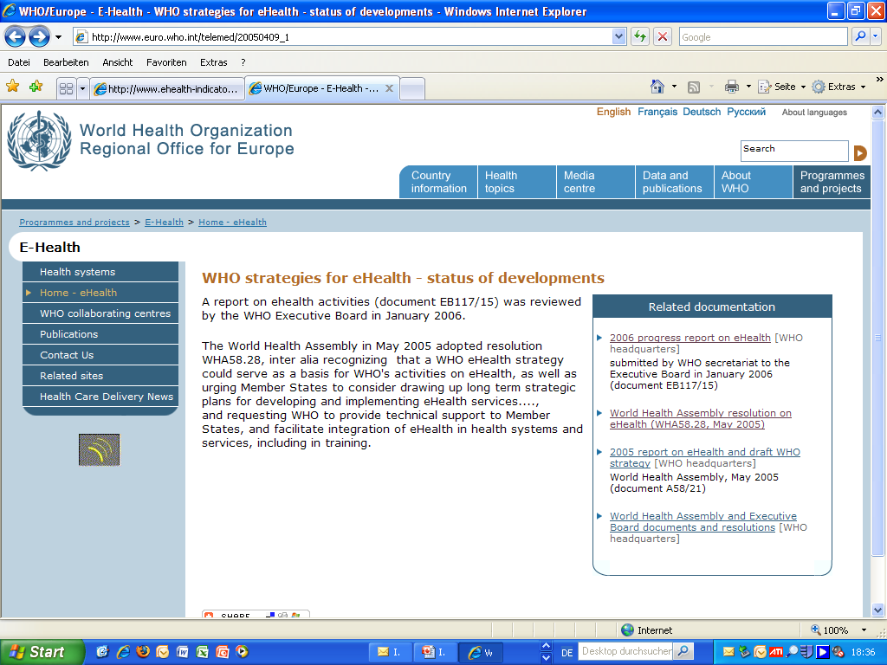
Resolution WHO EB115.R20 (2005) … Urges the Members States to
  - develop a national eHealth strategy, including legal and infrastructure frameworks, and public-private partnership
  - mobilize multisectorial collaboration
  - establish national eHealth centers and networks of excellence etc.

Slide 13
eHealth strategy in Switzerland
„Health strategy,
not eHealth strategy
required“

Slide 14
Netherlands: national infrastructure for data
exchange between electronic medical records
>50% of physicians opposed
to have their own linked EMR

Slide 15
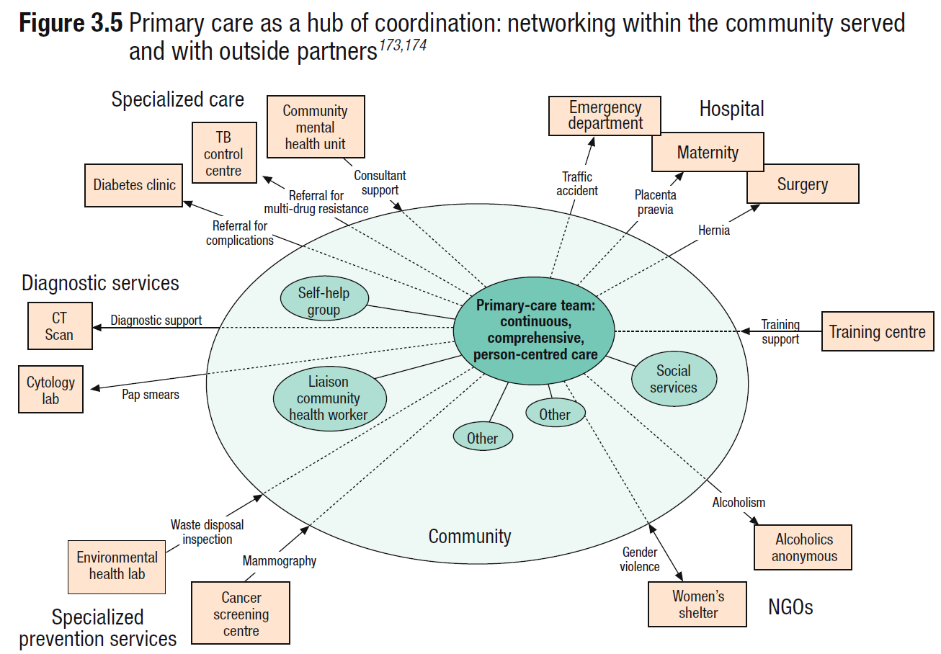

Slide 16
EU World Leader in deployment in primary care (EC Study 2007)
87%
80%
69%
66%
63%
62%
55%
44%
14%
15%
3%
1%
Notes:
16

Slide 17
GP attitudes towards ICT use in healthcare
Source: empirica: ICT and eHealth use among GPs in Europe 2007, Bonn April 2008

Slide 18
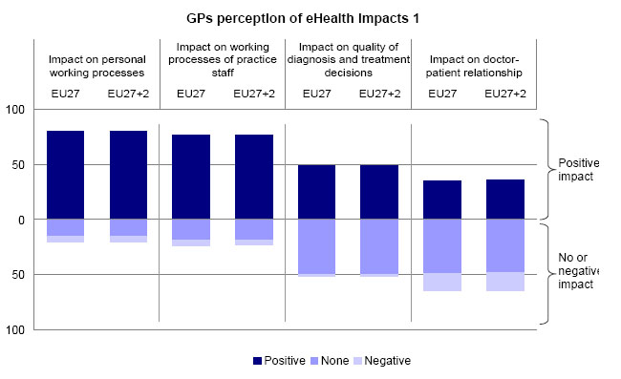
GP perception of ICT use in healthcare
Source: empirica: ICT and eHealth use among GPs in Europe 2007, Bonn April 2008

Slide 19
GPs’ access to computer in practices
(in %, EU countries 2007)
Random samples of 6,789 GPs in 29 countries
Source: empirica: ICT and eHealth use among GPs in Europe 2007, Bonn April 2008

Slide 20
GPs’ access to internet in practices
(in %, EU countries 2007)
Random samples of 6,789 GPs in 29 countries
Source: empirica: ICT and eHealth use among GPs in Europe 2007, Bonn April 2008

Slide 21
GPs’ access to broadband in practices
(in %, EU countries 2007)
Random samples of 6,789 GPs in 29 countries
Source: empirica: ICT and eHealth use among GPs in Europe 2007, Bonn April 2008

Slide 22
IT use by GPs: storage of administrative patient data (in %, EU 2007)
Random samples of 6,789 GPs in 29 countries
Source: empirica: ICT and eHealth use among GPs in Europe 2007, Bonn April 2008

Slide 23
IT use by GPs: storage of medical patient data (in %, EU 2007)
Source: empirica: ICT and eHealth use among GPs in Europe 2007, Bonn April 2008

Slide 24
GPs routinely using a computer during consultation (in %, EU countries 2007)
100%
Random samples of 6,789 GPs in 29 countries
66%
3%
Source: empirica: ICT and eHealth use among GPs in Europe 2007, Bonn April 2008
Notes:
24
Base: All GPs
Question: Do you use the computer during consultations? Yes, routinely.

Slide 25
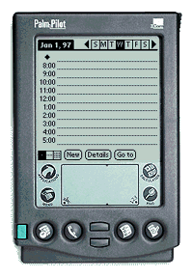

Towards eHealth Deployment: Step 2
Connecting providers: Messaging, EMR, HP tools, on line services
Hospital
Emergency
Pharmacy
GP
Health Centre
Secure Networks
Region 3
Mobile, Wireless
&
Broadband
mobile PC
Region 2
Region 1
Home
Mobility
Notes:
25

Slide 26
GP connectivity: to other GPs (in %, 2007)
Random samples of 6,789 GPs in 29 countries
Source: empirica: ICT and eHealth use among GPs in Europe 2007, Bonn April 2008

Slide 27
GP connectivity: to specialists (in %, 2007)
Random samples of 6,789 GPs in 29 countries
Source: empirica: ICT and eHealth use among GPs in Europe 2007, Bonn April 2008

Slide 28
GP connectivity: to hospitals (in %, 2007)
Random samples of 6,789 GPs in 29 countries
Source: empirica: ICT and eHealth use among GPs in Europe 2007, Bonn April 2008

Slide 29
GP connectivity: to health authorities
(in %, 2007)
Random samples of 6,789 GPs in 29 countries
Source: empirica: ICT and eHealth use among GPs in Europe 2007, Bonn April 2008

Slide 30
GP connectivity: to insurers/ reimbursers (in %, 2007)
Random samples of 6,789 GPs in 29 countries
Source: empirica: ICT and eHealth use among GPs in Europe 2007, Bonn April 2008

Slide 31
GPs: Electronic exchange of patient data by purpose (in %, EU 2007)
Source: empirica: ICT and eHealth use among GPs in Europe 2007, Bonn April 2008
Notes:
31
Base: All GPs
Indicator: Using electronic networks for transfer of patient data, % values.

Slide 32
GPs: Electronic exchange of patient data by purpose (selected countries in %)
 | Lab results from laboratories | Admin data to reimbursers | Medical data to care providers / professionals | Admin data to other care providers | Prescription to pharmacies | Medical data cross border
EU27 | 40 | 15 | 10 | 10 | 6 | 1
BE | 73 | 3 | 13 | 13 | 2 | 1
BG | 5 | 10 | 3 | 6 | 2 | 1
DE | 63 | 4 | 4 | 3 | 0 | 0
DK | 96 | 48 | 74 | 74 | 97 | 2
EE | 39 | 5 | 1 | 1 | 1 | 0
NL | 84 | 45 | 26 | 28 | 71 | 5
FI | 90 | 8 | 55 | 21 | 0 | 0
SE | 82 | 8 | 13 | 16 | 81 | 1
UK | 85 | 43 | 26 | 32 | 5 | 0
Source: empirica: ICT and eHealth use among GPs in Europe 2007, Bonn April 2008
Notes:
32
Base: All GPs
Indicator: Using electronic networks for transfer of patient data, % values.

Slide 33
Random samples of 6,789 GPs in 29 countries
Source: empirica: ICT and eHealth use among GPs in Europe 2007, Bonn April 2008

Slide 34
Readiness – use gap (example in %, 2007)
Source: empirica: ICT and eHealth use among GPs in Europe 2007, Bonn April 2008
Notes:
34
Base: All GPs
Indicator: Using electronic networks for transfer of patient data, % values.

Slide 35
GPs: ePrescribing (in %, 2007)
Random samples of 6,789 GPs in 29 countries
Source: empirica: ICT and eHealth use among GPs in Europe 2007, Bonn April 2008
Notes:
35
Base: All GPs
Indicator: Using electronic networks for transfer of patient data, % values.

Slide 36
Source: empirica: ICT and eHealth use among GPs in Europe 2007, Bonn April 2008

Slide 37
Denmark Leads the Way In eHealth:
An Example of High Performance
  98% of primary care physicians totally electronic health records and e-prescribing
  Paid for e-mail with patients
  All prescriptions, lab and imaging tests, specialist consult reports, hospital discharge letters flow through a single electronic portal accessible to patients, physicians, and home health nurses
  Specialist payment depends upon filing information in the electronic portal

Slide 38
Prescriptions
Prescriptions
1039105 = 73%
1389023 = 84%
GP´s
with
EDI : 2120 = 100 %
Specialists
with
EDI: 765 = 94 %
Hospitals
with
EDI : 63 = 100%
Pharmacies with
EDI: 322 = 100 %
Disch
Disch
. Letters
. Letters
Doctors on
Call
: 5 = 100 %
1131750 = 94 %
682923 = 85 %
Health Insurance
: 5 = 100 %
102
messages
/min
Lab.
Lab.
reports
reports
543040 = 82 %
988151 = 99 %
Lab Requests
349840 = 85 %
Referrals
Referrals
Referrals
Referrals
177525 = 65 %
Reimbursement
21049 = 99 %
Source: I. Johansen, Presentation to the International Society for Quality in Health Care,
25th International Conference, October 19-22, 2008.

Slide 39
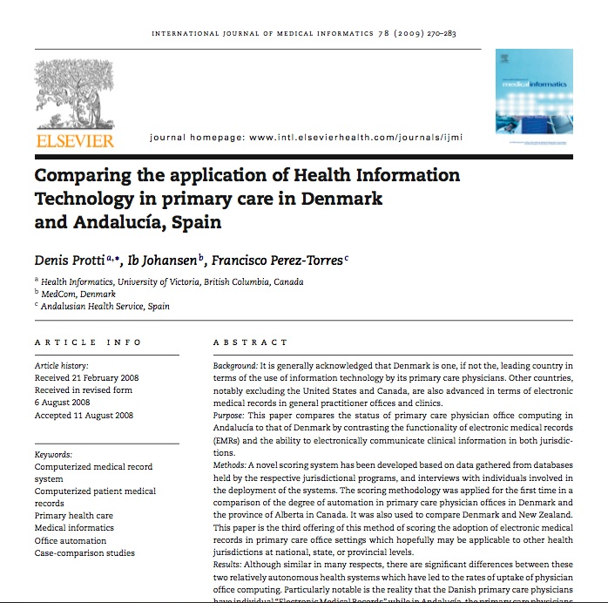
But even frontrunners can do better: comparing the application of Health IT in primary care in Denmark and Andalucía/Spain
“… Particulary notable is the reality that the Danish primary care physicians office have “Electronic Medical Records” while in Andalucía, the primary care physicians share a common record which, when secondary care is fully integrated, will indeed be an “Electronic Health Record …”
Protti D, Johansen Ib, Perez-Torres F. Comparing the application of Health information Technology in primary care in Denmark and Andalucía, Spain. International Journal of Medical Informatics 2009;78:270-283

Slide 40

Towards eHealth Deployment: Step 3
Connecting individuals with providers/
Patient-centred Health Information
Pharmacy
GP
Hospital
Emergency
Health Centre
Secure Networks
Region 3
Mobile, Wireless
&
Broadband
mobile PC
Region 2
Region 1
Home
Mobility
Notes:
40

Slide 41
GPs: telemonitoring routinely (in %, 2007)
Random samples of 6,789 GPs in 29 countries
Source: empirica: ICT and eHealth use among GPs in Europe 2007, Bonn April 2008
Notes:
41
Base: All GPs
Indicator: Using electronic networks for transfer of patient data, % values.

Slide 42
New Zealand: introduction of patient-centred
electronic health record

Slide 44
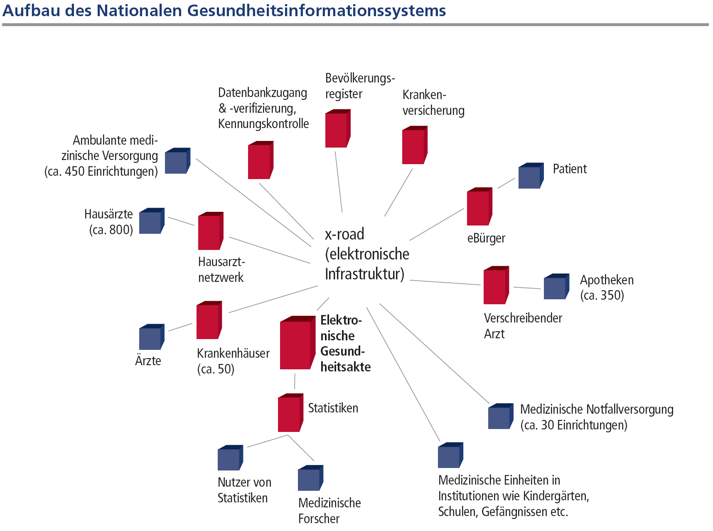

Slide 45
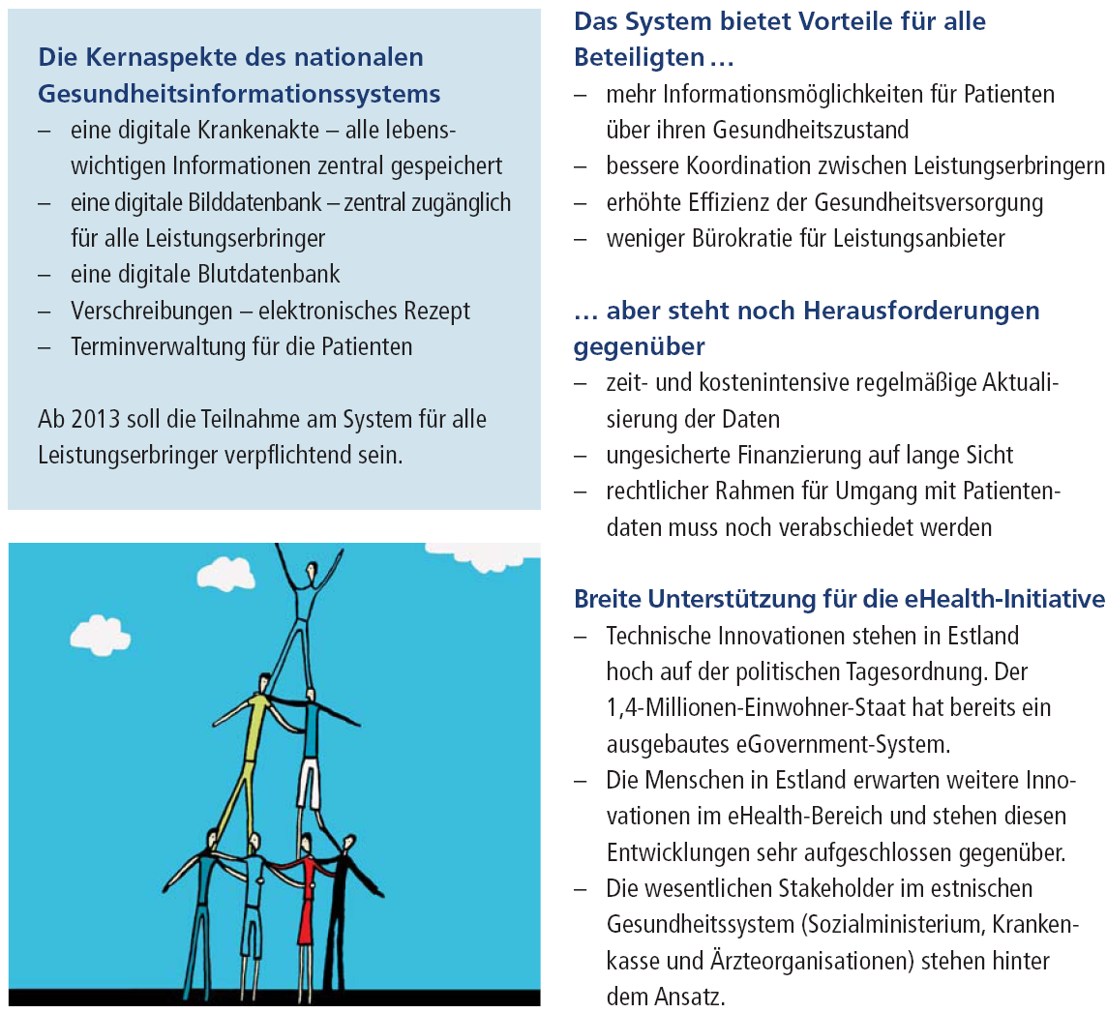

Slide 46
Zusammenfassung
eHealth-Entwicklung in Ländern sehr unterschiedlich (führend: DK), insbesondere zwischen Leistungsanbietern oft und mit Patienten fast immer wenig entwickelt
eHealth muss (Haus-)Ärzte einbeziehen
Gesundheitssystemstrategien, die eHealth beinhalten, vermutlich erfolgreicher als reine eHealth-Strategien
patientenbezogene Datensammlung bleibt überall Herausforderung

Slide 47
Präsentation, Literatur zum Thema etc. auf: www.mig.tu-berlin.de
Email: mig@tu-berlin.de

