Slide 1
Telecommunication Solutions for Smart Objects
08 July 2010
Marie Austenaa
VP Strategy & Products
marie.austenaa@telenor.com
Notes:
My name is Marie Austenaa and I head up the Strategy and Products team in Telenor Objects. Prior to this, I led Telenor’s research and innovation initiative on Connected Objects – which led to the establishment of Telenor Objects in July 2009. Telenor Objects is one of Telenor’s two main business units in M2M – the other is Telenor Connexion, offering cellular connectivity tailored to M2M services. I will now give an overview of Telenor Objects approach to M2M – or telecommunication solution for smart objects.

Slide 2
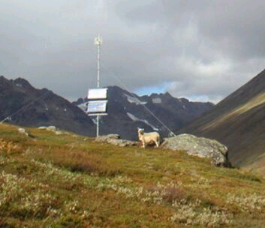


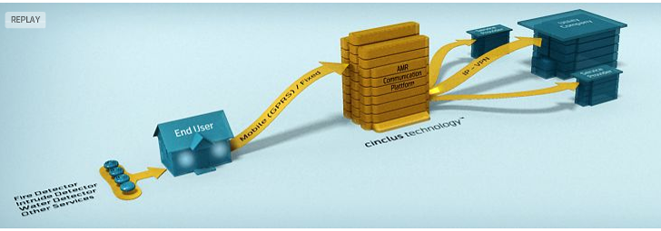


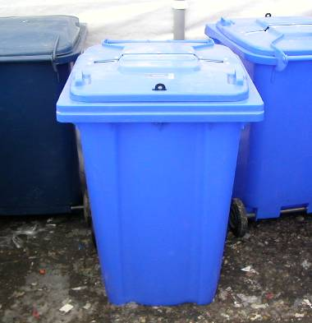
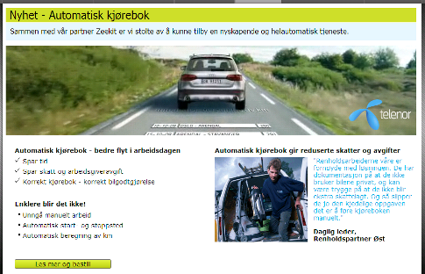
Telenor has provided M2M services and research since the 1990s
Telespor
Telenor Cinclus
(AMR)
Telenor R&I
Can do!
Telenor IRIS (RFID)
Notes:
Telenor has worked in the M2M market since the 1990s. Initial focus was on connectivity – and we had a lot of success in the automotive and alarm markets, but we also launched a number of vertical M2M services in for instance AMR, asset management, remote control and monitoring and RFID. In the end of 2007, I headed up an innovation programme on Connected Objects which combined business development with research activities. This took the best learnings from the different initiatives and new technology developments. This resulted in the launch of Telenor Objects in July 2009. hence Telenor believe we are fairly experienced in the M2M market, having tried different approaches.
We learned that all these different services did much of the same things, yet we continued to do the same all over every time we established a new vertical service: Connectivity handling (different bearers), device interfacing, data capture and storage, device monitoring, SMS, location, etc.
Telenor has provided M2M services and undertaken research activities in the market since the 1990s. Some of our earlier initiatives were cellular connectivity services for automotive and home alarm applications.
We have also established services to:
Track containers on railways – Telenor Traxion
Track sheep and periodic monitoring of movements to detect whether the animal is still alive and where it is – this is Telespor
- TelCage which is Monitoring and remote control of off-shore fish farms
- We did asset management based on RFID (this was integrated into Telenor Objects)
- Cinclus –Automatic reading of electricity meters
- Connexion: M2M connectivity

Slide 3
The classical approach to M2M
Application
X N
Communication
Device
Notes:
The classical approach to M2M services is “vertical” – specific devices are fully integrated with a specific application. This works very well – for closed solutions. The application makes the most out of the devices and may have tailored functionality to take advantage of specific device features. The customer buys an end-to-end solution from a service provider. However, we believe that this approach will limit the potential in the M2M market and in particular be insufficient in realising the potential in creating Smart Cities. WHY?

Slide 4
A few examples:

Slide 5
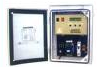







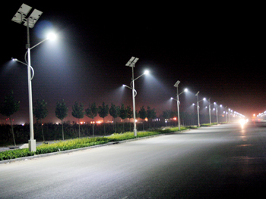
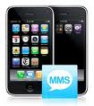
Intelligent public infrastructure
Web interface to control the infrastructure elements
Smart objects
Field engineering services
The public reporting issues with public infrastructure
Emergency services
The public
Contractos
....
Infrastructure elements with local connectivity (street lighting, manhole covers, rubbish bins…)

Slide 6






Assisted living
Sensors in the patient’s home
Patient’s view
Touch to talk and see:
Results
How are you today?
Fine
Dizzy
Hospital system and processes
Blood glucose
In pain
Please call nurse to get new medicines
Patient information routed onwards to hospital systems as required
Next of kin’s view
Actions or response based on results routed back to patient (as required)
Oxygen
Results and current actions
(video) call
Other interested parties:
Local health care providers
Social services
...
Blood pressure

Slide 7
Common features
  Large variety of smart objects which need to deliver and receive data
  There are a number of independent participants which benefit from access to the object data
  Large number of loosely coupled participants which needs to interact
  Most likely has not all use cases been thought about when the systems were initially designed and deployed
  Building new services on-top of existing infrastructure could yield significant service innovation and benefits

Slide 8
The classical approach to M2M may fail to deliver the full value of the Internet of Things
  Closed and standalone solutions
  High barriers for innovation due to complexity and inefficiency
    Inefficient - re-invents common functionality
    Complex – no specialisation of roles
  Limited freedom of choice and reusability for the end-user
  Sharing devices and information is difficult
  Not the Internet of Things
Notes:
We believe that the vertical approach to M2M will fail to deliver the full potential of M2M services and the internet of things. With this approach, there are high barriers for generating new services and for innovation. It is inefficient – it reinvents common functionality such as addressing, device interfacing, management functions. It is also complex as there is a need to take on responsibilities for both devices and application. A fully integrated service gives also limited choice in terms selecting the optimum combination of application and devices for the end user and it is hard to reuse existing infrastructure for instance of deployed GPS units or RFID readers. It is also hard to share access to devices and information. To conclude, we believe that the common vertical approach to M2M services is unlikely create the services and innovation the market to realise its potential.

Slide 9
M2M needs a layered approach to make it quick and easy to deploy new services
September 2009
M2M: the sleeper awakes, by Jeremy Green
  Curiously, this seems to be one of the rare cases where the business model has evolved more quickly than the technology. The connectivity part of M2M solutions is not particularly problematic; […]
  What M2M really needs is an architecture. This would define interfaces between different layers, protecting developers at each level from the complexity that pertains at all the other levels.
Notes:
What many argue – including us – is that the market needs a new approach to make it quick and easy to deploy new services. This approach would define the interfaces between the different layers and protect the developers at each level from the complexity found at the other levels. A device manufacturer would not have to know everything about the application in the same way as an application developer can focus on creating good software independent of the specific devices. A word processor does not need to know everything about the different printers, it just needs to be able to print.

Slide 10

Telenor Objects’ vision is to allow any application to control and monitor any device, by providing an open horizontal architecture for smart objects
Application
Application
Application
APIs and device interfacing to simplify data capture & processing, device control & monitoring, and information exchange
Other M2M service enabler
Communication
(GPRS, WLAN, Satellite, …)
Sensors
Actuators
Devices
Notes:
Our vision is to allow any application to control and monitor any device by providing an open horizontal architecture for M2M enabled objects. This is a kind of service layer or middleware between the devices and the applications using the information generated by the devices. Typical services are APIs and device interfacing to simplify data capture, processing and storage, device control and monitoring, device management and information exchange.
Note that this is not a centralised system – it is a network of networks – distributed and interconnected.

Slide 11
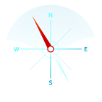




Faster from idea to implementation
Services and functionality provided by Telenor Objects:
Open APIs and device interfacing to establish separation and independence between application and device
Device library, integration tool, and certification
Data capture, data delivery, processing and storage
Infrastructure (device to application) monitoring
Generic and reusable services enablers (send / receive messages, RFID, SMS, email, IM, location, maps, EPCIS, notification etc.)
Interoperability and information exchange with other providers
Simple web interface for device configuration and status
Managed service with service level agreements, service desk and billing
Future proof with an open architecture design philosophy and open source community for key platform elements and functionality
Notes:
Service enablers include:
Generic: send/receive message, subscribe to messages from a specific IMSI, SMS, email, IM
Location: get position, set geo-fence
Configuration of device: set status (predefined and custom)
Alarms: configure threshold, define recipients
RFID: get tag, start / stop read, send command to RFID reader
GPS enablers: start send location, stop send location, clear alarm
Locally deployed logic

Slide 12
What is unique?
  Open and future proof architecture allows customers to freely choose the most suitable combination of devices and applications
  Open APIs create independence between applications and devices
  Device interfacing tools makes it easy to adapt and connect new devices to the platform
  Distributed platform concept
  Managed service – “platform as a service” concept
  Eco-system and network of partners

Slide 13
What are the customer benefits?
Freedom of choice
Risk reduction
VISION
Enable any application to control and monitor any device
Efficient competitive tendering
Specialization of roles

Slide 14
Conclusions
  Smart cities are complex systems – large number of loosely coupled participants interacting – including the public
  Existing services and infrastructure of deployed smart objects can be linked with new services
  Openness and collaboration are essential to encourage innovation and new services
  An horizontal and layered approach to smart services allows for separation between smart objects and application
    Risk reduction and freedom to choose, Efficient competitive tendering, Innovation, Specialisation of roles
  Privacy and security will be very important issues to address and resolve, but should not be a showstopper to try
  To stay future proof: when tendering for “Smart Services”, include separation of service components as a requirement

Slide 15
Additional information

Slide 16
Telenor’s main M2M service providers
Supports both vertical & horizontal development
Reliable global connectivity (GSM/UMTS/LTE)
Services for large-scale deployment and connectivity operations 24/7
Customized SIM and fulfillment solution
Supports horizontal development
Data capture, processing and sharing
Secure, reliable message handling and 24/7 solution monitoring
Quick implementation using device library
Notes:
Vertical approach: Transferring SMS or GPRS data from SIM to customer central system.
Horizontal approach: Generic M2M switch which gives the ability for any device to be monitored and controlled by any application in a safe and efficient manner.

Slide 17
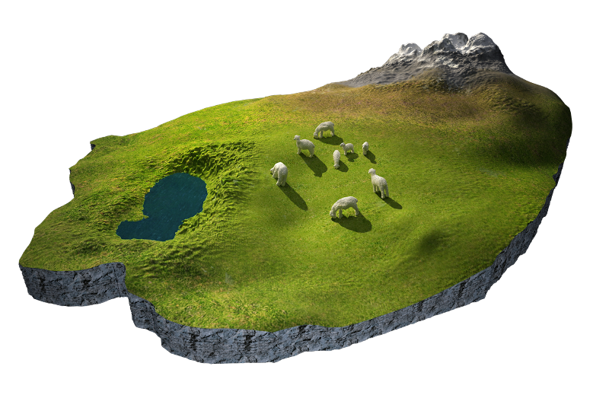
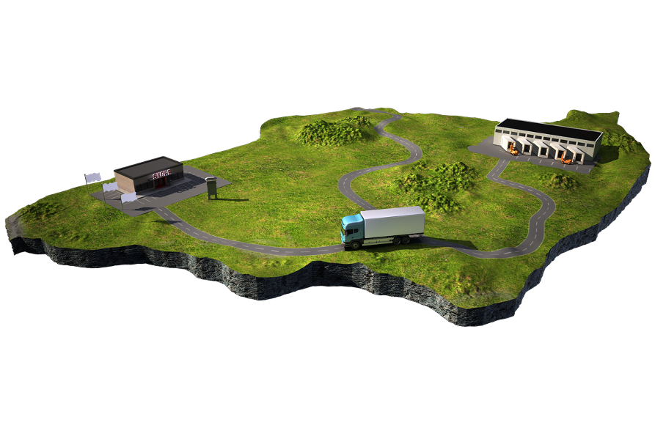
Telenor Objects AS www.telenorobjects.com
Established 1st of July 2009
Fully owned by Telenor ASA
Chairman: Arve Johansen
CEO: Hans Christian Haugli
Based on resources from Telenor Research and Innovation and Telenor Iris
Provides a reliable and highly scalable M2M infrastructure
Different solutions already delivered together with partners

Slide 18
Business model – Telenor Objects
Service providers
Customer specific applications, GUI etc.
Home
Health
Fleet
Food tracing
Energy
Automation
Logistics
APIs
Telenor Objects
Operational
Center
Managed
Services
24/365
Shepherd
Secure Message Exchange
and infrastructure related services
Generic
Functionality
”X”
Shepherd
Device providers
APIs
Variety of
Devices
Variety of
gateways
Variety of
sensors

Slide 19
There are 5 core elements to Telenor Objects

