Slide 1
HOW THE NETWORK WINS....
SMART BUSINESS NETWORKS
PROF. PETER VERVEST
pvervest@rsm.nl
21 November 2012
Notes:
Gestern mit Prof Picot gesprochen, ihm gefragt D oder E...er hat mir geantworted "Rudy Carrell ist schon lange gestorben...also deswege werde ich meines Referat auf E machen
peter vervest
professor decision and information sciences
partner D-Age | high tech consulting and investment group, Nl, Silicon Valley, Yerevan
my discussion is a Discovery Tour

Slide 2
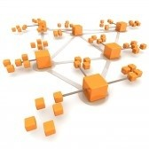
Agenda
networks
not chains
the network challenge
Notes:
about 10 years ago prof Kenny Preiss [AGILITY, agile competitors and virtual organizations, Lee Iacocca/ Chrysler Institute] came up with the term SMART + BUSINSESS + NETWORKS
Networks: companies become nodes in a network, not shackles in a chain – NETWORKING TECHNOLOGIES
Business: it is about economic life, adding value, ...admitted social media and social networking has gone much faster then Kenny and I expected BUT Facebook is about business...advertising....
Smart: important concept: smart is 1. the technology: we link, connect everything together, 10 BILLION things in 2016 says Forrester. See yesterday's event SMART GRID. But smart is also about how you do it, being clever is not enough...making money is....innovative, fashionable, short lived...
SBN may not be easy to recognize but STUPID business networks are.

Slide 3

Notes:
Networks can be very powerfull. Also disruptive. Every network aware company nowadays has a WEB SURVEILLANCE team [s]. As well as security teams. The scariest thing about networks is the speed whereby they can mobilize. Now here is an example. Who knows this film Project X? Released 1 March 2012. I have not seen the film but I have seen the results.

Slide 4
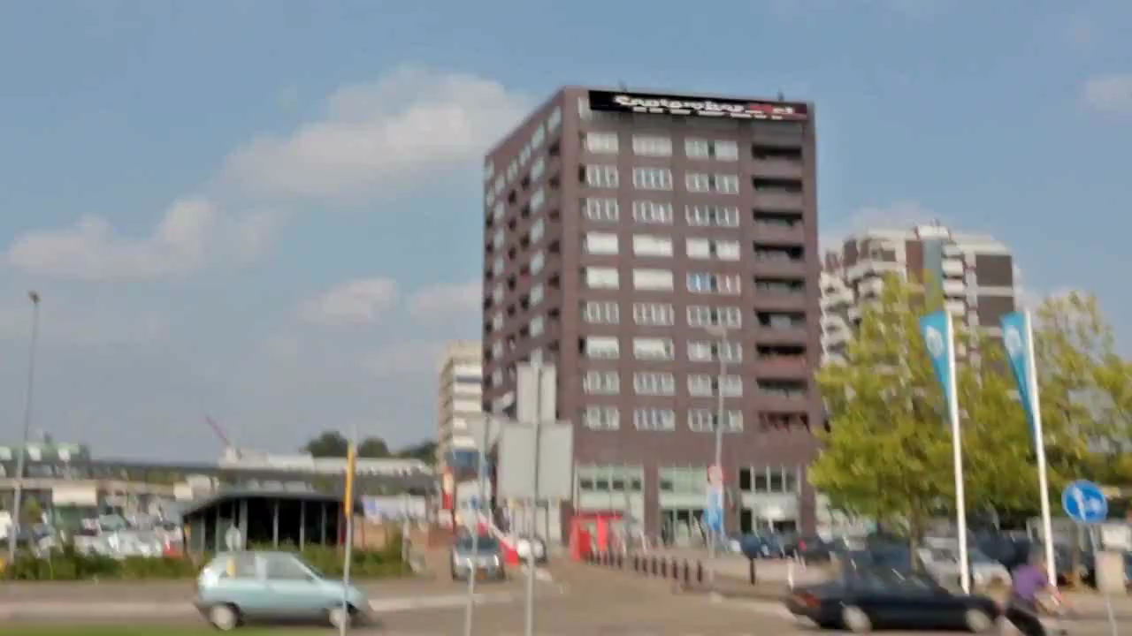
Notes:
Think of this: a small place north in the Netherlands, 3000 inhabitants. a 15-year old girl invites her friends via the events-option in Facebook to her 16th birthday party. She forgets to tick the box "private". The news goes round. 8.000 people come to Haren. The network brings out the "best" in people.....the police does not know what happens, the mayor goes on national radio to say "there is no party in Haren so do not come"....Twittering, Pinging, using Whatapps etc the youth come from all over the Netherlands and beyond...."if we are with more then 5000 the police cannot do anything" they say...and they are right. Is it a business network? students offer sleeping place in their tents for € 5, beer, food, transport, etc. Holland is shocked.
It has happened in Hamburg and other places in Germany. Project X parties sprang up all over the Netherlands. The police is actively monitoringFacebook, if the see it they call on the parents etc.
See the CARD – NL public transport card. Train, bus, metro, tram, etc one card. CiCo. My PhD students could see from the CI's that something was coming. You could see it on Facebook traffic. You could see it on Phone traffic.
THIS CAN ALSO HAPPEN TO A COMPANY!

Slide 5
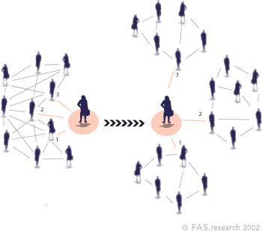
Core concepts
A network consists of actors (or nodes or vertices); e.g.
  People
  Companies
and relatonships (or links or ties or edges); e.g.:
  Colleagues
  Friends
  Buyers / sellers
  Strategic partners
Actors and relationships together form the network structure
Notes:
so NETWORKS are important --- Systems theory to Network theory. So what is a 'network'? Biology. Transport. Disease [bird]. See US NSF "Brains and Society" program. EXPLAIN TIE STRENGTH.
Mathematical basis used to be Graph Theory. But: Networks are "principally complex": a few rules can generate outcomes and if you see the outcomes you can not derive the rules! See cars in a wave. COMPLEXITY THEORY: properties of actors that you can only find out from studying these actors as a network.
Another important concept: Structure means TOPOLOGY. "a map".

Slide 6

Your social network
school
club
Linkedin
Facebook
Twitter
Flickr, Jabber, ...
Notes:
Pal Erdos: I have Erdos number 2. Milgram sending letters around. See Linkedin: the number of connections – you can type in the name of a person like The President of the USA and then it shows "How Far" you are distanced.
The number of links of a node is important: let us call this the DEGREE of a Node. If there are many nodes with a lot of links we speak of high DENSITY.
Duncan Watts. Strogatz: random wiring, structure. Social Network Analysis. p(k) is probability

Slide 7
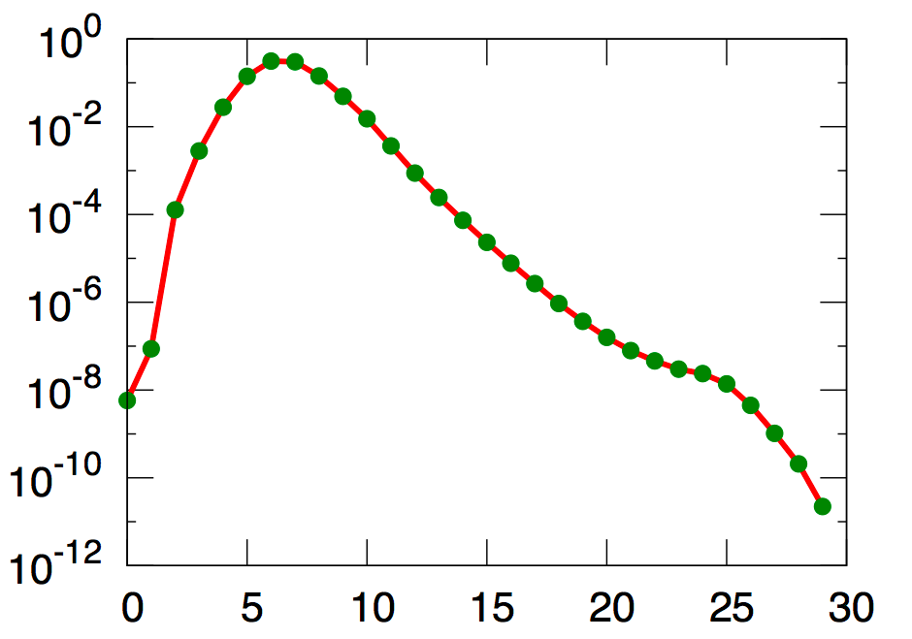
Jure Leskovitz, Eric Horvitz (2008)
average path length of 240 million active user accounts on Microsoft Instant Messenger is 6.6
p(l) (Probability)
l (Path length in hops)
a link between two users of IM is defined as “a two-way conversation at any point in time during a month-long observation period”
Notes:
six degrees seems to work.....this is called the path length.

Slide 8

Network analysis
path / path length
strong and weak ties
density
degree distribution
clustering/ betweenness
homophily/ affiliation
structural balance
traffic
search
Notes:
so over the recent years we have applied graph theory to simple and now complex networks. See Barabasi. I would not recommend this book, if you want to read a good book take NETWORKS CLOUDS AND MARKETS – REASONING ABOUT A HIGHLY CONNECTED WORLD, 2010, DAVID EASLEY AND JON KLEINBERG from Cornell University. But I mention Albert Lasszlo Barabasi from Notre Dame University [USA] because of outstanding work...not this book...is a bit weird, on LINKED.

Slide 9
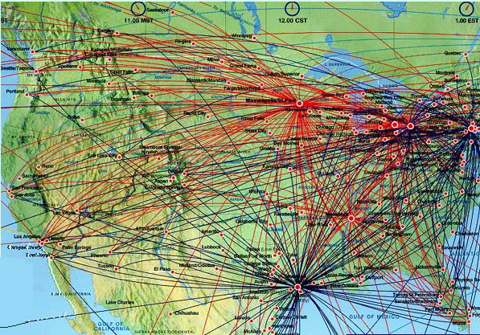
Barabási (in: Linked, 2003)
Power-law distribution
Internet is scale-free:
P(k) ≈ kª
through growth and preferential attachment
Scale-free Network
Notes:
Linked p. 71: degree distribution: Degree is the number of links of a node. A bell shaped curve would mean that most nodes have the same number of links, say most nodes would have 10 links, and there are very few nodes with low number of links and very few with a high number. Bell shaped like a "normal distribution". Called RANDOM network structure. The normal [or mean] in this example is 10. SCALE IS 10. On horizontal axis the number of links and on the vertical axis the number of nodes with [k] links. P[k] meand the probability that a node would have k links. What is found is that the internet does NOT HAVE A SCALE i.e. not a mean but it is a power law distribution meaning: most nodes have a few number of links and a few nodes have a large number of links, are highly connected. Airline network is scale free, highway network has a scale.
Why is this so important: LINKED p. 145 Paul Baran 3 types of networks structures: centralized, decentralized and mesh or distributed. 1964. Vulnerability and resilience. See Linked p. 166: directedness....in and out links, WWW is a directed network, so there are continents and islands....

Slide 10
Network structure and position
Does network position determine actor performance?
Bridging positions in a network connect actors that no not have a direct tie
Benefits of a bridging positions:
    Control
    Information
Bridging position
(in-between the structural hole)
Notes:
Burt. One of the key questions is: what position should I have in the network? Like: on Linkedin or on Facebook, same for business networks? Should you be the estate agent, the buyer of the house or the seller/ owner of the house [NL: certainly not the owner]. Specific position is the BRIDGE. Advantages: control and information. Als called STRUCTURAL HOLES where parts of the network are not connected.
Specific question: DOES ACTOR PERFORMANCE DETERMINE NETWORK POSITION – or – DOES NETWORK POSITION DETERMINE ACTOR PERFORMANCE?

Slide 11
Dynamics of networks
Bridging positions in a network connect actors that no not have a direct tie
Closure
Notes:
this shows that if there is an opportunity to link the network will change and can change dramatically. Think of Project X. The little girl gives a birthday party, the invitation links to other sides of the network, they link, the hole closes, no one can stop it, not easily. Same happens in business. On Amazon: ....... On eBay: ....... On: iTunes......

Slide 12
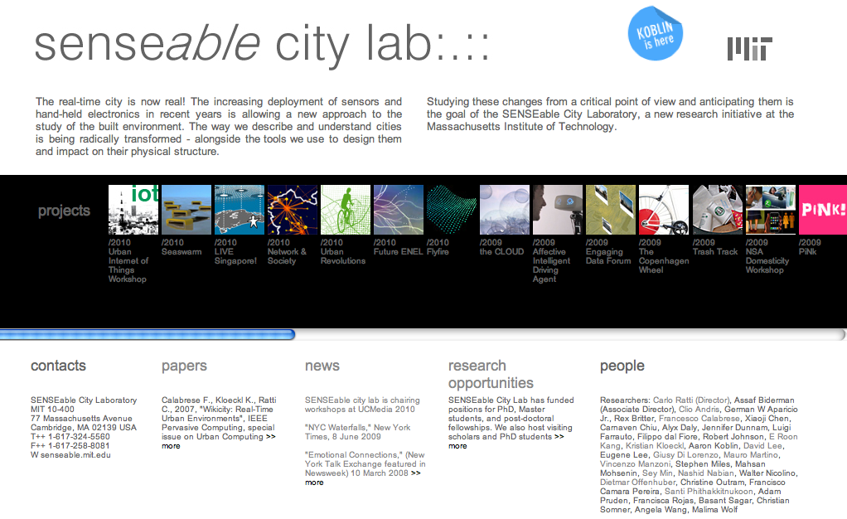
Mapping and horizon
Notes:
the need for a map....but what sort of map? See concept of NETWORK HORIZON.....

Slide 13
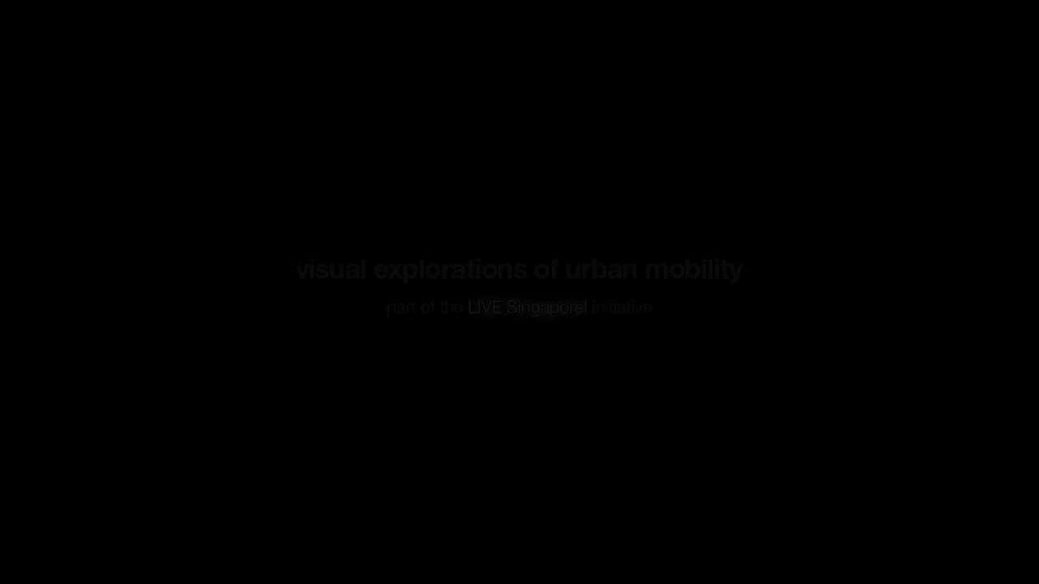
Notes:
example of bustraffic in Singapore. Remember OV-card NL. Think of PRIVACY.

Slide 14
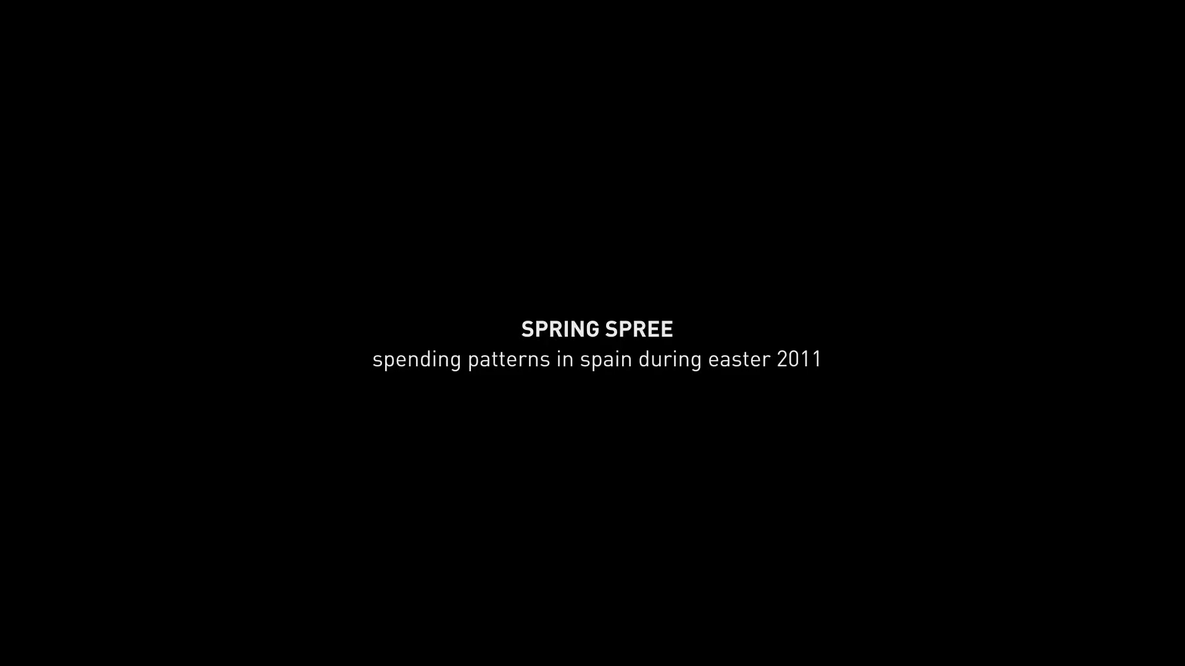
Notes:
Retail sale in Spain. Marks & Spences. Relate this to where people are, the weather, ..... a company needs to position itself on the right time and the right place...and it can now do it....

Slide 15
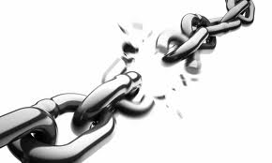
The problem with supply chains
Notes:
So let us go back to where business is today. MICHAEL PORTER'S VALUE CHAIN. SEE SUPPLY CHAIN AS A MORE OR LESS FIXED PATH OVER A NETWORK. A SPECIAL STRUCUTURE. YOU ALWAYS ORDER BEER FROM HEINEKEN...OR ELSE...The big issue: sequential, client-order decoupling, informaton breakage, slow.

Slide 16
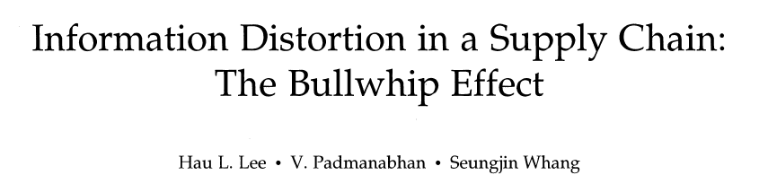
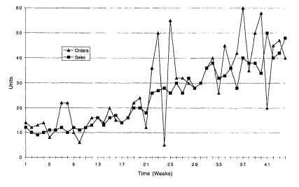

Propagation in supply chains
Notes:
The biggest problem in supply chains is: discrepancies between supply and demand. Not just in the chain, but between sequential actors in the chain – and what happens? [think of the car example – traffic jam] supply jam...they order too much or they order too little....also in JIT an enormous problem.
famous article in 1997 from Hau Lee et al. Stanford [honorary doctor at our university] on

Slide 17
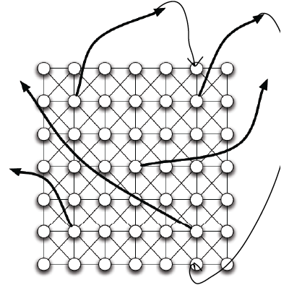
Propagation in business networks
multiple pathways
alternative routing
load balancing
Notes:
Now think of a supply chain as a TEMPORARY PATH in a network setup. You select your business partners in the network, you connect [estasblish a link], you pick the modules from the network that you need, plug these together as a fulfillment path, and then you say "run", or play. See Amazon. And once you are ready you disconnect and the path dies. Like the old telephone system. Or any telecommunications network. But now at the business level.
Again: think of Amazon: Let us challenge each other – we are going to set a bookshop, how would we do this today, how would we have done this 20 years ago?

Slide 18
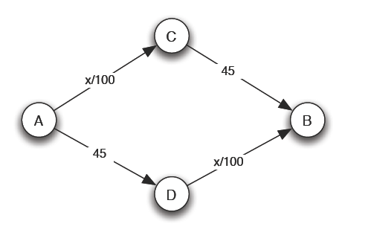
Braess's paradox
example:
x = number of cars
time to travel from A to B = x/100+45
assume 4000 cars: travel time in equilibrium = 65 minutes
Notes:
a word of warning: we really need to understand networks. The idea may be that "connections are always good for you" [do not ask what the network can do for you, ask what you can do for your network]. This is not the case: See Braess paradox. Note: there is no dominating strategy in this case.

Slide 19
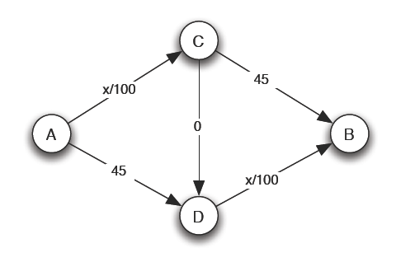
Braess's paradox
new link C-D
new Nash equilibrium = 80 minutes
dominating strategy at A is to go to C [x/4000] = 40 minutes [A->D = 40]
Notes:
nwo there is a dominating strategy: at A everyone takes C. This would change however if at A people who need to decide on what route to take know [and trust] the data at C.

Slide 20
The business challenge
Notes:
so what should the winning frim do?

Slide 21





Innerhalb eines Smart Business Networks sind verschiedenen Strategien möglich. Eine Brückenposition und ein weiter Geschäftshorizont bringen Positionierungsvorteile.
Frame Template
Smart Business Networks
Plattform-Provider:
Fähigkeiten und Verbindungen
Capability-Hub:
Fähigkeiten
Netzwerk-Orchestrierer:
Verbindungen
  Um eine vorteilhafte Position im Netzwerk zu erlangen oder zu behalten - um vorteilhafte Entscheidungen treffen zu könne -, muss ein Unternehmen Informationen über sein Netzwerk haben
  Der Geschäftshorizont: Der Grad der Vollständigkeit der Informationen, die ein Unternehmen über sein geschäftliches Netzwerk hat
Netzwerk-Strategien
Geschäftshorizont
Fähigkeiten
Verbindungen
nach Prof. Dr. P. Vervest, Rotterdam School of Management

Slide 22
The real thing?
Notes:
example from the real world – and this case NOT A VIRTUAL PRODUCT OR COMPANY, NOT A SERVICE, BUT OLD FASHIONED LET US MAKE GOOD PHYSICAL PRODUCTS.....

Slide 23
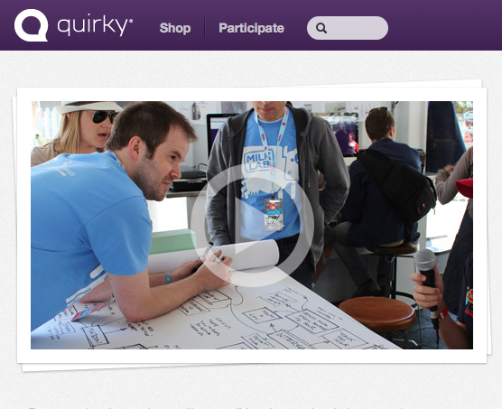
The real thing?

Slide 24

quirky.com – product development

Slide 25
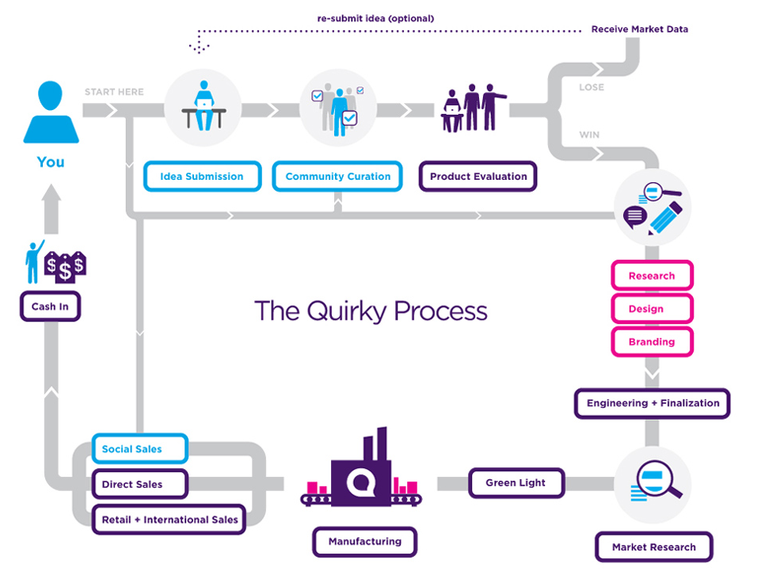
a socially developed product?

Slide 26
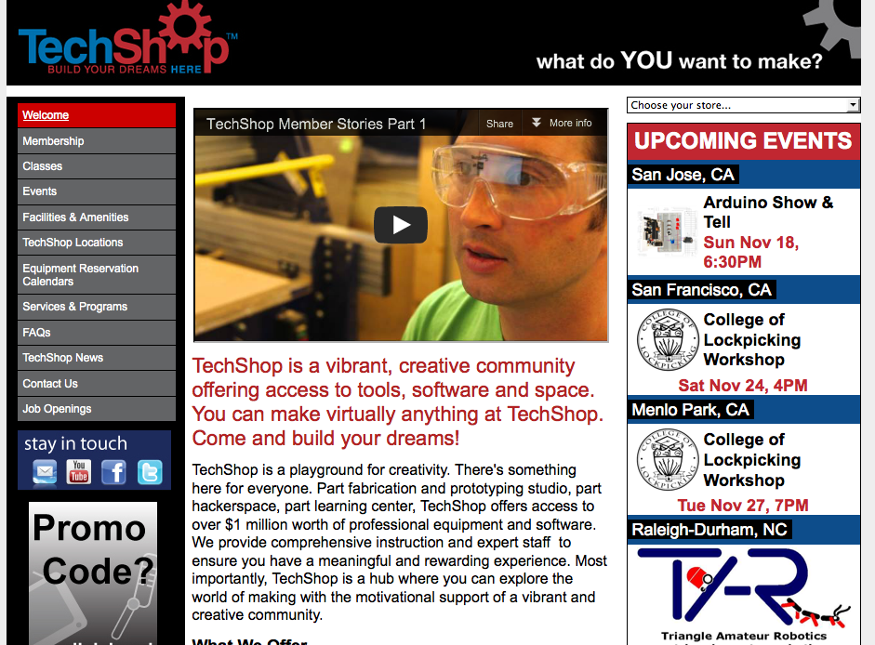
make it at Techshop?

Slide 27
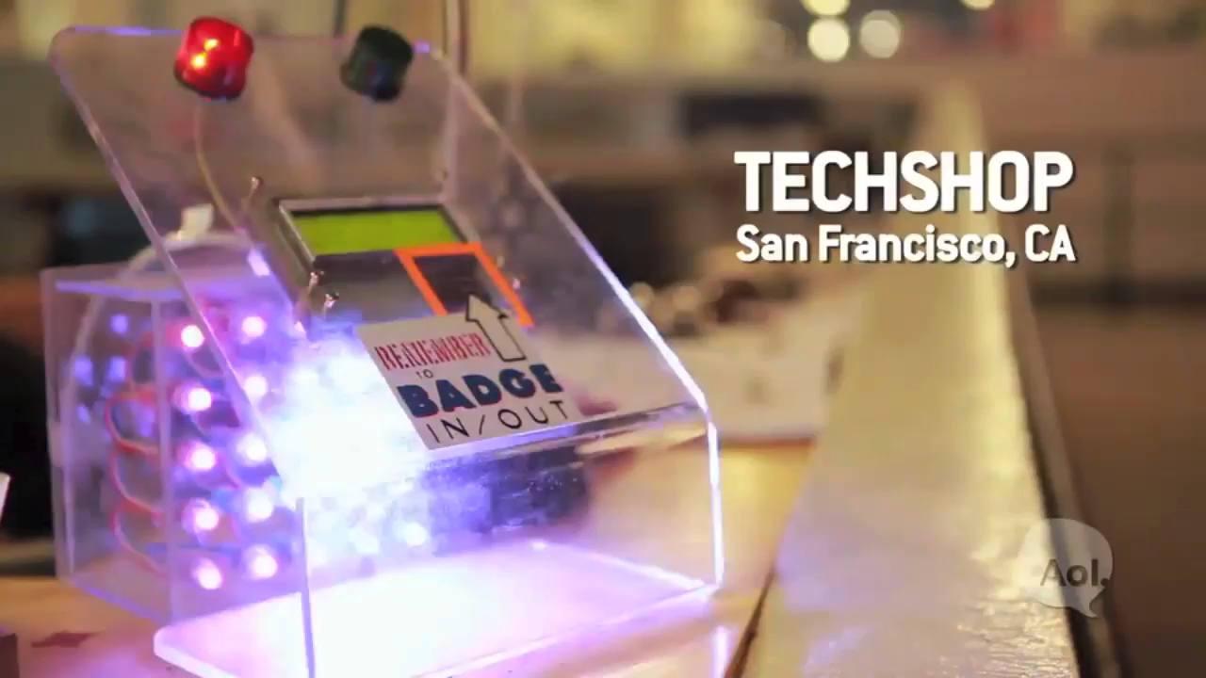

Slide 28
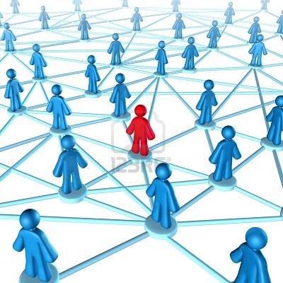
the network wins
Notes:
the question is not HOW the network wins but WHY the network wins.

