Slide 1
Smart Asset Management für Kunden in der Prozessindustrie
München, 22. November 2012

Slide 2
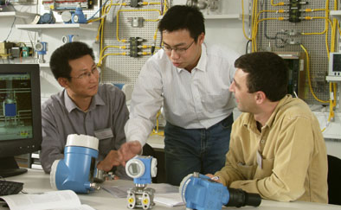
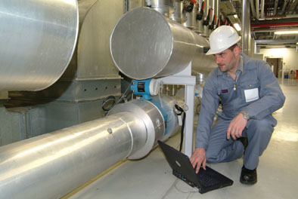
Endress+Hauser at a Glance
Process measurement instrumentation for production and logistics in the process industries
Consultancy and service in 97 countries
One of the largest privately owned companies in the automation industry
Headquarter in Reinach (Switzerland)
CEO: Klaus Endress
Key figures 2011
Net sales 1,5 bn Euro
Employees > 9400

Slide 3
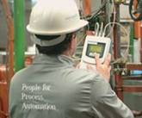
Endress+Hauser at a Glance
Pharmaceutical
Environment
Food and Beverage
Chemical
Pulp and Paper
Energy
Oil and Gas
Primaries
Renewable Fuels
Instruments
Services
Solutions

Slide 4
From Product Vendor to Solution Provider
Challenges as Product Vendor
Product commoditization
IP and parts piracy threat
Opportunity as Solution Provider
Innovative solution offering
Increase customer loyalty
Value Added Services
Extension of the Value Chain
Services
Customer
Asset Lifecycle Mgmt
devices
3rd party devices
Services and Information
to Differentiate

Slide 5
The challenge of our customers
Plant optimization
Process performance
plant availability
Target availability/efficiency
Unexpected failures
Short start-up time
High availability and process performance
Engineering
Procurement
Installation
Commissioning
MRO: Maintenance, Repair, Operation

Slide 6
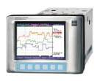
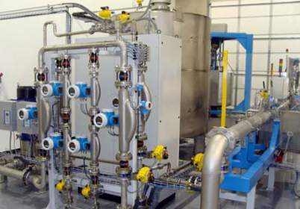
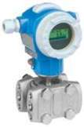
Plant Asset Management is important for our customers
Instruments and their signals to the control system are critical for process plant operation

Slide 7
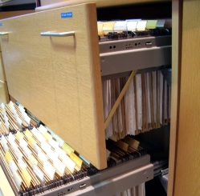
Reality Check
Is your information up to date and can you easily find it?
User manuals
Technical information
Safety statements
Product Status
Supplier specific events
Calibration data
Certificates
…
Software versions
Spare part information
Drawings
…
Master Data Management is a #1 topic in EAM

Slide 8
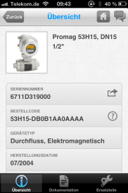
Alignment of ONLINE and ONSITE Services
Enabling Technology
Cloud
Mobile
Online Services
On Site Services
Commissioning
Repair
Calibration
Site Audit
Regular Maintenance
Engineering
Procurement
Installation
Commissioning
Operations

Slide 9
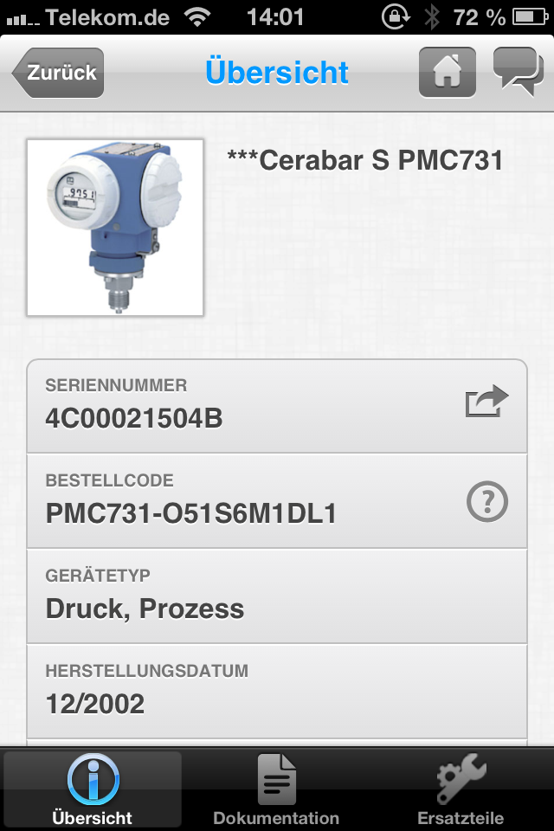
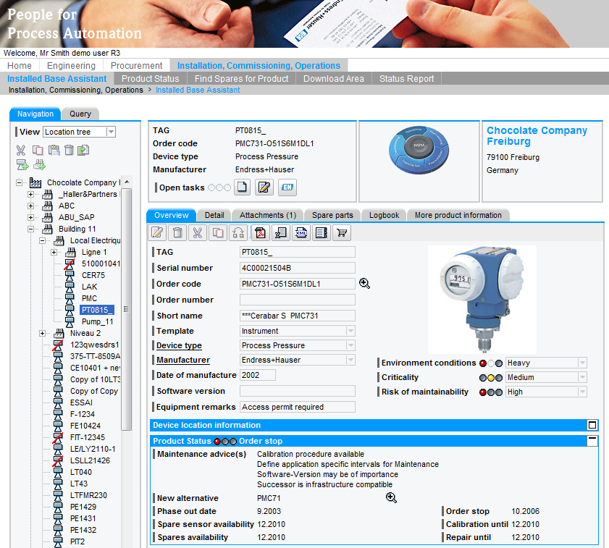

Slide 10
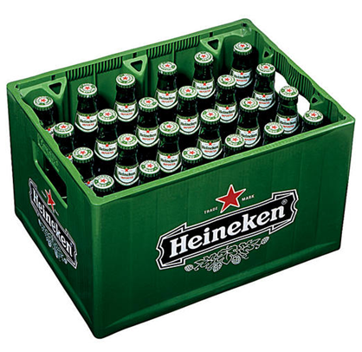
Closing the Gap
Production Plant
Application landscape
BPI
Service offer
Business processes
Tooling offer
Device business

Slide 11
BPI: We believe in „built-in” standards
Customer
BPI
Business
Process Integration
Business collaboration processes
Business process implementation
?
Built-in integration
standards
Endress+Hauser
Device supplier
Solution provider
Service provider
SAP, IBM Maximo, Intergraph, EPLAN... (major IT solution provider)

Slide 12
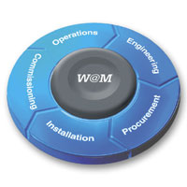
Klaus Endress. CEO Endress+Hauser Group
“I expect that every device we manufacture at Endress+Hauser is automatically available with all relevant life cycle information in the SAP systems of our customers. Appropriate information at the needed time is of unimaginable value because this improves the efficiency and therefore the result of the entire company."”
Endress+Hauser offers to its customers with their Asset Management Portal secure access to life cycle information of more than 17 million measuring devices.

Slide 13
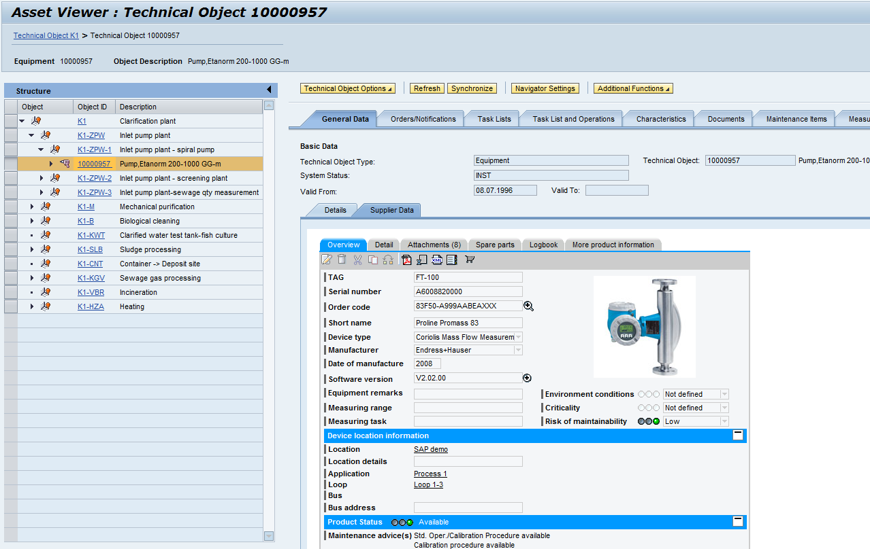
Supplier device information linked into SAP EAM
Available in ERP 6.0/EHP5
Co-Innovation project Endress+Hauser & SAP AG

Slide 14
The Future of Asset Information Management ….
…is based on integrated Processes across companies
Co-Innovation

Slide 15
Summary
Plant Availability and Process performance are key challenges in the process industries
Endress+Hauser offers ONSITE and ONLINE Added Value Services → Information as Differentiator!
Efficiency gain through Integrated Processes across company boundaries (BPI)
Co-Innovation

Slide 16
Any questions?

