Slide 1
Unternehmensübergreifende Integration für Kollaboratives Asset Management oder: Geschichten über Geschirrspüler und Füllstandsmesser
Dr. Jochen Rode, Head of Program Digital Manufacturing, SAP Research, SAP AG

Slide 2
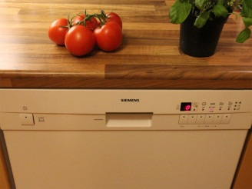
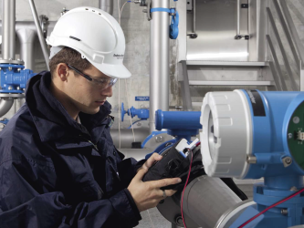
Agenda
SAP and SAP Research
Jochen’s Dishwasher
Endress+Hauser’s Radar Level Meter
Image courtesy of Endress+Hauser.

Slide 3
SAP Vision: Help the World Run Better and Improve People's Lives.
190,000+ customers
60,000+ SAP employees worldwide
1,200+ service partners worldwide
120 countries
40+ years of business process experience
24 industries

Slide 4
SAP Mission: Help Every Customer Become a Best-Run Business.
Innovation and Development
Sales
Ecosystem, Service & Support
Applications
Industry & LOB Solutions
Analytics
Regions
Mobile
Ecosystem
Channels
Database
Cloud
Customer
Powered by SAP HANA
Leverage the true power of SAP: transform key technologies into solutions for industries and lines of business

Slide 5
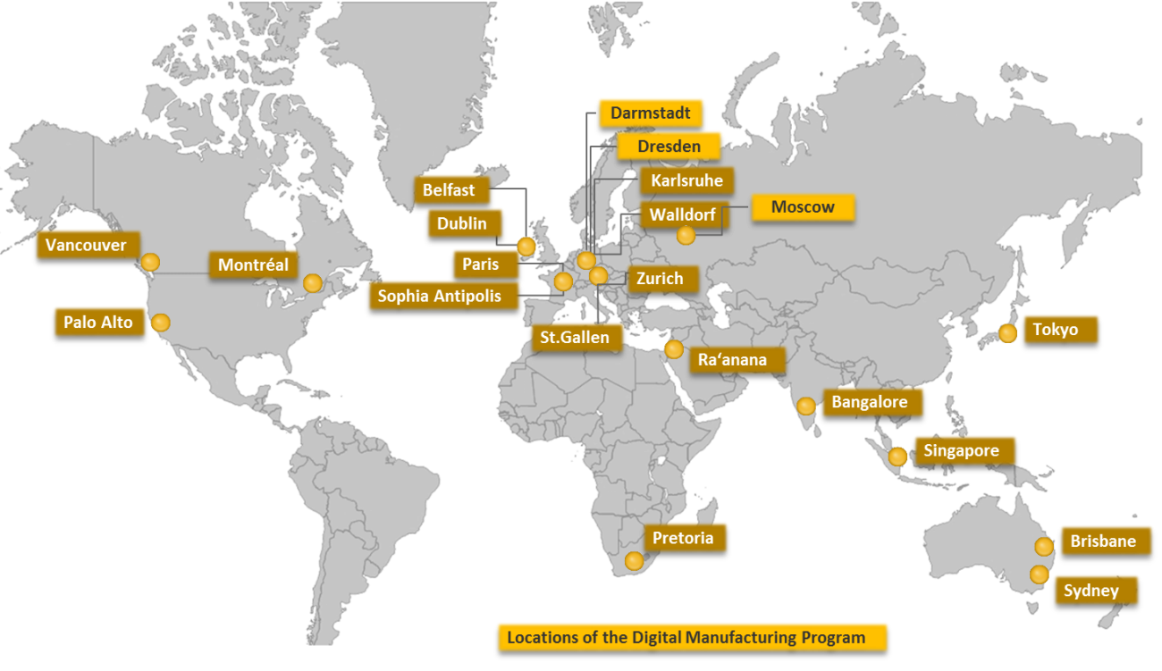
SAP Research A Global Team
The global technology research and innovation unit within SAP.
21 research locations worldwide with 700 employees.
11 programs in Applied Research, Advanced Development & Global Business Incubator.
A network of more than 800 partners from industry and academia

Slide 6
Jochen’s Dishwasher A True Story
Three months ago a strange noise appeared.
Three weeks ago my dishwasher stopped working.
My wife was in despair. I had a new job – dish washing.

Slide 7
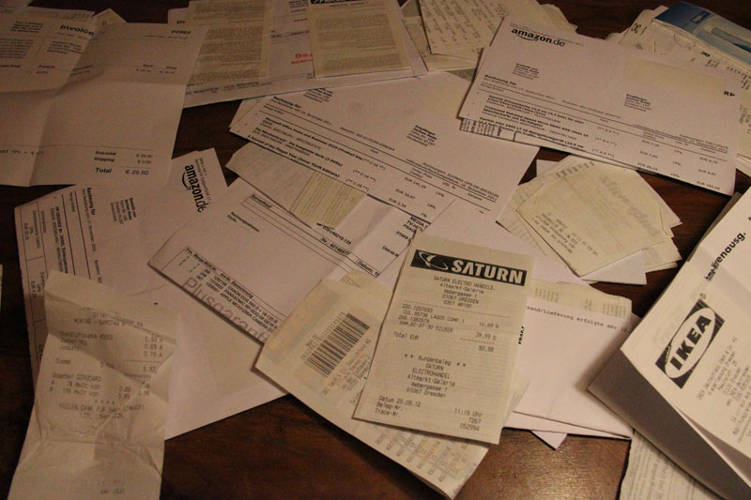
Jochen’s Dishwasher A True Story
Do I still have warranty? If so, where?
I spent 30min+ searching for the receipt.

Slide 8
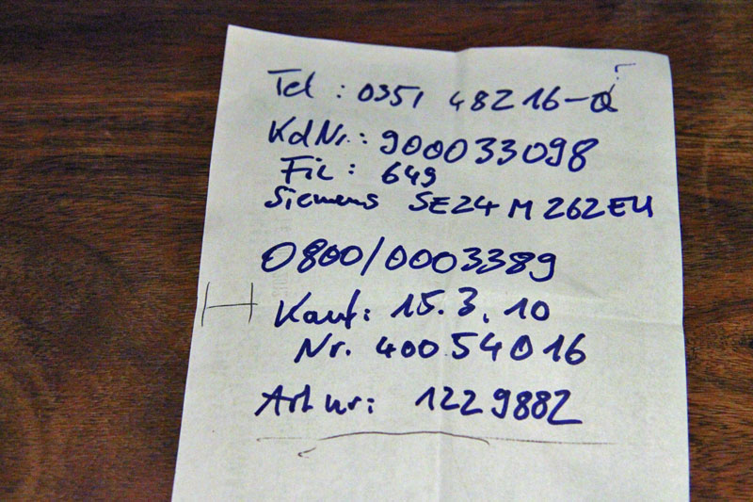
Jochen’s Dishwasher A True Story
Where is the support phone number?
„Hello! The warranty contract number please!“ Is it …? No! Is it…? No! 10min+

Slide 9
Jochen’s Dishwasher A True Story
The culprit: 1cm piece of a porcelain cup handle. Stuck in the pump.
I could have fixed it myself, given the right information.

Slide 10
Jochen’s Dishwasher A True Story
But I didn‘t because I hadn‘t the right information.
I called a service. Technician fixed it in <1min. 100 EUR.

Slide 11
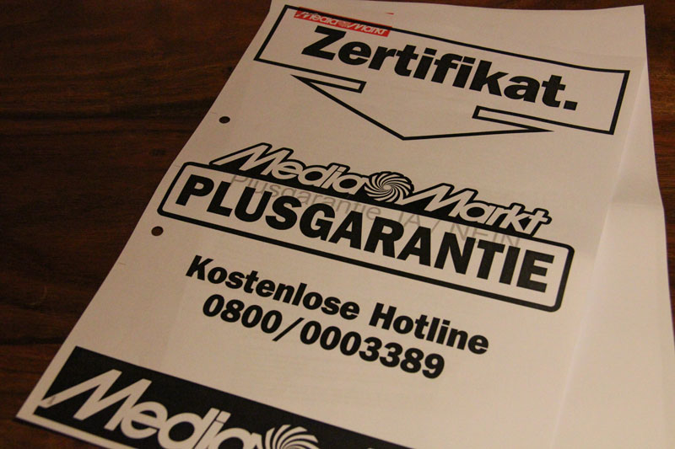
Jochen’s Dishwasher A True Story
But I didn‘t pay the 100 EUR. Mediamarkt / Siemens did.
Spot the business case! ☺

Slide 12
Jochen’s Dishwasher A True Story
How to save these 100 EUR for Mediamarkt / Siemens?

Slide 13
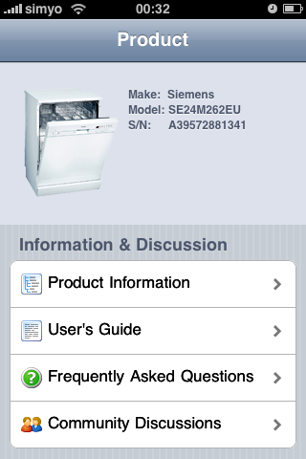
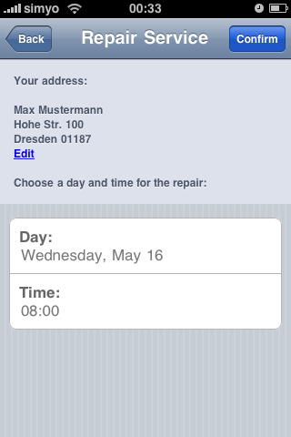
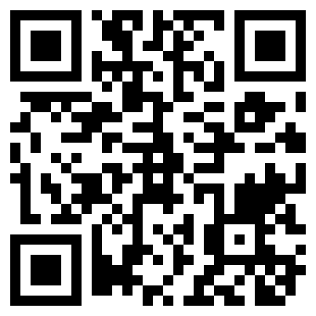
Jochen’s Dishwasher How things should be.
1. Scan a QRCode (or NFC tag) to identify make, model, and serial number.
2. A mobile app offers a list of information and services for the dishwasher.
3. The app guides to the solution: Help yourself (save money) or use service ($$$).

Slide 14
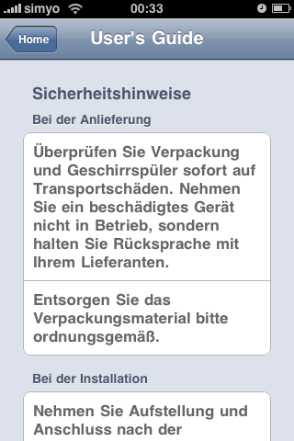
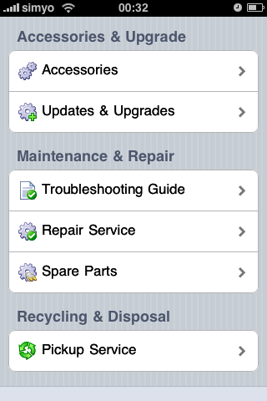
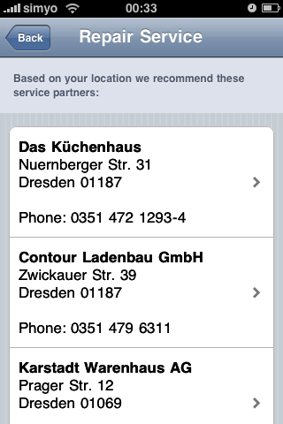
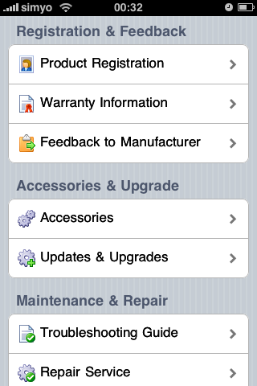
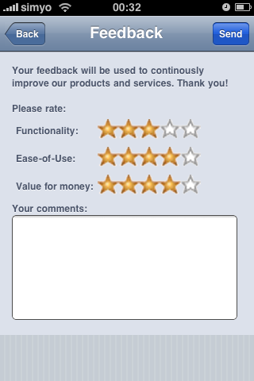
Jochen’s Dishwasher How things should be.
Easily offer value-added services, from user‘s guide to feedback to manufacturer.

Slide 15
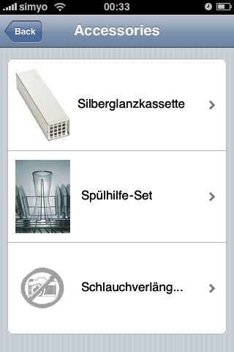
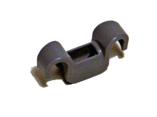
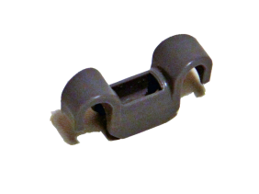
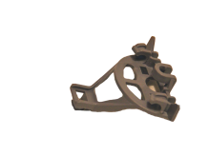
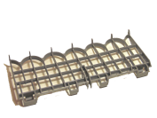
Jochen’s Dishwasher How things should be.
Or how about 3D printing a spare part on demand?
Lager für Unterkorb…
428344 Lager für Unterkorbbefestigung
In 7+ years?!
Seitenlager für Unterk…
5.95 EUR
Tassen-Etagere…
0.10 EUR

Slide 16
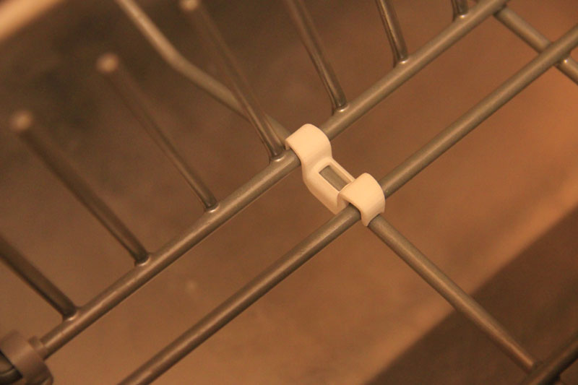
Jochen’s Dishwasher How things should be.
This also is an information management problem.
How does the CAD drawing get from the OEM to the 3D printer – securely?

Slide 17
Jochen’s Dishwasher How things should be.
„We need to talk!“ Enterprises must collaborate, exchange information.
Consumer, OEM, supplier, support, repair shop, insurance company...
Consumer
…
OEM
Repair Shop
Component Supplier
Support

Slide 18
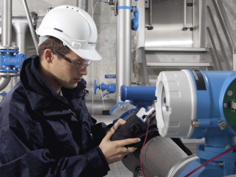
Industrial Asset Information Management What’s the problem?
Find the differences to Jochen‘s dishwasher!
Not many.
The problem?
Organizational boundaries!
Owner/ Operator
System Integrator
OEM
Maintenance
Component Supplier
Support
Image courtesy of Endress+Hauser.

Slide 19
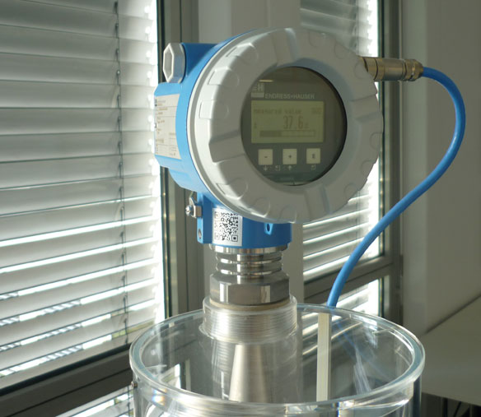
Industrial Asset Information Management An Example
Let‘s assume we are responsible for maintenance in a large chemical factory.
…and have a problem with a radar level meter.*
*which won‘t happen with a device of Endress+Hauser. ☺

Slide 20
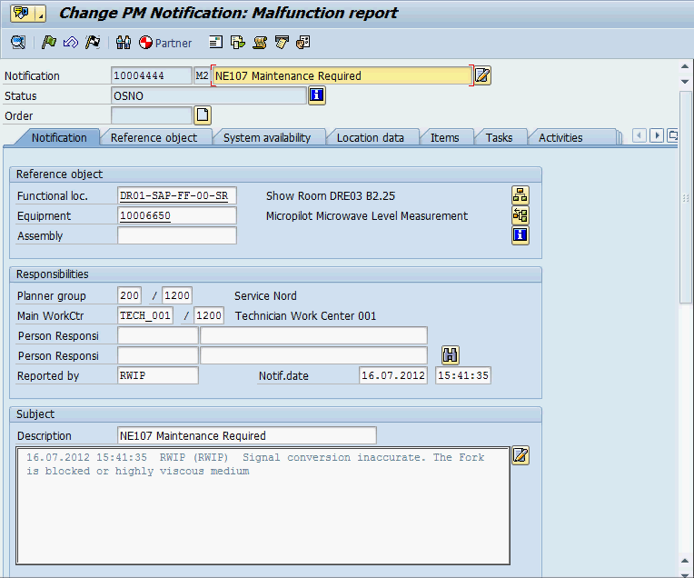
Industrial Asset Information Management An Example
To solve the problem we need:
…info from the ERP system about the asset and its maintenance history.

Slide 21
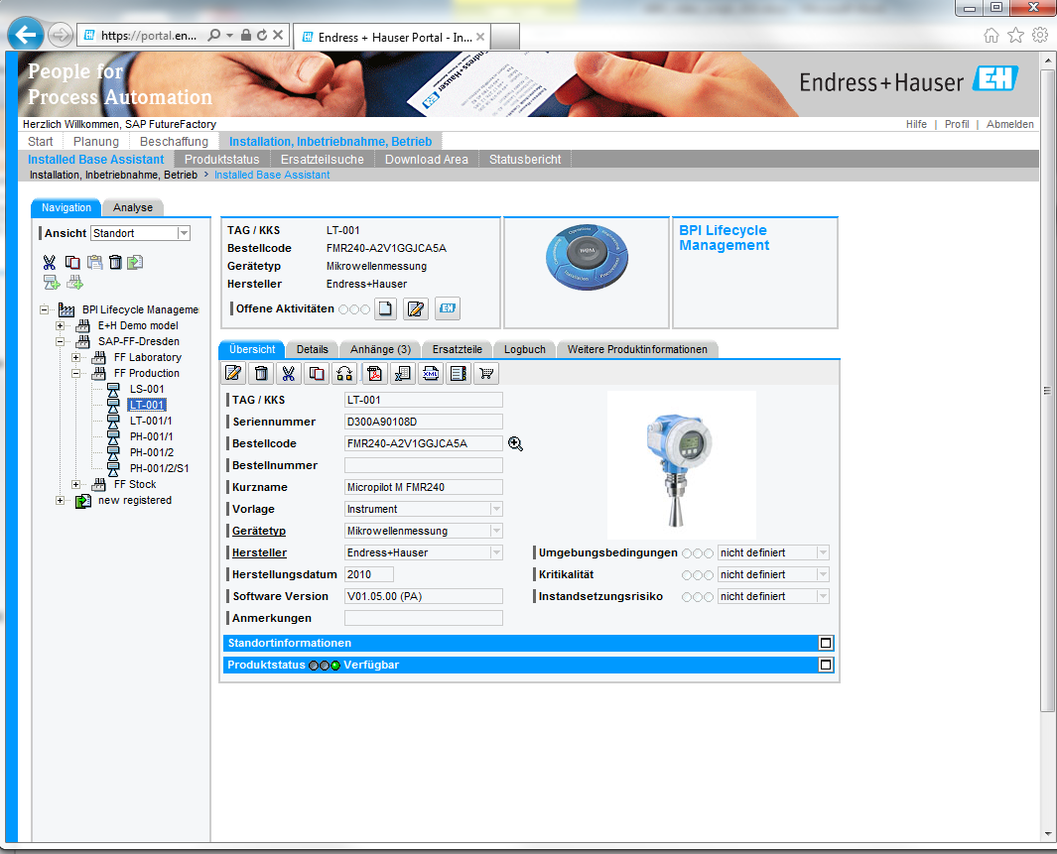
Industrial Asset Information Management An Example
…info from the asset supplier like repair manuals and software updates.
Screenshot courtesy of Endress+Hauser.

Slide 22
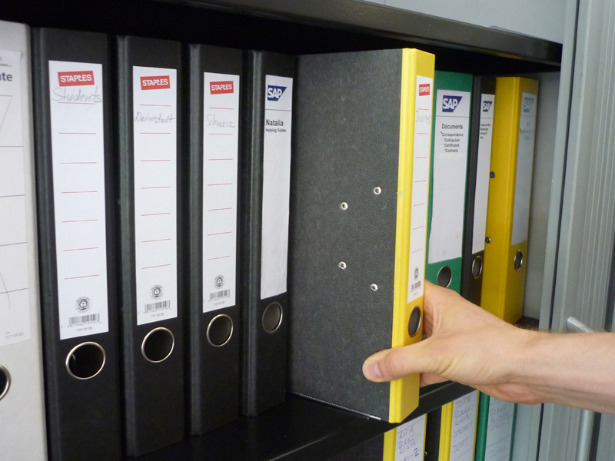
Industrial Asset Information Management An Example
Often we do paper work.
Or manually search several IT systems.

Slide 23
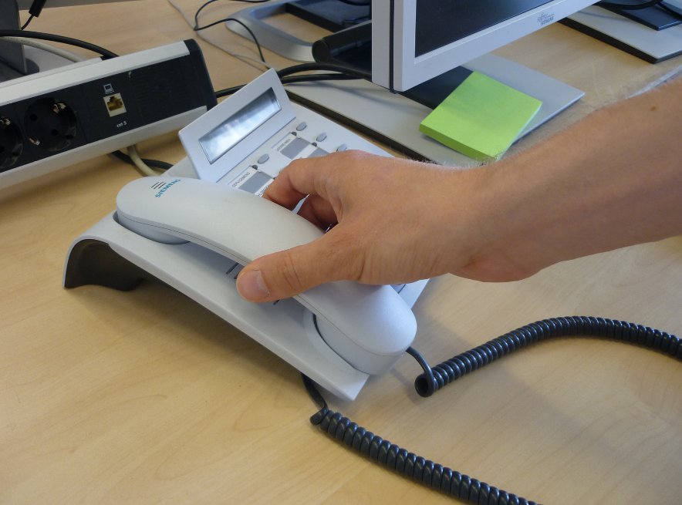
Industrial Asset Information Management An Example
Or we spend our morning on the phone with the asset supplier.

Slide 24
Industrial Asset Information Management The Vision
Picture this AIM ☺: Transparent and secure access to asset information from various data sources distributed across different organizations.
Image courtesy of Endress+Hauser.

Slide 25
Industrial Asset Information Management The Future
The smart asset will directly send a malfunction notification to your ERP system.
Or tell itself when a part has been exchanged.

Slide 26
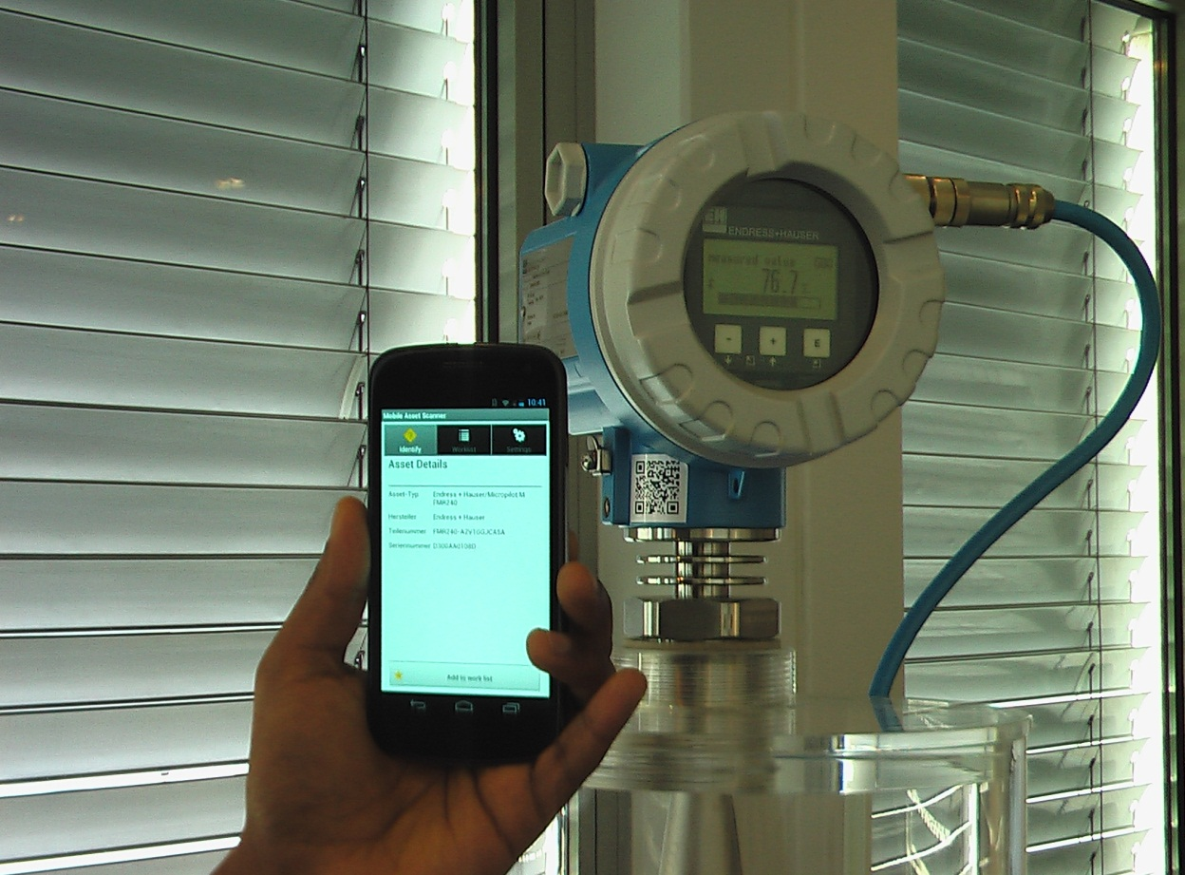
Industrial Asset Information Management The Future
Do you want to get all info on your smart phone? Just scan the asset!
(Remember Jochen‘s dishwasher? ☺)

Slide 27
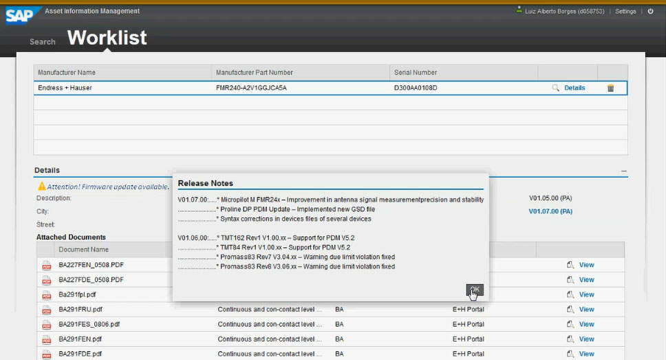
Industrial Asset Information Management The Future
You will see all asset-related information regardless of their source!

Slide 28
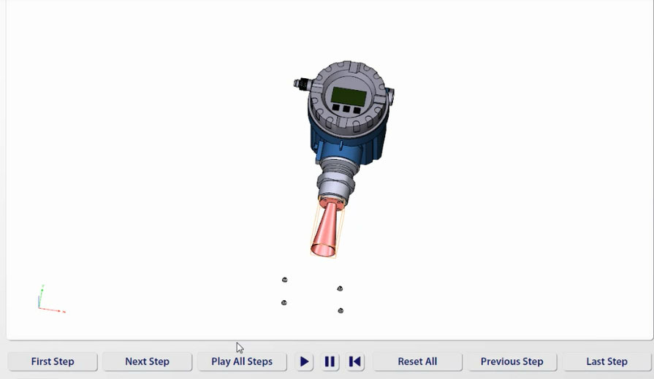
Industrial Asset Information Management The Future
Boring?
How about an animated repair instruction in a 3D PDF file?
3D model courtesy of Endress+Hauser. Visual work instructions powered by SAP Visual Enterprise.

Slide 29
Industrial Asset Information Management Why?
Less time for information search means more time for problem solving.
Less time for fixing means less downtime and more time for production.
Less effort for data management means lower costs.

Slide 30
Industrial Asset Information Management How does this work?
All data stays where it is. With its owner! No copy&paste, no redudancies.
A cloud-based platform maintains links pointing to the original data sources.
This central „white-label“ platform carries the logo of the OEM.
…
Owner/ Operator
Maintenance
Asset Information Management operated by [OEM], powered by SAP
…
OEM
Component Supplier
Support
System Integrator
Owner/ Operator
Maintenance

Slide 31
Industrial Asset Information Management Don’t fire your support staff!
Not everything can or should be automated.
Leave the complex problems to humans and the tedious work to AIM!

Slide 32
Thank You!
PS: We‘re looking for pilot customers. Apply now for your pilot license!
Dr. Jochen Rode Head of Digital Manufacturing SAP Research SAP AG Chemnitzer Str. 48 01187 Dresden, Germany
T +49 351 4811-6110 jochen.rode@sap.com

