Slide 1
Sicherheit in Telekommunikationsnetzen - neueste Entwicklungen
Thorsten Schneider
Head of Security Business at Nokia Siemens Networks

Slide 2
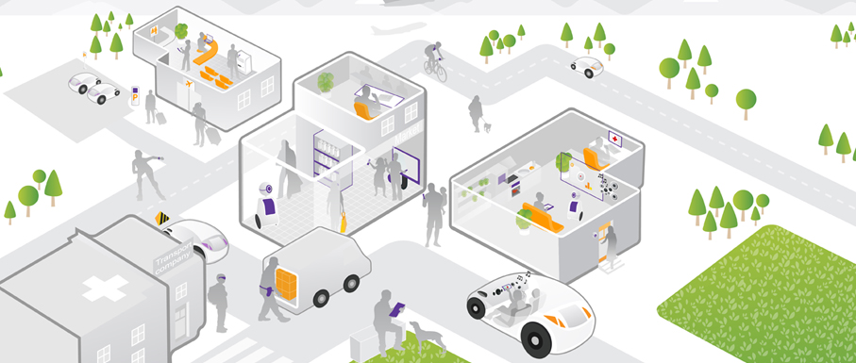
Communication is vital for our society and economy
– security is mandatory and even more critical in the future
“Always connected”, social networks, e-life
Consumers
Cyber war and
cyber terrorism
Energy providers use communication networks for control
Real-time communication & control, all connected
Smartphones become the main interface to the internet
Critical Infrastructure
Cyber crime
and fraud
500 Mio users share personal data on Facebook
Huge diversity of apps cover all aspects of life
Communication is recognized as critical infrastructure
Transportation flows are optimized through communication
Spying and
business attacks
Privacy violations
and financial attacks
Virtual collaboration & business
Corporate services (like IT) move into the cloud
Public safety uses off- the-shelf broadband communication
Regulation has to balance needs and affordability
Work from everywhere,
cloud services, smartphones
State departments rely on real-time collaboration
Enterprises
Broadband penetration & connected world, e-services
Smartphones are used for data access and communication
Governments

Slide 3
Mobile Broadband & Smart Phone usage is growing fast
– malware and attacks are growing even faster
Mobile & Mobile Broadband subscribers
and Smartphone users
155%
growth of mobile malware
across all platforms in 2011*
>3000%
explosion in malware
targeting Android in 2H2011*
1Million
security events per day in
large networks
40.000
mobile devices active
under botnet control in
first half 2011 **
Mobile subs
MBB subs
Smartphone users
Sources:*Juniper 2011 Mobile Threats report; ’’* Damballa Threat report first half 2011

Slide 4



Operators’ main tasks to protect the mobile infrastructure and the customers in an all IP environment
OSS/ BSS / IMS / VAS domain
Customers
Radio
Transport
Core
Internet
GSM/3G/LTE
Non-3GPP IP access
GRX/IPX network
Untrusted
Trusted
Unified end-to-end security

Slide 5

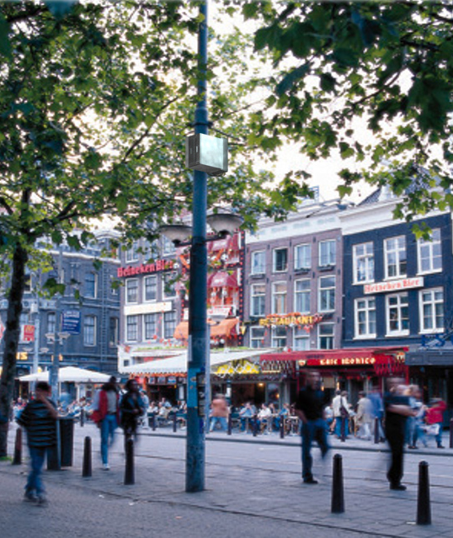
The flat all-IP architecture requires enhanced attention to security
IP based transport outside
CSP buildings
Ensure
security
Eavesdropping
voice and data
Denial of
service
Exposure to
unauthorized
access
3G
Encrypted traffic

Slide 6


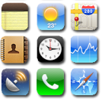


Attacks on Smartphones cause damage to operators and customers
Network Availability
Reputation
Business
Open App Store model provides a route to ‘inject’ malware into cloned legitimate apps
Malware
Exploits iOS vulnerabilities and phone control via Internet based drive-by attacks
Operator
Sending Premium-SMSs without owners knowledge resulting in monetary loss
Trojans
Infecting and
polluting
the Network
Devices attacked to join botnets through ‘ZEUS’ a ‘development’ tool sold by cybercriminals
100,000 devices impacted by sending messages with links to malicious sites to all the contacts in the address book
Botnet
Source: IDC Feb 2012

Slide 7
The huge gap between users’ perception and how they act
When asked: concerned
In real life: careless
62%
download applications without checking it is from a trusted source*
> 50%
89%
“Concerned about security”
do not use a password or PIN
to lock their smartphone.**
66%
leaves mobile applications accounts continuously logged-in, if they can.**
41%
“Afraid of personal data being sold to 3rd parties”
rarely or never change their security settings on their smartphone ***
80%
60%
wish there was an easier form of authentication for mobile application **
Opportunity in delivering convenience
Sources:*Ponemon Institute March －2011; ** such as email, shopping apps and social networking , Confident Technologies, 2011 ‘’’* Source: confident technologies

Slide 8










Security protection needs to go across all layers
Customer
layer
At the office
Customer visit
On the road
At home
    Unique
    holistic
    protection
    across all
    layers
Device
layer
Smart Phone Security
Services
layer
Security as a Service (web, message, access)
Web & Message Security
Network
layer
Mobile Broadband Security
Unified end-to-end security

Slide 9
Summary
Strong growth in Smart Phone and Mobile Broadband usage
Telco network is a critical infrastructure for many industries
Security measures now need to protect all layers - from device to network

