Slide 1
Bedrohungen heute – Herausforderungen von morgen
Marco Preuß Head of Global Research and Analysis Team, Germany
Kaspersky Labs GmbH

Slide 3
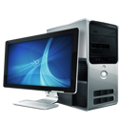
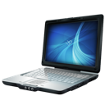
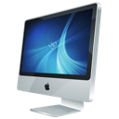
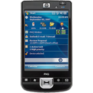

Slide 4
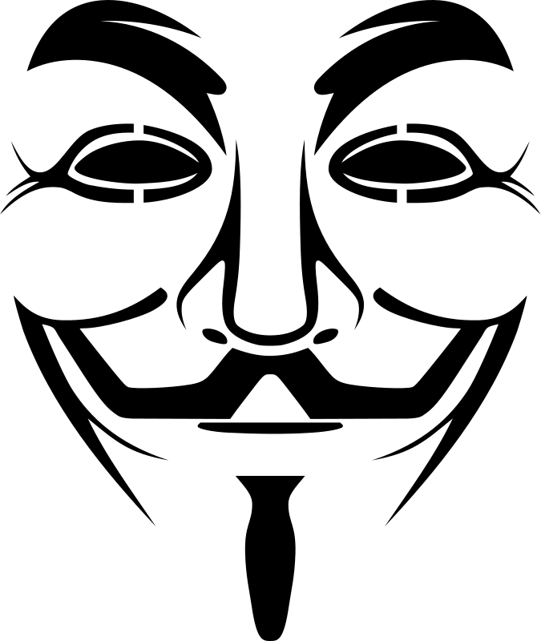

Slide 5
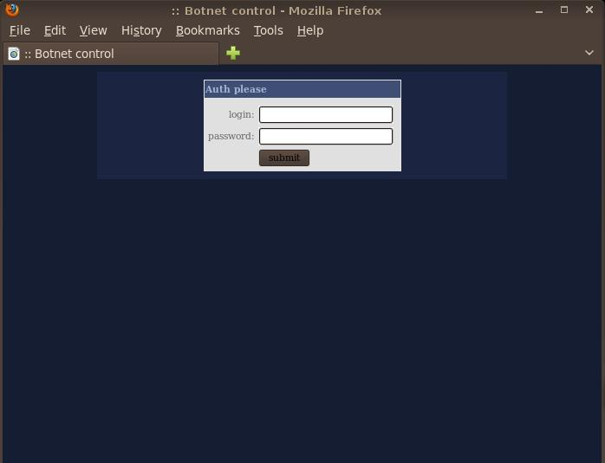
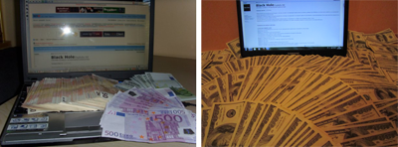
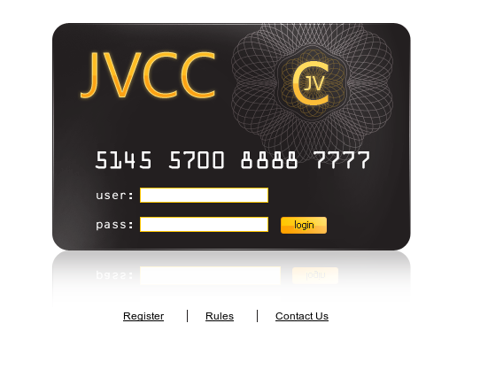
Cybercrime & Underground

Slide 6
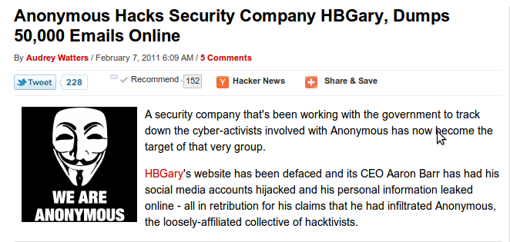
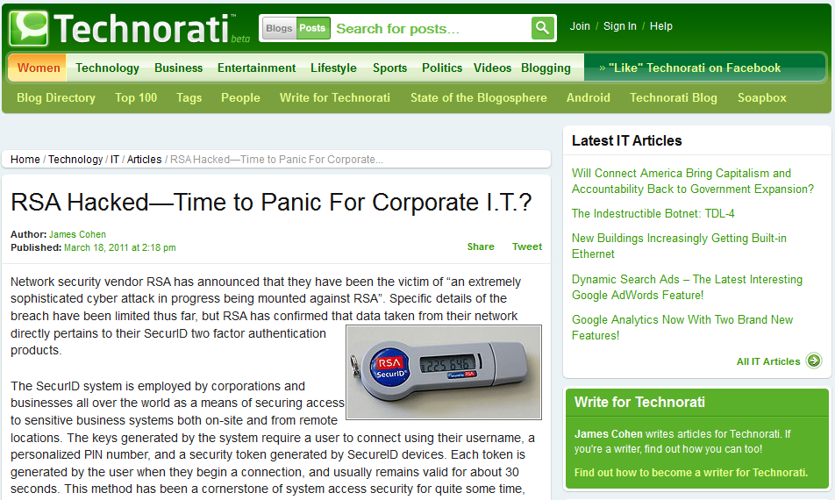
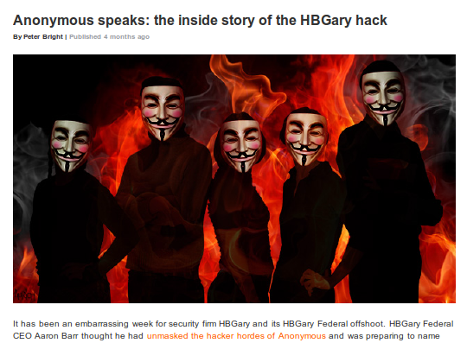
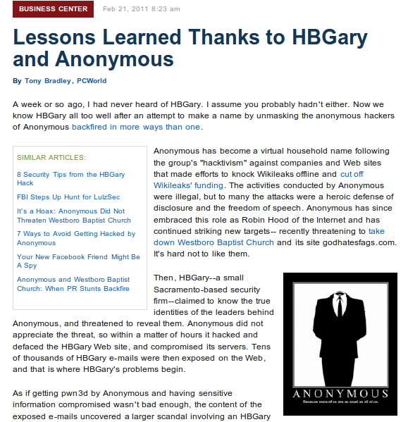
Targeted Attacks
HBGary Federal
> 50.000 confidential e-mails leaked
PR Schaden
CEO zurückgetreten

Slide 7
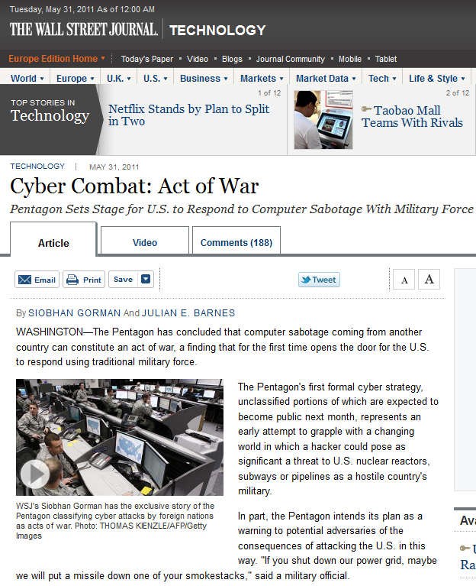
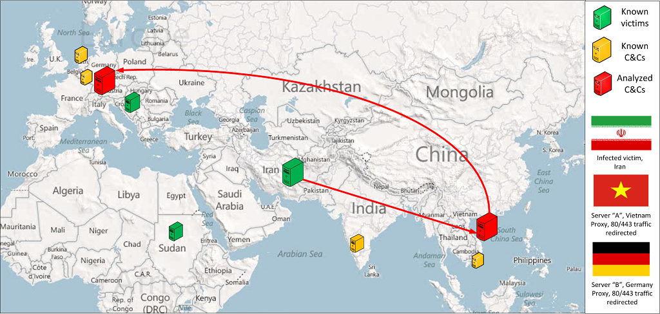
Cyber…what? Sabotage or war?
Quote: "‘If you shut down our power grid, maybe we will put a missile down one of your smokestacks‘ said a military official“
Duqu was designed to spy on Iran’s nuclear program.
It was active since 2008, preceding Stuxnet.

Slide 9
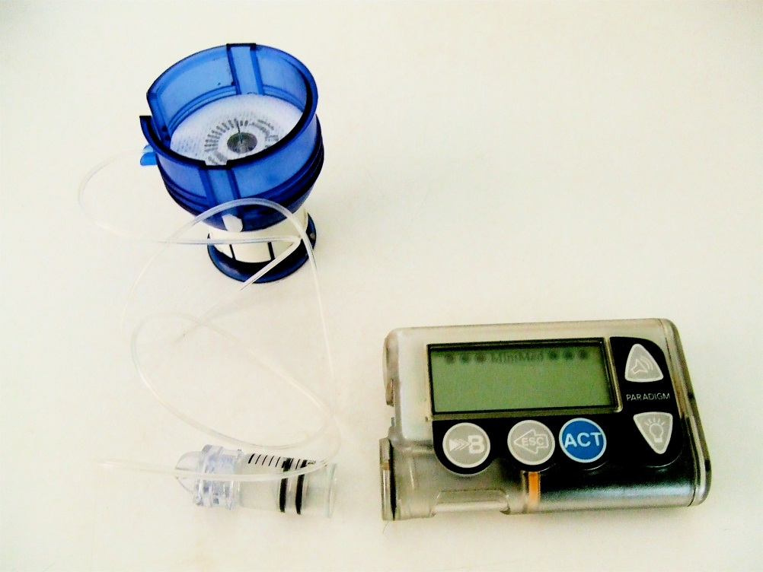
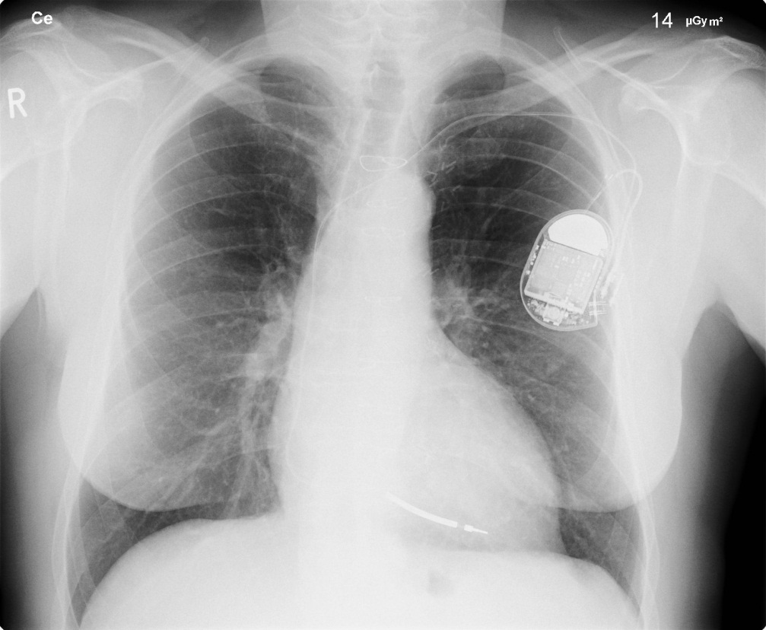
Health Care
Insulinpumpe mit Wireless-Remote-Control
Hack: 2011 by Jerome Radcliffe
Herzschrittmacher mit unverschlüsselter Wireless-Remote-Control
Hack: 2008 by Kevin Fu

Slide 10
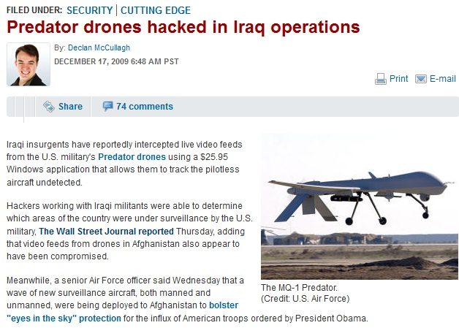
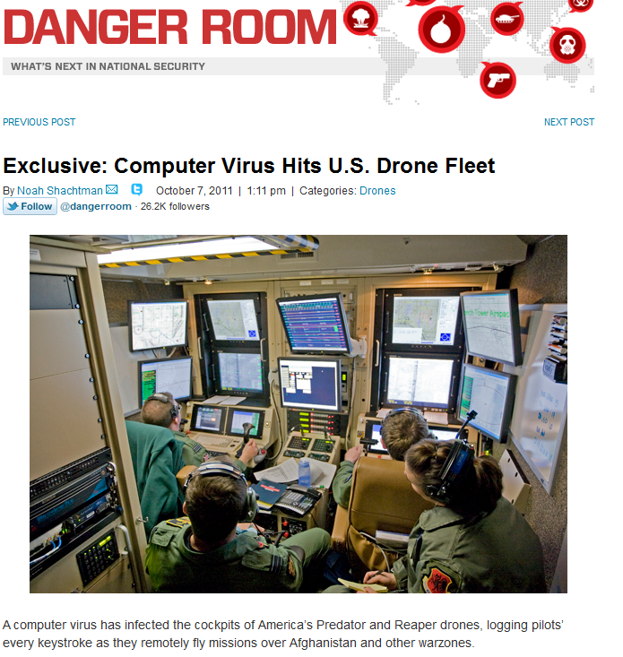
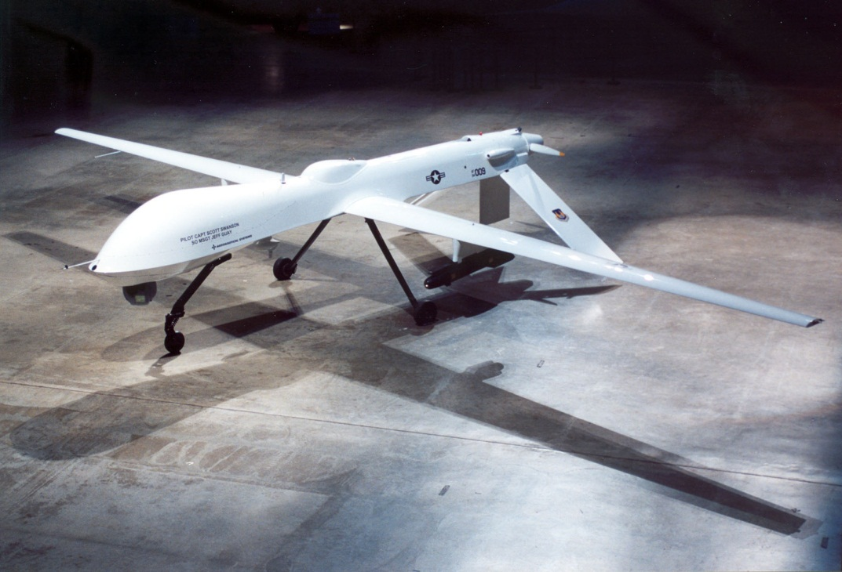
General Atomics MQ-1 Predator
Unmanned aerial vehicle (UAV)
Fully remote controlled
Armed version in use since 2001
Can be equipped with Hellfire missiles

Slide 11
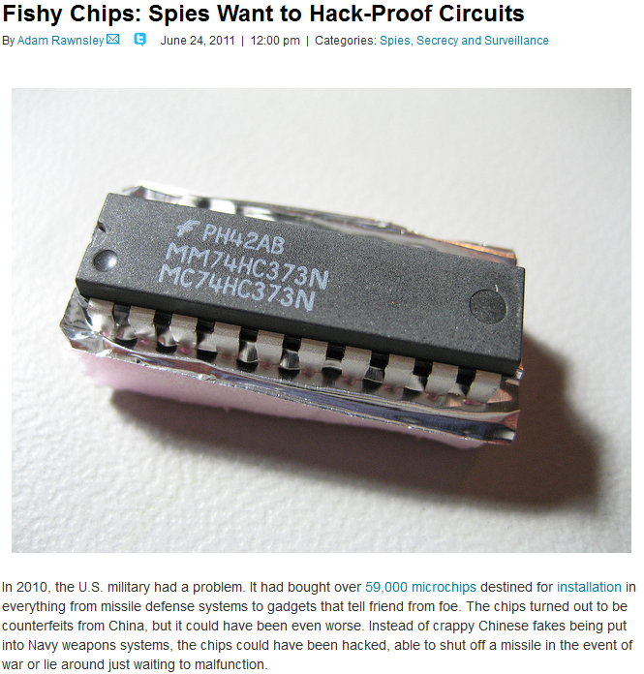
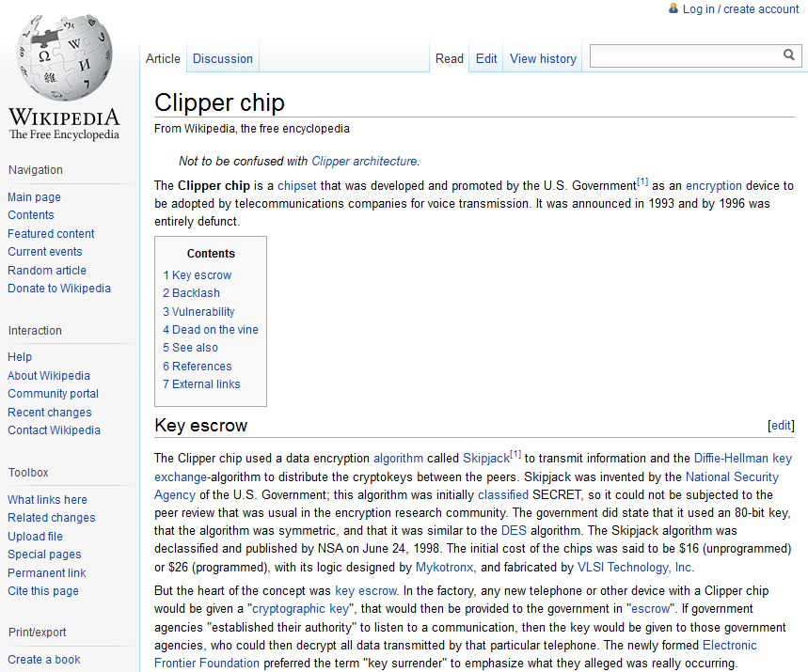
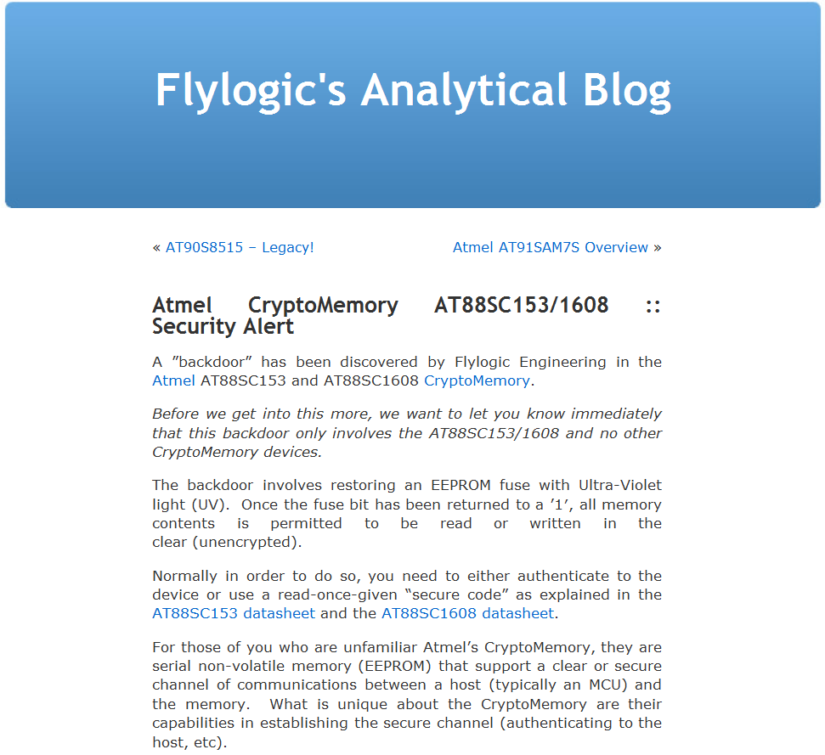
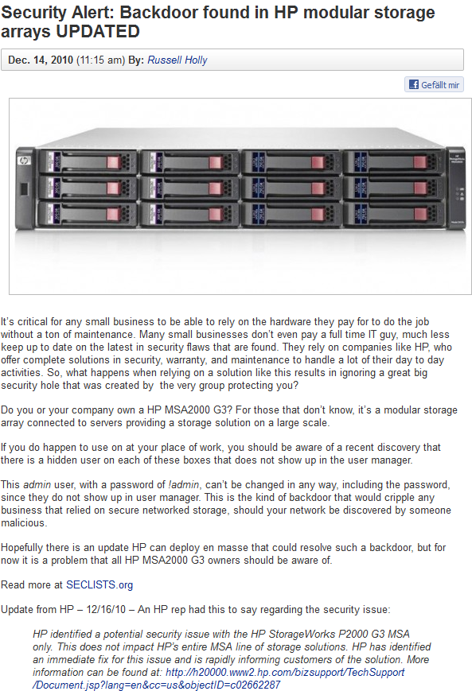
Hardware backdoors and "backdoors"
Source: http://www.wired.com
PAGE 11
| ISSE 2011 Prague | 23rd of November 2011
Source: http://www.flylogic.net

Slide 12
Vielen Dank!

