Slide 1


Impact of Enterprise Social Networking on Business Success
Georg Ell
General Manager, Yammer EMEA
@yammerguy, gell@yammer-inc.com, +44 (0)7792 213 204

Slide 2
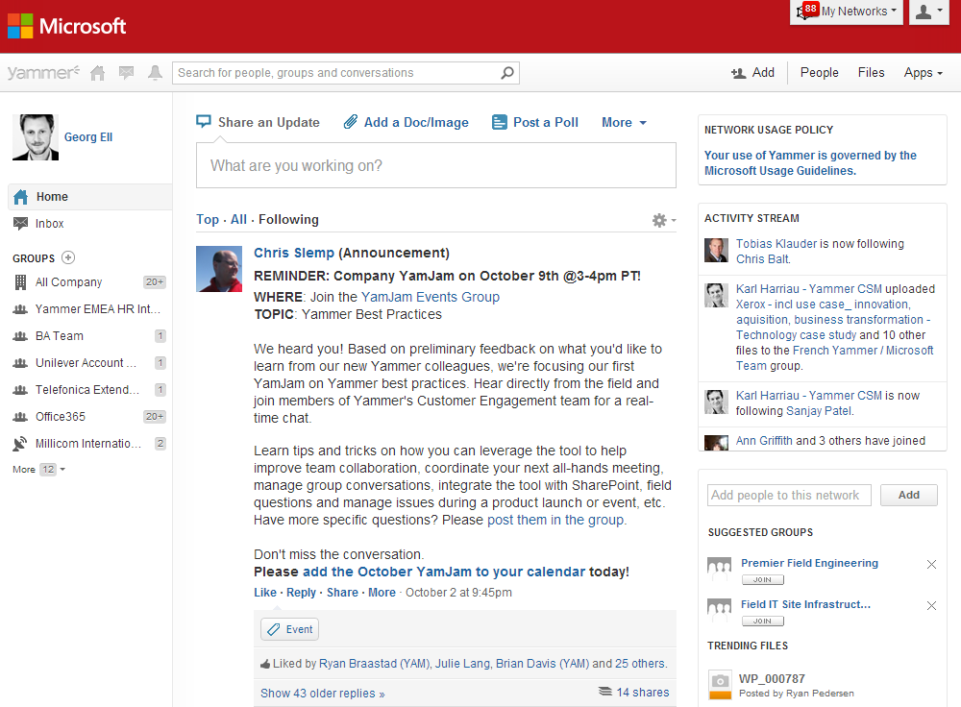






Yammer Introduction
First mover and leader in ESN with 5+ million registered users
Used by over 85% of the Fortune 500 companies
Around 400 employees, with offices in US, UK, and Australia
In 150+ countries and 23 languages
Enterprise software built for and loved by users
Acquired by Microsoft for $1.2bn and now part of the Office Division
Leader
Magic Quadrant for Social Software in the Workplace
Leader
Cloud Collaboration
The Forrester Mobile Wave
The Forrester Activities Streams
Winner
The Forrester Groundswell Award
Top 50
Venture Backed Companies
Game-Changer:
Innovation
Innovation Application
Software Company to Watch

Slide 3





















Global leading enterprises choose Yammer – EMEA.

Slide 4
transform
the way we work together

Slide 5

Our Vision for Social
Business
Transformation
Unified
Platform

Slide 6
Drive key business initiatives across your organization.
Team Collaboration
Employee Engagement
Business Agility
Social Intranet

Slide 7
Top initiatives across our 200k+ networks.
Team Collaboration
Employee Engagement
Collaborate with teams across geos and functions
Manage projects
Drive competitive intelligence
Manage events
Launch marketing campaigns
Identify expertise
Accelerate learning, development & onboarding
Share best practices
Drive corporate communications
Retain employees
Business Agility
Social Intranet
Company re-org and re-alignment
Launch new products
Enter new markets
Mergers & acquisitions
CEO change
Transform relationships with customers, partners, suppliers
Replace outdated intranets/portals
Integrate directly with SharePoint
Connect with customers, partners, suppliers
Become a Social Layer across existing business apps
Collaborate on one platform

Slide 8
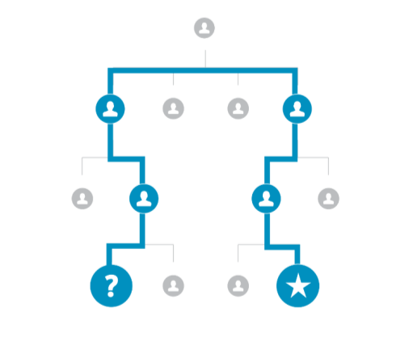
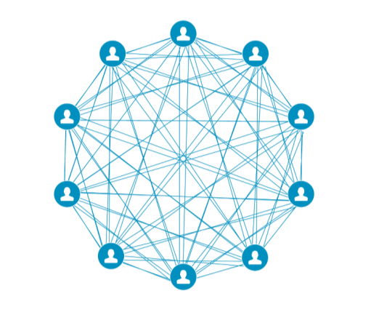
Employee Engagement
Remove communication barriers and give employees a voice, information,
and the tools they need to take your business to the next level.
Companies with
engaged employees see
18%
higher productivity
&
51%
lower turnover
“Social networking improves how employees connect with the work
they are doing and how incredibly impactful that work can be.”
– CIO of a major international food services company
Source: Gallup Consulting, Employee Engagement, What's your Engagement Ratio?

Slide 9
Team Collaboration
Teams need to connect, learn from each other, and thrive in a world of rapid change.
Organizations see a
20% - 25%
boost in productivity with social
Sales
Marketing
Finance
“Yammer helps us harness the wisdom of our people across multiple teams, geographies and brands to achieve our purpose of delivering business solutions for competitive advantage.”
– CIO of a global financial services organization
Source: McKinsey, The Social Economy

Slide 10
Business Agility
People, culture and communication are the key success drivers for agile business’.
64%
of successful
transformations
engage & energize
the organization through ongoing communication
& involvement
CUSTOMERS
COMPANIES
Employees
PARTNERS
"Yammer glued people together and showed underperforming
markets. We noticed the most active groups on Yammer were
also the most profitable in our organization."
– Senior Director of a major international retailer
Source: McKinsey, : What Successful Transformations Share

Slide 11
Social Intranet
Traditional Intranets offer great capabilities for publishing content and providing access to structured information. Social brings these intranets to life with fresh discussions and active communities.
Knowledge workers spent
28 hours
each week writing e-mails, searching for information, and collaborating internally
“Yammer has given our people a platform for open conversations, enabling us to share more ideas and solve problems faster across our business.”
– COO of a major international telecommunications company
Source: McKinsey, : The Social Economy, July 2012

Slide 12
Customer Success
real world stories

Slide 13

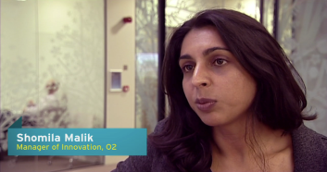
Increase productivity with both Yammer & SharePoint.
Faster problem solving, by identifying and acting on solutions within 24 hours instead of weeks.
Telecomms | EMEA | 11,000 employees and 450 retail stores
Global telecommunications, internet, and financial services company with mobile, distributed workforce turned to Yammer to improve communications, boost innovation, and accelerate collaboration.
Works with SharePoint to create a more social, mobile, and engaging experience.
Support issues resolved in minutes while freeing up IT resources for priority projects.
“Yammer has given our people a platform for open conversations, enabling us to share more ideas and solve problems faster across our business.”
Derek McManus, COO, Telefonica O2

Slide 14
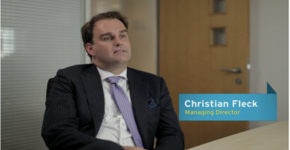
Connecting and engaging employees worldwide
Effective executive communications, build excitement for key initiatives and provide greater visibility for employees.
Professional Services | UK & Ireland | 1200 employees in 5 offices
Global provider of business solutions for legal professionals chose Yammer to build employee engagement through dialogue-based communications, improving product and service delivery, and joint problem-solving .
Improved access to expertise increases cross-functional team work and workflow efficiency.
Connects global offices keeping everyone across the company engaged in important conversations.
“I’m on the road a lot, and Yammer gives me the ability to communicate with all the teams I work with, right across the globe. If I’m offline for two or three hours, it lets me get up to speed quickly.”
Jane Treadwell-Hoye, Direcor, Discovery and Innovation, Lexis Nexis International

Slide 15


Get Started Today!
Sign up and try Yammer
http://www.yammer.com
Download the evaluation and experience Office 365
http://office.com/preview
http://www.youtube.com/user/YammerInc for customer testimonials and more
Attend YamJam Live ‘12 & SharePoint Conference
San Francisco, October 30th &Las Vegas, November 12th-15th, 2012
https://yamjam.com/

