Slide 1
New TV - Fernsehlandschaften 2015
FORUM 1: NUTZUNGSVERHALTEN
Andreas Mueller-Schubert
GM, Interactive Entertainment Business
Microsoft Corporation
Mai 11, 2011
Notes:
PURPOSE OF THIS SLIDE: Introduction (1 minute)
Hello, I am Andreas Mueller-Schubert
GM Microsoft Corporation, part of the Interactive Entertainment Business focused on software platforms to deliver TV & Video experiences to consumers in partnership with operators

Slide 2
TV Landscape in 2015
User behavior:
What will change?
What will stay?
Notes:
PURPOSE OF THIS SLIDE: Transition to the panel topic: “User behavior – what will change, what will stay?” (1 minute)
Looking ahead to what the TV landscape will be like in 2015, there are several consumer trends that are really driving the prioritization of new technical capabilities and product experiences for the television industry

Slide 3
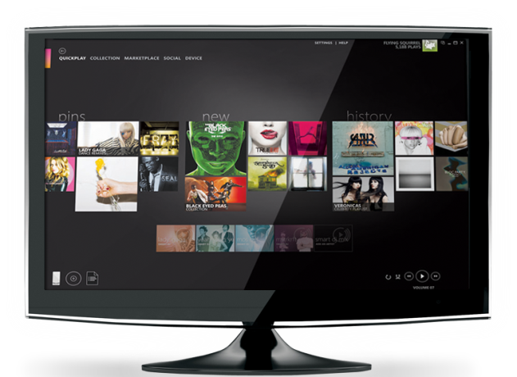
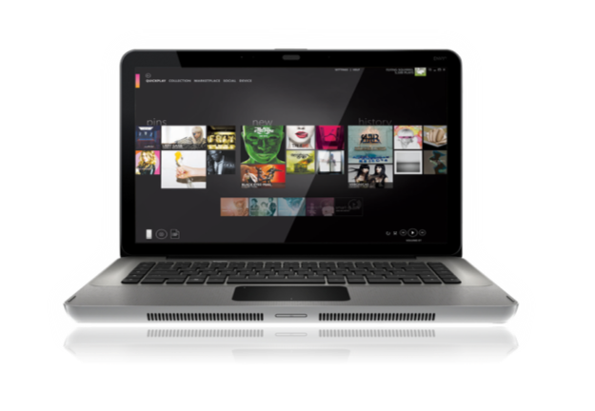
trends & market DYNAMICS
Natural User Interface
BIG BETS & INVESTMENTS
Interactive Social Experiences
Multi-Screen Offerings
On Demand Entertainment
Notes:
PURPOSE OF THIS SLIDE: Highlight industry trends and market dynamics that are shaping Microsoft’s approach to entertainment (4 minutes)
Consumer demand is making us figure out how best to deliver great entertainment both inside and outside of the home – beyond the traditional TV + STB combination
More IP-enabled devices in the home means more screens to consume content
In addition to Microsoft’s deep investments in Cloud + IP, there are 4 additional areas we are focused on are:
On Demand Entertainment
Multi-Screen Offerings
Interactive Social Experiences
Natural User Interface
Microsoft and our partners are delivering many new services to consumers. I’d like to share a few examples with you of products we ship direct to consumers and those with our partners to articulate how we think about entertainment – today and in the future.

Slide 4
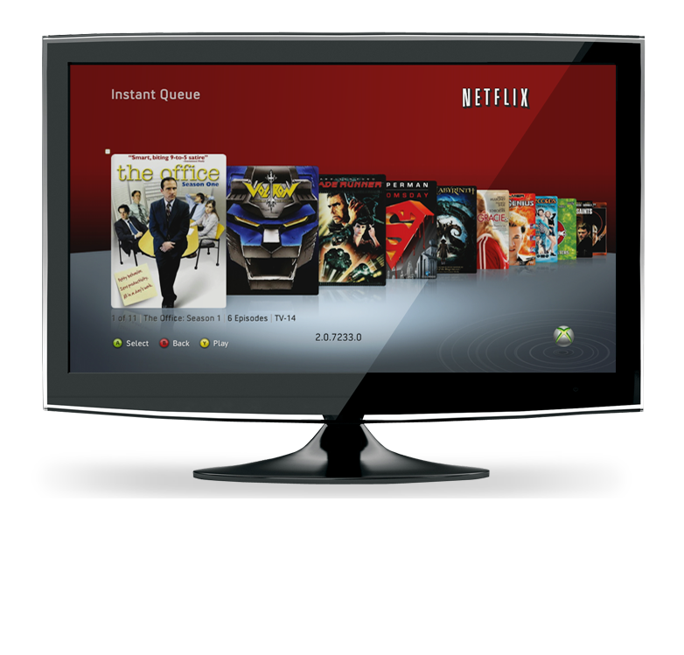
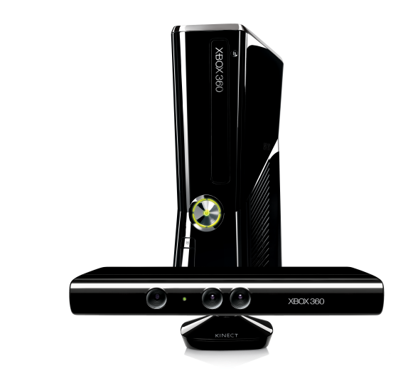
On demand entertainment
Notes:
PURPOSE OF THIS SLIDE: On Demand Entertainment (2 minutes)
With On Demand, consumers get instant entertainment
Access to the movies, videos and TV programs they love
Broadband connections, IP enabled devices, and the cloud make this possible
Microsoft’s partnership with Netflix is a good example of taking a popular service and adding new features to make the Netflix on demand experience even more engaging and interactive:
Since the Xbox 360 launched in 2005, Microsoft has been dedicated to continuously reinvesting in the platform to add new experiences and services.
What was launched as the ultimate gaming machine has quickly evolved to become an all-in-one entertainment device with features for every member of the household.
In 2008, we launched a complete refresh of the Xbox 360 user interface and we were the first console to deliver Netflix streaming.
Netflix is the world's leading Internet subscription service for movies and TV shows with >23M members in the United States and Canada
(confirm below has already been announced)
We are the only device that lets you share your favorite movies and TV shows with up to seven friends in a Movie Party.
And this spring, Xbox will be the only place to enjoy thousands of Netflix movies and TV shows controller-free on the biggest screen in your home.
Browse the full Netflix library to find the movie or TV show that you want, or launch Netflix from the Kinect Hub and select from one of the recommended titles with voice or gesture controls.
Even play, pause, fast forward and rewind what you’re watching with the wave of your hand or the sound of your voice.

Slide 5
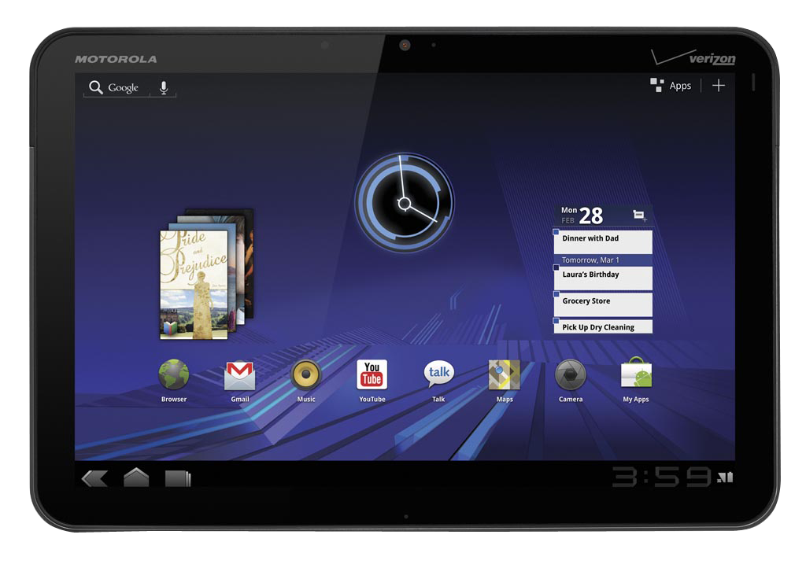
Multi-screen offerings
Notes:
PURPOSE OF THIS SLIDE: Multi-Screen Entertainment (2 minutes)
Consumers want to access their content across multiple screens
Microsoft and our partners are delivering multi-screen services today to consumers around the world
Microsoft Mediaroom is the #1 IPTV platform
More than 30 operators are delivering Mediaroom-powered TV and Video services to consumers around the world– totaling more than 7M subscriber households and 14M set top boxes deployed
Mediaroom goes beyond connecting devices to powering the cloud so operator partners can deliver a consistent premium entertainment experience across multiple screens and networks
Investments in cloud + IP allow us to deliver these multi-screen experiences – both inside and outside the home

Slide 6
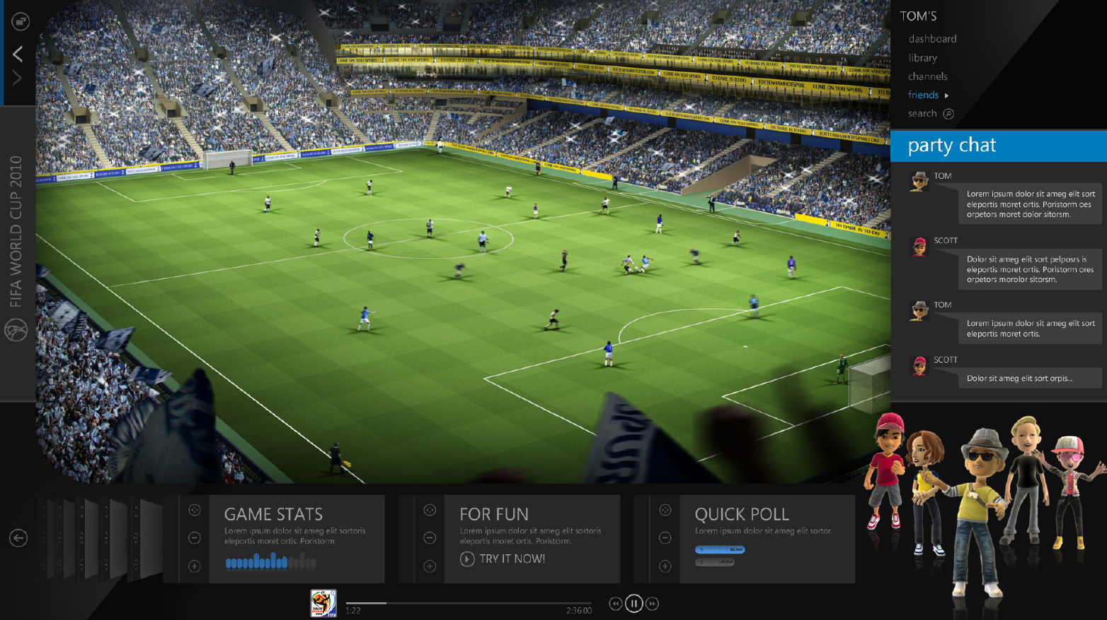
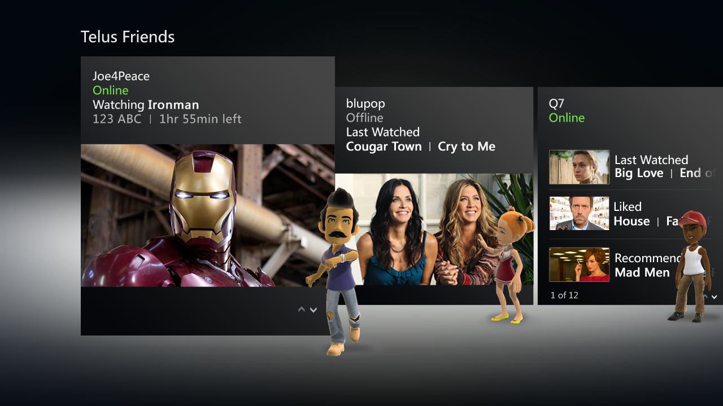
Interactive social experiences
Notes:
PURPOSE OF THIS SLIDE: Interactive Social Experiences (2 minutes)
In addition to access to your content, across more screens, we are integrating social features to entertainment experiences.
These are available today from Xbox 360, Xbox LIVE and Mediaroom.
You can watch Live TV with friends
See what your friends are watching via recommendations
Even interact with Party Mode – watch virtually with your friends, communicate and even share popcorn

Slide 7
Natural user interface
Notes:
PURPOSE OF THIS SLIDE: NUI and VUI (2 minutes)
Innovations in natural user interface and voice are changing the way consumers can engage and interact with entertainment
Kinect for Xbox 360 is removing the barriers between you and your entertainment
Launch all your entertainment – playing games, watching movies, TV shows and sports, listening to music, video chatting and more - using your hands and voice to navigate
Makes the best content even better – delivering controller-free sports, movies, TV shows, music, and more
Guinness World Records: Kinect has been awarded the record for “fastest selling consumer electronics device,” selling 8M Kinect sensors within the first 60 days of launch
Wrap up: (1 minute)
Microsoft is continuing to build a diversity of entertainment, with tailored experiences for the living room, and new ways to share it with friends. We want to transform entertainment, making it richer, more interactive and more social. Whether it’s movies, music, television or sports, the powerful combination of Xbox 360, Xbox LIVE, Kinect, Mediaroom and our operator partners is an exciting and giant leap forward.

Slide 8
© 2011 Microsoft Corporation. All rights reserved. Microsoft, Mediaroom, Segoe font and the Microsoft Mediaroom logo are trademarks of the Microsoft group of companies in the U.S. and/or other countries. The information herein is for informational purposes only and represents the current view of Microsoft Corporation as of the date of this presentation. Because Microsoft must respond to changing market conditions, it should not be interpreted to be a commitment on the part of Microsoft, and Microsoft cannot guarantee the accuracy of any information provided after the date of this presentation. MICROSOFT MAKES NO WARRANTIES, EXPRESS, IMPLIED OR STATUTORY, AS TO THE INFORMATION IN THIS PRESENTATION.

Slide 9
Additional Microsoft talking points
As the top-selling console in 2011, Xbox 360 is one of the most successful devices for delivering unique games and entertainment to your television
Xbox has sold more than 50 million consoles and 10 million Kinect sensors in 38 countries
Kinect for Xbox 360 delivers controller-free sports, movies, TV shows, music, and more, exclusively to your living room. For the first time the technology can become all but invisible, and your entertainment will be front and center
Xbox LIVE is the largest social network in the living room with 30 million active members in 35 countries
Microsoft Mediaroom is the world’s #1 IPTV platform – 30+ deployed operators, 7M sub HH, 14M STB deployed
In 2006, Xbox 360 was the first console to add HD TV shows and movies for download
In 2008, Xbox 360 was the first console to deliver Netflix streaming
Our partner Netflix is the world's leading Internet subscription service for movies and TV shows; Netflix has >23M members in the U.S. and Canada
In 2009, we delivered instant 1080p HD streaming video to the Xbox 360 console through Zune video
Xbox LIVE includes apps customized for the television from Netflix, Facebook, Twitter, Zune, Last.fm, ESPN to BSkyB
30 million active Xbox LIVE members are each spending more than 40 hours per month on the service – that’s more than one billion hours being spent on the service every month
In the last year alone there has been a 157% increase in the time spent watching movies and television on Xbox
42 percent of Xbox LIVE Gold members in the U.S. are watching an average of an hour of television and movies on their Xbox, every single day or more than 30 hours of digitally distributed television and movies a month
Notes:
PURPOSE OF THIS SLIDE: Backup stats for Q&A

