Slide 1
Aktive Gestaltung von Next Generation Communication durch Politik und Regulierung an den Beispielen USA und Australien
Münchner Kreis: Next Generation Communication Herausforderungen für die “Digitale Gesellschaft” Der Blick nach draussen
Arnold Picot
Institut für Information, Organisation und Management Ludwig-Maximilans-Universität München
Münchner Kreis München, 16. Juni 2010

Slide 2
Agenda
Einführung
Breitbandstrategie USA und Australien
Europäische Aktivitäten im Vergleich
Fazit
Notes:
Gliederung: Sollen wir uns so explizit auf kabelspezifische Herausforderungen konzentrieren oder in der Gliederung etwas allgemeiner sein, z.B. mit dem Folgepunk tzusammenpacken und im Verlauf auch, soweit wir was zu bieten haben, auf Kabel eingehen?
Übrigens: die Diss. von Mathias Kempf enthält schönes Strukturmaterial zur Kabelbranche! Evtl. das eine oder andere Bild darus nehmen?
Regulierung vor oder nach Beschreibung der Marktsituation?
Einführung: ist es sinnvoll, die Einführung (vgl. die beiden Folgefolien) auf BB und DD allein zu konzentrieren? Sind BB und DD nicht bereits aktuelle Herausforderungen, die im Zusammenhang mit der BB

Slide 3
Providing high speed broadband Internet access is a major challenge for politicians and governmental related activities.
Next Generation Communication
Current Situation
Broadband hardly available in rural areas
High competition levels in cities with multiple access technologies and high bandwidth
Currently 56 kBit/s defined as Universal Service according to European Framework
Public Broadband Programs
EU Digital Agenda 2020
What sort of engagement is most effective?
What kind of infrastructure does guarantee highest sustainability?
1
Rural areas suffer from economic and social deficits due to lack of broadband
Digital Divide widening
Various governmental ICT related activities started
2
3
Additional Challenges

Slide 4
In several nations the growth of broadband penetration has slowed down due to technical undersupply.
OECD Data
Selected OECD Fixed broadband subscribers per 100 inhabitants from 2003, 06, 07, 09
Increase of BB Penetration Levels in some countries not blocked by demand, but by a lack of supply
Focus on international programs of Australia and USA
Implications for Germany?
Source: OECD (2010)

Slide 5
Agenda
Einführung
Breitbandstrategie USA und Australien
Europäische Aktivitäten im Vergleich
Fazit
Notes:
Gliederung: Sollen wir uns so explizit auf kabelspezifische Herausforderungen konzentrieren oder in der Gliederung etwas allgemeiner sein, z.B. mit dem Folgepunk tzusammenpacken und im Verlauf auch, soweit wir was zu bieten haben, auf Kabel eingehen?
Übrigens: die Diss. von Mathias Kempf enthält schönes Strukturmaterial zur Kabelbranche! Evtl. das eine oder andere Bild darus nehmen?
Regulierung vor oder nach Beschreibung der Marktsituation?
Einführung: ist es sinnvoll, die Einführung (vgl. die beiden Folgefolien) auf BB und DD allein zu konzentrieren? Sind BB und DD nicht bereits aktuelle Herausforderungen, die im Zusammenhang mit der BB

Slide 6
The Broadband Technology Opportunities Program consists of 7.2 billion USD in order to supply underserved areas with broadband.
USA: The National Broadband Plan I/III
The National Broadband Plan
74.1 % of the population are „online“
26,6 % of the population has broadband
“Broadband Technology Opportunities Program” announced under Obama as outcome of the American Recovery and Reinvestment Act 2009 in order to provide “access to consumers residing in unserved… and underserved areas… and stimulate the demand for broadband, economic growth, and job creation.”
Investments of 7.2 billion USD
“Broadband Data Improvement Act”, precedent project signed by Bush
Data collection
Generation of broadband atlas
Additional funding from United States Department of Agriculture
Source: FCC (2009); FCC (2010); US Congress (2009); Nielsen (2010); WIK (2010)

Slide 7
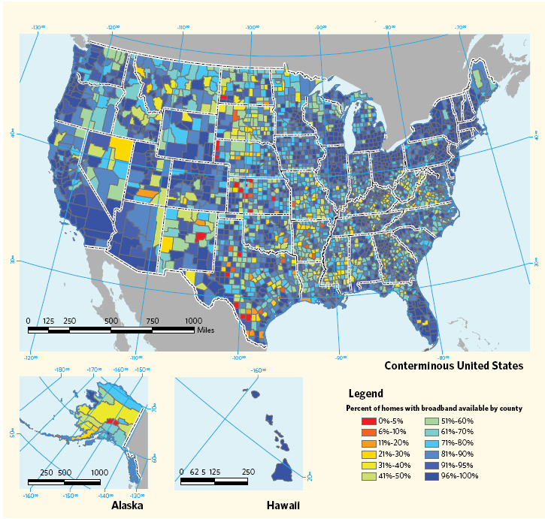
Currently, the National Broadband Plan does not support the development of a next generation network across the US.
USA: The National Broadband Plan II/III
USA Broadband Coverage 4 MBit/s
Develop Broadband Ecosystem in four ways
Establishing competition policies
Ensuring efficient allocation
Incentives for Universal Access.
Updating policies, setting standards and aligning incentives to invest
Status Update:
Requests from public and private institutions for grants can be submitted
Incumbents have not submitted requests
No national NGN rollout program existing
Source: FCC (2009); FCC (2010); US Congress (2009)

Slide 8
The National Broadband Plan targets 6 ambitious goals for the United States until the year 2020.
USA: The National Broadband Plan III/III
1
At least 100 million U.S. homes should have affordable access to actual download speeds of at least 100 megabits per second and actual upload speeds of at least 50 megabits per second by 2020.
2
The United States should lead the world in mobile innovation, with the fastest and most extensive wireless networks of any nation .
3
Every American should have affordable access to robust broadband service, and the means and skills to subscribe if they so choose.
4
Every American community should have affordable access to at least 1 gigabit per second broadband service to anchor institutions such as schools, hospitals and government buildings
5
To ensure the safety of the American people, every first responder should have access to a nationwide, wireless, interoperable broadband public safety network.
6
To ensure that America leads in the clean energy economy, every American should be able to use broadband to track and manage their real-time energy consumption
Source: FCC (2009); FCC (2010); US Congress (2009)

Slide 9
Australia and Finland took a straight forward position in providing nationwide high-speed broadband to every citizen.
Australia: The National Broadband Network I/III
The National Broadband Network
80,1 % of the population are „online“
24,9 % of the population has broadband
National Broadband Network” announced in April 2009
Investment of 43 billion AUD (~ 30 bn EUR)
Goals:
100 MBit/s for 90 per cent of population
12 MBit/s for last 10 per cent
Timeframe: 8 years
Measures:
NBN Co builds and operates network
Owned by > 50 per cent by the government
Privatization after5 years of completion
National Broadband Network
Open Access
No end consumer services
Telstra Network partially integrated
Source: DBCDE (2009); Nielsen (2010)

Slide 10
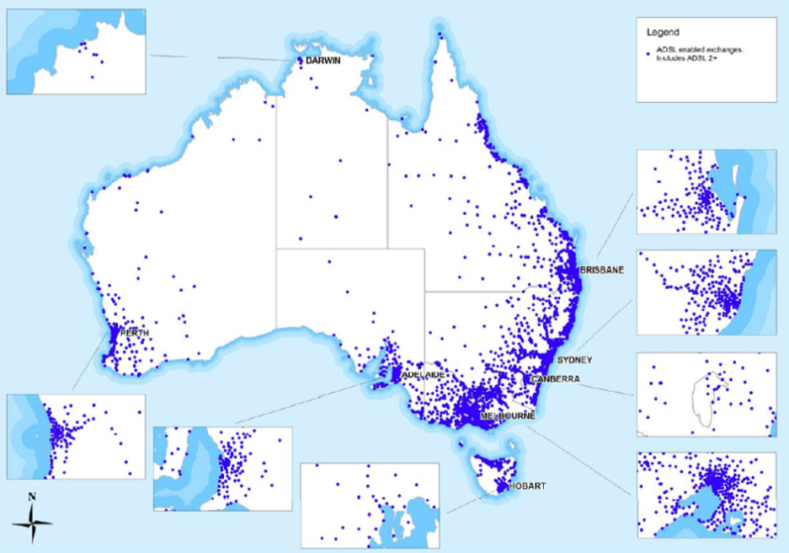
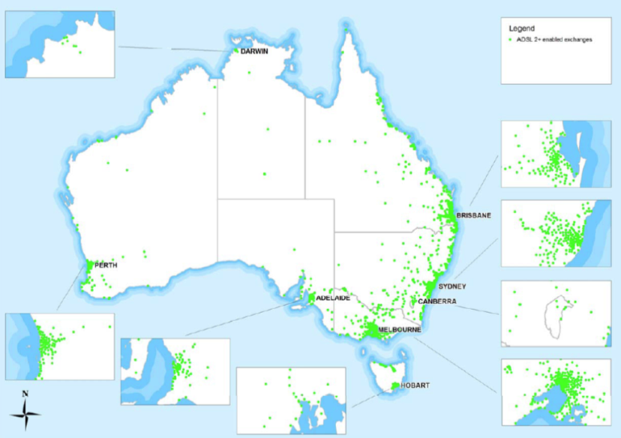
In Australia, just 2.6 % of the entire population live in remote areas, but only 48% are within range for broadband access with more than 1.5 MBit/s.
Australia: The National Broadband Network II/III
ADSL Penetration Australia
ADSL2+ Penetration Australia
2008: >45 % of exchanges without DSLAM
Wireless only available in residential areas
2008: only 48 % of entire population live within 1.5 km range of ADSL2+ enabled exchanges
Australian Government took immediate action in 2009 with National Broadband Network:
Partially integration of Telstra infrastructure
Rollout for NGN backbone network and pilot area Tasmania started in March 2010
Source: ACMA (2008); Australian Bureau of Statistics (2004); DBCDE (2009);

Slide 11
The Australian Government stated concrete job market supporting targets.
Australia: The National Broadband Network II/III
Goals of the National Broadband Network
Directly support up to 25,000 local jobs every year, on average, over the 8 year life of the project.
Connect all other premises in Australia with next generation wireless and satellite with 12 MBit/s
Connect 90 percent of all Australian homes, schools and workplaces with 100 MBit/s

Slide 12
Agenda
Einführung
Breitbandstrategie USA und Australien
Europäische Aktivitäten im Vergleich
Fazit
Notes:
Gliederung: Sollen wir uns so explizit auf kabelspezifische Herausforderungen konzentrieren oder in der Gliederung etwas allgemeiner sein, z.B. mit dem Folgepunk tzusammenpacken und im Verlauf auch, soweit wir was zu bieten haben, auf Kabel eingehen?
Übrigens: die Diss. von Mathias Kempf enthält schönes Strukturmaterial zur Kabelbranche! Evtl. das eine oder andere Bild darus nehmen?
Regulierung vor oder nach Beschreibung der Marktsituation?
Einführung: ist es sinnvoll, die Einführung (vgl. die beiden Folgefolien) auf BB und DD allein zu konzentrieren? Sind BB und DD nicht bereits aktuelle Herausforderungen, die im Zusammenhang mit der BB

Slide 13
Several nations have made broadband a legal right (universal service).
International Universal Services
Australia Broadband Guarantee
Switzerland
Provides all Australian residential and small business premises with access to Metro-comparable Broadband Services
Metro-comparable actually
512/128 kBit/s
3 GB per month usagage
Annual price < 2.500 AUD
600/100 kBit/s Universal Service
Swisscom did not ask for financial compensation
Individual negotiation with customers possible
E.g. mobile
Other compensation
Broadband access is a legal right
1 MBit/s minimum by July 2010
Downstream at least 75% of required speed in 24h
Provider may choose technology
Average speed at least 59% of required speed in four hour average
Actually under consideration by the government
1MBit/s at
Affordable priced
Any home, any provider
Measure will include universal service fund
Target: 2011
Finland
Spain
Source: Australian Government (2009); Finish Government (2009); COMCOM (2008); Spain Government (2009)
Notes:
Ja, Schweiz ist wichtig!

Slide 14
In 2015 100 MBit/s shall be available within a minimum distance of 2 km for 99 % of the entire population.
Finland: National Plan for Action
Finland
83,5 % of the population are „online“
29,7 % of the population has broadband
“National plan of action for improving the infrastructure of the information society” passed in December 2009
Objectives: Access to information society services regardless of place of residence or location
Measures:
Upgrade of public telco network
Ensure reasonable price
State funding
2010: 1 MBit/s per user as universal service
2015:
100 Mbit/s in minimum distance of 2 km for 99 per cent of population
Up to 67 per cent of cost will be covered by public funding
Source: ITU (2009); Finish Government (2010)

Slide 15
Comparing international broadband funding schemes, country specific factors have to be addresses accordingly.
National Broadband Plans compared
State | BB Penetration per 100 inhabitants | Subsidy in USD/household
Australia | 25,4% | 3.513 USD/HH
EU | 22,9 % | 7,5 USD/HH
Finland | 29,7 % | 250 USD/HH
France | 26,6 % | -
Germany*) | 27,4 % | 7,5 USD/HH
Italy | 18,5 % | 98 USD/HH
Japan | 23,6 % | 10,5 USD/HH
UK | 22,4 % | 43 (68) USD/HH
USA | 25,8 % | 65 USD/HH
Main Considerations
Rollout costs are about 880 € - 2.500 € /HH
What is the total number of white areas?
Which financial support is required to close the gaps?
Source: Holznagel/Picot/Deckers/Grove/Schramm (2010) *) in case of Germany, effect of stimulus package not included.

Slide 16
Agenda
Einführung
Breitbandstrategien: USA und Australien
Europäische Aktivitäten im Vergleich
Fazit
Notes:
Gliederung: Sollen wir uns so explizit auf kabelspezifische Herausforderungen konzentrieren oder in der Gliederung etwas allgemeiner sein, z.B. mit dem Folgepunk tzusammenpacken und im Verlauf auch, soweit wir was zu bieten haben, auf Kabel eingehen?
Übrigens: die Diss. von Mathias Kempf enthält schönes Strukturmaterial zur Kabelbranche! Evtl. das eine oder andere Bild darus nehmen?
Regulierung vor oder nach Beschreibung der Marktsituation?
Einführung: ist es sinnvoll, die Einführung (vgl. die beiden Folgefolien) auf BB und DD allein zu konzentrieren? Sind BB und DD nicht bereits aktuelle Herausforderungen, die im Zusammenhang mit der BB

Slide 17
The German „Breitbandstrategie“ might stay behind the targets of the European Digital Agenda 2020.
Next Generation Communication in Germany
EU Digital Agenda 2020
German “Breitbandstrategie”
2.4. Fast and ultra fast internet access
“We need very fast Internet for the economy to grow strongly and to create jobs and prosperity, and to ensure citizens can access the content and services they want.”
Broadband Access
2013: Basic broadband for all
2020:
30 MBit/s for all European
100 MBit/s for > 50% of HH
Guarantee universal broadband coverage with increasing speeds
Open and neutral internet
German Broadband Strategy:
2010: 1 MBit/s area wide
2014: 75 % of HH with +50 Mbit/s
Measures:
Using synergies for NGN rollout
Supporting frequency efficiency
Financial Support
Regulation supporting innovation and growth
“Breitbandatlas lists >1 mio people offline:
Broadband: ~ 128 kBit/s
713 municipalities not served
632 municipalities underserved
Source: EP (2010)

Slide 18
Vielen Dank!

