Slide 1
Technology and Evolution of
Cognitive Systems

Slide 2
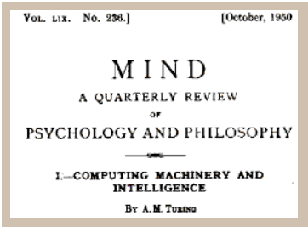
Alan Turing, 1950: „Can machines think?“

Slide 3

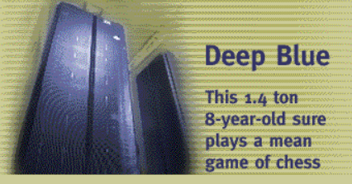
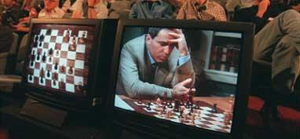

1997: Can machines play chess?
On May 11, 1997, an IBM computer called IBM Deep Blue beat the world chess champion after a six-game match.
It was the classic plot line of man vs. machine.
Behind the contest, however, was important computer science, pushing forward the ability of computers to handle the kinds of complex calculations needed in many fields of science.

Slide 4

The practical issue today: Information Overload and Complexity
  80%
  today is unstructured

Slide 5

Automated Open-Domain Question Answering
A long-standing challenge of artificial intelligence to emulate human expertise
Given
Deliver
Precise Answers
Determine what is being asked & give precise respones
Accurate Confidence
Determine likelihood answer is correct
Consumable Justifications
Explain why the answer is right
Fast Response Time
Precision & Confidence < 3 seconds

Slide 6
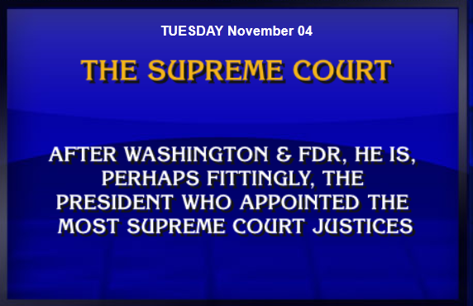

Grand Challenge
Proof point: Build a system that wins an open question game: Jeopardy!
Can we build a system that
“digests” large amounts of unstructured information (especially text)
and then answers open questions based on this data?
There is no way to program such a system in the traditional way.
It will have to learn!

Slide 7
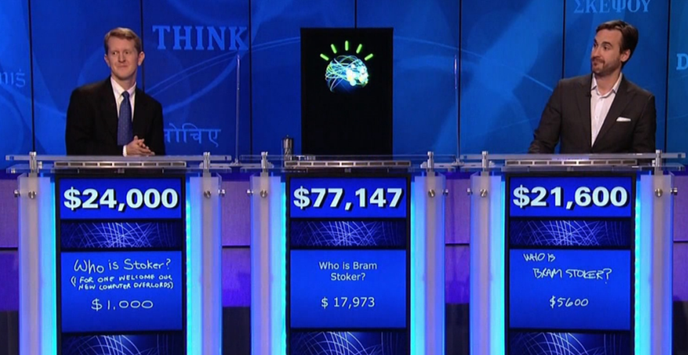
Jeopardy!
In February 2011, an IBM computer called IBM Watson beat the two all-time Jeopardy! champions, Brad Rutter and Ken Jennings, after many months of training.

Slide 8

Key Features of Watson
Understands
natural language
Generates and
evaluates hypotheses
Adapts
and learns

Slide 9

How does Watson learn?
Import selected bodies of literature.
Curate imported data.
Ingest all data to build a corpus of knowledge.
Train through prepared Q&A.
----- Go Live -----
Learn continuously from feedback.

Slide 10
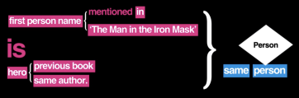
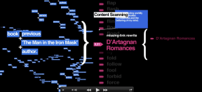
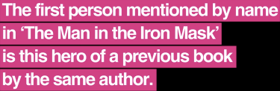
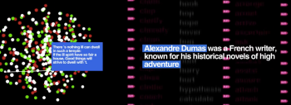
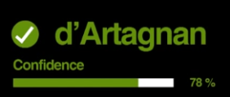
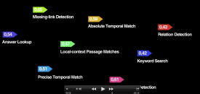
How does Watson answer questions?
Question Analysis
Hypothesis Generation
Hypothesis & Evidence Scoring
Final Merging & Ranking

Slide 11
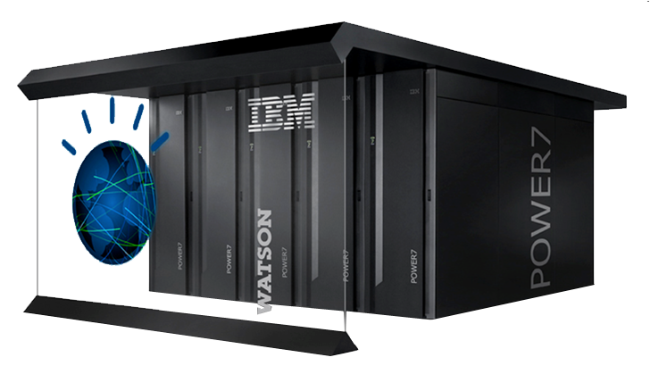
Watson for Jeopardy! System
2880 processors
80 TeraFLOPS/s
15 Terabyte RAM

Slide 12





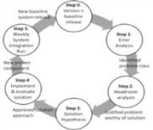


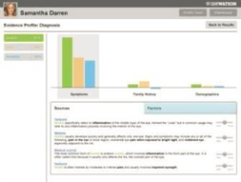
Beyond Jeopardy!
Watson 1.0: Jeopardy!
Watson Evolution
Specific questions
Statistical
analysis
Rich problem
scenarios
Interactive & multimodal
dialog
This poet wrote to a friend, “We are by September and yet my flowers are as bold as June. Amherst has gone to Eden.”
Batch
training
Statistical
ranking
Continuos
learning
Evidence
profiles

Slide 13

Our Definition of Cognitive Computing
Cognitive computing systems learn and interact naturally with people to extend what either humans or machine could do on their own.
They help human experts make better decisions by penetrating the complexity of Big Data.

Slide 14


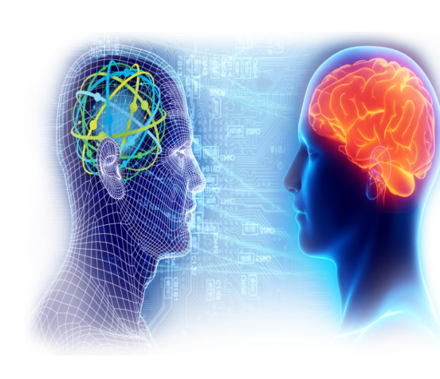
Cognitive systems expand the problems we can address
Programmatic Systems
Cognitive Systems
Leverage traditional data sources
Follow pre-defined rules (programs)
Provide the same output to all users
Are taught, not programmed.
Learn and improve based on experience
Interpret sensory and non-traditional data
Relate to each of us as individuals
Allow us to expand and scale our own thinking
Notes:
Main point: Cognitive systems work in a fundamentally different way and expand the problems we can address as people
Programmatic Systems
Programmatic Systems have proven to be exceptional at handling what I would call traditional data. Numbers, databases, specific input fields from applications.
They can follow the rules that we create…. If X, then do Y
And generally, these systems are stable and trustworthy and provide the same output all of the time… that’s why we like them for processing financial transactions!!
Cognitive Systems
However, there are many issues where programmatic systems get stuck very quickly
E.g. if I want to read millions of pages of the latest healthcare research and figure out how it applies to a patient I am seeing… programmatic systems can’t help… they can’t read and understand content like you and I can… at best they can match key words and put relevant documents in front of me to read, but that still requires a lot of work on my part
People have tried to create code / rules to apply healthcare logic, but they are very brittle and difficult to update as new information comes forward
By contrast, cognitive systems are taught how to solve problems by doing practice examples. They are not programmed
They learn from experience and get better
They can understand and interpret sensory data like language, images, etc and apply them in complex ways where they are no clear answers
And they relate to each of us as individuals enabling us to scale our own thinking
We saw the very beginning of this type of system w/ Watson on Jeopardy! where the system had to understand language, puns, subtleties and apply it to vast amounts of content to come up with probable answers. This showed us that it was possible to build a different type of system, but that initial Watson system just scratched the surface

Slide 15


A new partnership between humans and computers!
Enhance
the cognitive process of professionals to strengthen decision making in the moment
Scale
expertise by elevating the consistency and objectivity of decision making across an organization.
Accelerate development of expertise in others by capturing the expertise of top performers

Slide 16
Cognitive learning systems enhance our abilities to perceive, reason and relate
IBMWatson
Perceiving
Relating
Reasoning
Perceiving:
Understand the world as we do: interpret sensory input beyond traditional data
Reasoning:
Think through complex problems: deepen our analysis and inspire creativity
Relating:
Understand how we communicate, and personalize interactions
Learning:
Learn from every interaction, scaling our ability to build experience
Learning

Slide 17
Research areas in Cognitive Computing
Visual sense,
Sound
IBMWatson
Perceiving
Relating
Reasoning
Social graph based communication,
Empathy,
Arguing,
Humor,
Creativity,
Intuition
Moral compass,
…
Advanced algorithms,
Analytics acceleration,
Multi-objective decision support
Learning
More automated learning

Slide 18
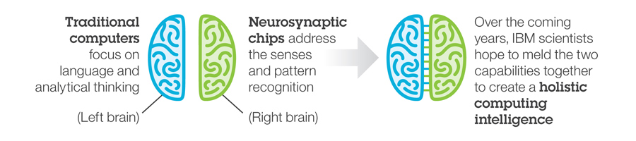
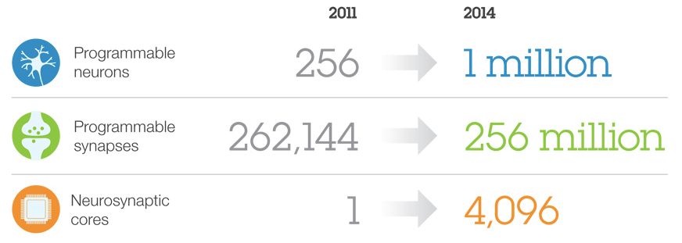
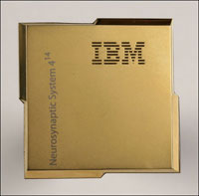
Research on future cognitive systems

Slide 19
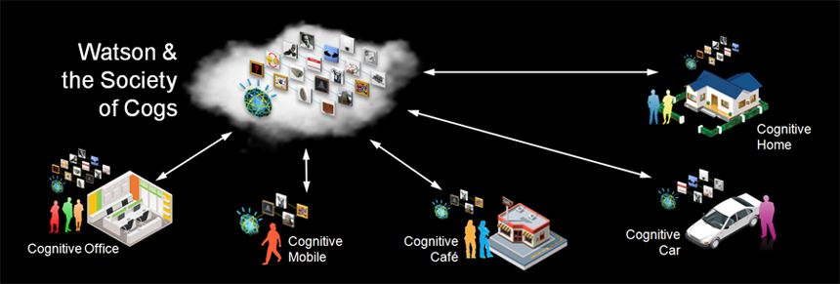
A society of cognitive systems interacting with humans
Various Cognitive Systems and Humans will interact and collaborate:
Human to Cognitive System
Cognitive System to Cognitive System
Human to Human

Slide 20
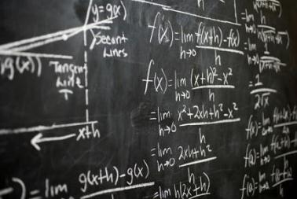
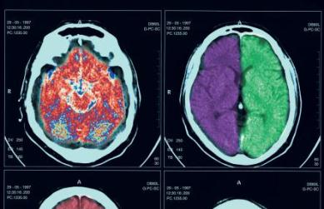







Numerous applications
20

Slide 21
The new era of cognitive computing will transform our future
Tabulating
Systems Era
Programmable
Systems Era
Cognitive
Systems Era

Slide 22

Dirk Wittkopp
Vice President
Geschäftsführer
IBM Deutschland Research & Development GmbH
wittkopp@de.ibm.com

Slide 23
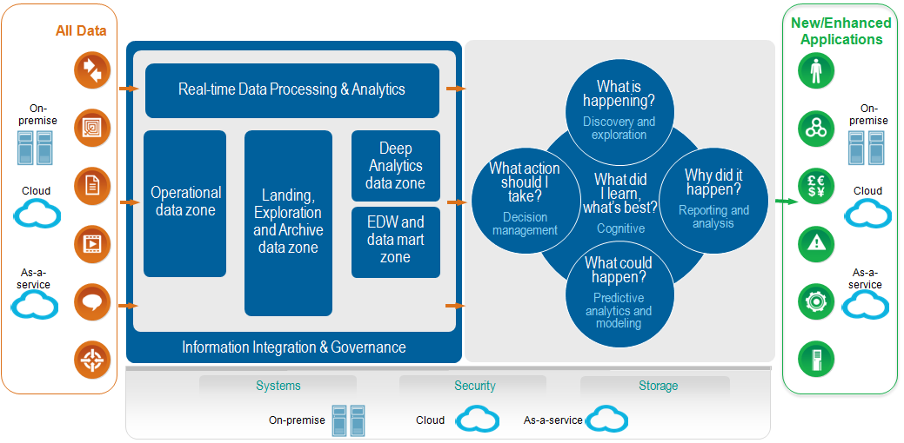
Architecture for Big Data & Analytics
23

