Slide 1
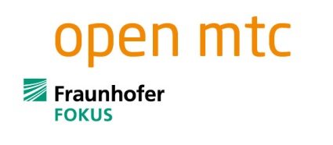




Standardisierte M2M-Plattformen als Schnittstelle zum Nervensystem der Smart City
Fachkonferenz: M2M und das Internet der Dinge - vom Hype zur praktischen Nutzung
Munic, May 06, 2013
Dr. Sebastian Wahle | sebastian.wahle@fokus.fraunhofer.de

Slide 2
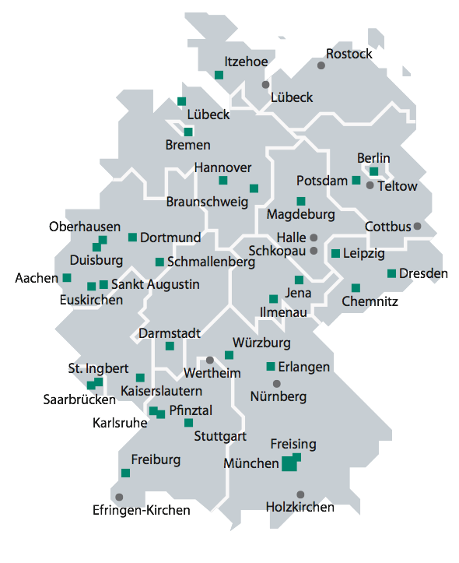
About the Fraunhofer Association
The Fraunhofer association is Europe‘s largest organization for applied research.
Fraunhofer develops products and processes through to technical or commercial maturity
Fraunhofer maintains
  60 self-contained Fraunhofer Institutes
  throughout Germany
  with a staff of 20, 000 scientists and engineers
  1.8 billion Euro annual budget
70% of funding are raised through innovative
development projects, license fees and contract research
Sub-companies and representative offices all over the world
Fraunhofer FOKUS is the telecommunications institute within Fraunhofer

Slide 3

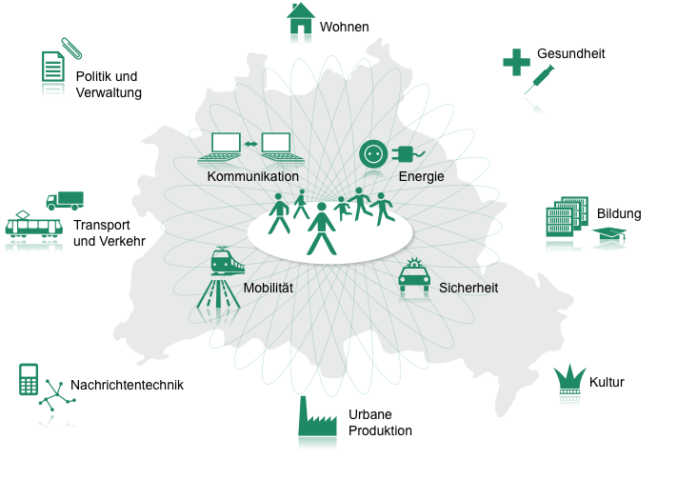
E-Living
E-Health
Politics &
E-Government
Communications
Energy
Education
Transport &
Traffic
Mobility
Security
Signal Transmission & Networks
Culture
Urban
Production

Slide 4
To Become Smart Means to Make Sense out of the Raw Data
Intelli-
gence
Knowledge
Information
Sensor Data & Actuators
act
Inference
M2M Communication
M2M Communication
Perception
sense
Comprehension

Slide 5



M2M vs. IoT
Internet of Things – High level information
Things are modelled to have attributes, e.g. room has an attribute “temperature"
Discovery of information based on specific criteria: e.g. give me the “average temperature of all rooms in the 2nd floor”
type
Thing
name
IoT
attribute
…
Machine-2-Machine – Low level information
Sensor and actor devices, e.g. temperature sensor
Discovery of information based on specific sensor readings: e.g. get the temperature value of sensor 60:FA:CD:6D:D0:4B
M2M
21°
C
Generally, IoT is part of a larger vision including legislation, security & privacy, governance, business models, etc.

Slide 6

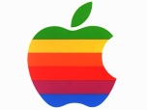

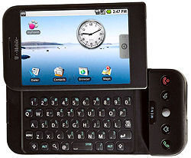

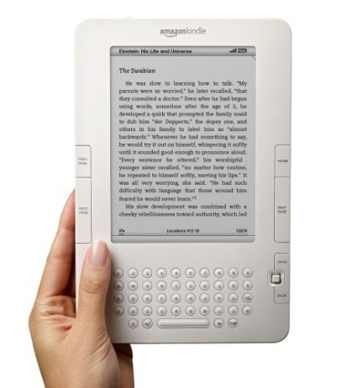


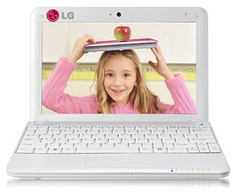

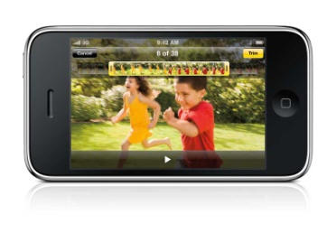
M2M – Total Convergence of Communication
The telecommunication industry and other business branches are currently merging into a total convergence mediation layer possibly around the operator core networks.
M2M Services
Automotive &
Railways
Metering
Other Business Branches
Remote Maintenance
and Control
Security
Tracking & Tracing
Healthcare
Consumer Electronics
Operator
Core
Network
Payment
Comm. Industry
Internet
Services
Telco
Services

Slide 7
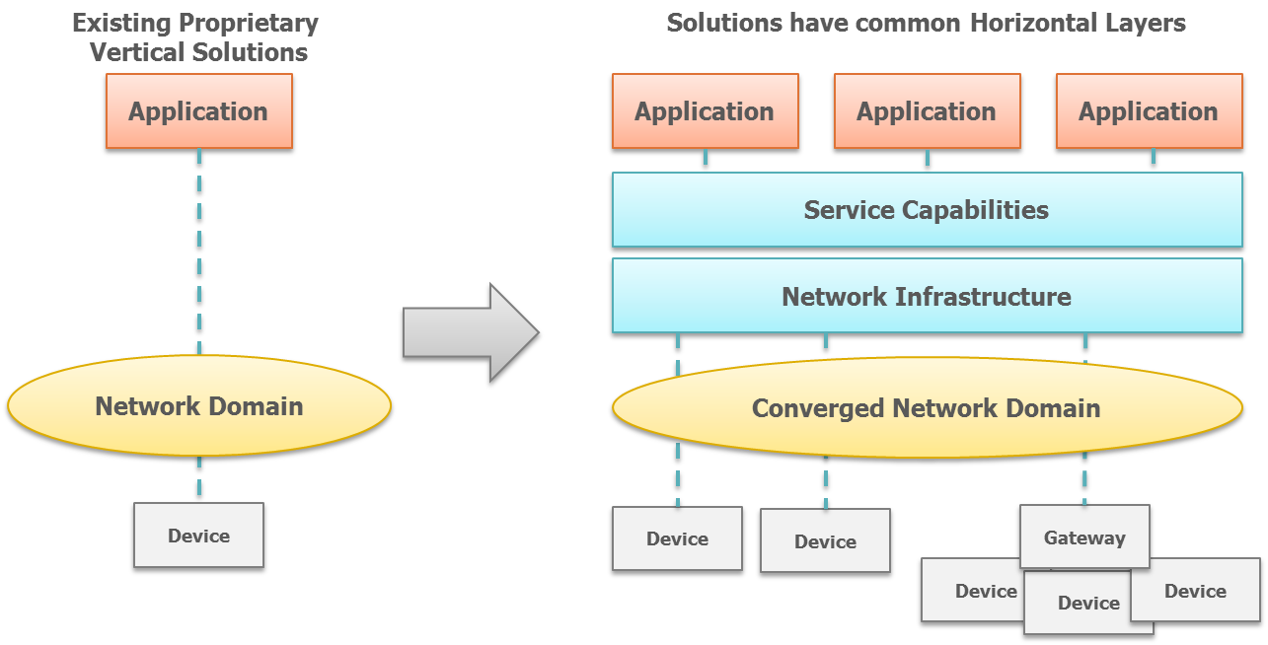
Stop the Silo Mindset - Horizontal Approach for M2M
In line with ETSI TC M2M specifications

Slide 8
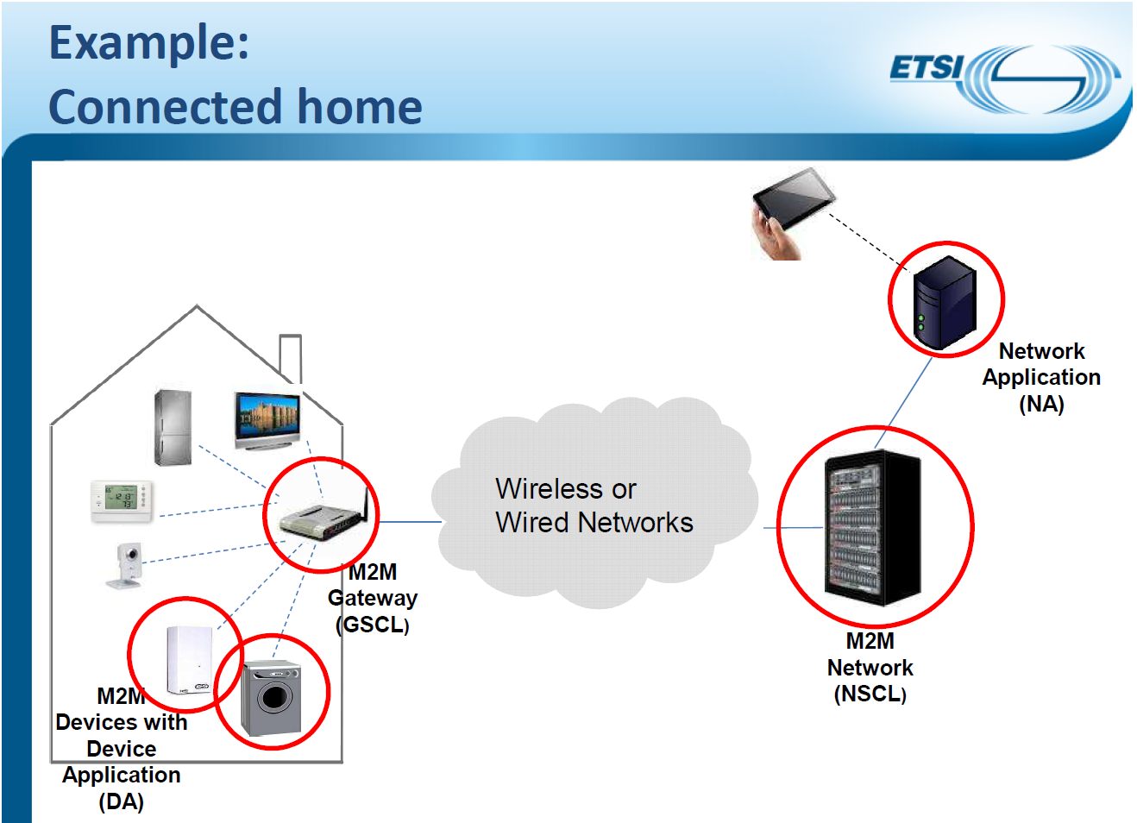
mIa
mId
dIa

Slide 9

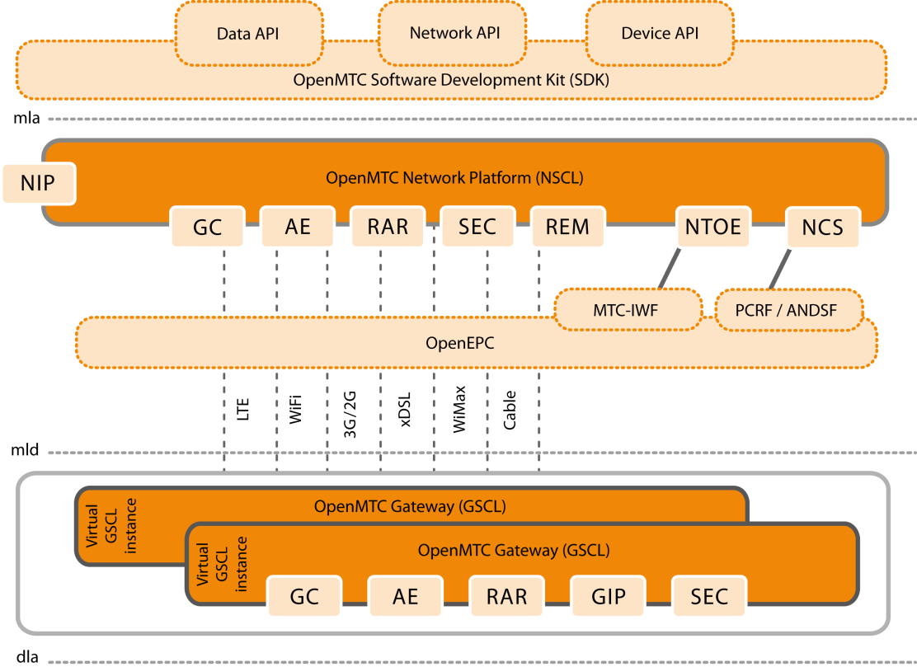
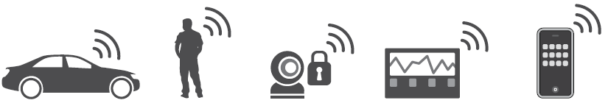
OpenMTC Features
OpenMTC implements most of the features of ETSI TS 102.921 and 102.690 including a
  Network Service Capability Layer (NSCL)
  Gateway Service Capability Layer (GSCL)
Both layers implement service capabilities:
  Communication (LTE, 3G, WiFi, fixed)
  Application Enablement (network, device and gateway applications)
  Data storage (devices, applications, sensor measurements)
  Security & Device Management
OpenMTC allows interworking with
  OpenEPC (integration with the core network, QoS, access network selection)
  OpenIMS (IP Multimedia Subsystem)
  Various sensors and actuators (e.g. FS20 devices, HTML5)

Slide 10
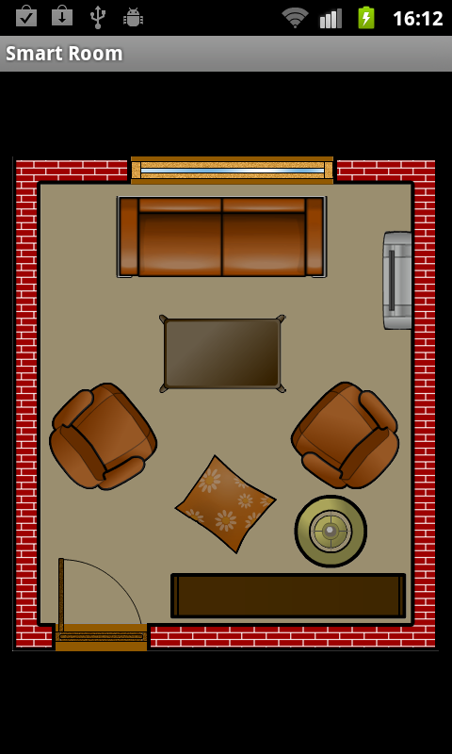
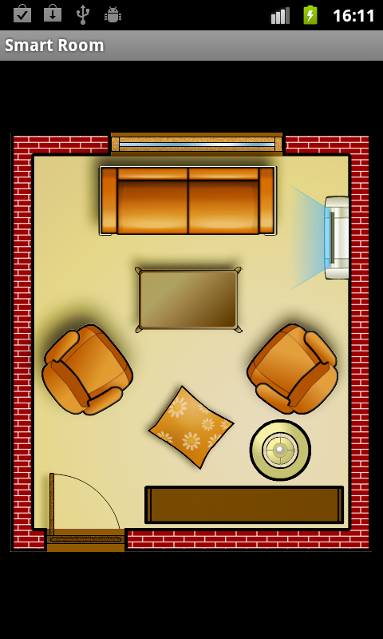
Impressions
OpenMTC Smart Home Android App
Builds upon the platform
Allows to control home devices such as light and air conditioning
Took a student 3 weeks to develop
OFF
ON

Slide 11
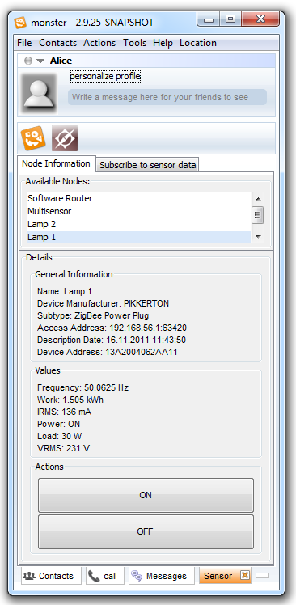
Impressions
M2M and IMS integration
Use communication clients to include machine communication
Bridge M2M & H2H
Browse available M2M
devices & provided data
Easily perform actions on the devices

Slide 12
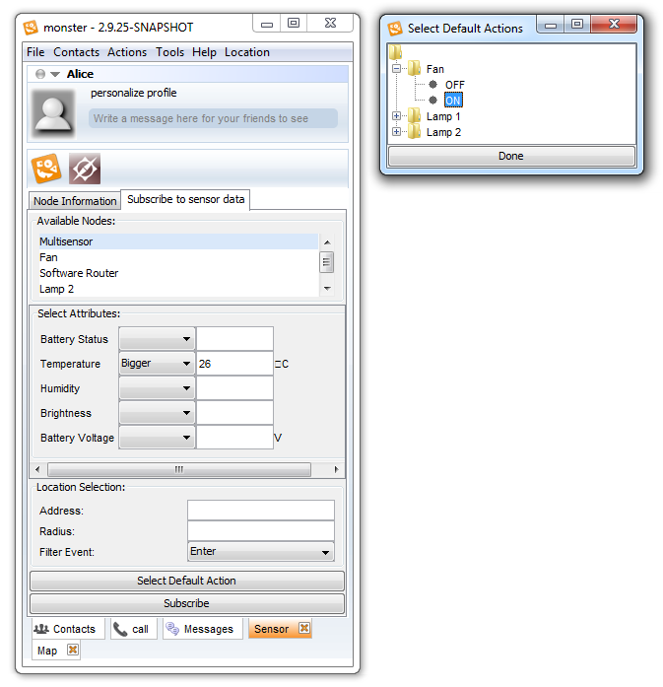
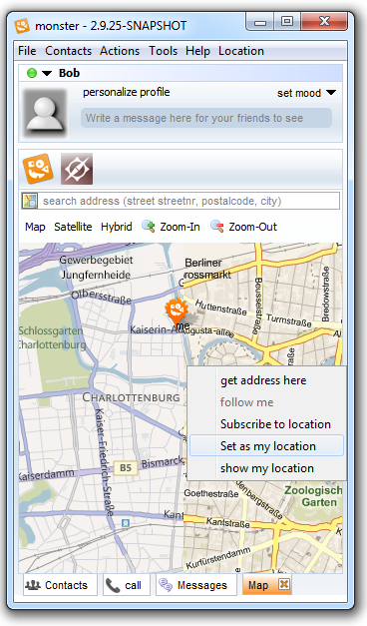
policy action definition
policy condition definition

Slide 13
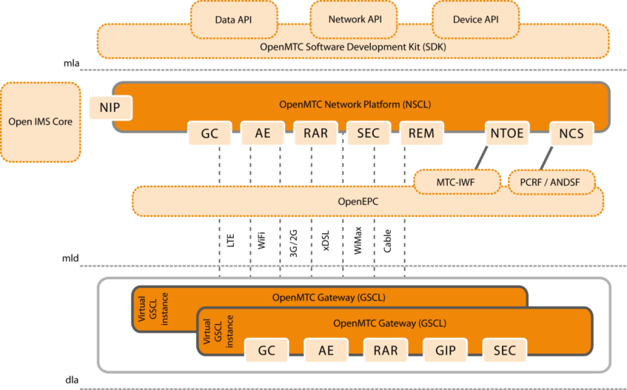

M2M Demo: WiFi Device Tracking
Detect mobile devices at different locations using WiFi and Bluetooth
Enable easy tracking of devices
Gather statistics regarding device type, manufacturer, number of devices, etc.
Supported by a standard-based M2M platform
Usage scenarios:
  Smart City Traffic
  Location rating
  Proximity marketing
Tracking applications and metrics
Detect mobile devices

Slide 14
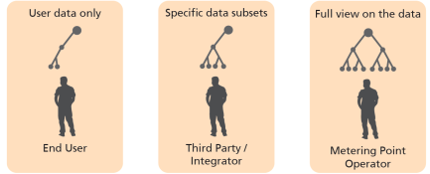
M2M Demo: Cloud Elasticity & Smart Metering
Federated cloud deployment
Automatic elasticity scaling application servers and database
Different stakeholder views on utility metering data
Third party access based on access rights and policies
Usage scenarios:
  Utility metering
  Value added services
  Home Automation
Stakeholder views
&
Home Automation
Metering data

Slide 15




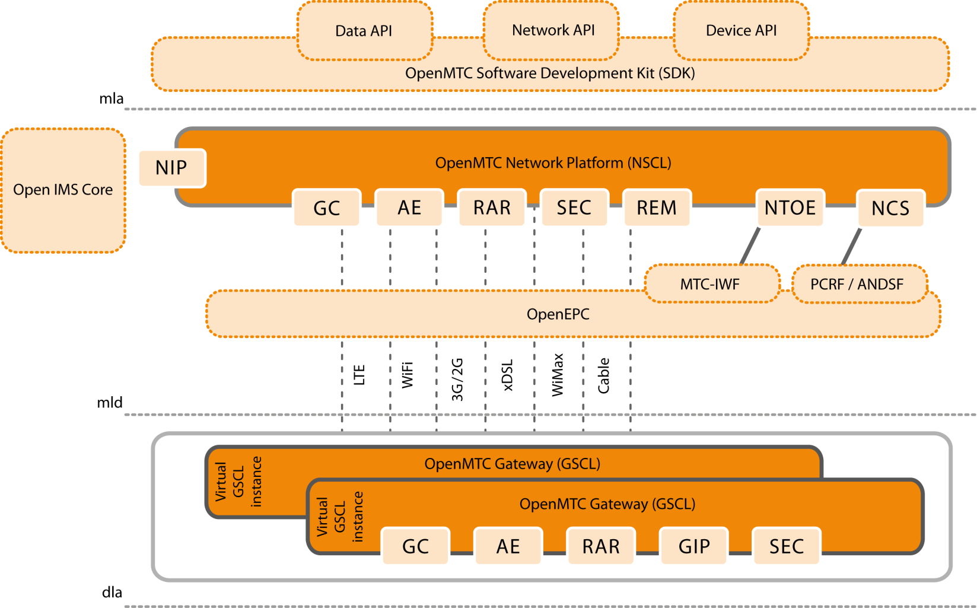
Current and Upcoming Projects
Varios Usage Projects
Water Management
eHealth
eEnergy
H2O4Us
TRESCIMO

Slide 16
Summary, Challenges & Input for Discussion
Horizontal platform standardization and deployment will be needed to overcome M2M silos
Interfaces for rapid prototyping and application development needed
Convergence of M2M and H2H communication and data
Application ideas exist, a lot of technology exists, but we lack solid business models for cross domain data usage in Smart Cities
What about a public good approach?
  IoT infrastructure and data to be seen and financed as public good
  Open access and interfaces to sensors and data: e.g. traffic data, environmental data
On the other hand: How intrusive do we want our cities to be?
Philosophical question: How much IoT does humankind actually require?
Challenges and road blockers for solid business models today : complex ecosystems, many different market players, legal uncertainty, security & privacy issues
Notes:
Hackers schalten das Licht ab
Funkenden Perserteppich
Video call der Sec camera, Netzhautimplantatat, Hörgeräte mit Aufnahemfunktion
Wir müssen das doch eher als öffentliches Gut betrachten
So wie wir Straßen und Polizei haben, sollten wir daoch auch Zugang zu Daten haben, Verkehrsdaten, Umweltdaten, OpenData,
Wieviele Sitzenbleiber gibt es in den Grundschulen? Was ist der Durschnitt der Abi Zensuren einer Schule?
Wieviele Akaemiker wohnen im meinem Bezitrk?
Often there are human users behind the M2M applications
Twofold purpose of applications, e.g. Smart Grid/Metering: (a) automatic control of home appliances, (b) humans to change their energy consumption behaviour
Communication convergence M2M and H2H: video call initiated by human or a security camera

Slide 17


www.open-mtc.org
info@open-mtc.org

