Slide 1
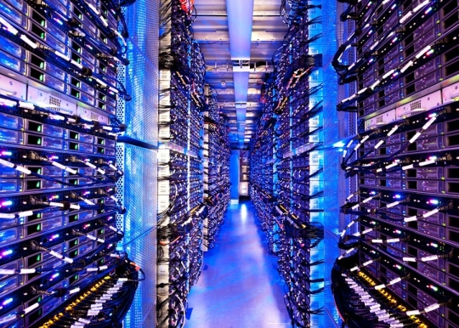


Run Connected
Evan Schultz
Global Partner Senior Director
IoT / M2M, Technology Partners
evan.schultz@sap.com

Slide 2
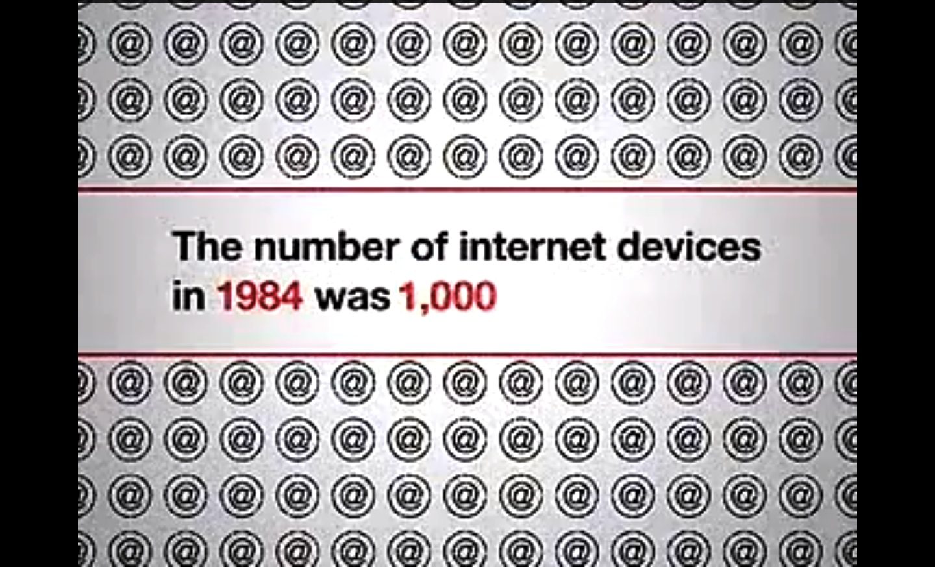
The number of internet devices in 1984 was 1,000

Slide 3

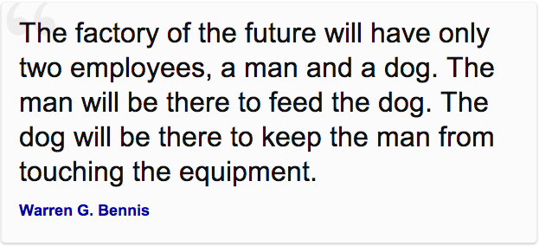


Slide 4

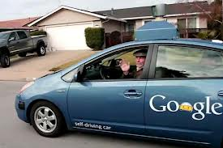
Hollywood or Reality?
Hello Mr. Yakamoto and welcome back to the GAP!
Self Driving Cars

Slide 5

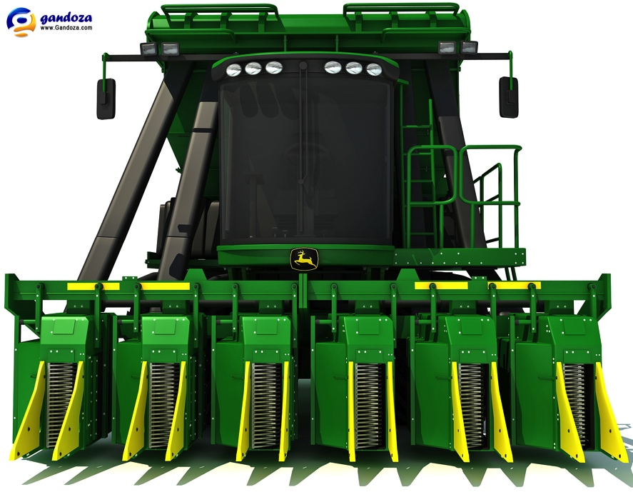
Mobile Information Factories
70% of all computer chips do not go in to computers
GPS shows where it is
Microwave sensors measure cotton flow
RFID tags let processors know the origin of each bundle
Wireless communications
Computing power of 8 PCs
John Deere doesn’t make tractors but rather “sophisticated mobile information factories”*
* Quote from John Deere CEO Bob Lane

Slide 6
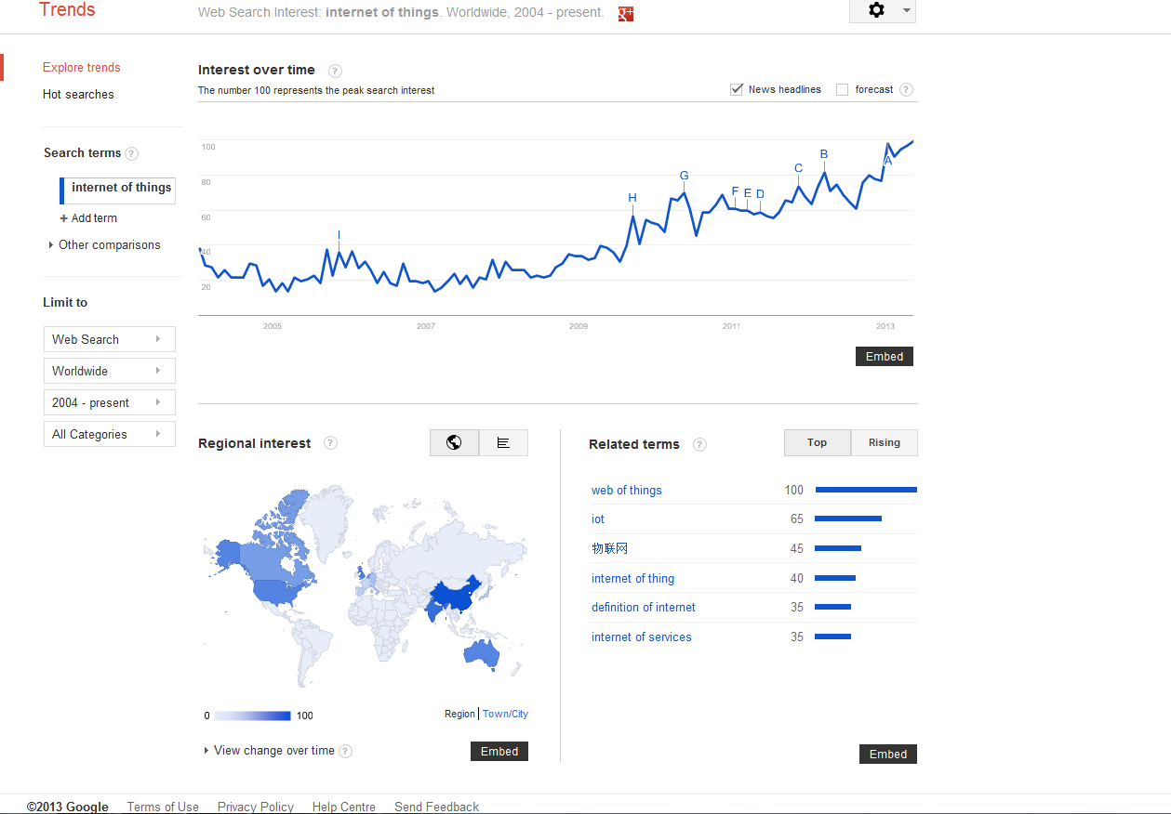

Slide 7
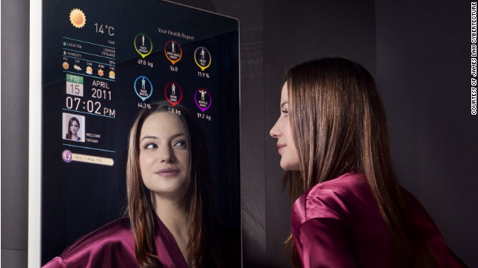
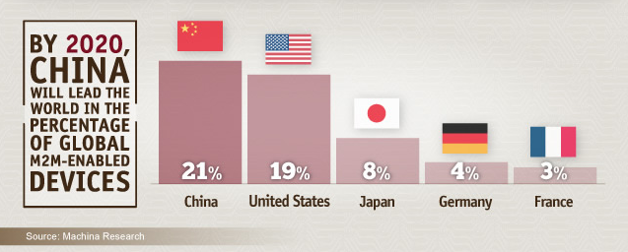
Beijing plans to invest 5 billion yuan ($800 million) in the IoT industry by 2015.
The Ministry of Information and Technology estimates China's IoT market will hit 500 billion yuan ($80.3 billion) by 2015, then double to 1 trillion yuan ($166 billion) by 2020.
Notes:
If there's a race to lead the Internet of Things (IoT), China aims to set the pace. Since Chinese Premier Wen Jiabao identified IoT as an "emerging strategic industry" in an interview on state media.

Slide 8
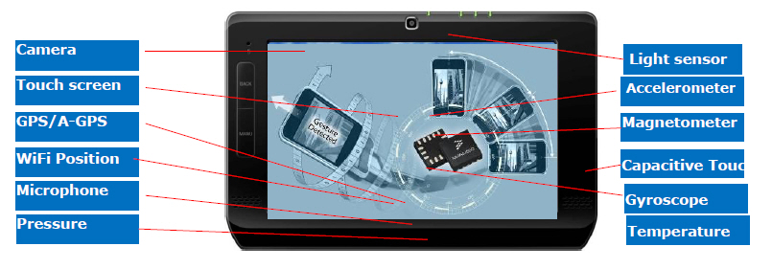
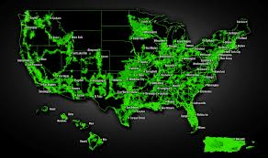
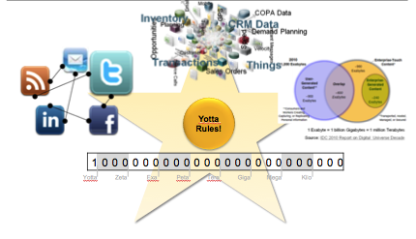
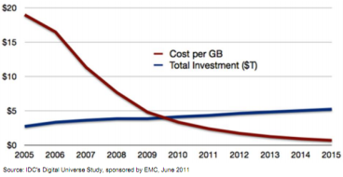
What is Driving This Change?
Sensor
Cost
Wireless
Availability
Yotta Data
Hardware
Cost

Slide 9



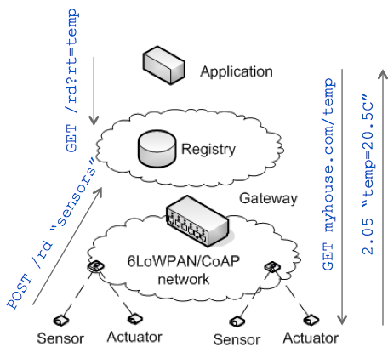









Standards Accelerating Widespread Adoption
IP and Embedded Web Services
  Standardization in IETF
  Application framework in IPSO Alliance
  Liaisons between IPSO Alliance and other device-oriented alliances
Momentum in industry and standardization
  Embedded web services in ETSI, ZigBee, OMA
  Products available and deployed
Notes:
jcoap on google code for import to eclipse
microsoft .net micro with 6lowpan support, http and dpws
5/6/20132010-12-10
9

Slide 10

Mobile is now an intrinsic part of life
What would you give up for a week to keep your mobile phone?
Brushing Teeth
22%
Caffeine
55%
Exercise
54%
???
33%
*Bersin & associates 2012

Slide 11




Business apps: Fastest growing app category on App Store
Yet...
80%
50%
WW enterprise apps market¹
$7.7b
of Fortune 500 plan to
implement mobile apps in 2012²
of Enterprises lack mobile app developers³
$2.7b
2010
2015
“
”
Beyond telecoms, some of the most successful brands in the ranking – from Coca-Cola to Visa – have used mobile platforms and marketing strategies to ignite growth - Pierre Dupreele, SVP, Millward Brown Optimor
1. IDC; 2. Forrester – “Mobile Trends of “Fortune 500” Companies” – Jun 2012; 3. Custom Solutions Group – “Mobile in the Enterprise: The Gap Between Expectations and Expertise” - 2012
Notes:
Leading to B2E and MMS

Slide 12










Big Data Characteristics
Big Data is not new and can be solved because of emerging affordable solutions
Data Volume
Structured Data
Volume
Automobiles
Location-
based Data
Lots of data and Petabyte data size is normal
!
Machine Data
Variety
Mobile
IMHO, it’s great!
No-relational data and Many formats
Text Data
Velocity
Click Stream
7.9 Zettabytes
Fast collection, processing and consumption
Point of Sale
Value
Social Network
Competitive differentiator for Business
1.8 Zettabytes
Customer Data
RFID
Smart Meter
1 Terabyte = 1024 Gigabytes
1 Petabyte = 1024 Terabytes
1 Exabyte = 1024 Petabytes
1 Zettabyte = 1024 Exabytes
2011
2015
Future

Slide 13
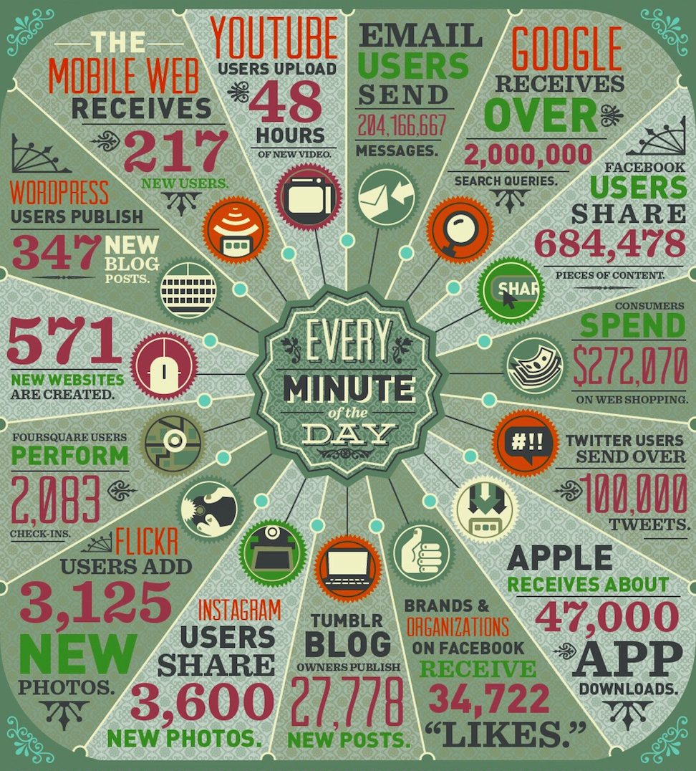
Data Never Sleeps
How much data is created every second?
2013 – 2 ½ Zettabytes in a day v/s all of 2008
Digital universe will reach 4 Zettabytes (~4 B TB) by 2013 (50% YoY growth)
40% growth in global data v/s 5% in IT spending
Gas Turbines generate 500GB / day
Single Jet engine – 10TB in 30 mins

Slide 14
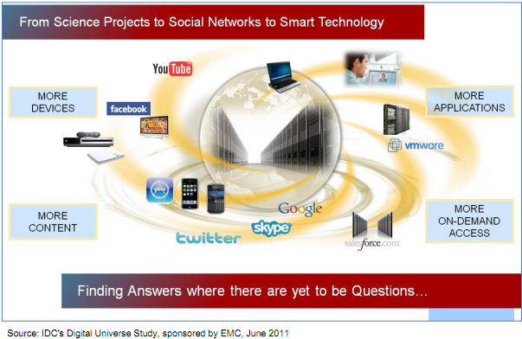
Big Data is Deluging
Big Data is not the created content, nor is it even its consumption — it is the analysis of all the data surrounding or swirling around it.
Source: IDC 2011 Report on Digital Universe Decade

Slide 15
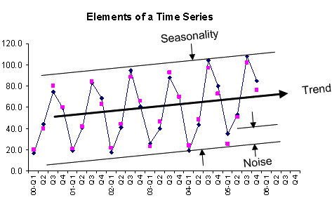
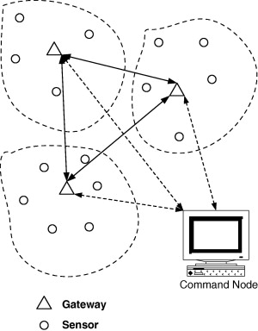
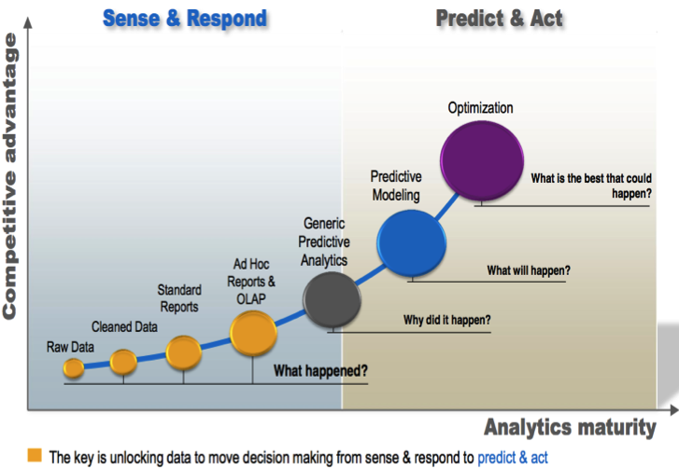
M2M Data Problem
Multi Site
Fast Data
Big Data
Edge Intelligence
End point correlation
M-M Actuation
Time Sensitive Data
Event Correlation
External Data Sources
Large Data sets
Predict & Act

Slide 16
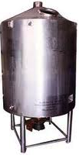
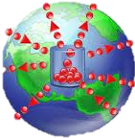
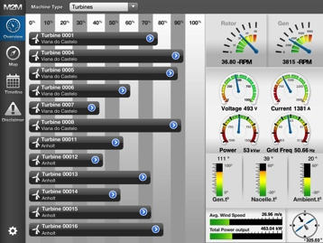





Simplifying the Internet of Things
Observing the Physical World
Changing the Physical World
Visualization
Data Aggregation
Analysis
Discovery, Identity, Provision, Secure
Remediation

Slide 17
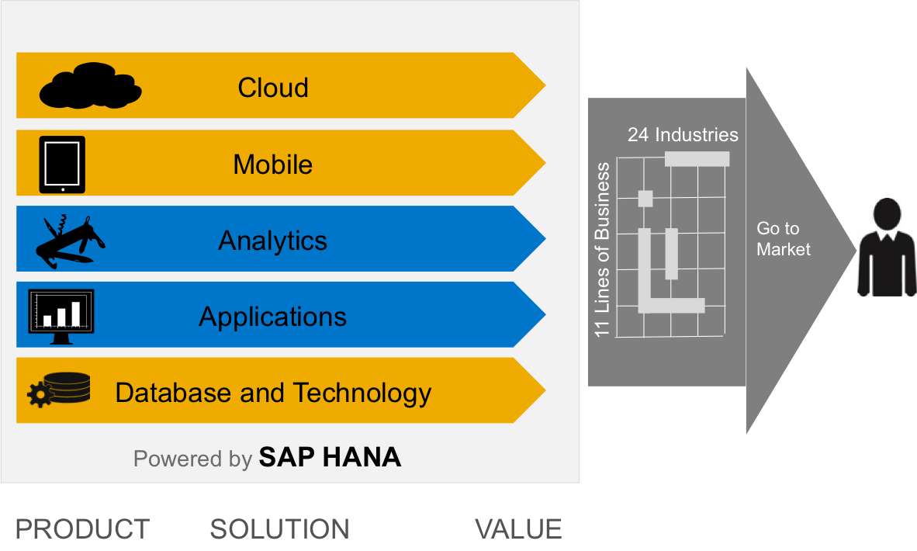
Why SAP ?
  SAP is in a unique position! No other company can leverage such a broad and existing portfolio of products to create a market leading M2M offering
  M2M cuts across all five business domains: Cloud, Mobile, Database, Analytics and Applications
  SAP has the scale to support enterprise customers
  SAP has the critical business process know-how across a variety of industry verticals
  SAP’s is a trusted partner with their customers

Slide 18



Analyst rank SAP as LEADER in Enterprise Mobility
#1
Gartner ranks SAP as the industry leader in Mobile
App Platforms.
Completeness of Vision
Ability to Execute
Mobility Report
“Mobile Device Management is Dead. Long Live Enterprise Mobile Management!”
“WINNERS”
SAP
Antenna
Boxtone
Mobile Management
Market-Shares (MDM)
SAP 16.4%
Microsoft 6.7%
MobileIron 6.6%
Good 6.4%
Airwatch 4.5%
Symantec 4.1%
HP 4.0%
SOTI 3.2%
Boxtone 3.0%
IBM 2.7%
Source: IDC Report, September 2012.

Slide 19
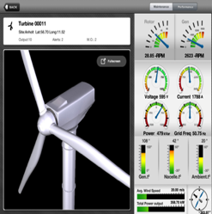
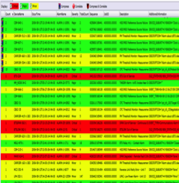
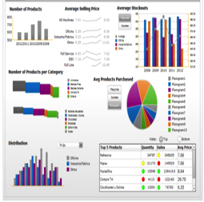
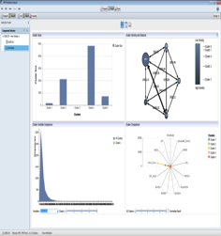

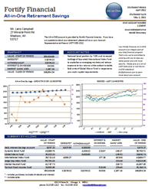
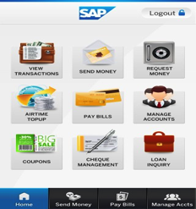

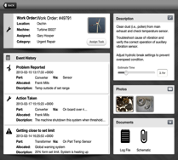










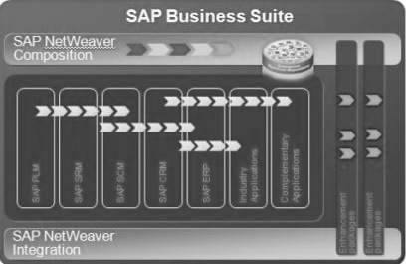


M2M Application
Real Time Dashboards
Notifications & Actions
Operational
Reports / KPI
Data Insights
Mobile Apps
Personalized Portals
Consumer Apps
Consumer Apps
Predictive Algorithms
Operations
Operations / Executive Management
Data Scientists
Mobile Work Force
Customers Suppliers
Consumers
Social
Media
Charging
M2M Data
Integration
M2M Applications – Data & Analytics Visualization
HANA
IQ
Complex Event Processing

Slide 20


IoT – Creating Business Value
Improved Efficiency
Reduce Costs
Asset Tracking
Quality Improvements
Supplier Management
New end user interactions
Dynamic pricing models
New product & service models

Slide 21

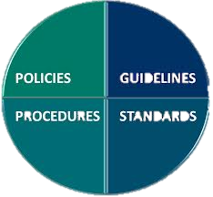
IoT – Opportunities for all of us
Device Identity
Bi directional trust
Secure encryption
Internet standards
Data privacy
Legal liabilities
IT v/s Business
Govt. regulations

Slide 22

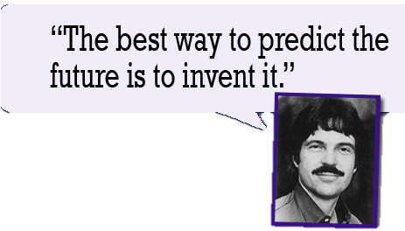
Alan Kay - Xerox’s Palo Alto Research Center (PARC)

