Slide 1
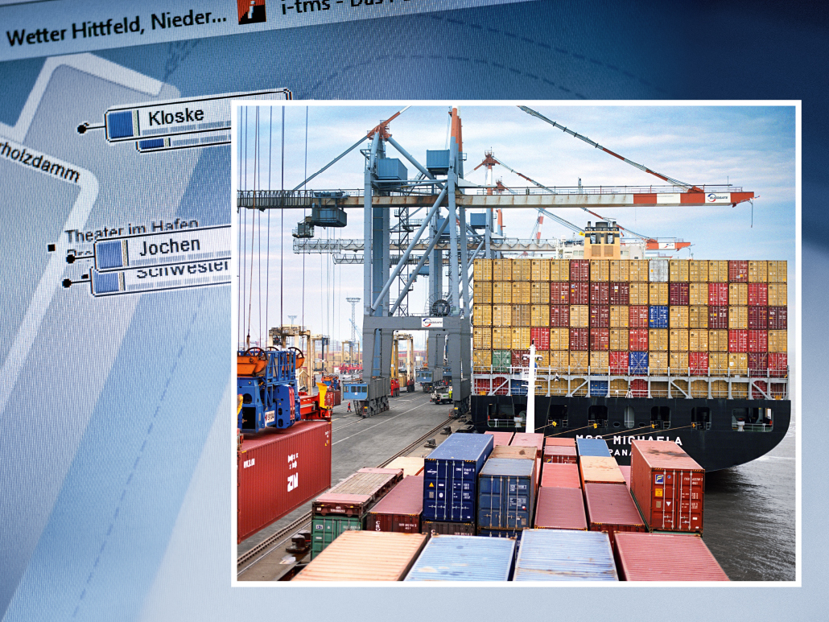
SMART PORT LOGISTICS – CLOUD SERVICES FOR A SMART APPROACH CONTROL WITHIN HAMBURG HARBOUR
Markus Lindemann, GCC Embedded & M2M Solutions

Slide 2



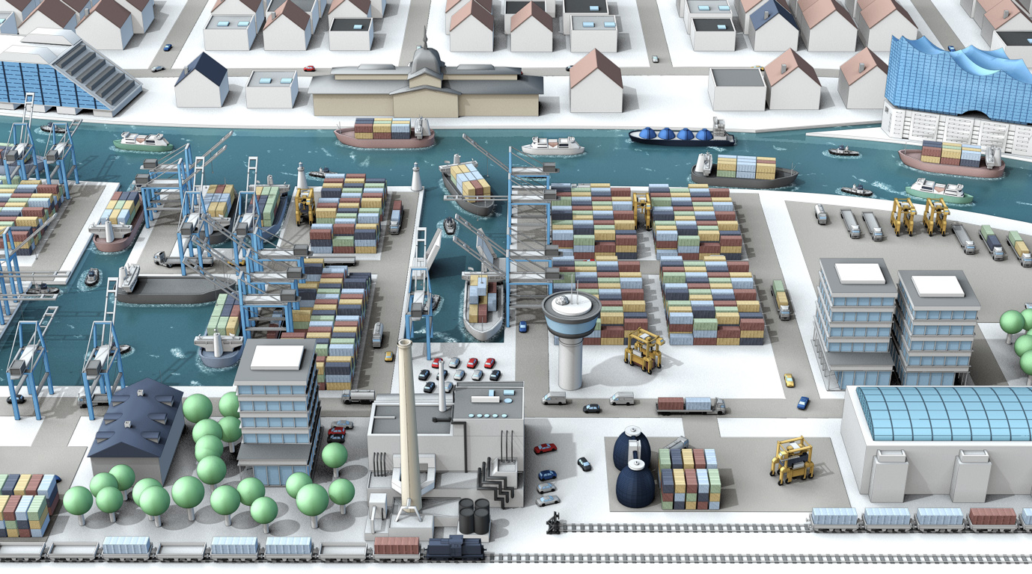
SMART PORT LOGISTICS POWERED BY

Slide 3
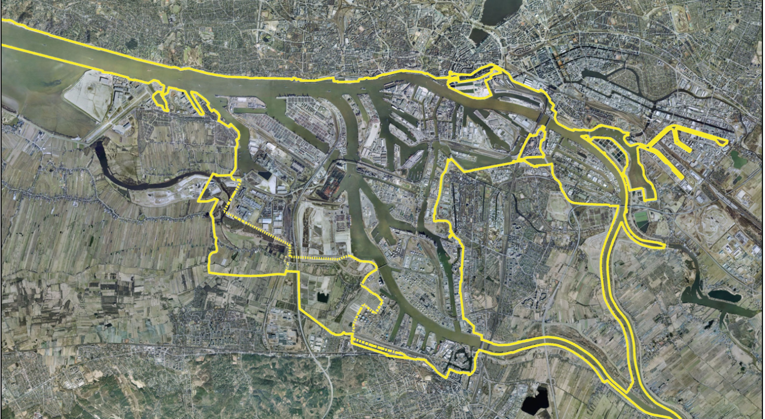
PORT OF HAMBURG
FACTS & FIGURES
PORT INFRASTRUCTURE
ROAD 132 km
Railway 300 km
Quay Wall 52 km
Land 7.156 ha

Slide 4


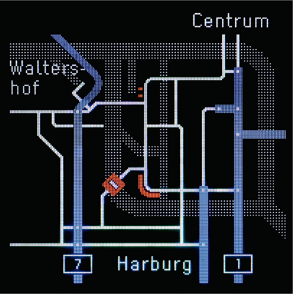
HAMBURG PORT AUTHORITY - HPA
PORT ROAD MANAGEMENT
Basic elements of Port Road Management (PRM)
  comprehensive traffic detection (induction loops, video detection, Weigh in Motion (WIM), Bluetooth)
  dynamic traffic information boards, to minimize the effects
  of grid disturbances
Concept PRM
  graphical representation of information on the overall situation
  text panels for track-based information at strategic nodes
Ideas for a individual traffic steering
  driver gets information from the Port Road Management Center in time about the traffic situation
  messages are also available for the driver after passing the graphical information displays.
  drivers get offered value-added services (eg, display of free parking at the next two rest houses on the route, traffic conditions)

Slide 5
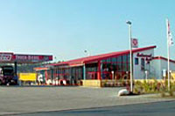



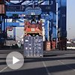





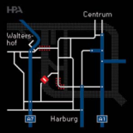






VISION
INTERMODAL TRAFFIC MANAGEMENT
Private Cloud
Information feed from
various information platforms
Parking Operator
Information about free slots
PRISE
Container Terminals
TransPort – Rail Basic
Trucking Co, Freight Forwarders
Telematic Front-End
Port Road Management
Infrastructure &
Traffic Information
Telematic Front-End
Systems of other
Stakeholders
TelematicOne Units
Other Telematics Units

Slide 6
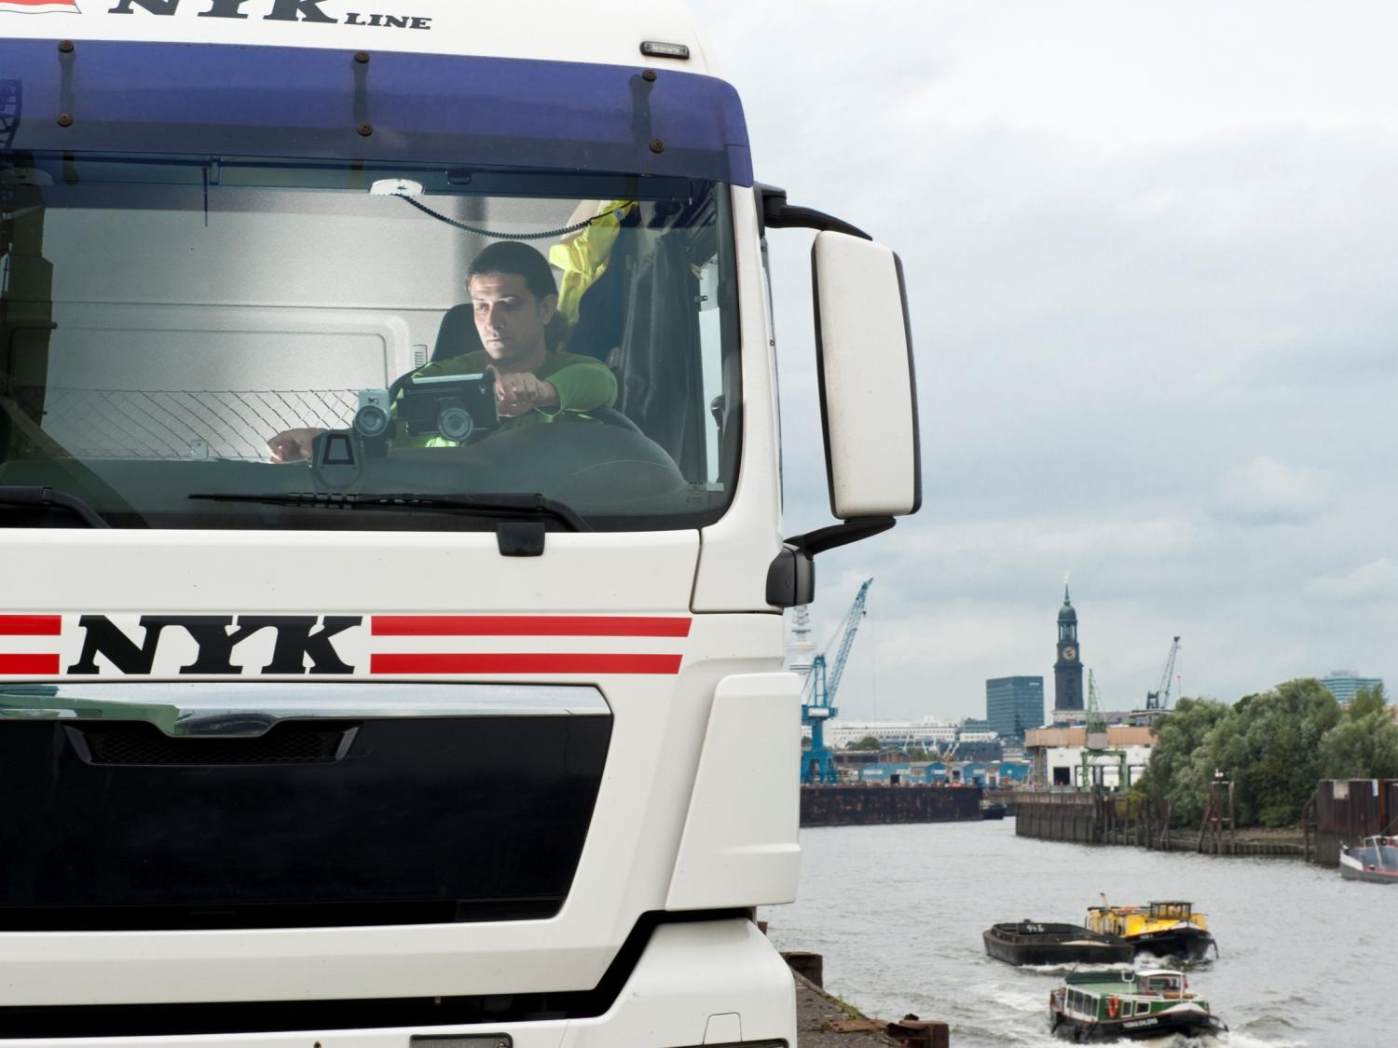
VISION: INTERMODAL TRAFFIC MANAGEMENT
Once the information of the three transport modes are united in one system, […] the Port of Hamburg could take a leadership over other competitors in IT-supported business processes in port industry.

Slide 7
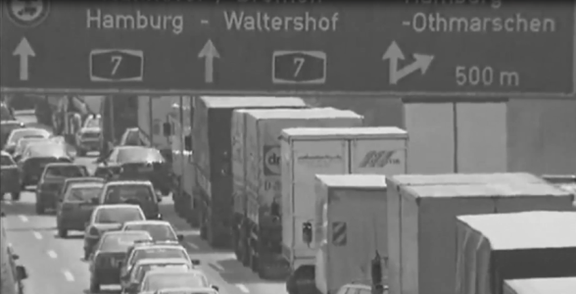
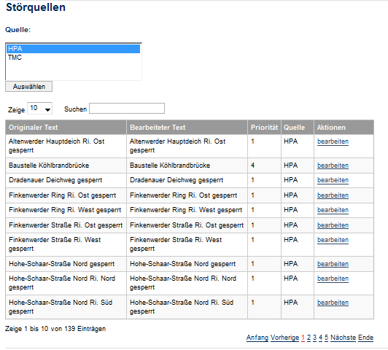
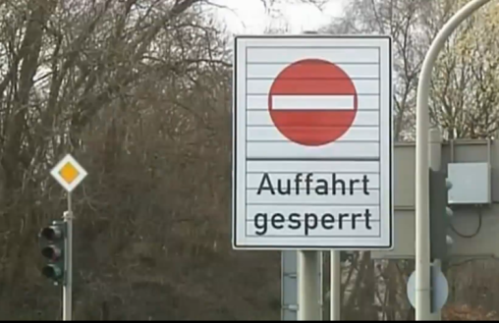
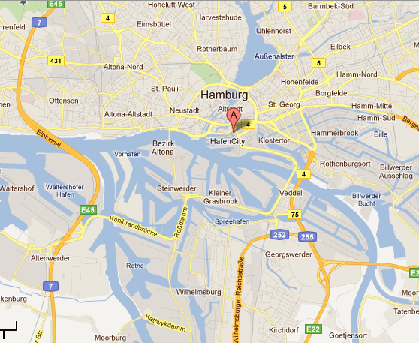
INFRASTRUCTURE AND SERVICE PROVIDERS FEED THE SYSTEM WITH UP-TO-DATE INFORMATION AND ENABLE USERS TO MAKE SMART DECISIONS
geofence M
geofence P
geofence N
geofence O

Slide 8
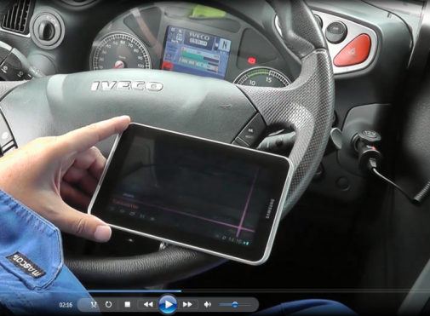
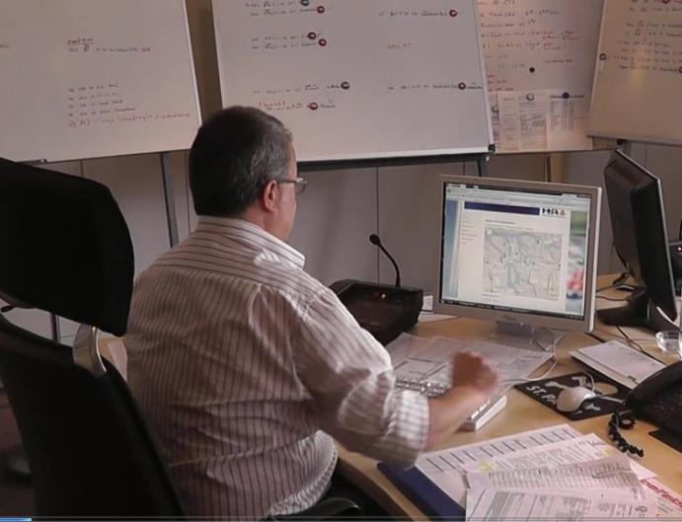
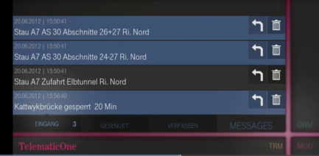
INFRASTRUCTURE USERS GET PERSONALIZED SET OF RELEVANT TRAFFIC & INFRASTRUCTURE INFORMATION RIGHT IN TIME TO OPTIMIZE THEIR BUSINESS

Slide 9
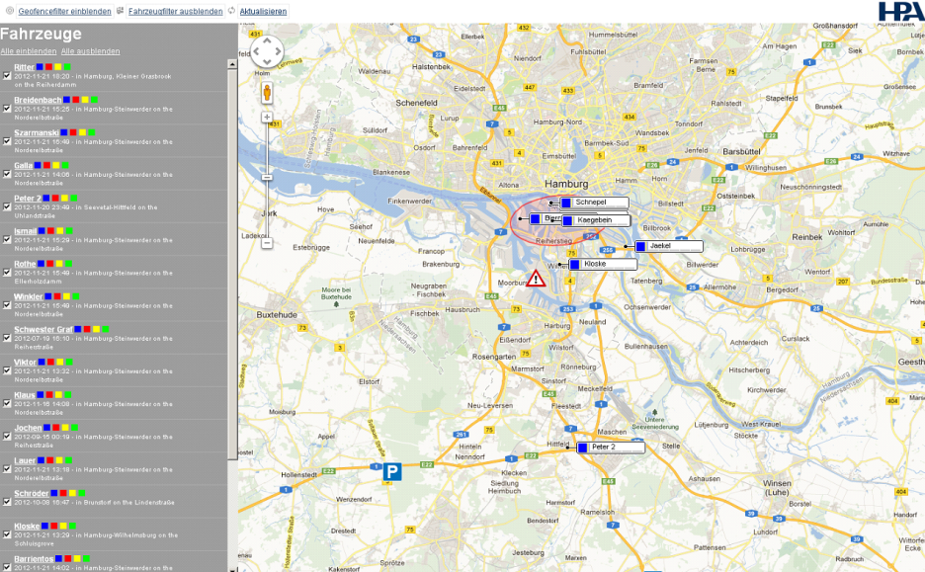
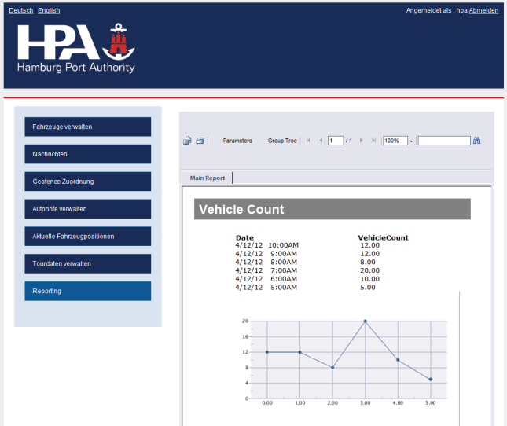
FLOATING CAR DATA FROM FREIGHT FORWARDERS PROVIDE A VALUABLE INPUT TO INFRASTRUCTURE ASSESSMENT AND OPTIMIZATION

Slide 10






SMART PORT LOGISTICS
FIELD TRIAL PARTICIPANTS
Parking Space Provider
Smart Port
Logistics
Port Road Management
Freight Forwarder
Telematic One Cloud Service Provider
Traffic Data
Business Web Cloud Service Provider

Slide 11
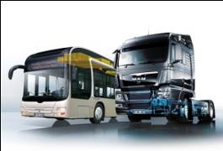

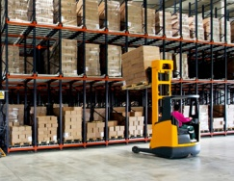

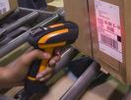
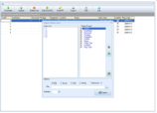
INTEGRATION & ENCAPSULATION OF M2M FUNCTIONALI-TIES WITHIN DT‘S M2M INTEGRATION PLATFORM. SERVICE EXPOSURE THROUGH AN OPEN SERVICE MARKETPLACE
Truck- & Trailer OEMs
Freight Forwarders
Logistic Network Operators
M2M Integration Platform
Logistics Services
Connected Car
Services
other „Connected Things“
Services
Service
Marketplace
Remote
Device Management
Complex
Event Processing
Data Integration
Device Abstraction
Connectivity
Management
Data Collection
Truck & Bus
Trailer
Goods
Infrastructure
Devices
3rd Party Services

Slide 12
THANK YOU!
 | Markus Lindemann
Contact | Telefon +49 5361 186-526 Mobile +49 151 14823333 E-Mail markus.lindemann@t-systems.com
 | Head of Global Competence Center Embedded & Machine 2 Machine Solutions Alessandro-Volta-Str. 11, 38440 Wolfsburg

