Slide 1
‚Internet der Dinge’ - Chancen und Herausforderungen für bestehende Unternehmen
Bernd Groß – Geschäftsführer, Cumulocity GmbH
Cumulocity - A compound word from ‘Cumulus Cloud’ and ‘Velocity’

Slide 2
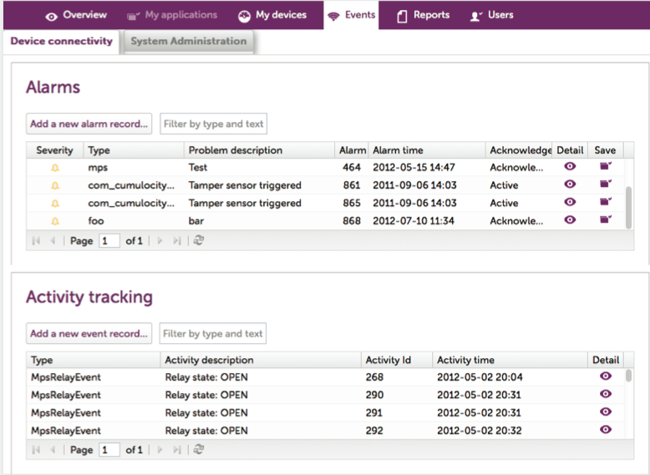
Three categories of M2M Applications (1/3)
#1 Business Process optimization
Shift moved from
large to medium
small enterprises
Enterprise IT e.g. ERP
Wide
Area
Network
Middleware layer
e.g. Cloud Platform
Device Operations
Often
requires a
Business
Transformation
Approach (PPP)
Operations
Sensors
Devices
  ‘Creating a virtual image of the real world’
  ‘You can only manage what you can measure’
  Examples: remote maintenance, smart city use cases, supply chain

Slide 3
Three categories of M2M Applications (2/3)
#2 Introducing new Business Model
Wide
Area
Network
Middleware layer
e.g. Cloud Platform
Operations
Sensors
Devices
  New Business Model based on usage based pricing,
  event based pricing
  Examples: UBI, Printing, Coffee machine, ‘TaaS’ etc.

Slide 4
Three categories of M2M Applications (3/3)
#3 New Service Offering/ New Revenue Streams (big data emerging)
Wide
Area
Network
Middleware layer
e.g. Cloud Platform
Operations
Sensors
Devices
  Example – Connected vending solution with advertising billboard, cashless payment, ‘30min WiFi access’ when purchasing a drink, Telematics data monetization

Slide 5
And in the future?
#1 Business Process optimization
?
#2 Introducing new Business Model
#3 New Service Offering/
New Revenue Streams

Slide 6
And in the future?
‘Internet of Things’ => Mashups
Everything will be Connected across different verticals
Telematics/ Logistic,
Energy, Health, Industry 4.0, Smart City, Retail etc.
#1 Business Process optimization
#2 Introducing new Business Model
#3 New Service Offering/
New Revenue Streams

Slide 7











Challenges for ‘Industrial M2M’
Customized software and hardware development
  Expensive and long development time
  Vendor lock-in?
  Standardization still emerging
  Integration into existing backend systems e.g. ERP vs. renewal of IT
Closed usage, closed systems – Innovations?
Interworking with the ‘Connected World’
  Internet business model is based on Data Monetization
    consumer is advertising base
    enterprise is usage based based
  Do I produce a Product or a connected smart object?
Industry 4.0 applications/
IT backend
Communication
network
Embedded Computing
Industrie 4.0
Automation

Slide 8

Shift from Closed Systems to Open Systems
Bespoke
Solution
Telematics
Health
Retail
Industry
4.0
…
Vertical
Open REST APIs
Open System
Application Cloud
Monitor, Control, Analyze,
Manage etc.
DB
Closed
System
Device Cloud
Cloud based storage
& Device Management as a Service
Open REST APIs
Any device, sensor

Slide 9
Thank you!
Bernd Gross
Geschäftsführer Cumulocity
Phone: +49 172 40 84 116
Email: bernd.gross@cumulocity.com
www.cumulocity.com

