Slide 1
Our world of Smart Objects of Tomorrow
Peter Friess EC Coordinator Internet of Things European Research Cluster DG CONNECT - DG for Communciations Networks, Content and Technology
European Commission
Images source: Internet wallpaper sites

Slide 2
The Internet of Things has finally arrived
_Attention of many governments
_Industrial stakeholders are taking up the subject
_End-users get more used to smart devices
_Powerful combination with various approaches – Cloud, Future Internet, Big Data, robotics…
_Emerging business models like M2M, ,IOTS, IOE…

Slide 3
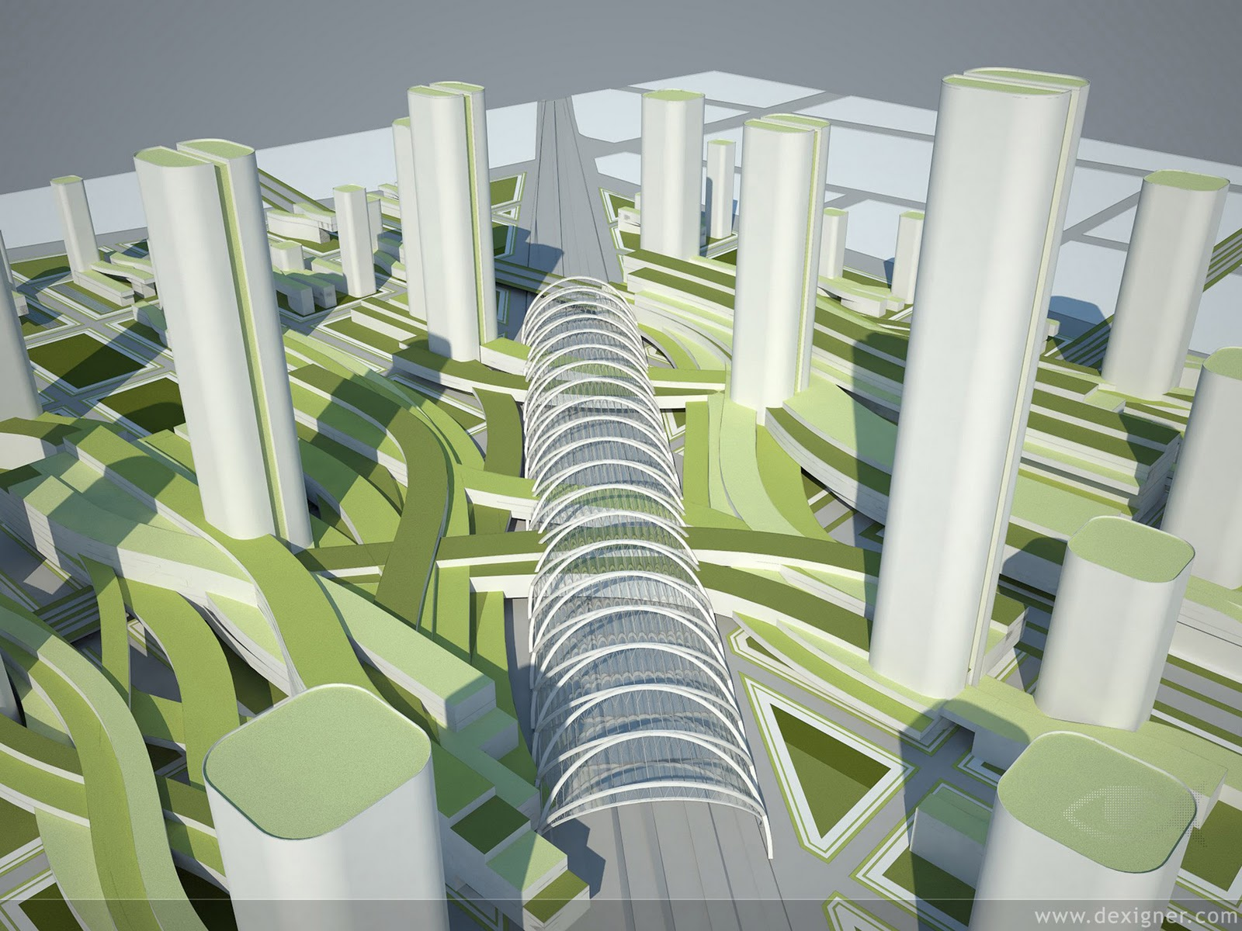
Major Internet of Things application areas for the moment
_Smart Cities (and regions)
_Smart Car and mobility
_Smart Energy
_Smart Home /assisted living
_Smart Industries
_Public safety
_Disaster prevention
_Agriculture
_Tourism
_….

Slide 4
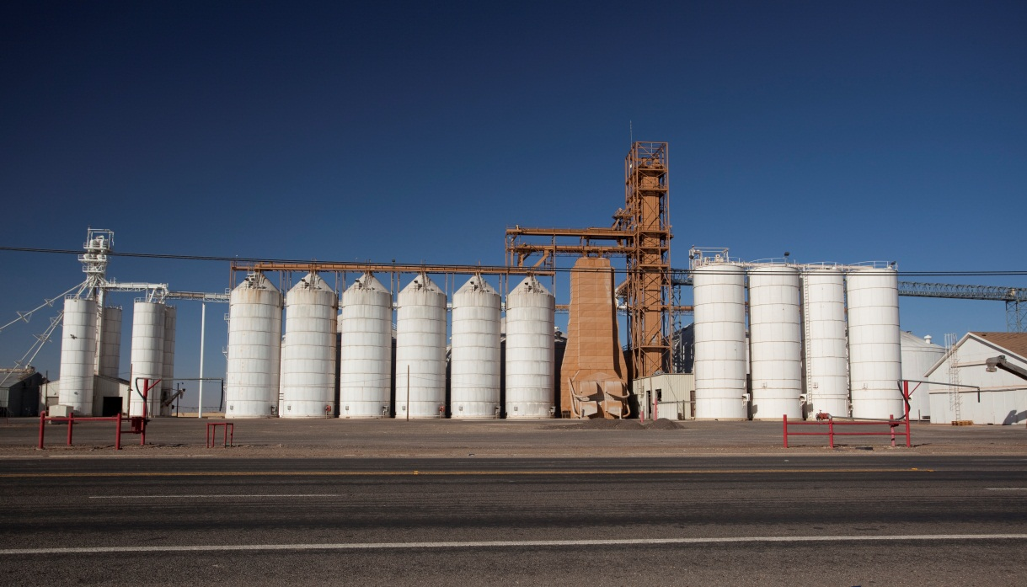
But what about the current mind set…
… Vertical application silos

Slide 5
Why does the Internet of Things not really work today?
No forward approach towards universal numbering
Not enough push on multi purpose sensor networks
No solid IOT architectures
Missing semantic interoperability
No clear models for ownership of data
No augmented and rich interfaces
Too much focus on existing technology / business approaches

Slide 6
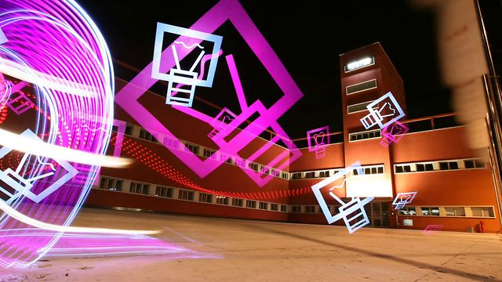
Future research and innovation
Real-time interoperability of real and virtual objects
Generic IOT platforms for smart connected objects
Security and Privacy design related to less controlled environments
Integration of results from nano, bio and neuro sciences
Application of autonomous/self-organising system behaviour
Real-time models and design methods for service development
....

Slide 7
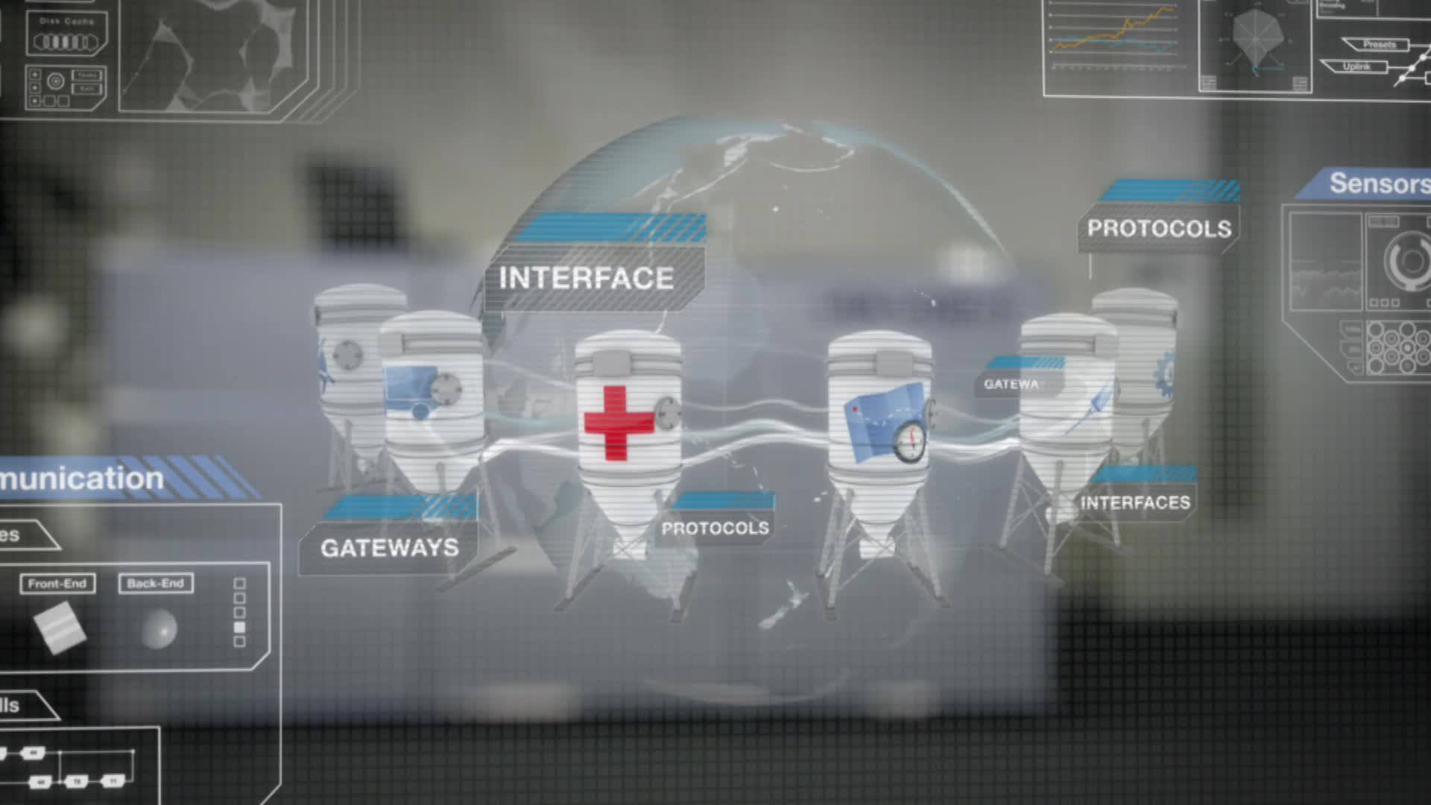
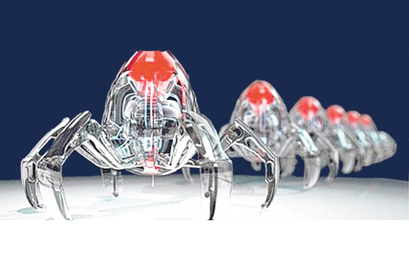
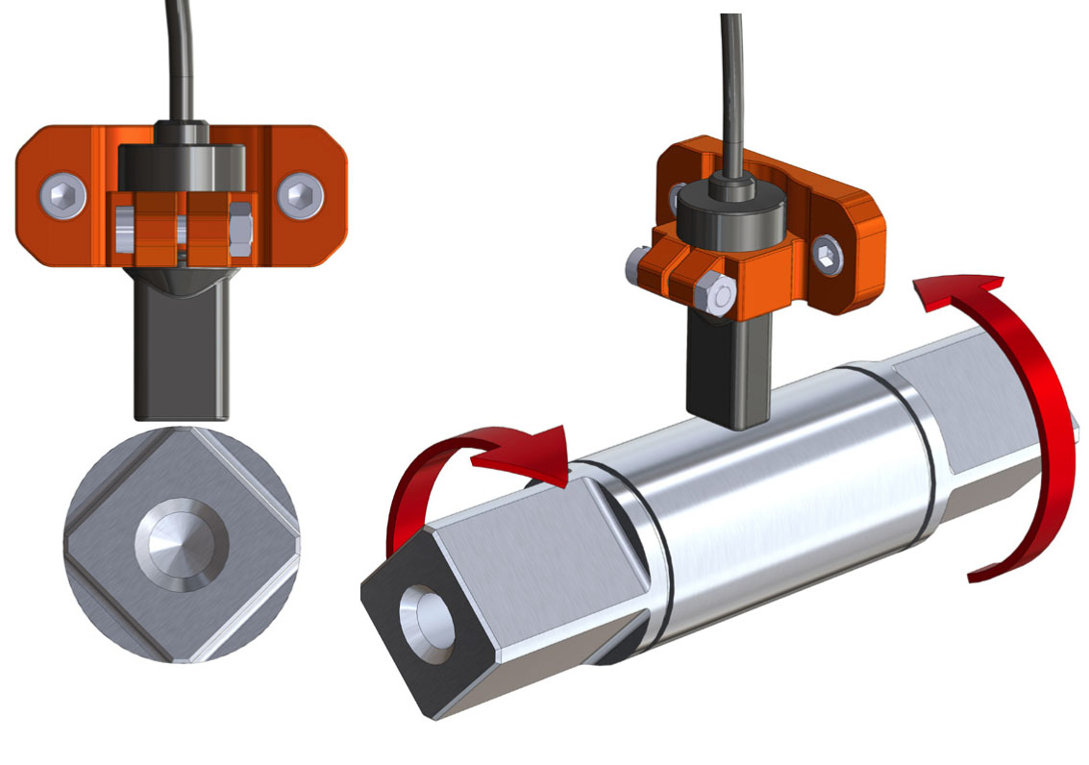
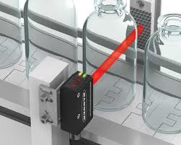
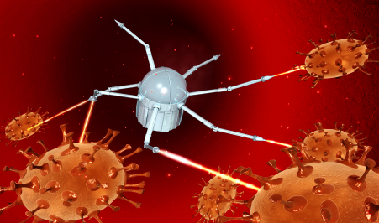
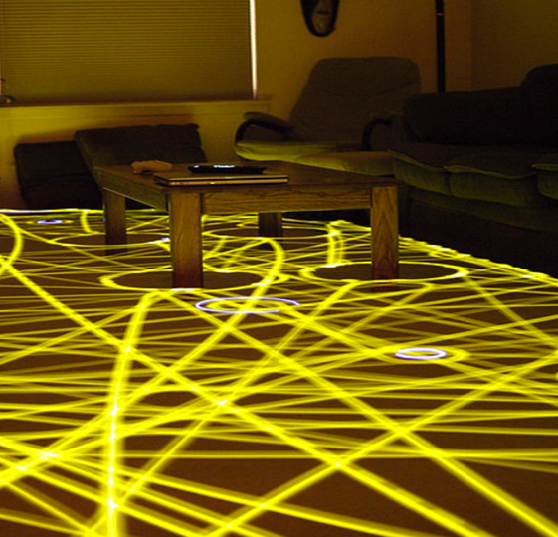
From sensor…
…to smart object

Slide 8
Towards the IOT universe(s)…
Explore new
worlds
Master the virtual
Connect application silos
Connect sensors and objects
Societal change
Technological change

Slide 9
EC support
Research
FP: 70 MEUR direct funding in three calls
H2020: IOT cross-objective and related to networks
IERC – Internet of Things European Research cluster
IOT Pan-European research area
Innovation / take-up
Encourage industry initiatives
Build public sector leadership
Venture capital funding
Politics / society
Promotion of standardisation and interoperability
Advancement in competive mobile access
Promotion and orientation of EU values and norms (privacy by design, data protection directive)

Slide 10
www.internet-of-things-research.eu

