Slide 1
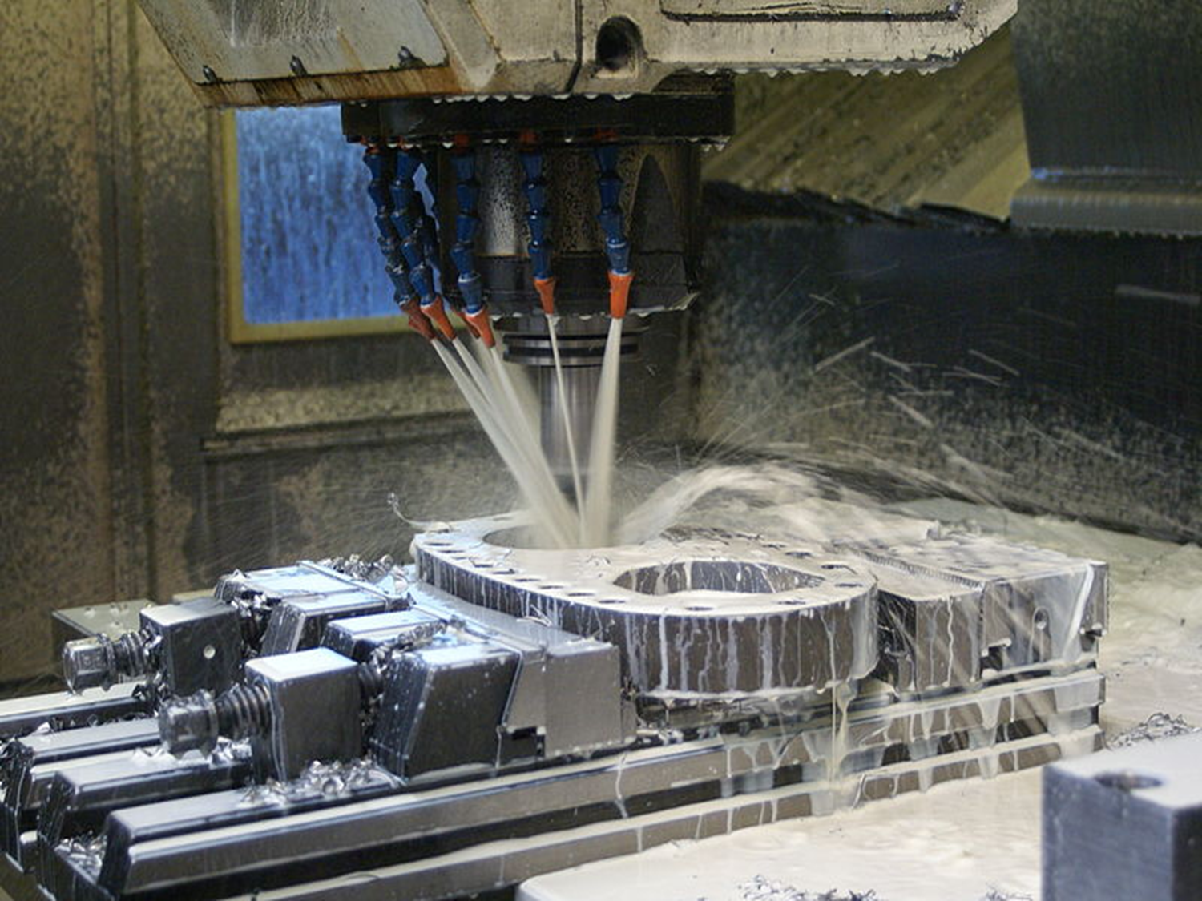

SAP for Industrial Machinery & Components
Industrie 4.0 für den Anlagen & Maschinenbau
Heiko Flohr, Global Head IBU Industrial Machinery & Components, SAP AG

Slide 2

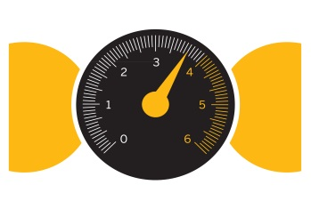
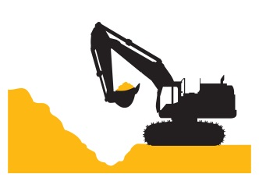
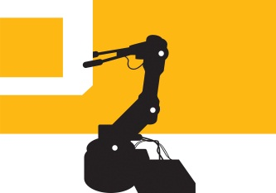

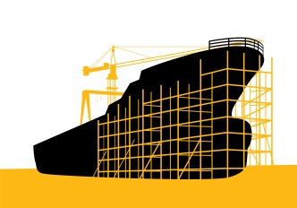
Our Industry Expertise Helps Companies Run Better
6.400+ SAP Customers in the
Industrial Machinery & Components industry
in every of the five industry segments
AUTOMATION & CONTROL SOLUTIONS
CONSTRUCTION & MINING EQUIPMENT
MACHINERY & EQUIPMENT
ENERGY & POWER
EQUIPMENT
RAIL EQUIPMENT & SHIPBUILDING
Motion and Fluid Control
Electrical Equipment, Appliance, and Components
Measuring & Controlling Devices
Construction Machinery
Mining Machinery
Heavy Equipment Dealers & Rentals
Metalworking Machinery & Tools
Special Industry Machinery
Elevators, Escalators, and Material Handling Equipment
Heating, Ventilation, Air Conditioning, and Refrigeration Equipment
Oil & Gas Machinery
Turbines and Generators
Pumps and Pumping Equipment
Air & Gas Compressors
Transformers
Railroad Equipment
Ship Building and Repairing
Notes:
5 main Segments => Structure of IM&C
A&C : e.g. Siemens, ABB
C&M : Machines on wheels (e.g. CAT, Hitachi)
M&E : Biggest Segment
E&P :Turbine, Nuclear Transformation, Wind, …
R&S : High Speed Train, …

Slide 3
The Next Generation Business Model
Solution Provider Network
Delivering Turn-Key Solutions
Leveraging Eco-systems
Leveraging New Technologies
Contract Manufacturer
BANK
Bank
Supplier
Competitor
New Value and Revenue Streams
IM&C Manufacturer
3rd Party
Service Provider
Customers
Direct & Channel Sales
New Technology
Distribution
Customers
Customers
Notes:
<click>
The first opportunity is Delivering turn-key solutions.
The business transformation toward a solution provider network includes a shift from just selling finished goods and spare parts to providing complete aftermarket service and value-added support in addition to the original equipment. This network could include parties like 3rd party service providers for installation and non traditional partners like banks for financing.
Why are turn-key solutions important?
A study by Deloitte found that some of the best performing manufacturing companies generate 50%of their revenue from services, while the average company is only at 26%
Additionally, the average profitability of service and spare parts operations are typically more than 75% higher than the profitability on original equipment and machinery
<click>
The second opportunity is leveraging ecosystem networks.
Going beyond the four walls of the manufacturing plant and extending out to ecosystem networks present opportunities for manufacturers to collaborate more closely downstream with customers and upstream with suppliers. This increased collaboration can create new value for the customer by enabling you to be the one stop shop for the customer and create revenue stream enhancements for the manufacturer. Leveraging your ecosystem also provides a unique competitive advantage for your company as it is much more difficult to copy an ecosystem than a product or service .
<click>
The third opportunity for manufacturers is to drive customer value through innovating processes and leveraging new technologies.
Product sales cycle of machinery manufacturers is getting shorter because product innovation is getting faster; however, aftermarket sales and service cycle is getting longer. By leveraging technology, machinery manufacturers can create products in a totally different way.
Mechatronics, for example, which combines mechanics, electronics, and computing to provide a synergistic approach to using hardware, electronics, and imbedded software, is becoming increasingly important
So if these are the opportunities that present themselves to industrial manufacturers, what must Industrial manufacturers do to capitalize on these opportunities?

Slide 4

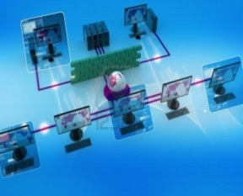

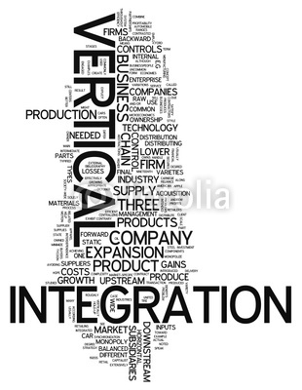
SAP for Industrial Machinery & Components
5 Elements of Industry 4.0 / Integrated Industry
1
People & Machines
2
New Business Models
3
End-to-End Processes
4
Vertical Integration
5
Machine Life Cycle
+ 20 years

Slide 5

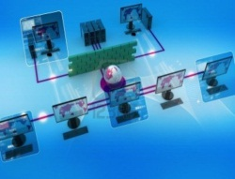
SAP for Industrial Machinery & Components
5 Elements of Industry 4.0 / Integrated Industry: The future will come automatically-
1
    Increasing Digitalization – Virtual World and Real World coming together – “White Collar Robots”
    What can be automated, will be automated
    Human – Machine Interface need to be developed new
People & Machines
2
    Collaborative Consumption; Sharing Economy; Asset Light lifestyle
    New Industrial Downstream Service e.g.“Machine Benchmarking”
    Pay on Production Models; Scan and Copy (3D); Usage Based Billing
    Asset Life Cycle Business Models with continuously changing partners
New Business Models
3
    Networked and decentralized organized services (Fractal)
    Cyber Physical Networks; Usages of Vision and Noise
    Heterogynous system structure need to need harmonized
    Plug & Produce – Dynamic Processes
E2E Process
4
    Automation of business processes
    Creation and processing of data on all levels of details
    Assembly & Sub Assembly are self-controlled and part of the autom.
    People Safety needs to be reached on the highest level possible
Vertical Integration
5
    Alignment of the different life cycle of Software, Mechanics, Automatisation and the respective area for usage in production, energy, process areas need to be aligned over a longer period of time.
    Incentive & Registration Models to stay connected
Machine Life Cycle
+ 20 years
Notes:
1 ) Roboter lernen und werden nicht mehr programiert
2) Virtual Zäune um gegenstände
)9 argumented Reality

Slide 6
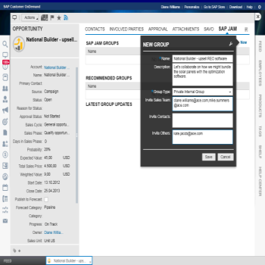
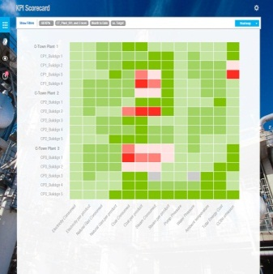
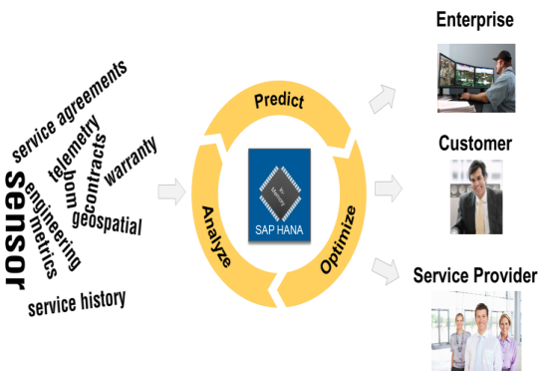
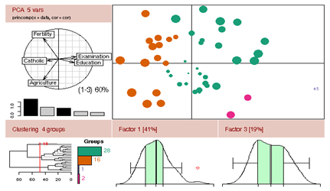
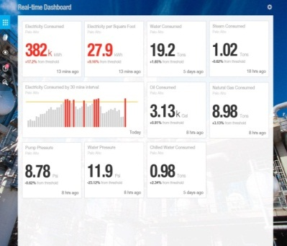
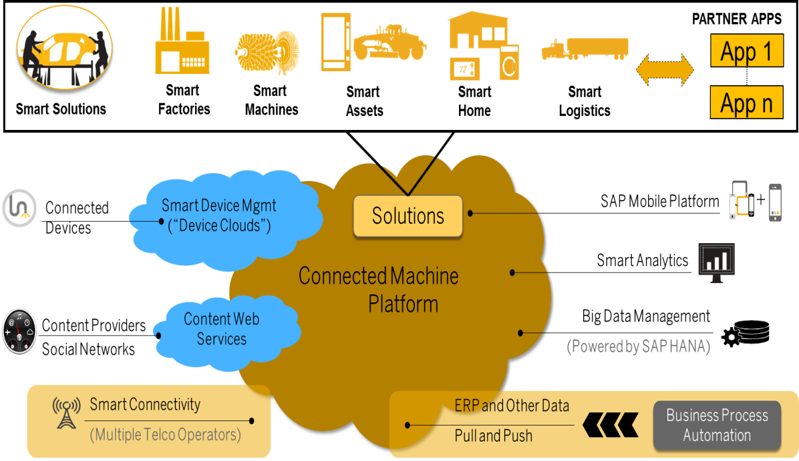
The Machinery Cloud Emerges: Emerging Applications
Some Examples
Service Tickets
Machine Heat Map
Predictive Analytics
Customer Dashboard
Notes:
As our customers are starting to make the vision a reality, so are we..
I would like to highlight a couple of very exciting emerging solutions, Predictive Maintenance & service and Configurable Product analysis as early examples of solutions that leverage the capabilities of the connected machine platform and start to deliver on the vision of the Machinery Cloud

Slide 7


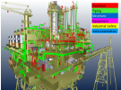





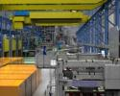

Industry 4.0: Idea to Performance
Integrated Business Solutions to Accelerate Idea to Product and Service Performance
innovate
design
plan
make
service
Visualization
Mobilize and flexible work force
360 degree analytics on products, assets and services
Collaboration across boundaries
Modular Design
Adaptive Manufacturing
Connected Systems
Invent, plan, visualize
Design for customer needs
Systems engineering
Interactive manufacturing networks
Machine to machine communication
Cyber physical systems
Intelligent connected assets
Just-in-time local 3D production
Connecting machines & humans
Embedded sustainable operations
Manage big data, understand the past and predict the future
Integration
SAP ERP
CAx
SAP M2M
Smart Sensors
Social Networks
Notes:
SAP has the opportunity and will deliver on a platform that enables companies to confidently innovate and grow in a connected world.
This graphic shows the structure of “360 Product” regards the solution layers as well as the end to end process coverage.
360 Product manages all processes, staring by Invent to Design, followed by Plan, Manufacture and Service. The goal is to look into this from an integrated process perspective to enable manufacturers to bring innovative products / services faster and highest quality to market.
Visualization: 3D visualization is changing the paradigm to communicate and collaborate across engineering, manufacturing and service. Visualization linked with business information is simplifying complex product descriptions while bringing all information around a product or component to the consumer on a finger tip anytime anywhere. Visual work instructions help to communicate more efficient in manufacturing while service information linked with visual instructions empower the service worked with all information he need.
Mobile: Mobile provides the flexibility to have all information which are needed in Engineering, Manufacturing or Service available anytime anywhere, combined with 3D visualization and analytics the workforce productivity is increasing.
Analytics: provide a 360 view on all required information of a product / service across roles and organizational boundaries supports fast and fact based decision making. Imagine a service worker can search at the customer side through a 3D product representation about spare parts, price, availability, quality reports and get visual via moves instructed how to exchange a component.
Data and Process Information center: integrated solutions for design (PLM), manufacturing (ME, MII, QM) and EAM provide the consistent description of data, structures, and processes for the products, services and assets.
HANA: All this applications can be supported by HANA to get real time information, for better and faster decision making
Integration: The open architecture of SAPs solutions allow to interact during all process steps with other systems, machines, or networks.
360 Product addresses the 5 Market category of SAP in an integrated and comprehensive fashion and represents a unique offering to provide highest value to our customers

Slide 8
Thank you
Heiko Flohr
Global Lead Industrial Machinery & Components
SAP AG
Heiko.Flohr@sap.com

Slide 9

www.sap.com

