Slide 1
Powering the Connected World™

Slide 2
Short Speaker Biography
John Canosa
Late 1980’s – University of Rochester, Laboratory for Laser Energetics. Developed one of World’s Largest System of Networked Microcontrollers. 10,000+ points of sensing & control.
Late 1990’s – Questra Corporation CTO. Pioneer in Web secure based remote monitoring / remote services application.
Present - ThingWorx. The first true application platform for rapidly developing and deploying for M2M/IoT applications.

Slide 3
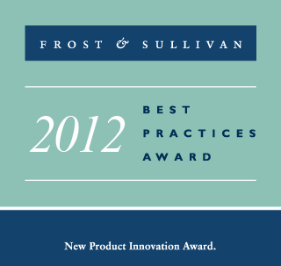
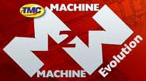
Founded 2009, Successful Software Entrepreneurs
Venture Backed (SFE)
Disruptive, Successful & Growing Rapidly
Recognized Leader
“ThingWorx is re-defining the concept of
connected platforms and creating a new market meta-category”
2013 Winner:
Best Platform for Enabling Third Party Developers
Notes:
And a little bit about our company …
Gartner 2011 Cool Vendor -

Slide 4
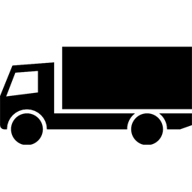
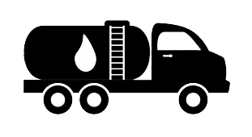
Some Misguided Thinking About Mass Adoption of M2M/IoT
“The Answer” (42!)
“Big Data”
All we need is IPv6!
It’s all about big data!
“The Cloud”
MQTT will Open the Floodgates!
ETSI Standards are the key!

Slide 5
Mass Adoption is Driven by Value Creation, not Technology
The Value of M2M/IoT Can Only Be Realized Through Applications and Interactions

Slide 6
1 Trillion
100M
Apps
5M
Apps
50B
10K
1B
2010
2020
2035
Notes:
We are just at the beginning of this connected revolution ---- let me give you some numbers
2010
2020 50X increase....
25 years 1000X increase
we are in the first phase of the connected revolution which will lead to even greater opportunities for innovation and a step change in business efficiency
But only if we capitalize on it

Slide 7
Applications are the Key to Value Creation
Rapid Application Development is the Bottleneck Holding Back Mass Deployment of M2M

Slide 8
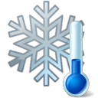
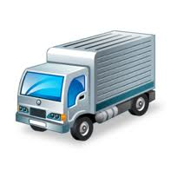
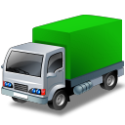
Applications are the Key to Value Creation
Big Data Analytics
Consumer
Sentiment
Optimized Operations
Real-time Demand
Production Scheduling
Temperature
Forecasting
Traffic
Smart Vending
Repair
Replenish

Slide 9
Applications are the
Connected
Key to Value Creation
Big Data Analytics
Consumer
Sentiment
Optimized Operations
Real-time Demand
Production Scheduling
Temperature
Forecasting
Traffic
Smart Vending
Repair
Replenish

Slide 10
What is Required to Remove the Application Bottleneck?
Ubiquitous Connectivity
Easily Extensible, Business Oriented Semantic Models and the Tools to Create Them
Remove the Dependency on the Programmer or IT Specialist for Generating Interactive Applications

Slide 11
Ubiquitous Connectivity
App 1
App 2
App N
HTML5 User Interface
Native Mobile Apps
ERP/CRM
EAM
Micropayments
Service Mgmt
Content & Services
Social Sources
App Server (Cloud, Customer Data Center, On-Premise, Embedded)
Platform APIS
Business App Integration
External APIS
Application Enablement Platform
Data
Storage
Dev
Studio
App
Services
Device
Cloud
App
Templates
External
Integration
Internet
APIs
APIs
3rd Party
Device
Clouds
Provisioning Platform
Mobile Network
Direct to API
3rd Party
Agent
ThingWorx
Microserver
Sensors, Machines,
Devices,
Systems
Dev Cloud
Agent
3rd Party
Agent
ThingWorx
Microserver

Slide 12
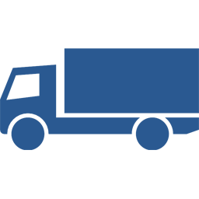
Extensible, Business Oriented Semantic Modeling
Properties
Services
Events
Subscriptions
Contained Things
Mashups
Notes:
Need to define each type of Thing.

Slide 13
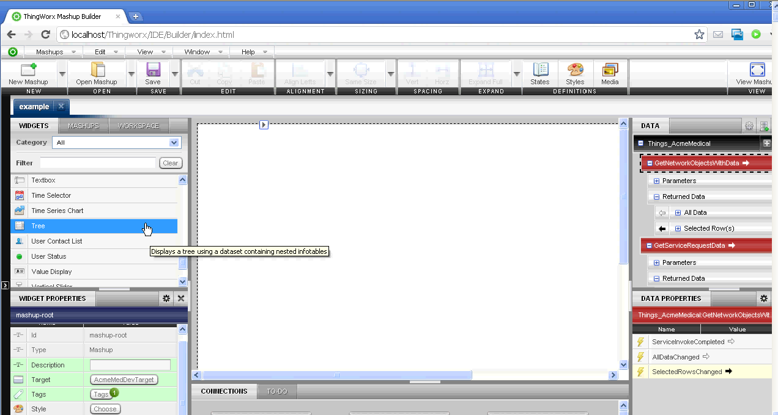
Removing The Programmer / IT Specialist From the Equation

Slide 14
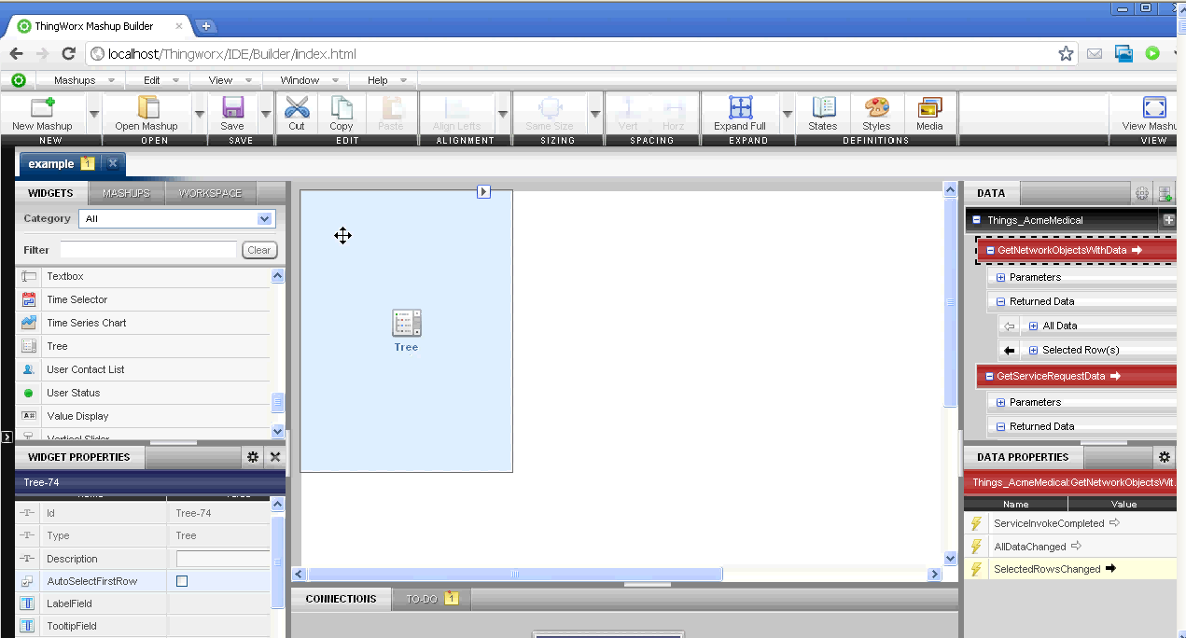
Removing The Programmer / IT Specialist From the Equation

Slide 15
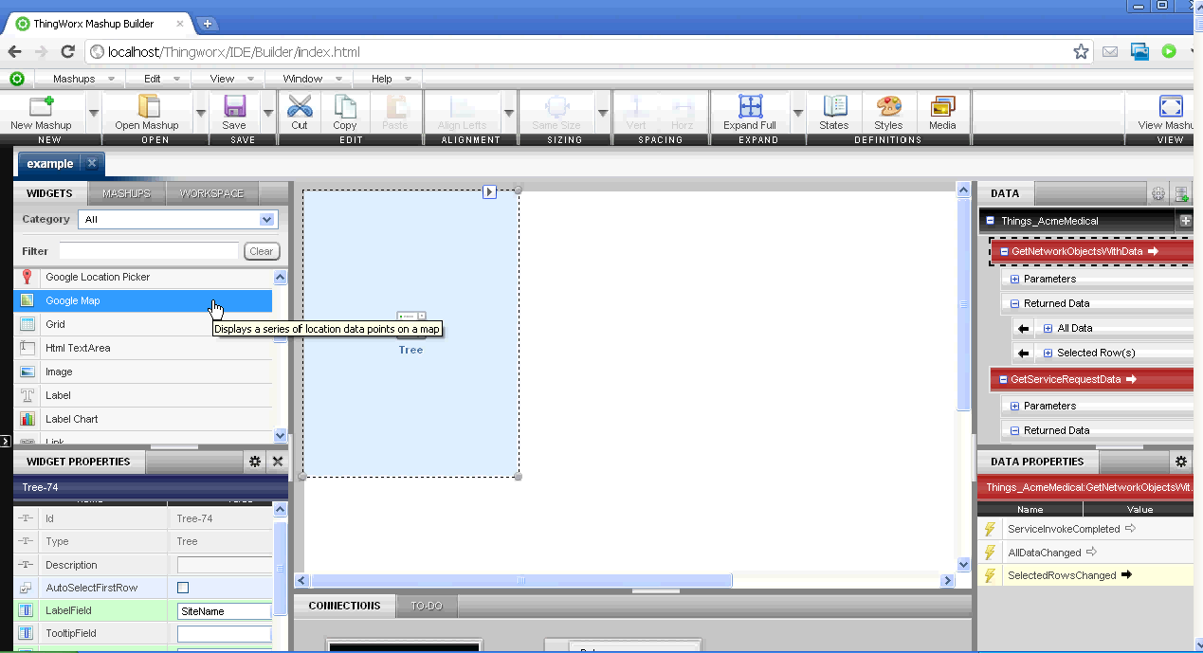
Removing The Programmer / IT Specialist From the Equation

Slide 16
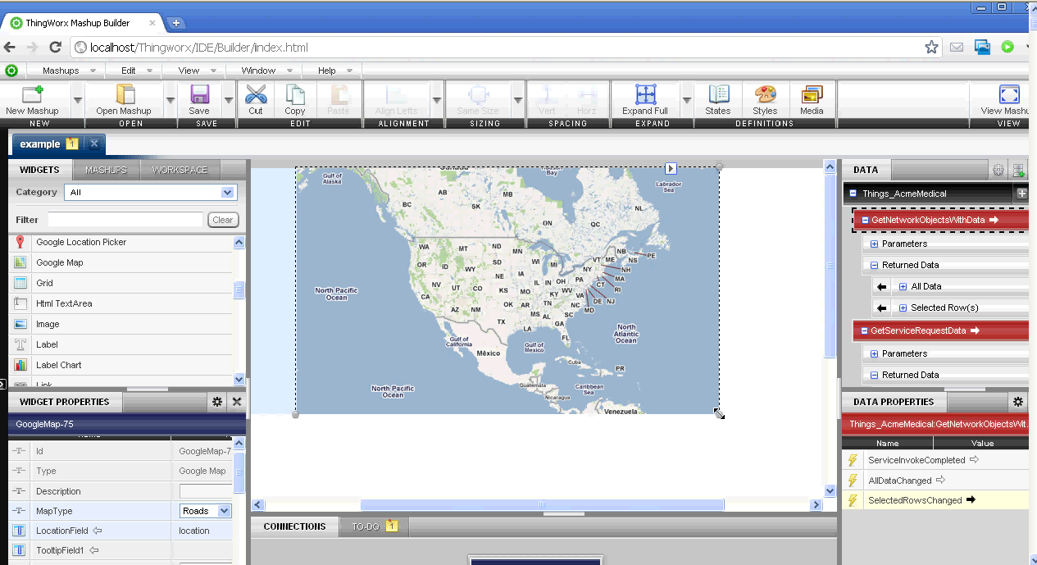
Removing The Programmer / IT Specialist From the Equation

Slide 17
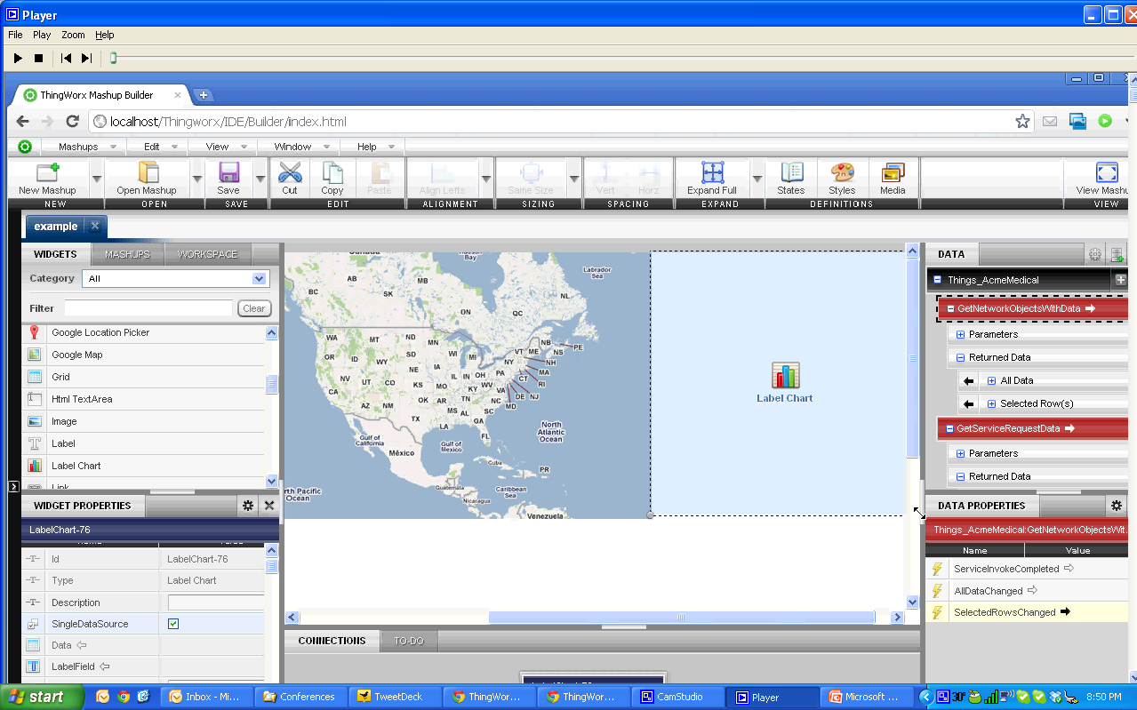
Removing The Programmer / IT Specialist From the Equation

Slide 18
Removing The Programmer / IT Specialist From the Equation

Slide 19
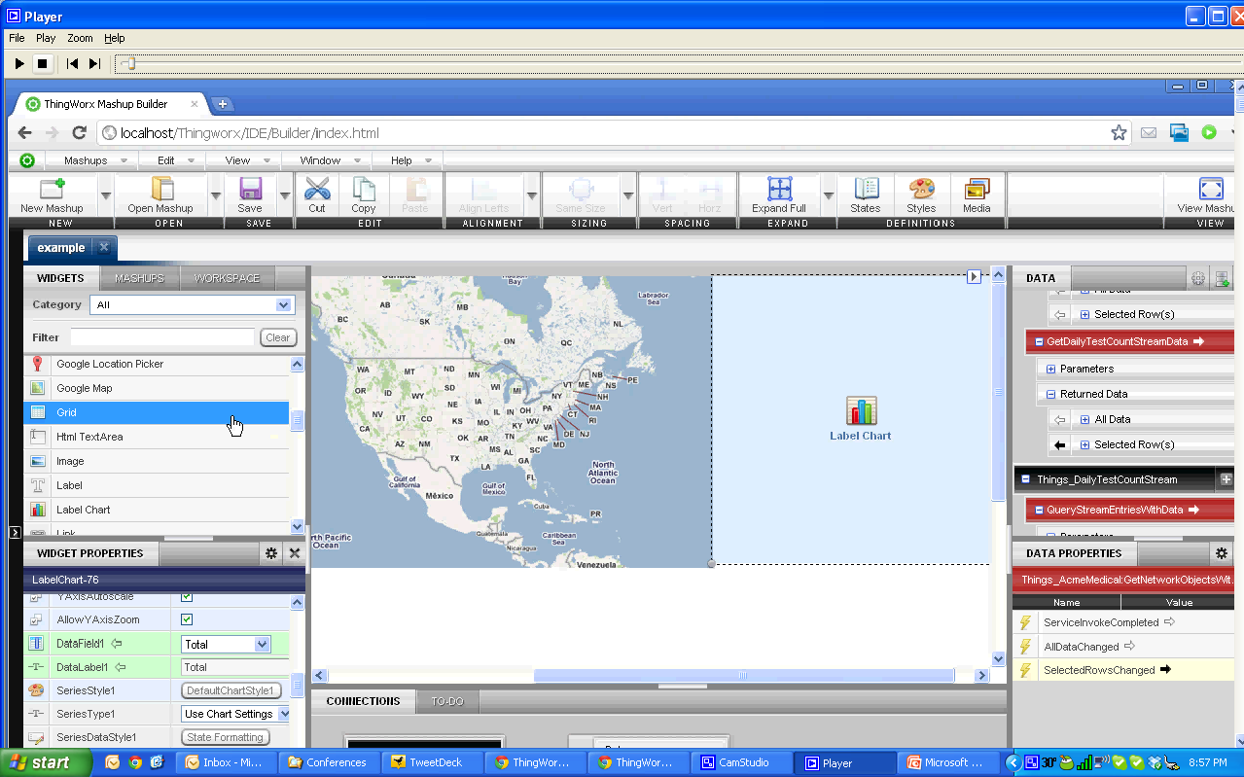
Removing The Programmer / IT Specialist From the Equation

Slide 20
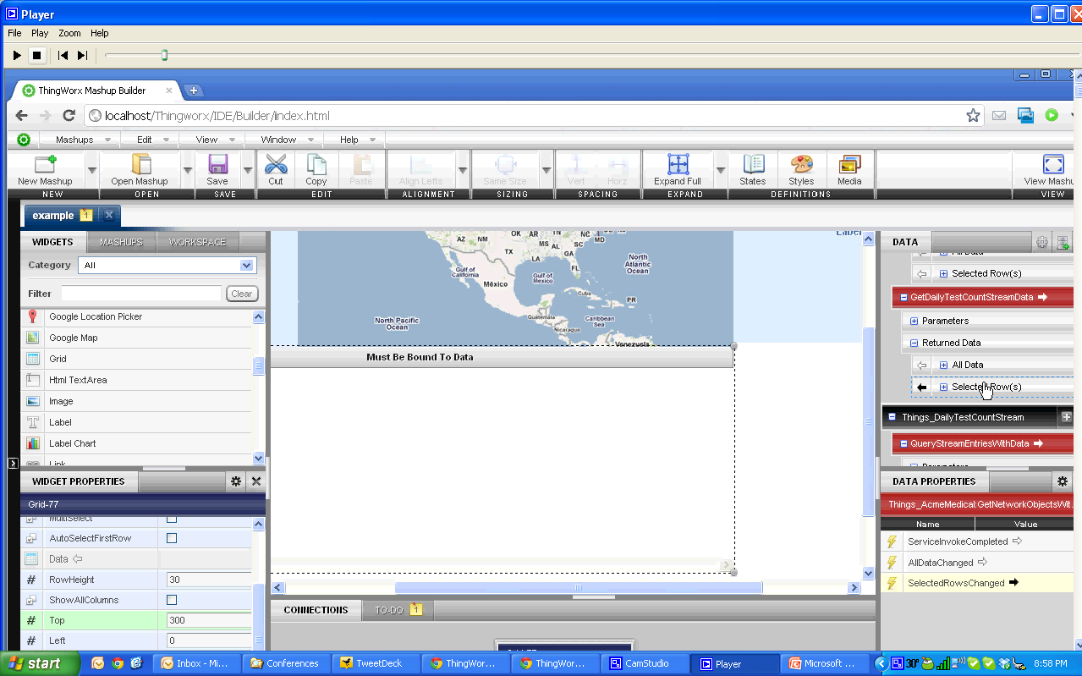
Removing The Programmer / IT Specialist From the Equation

Slide 21
Removing The Programmer / IT Specialist From the Equation

Slide 22
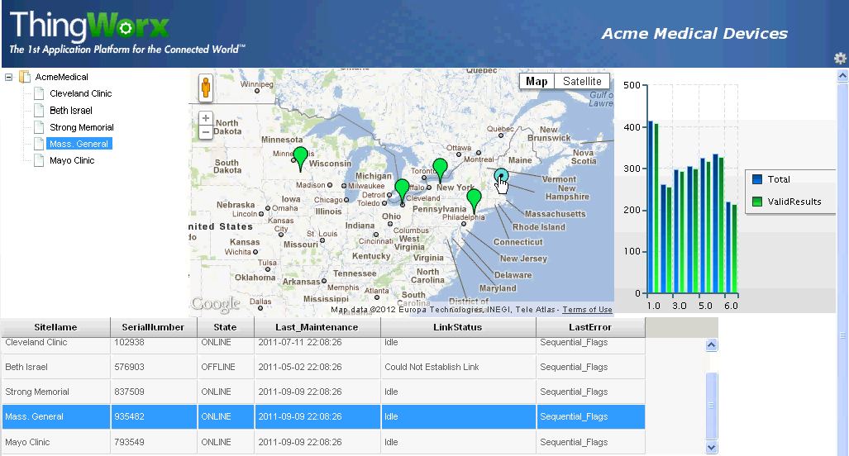
Removing The Programmer / IT Specialist From the Equation

Slide 23
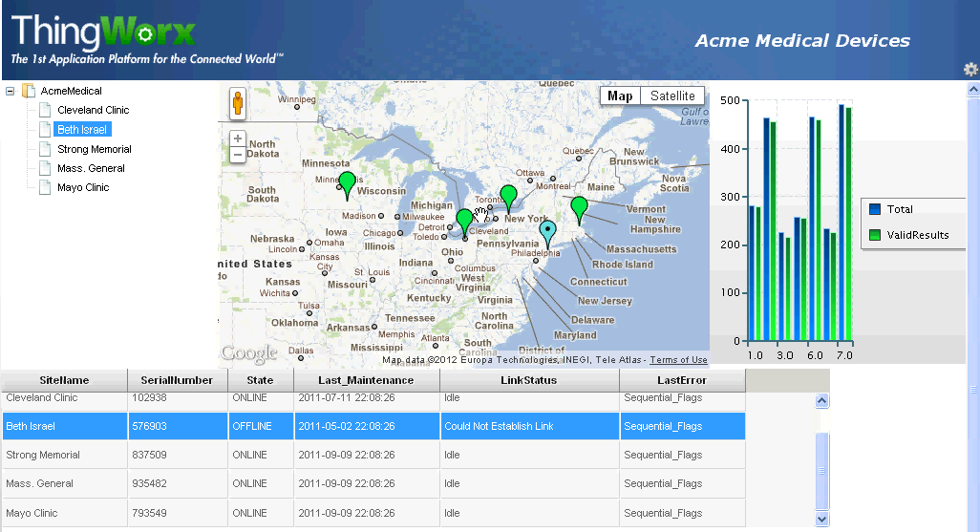
Removing The Programmer / IT Specialist From the Equation

Slide 24
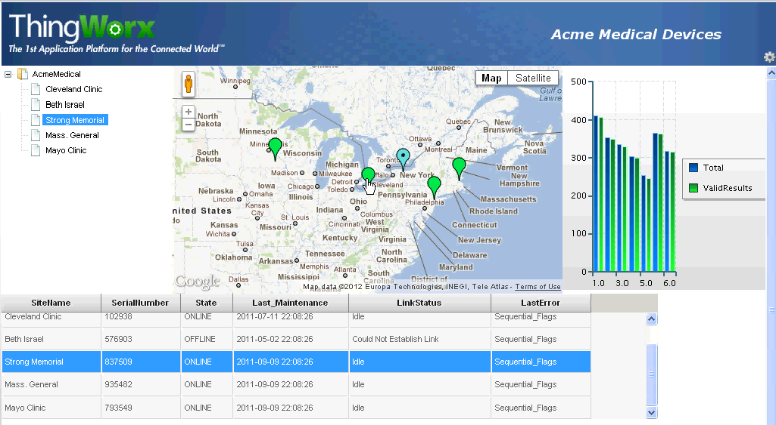
Removing The Programmer / IT Specialist From the Equation

Slide 25
Removing The Programmer / IT Specialist From the Equation

Slide 26
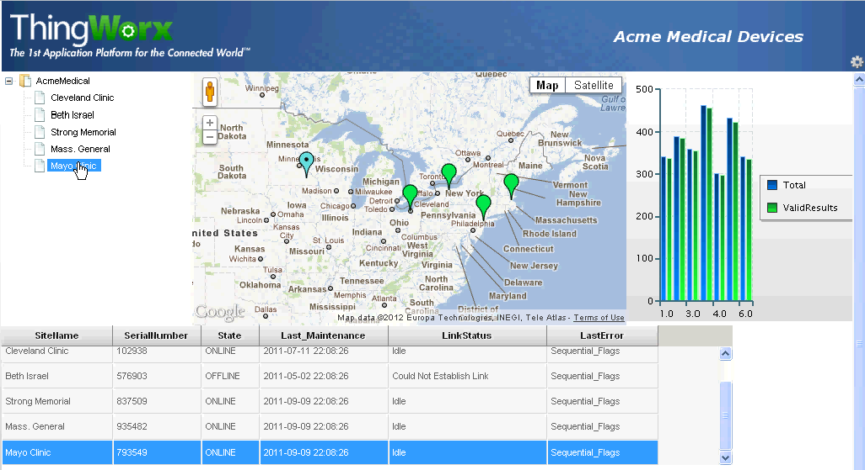
Removing The Programmer / IT Specialist From the Equation

Slide 27
Summary: Mass Deployment of M2M Requires a Major Shift
10X Faster
Only Complete Platform Designed to Build & Run Applications Connecting
Build and Run Applications Connecting
PEOPLE SYSTEMS THINGS
Notes:
This is where ThingWorx comes in
Started 3.5 years ago
We have built the 1st Platform designed specifically to build and run Connected Applications
Applications that connected people - systems/data and smart things
We profess and our customers experience between a 5 - 10x reduction in App Development time
Critical advantage as we imagine and develop the Millions of applications required to make the CW a reality

Slide 28
Vielen Dank für Ihre Zeit und Aufmerksamkeit
IoT Data Services
Cloud Services
Device Connectivity Platforms
Device Clouds
Business Applications
Social Services
Industrial Systems
Human Interface
Sensor, Devices, Gateways, Equipment, Mobile Assets

Slide 29
The 1st Application Platform for the Connected World

