Slide 1
Make Fitness Your Lifestyle
Strictly Confidential

Slide 2
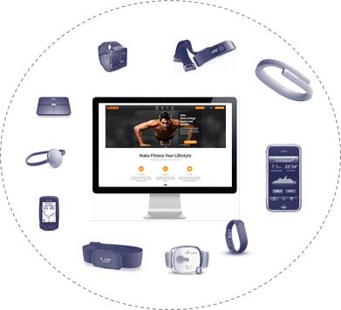
Our Vision
We follow a B2B2C strategy using a “meta franchise” network of gyms to build a comprehensive fitness platform online
Built “Meta Franchise” Network of Gyms
Establish End Customer Contact
Built Fitness Platform
New relationship
End Customer
Customer Acquisition
Customer Care
Upselling
Conventional relationship
Gyms

Slide 3
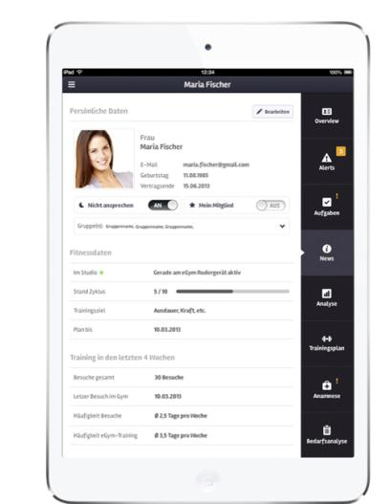
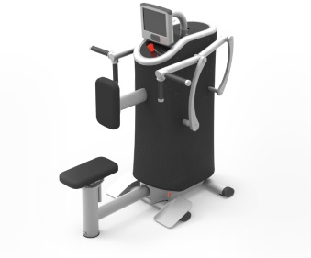
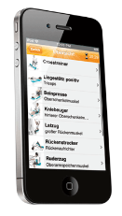
With smart gym equipment and a CRM system we can significantly improve customer care for gyms
Smart Gym Equipment
CRM Systems for Gyms
Gym Trainer Tablet App
1. Objective based,
guided, interactive training
3. Optimized equipment training sequence
Training plan generation
Activity data tracking
Contract information
Live alerts
1
5
2
4
3
2. Highly effective training due to automatic weight adjustment
4. Online progress tracking and social comparison
Mobile End-User App
Training plan access
Activity tracking free weights etc.
Weight
Repetitions

Slide 4
Company history
2010: Initial start, Exist Gründerstipendium
➔ Result: first prototype
2011: first institutional money (HTGF, BK)
➔ Result: 1 year field test
2012: Series A financing round (Industry professionals)
➔ Result: entering the market

Slide 5
Current situation
70 employees
Sold to 200 gyms within the first year at the market (2013)
Big product pipeline

Slide 6
Challenges on every stage
2010: Initial start, Exist Gründerstipendium (Prof. Picot)
➔ Result: first prototype
Fundraising relatively easy
High technological risk
Acquiring field test customer, essential but relatively easy
Biggest challenge: timing ➔ prototype completed when money for seed financing round needed.

Slide 7
Challenges on every stage
2011: first institutional money
➔ Result: 1 year field test
Fundraising relatively easy
Low technological risk
Acquiring first customers: essential but relatively easy
Biggest challenge: fixing problems very fast given a low budget

Slide 8
Challenges on every stage
2012: Series A financing round
➔ Result: entering the market
Fundraising difficult (higher investment amounts + smart money needed)
Low technological risk
Acquiring customers at scale: challenging
Biggest challenge: transformation from a creative environment to an execution focused organization

Slide 9
eGym today
Going international
Growing the organization as fast as the revenue growth, not faster, not slower
Launching several product lines at the same time

