Slide 1
ICT Innovation for Global Energy Efficiency
GJS2012
“The Influence of ICT on Energy Efficiency: Perspectives from Germany and Japan”
November 21th, 2012
Haruhisa Ichikawa
The University of Electro-Communications
Notes:
15min.

Slide 2
Possible ICT Contribution for Global Energy Efficiency and Sustainability
Reduce Energy Consumption
  Reduce Inefficient Energy Consumption
    Energy production inefficiency
    Energy consumption inefficiency
  Restructure Energy Consuming Activities
    Ex) Restructure economic activities for reducing the energy consumed for transportation
  Reduce Energy Consumption Increase
    Innovation for developing countries’ economies not to become energy-intensive
Increase Available Energy Source
  Utilize Renewable Energy Source
    Requirements for developing countries’ grids are different from the ones for developped countries
  Explore New Energy Source
Reduce Ill Effects of Energy Consumption for Environmental Sustainability
ICT Contribution estimated in SMART 2020

Slide 3
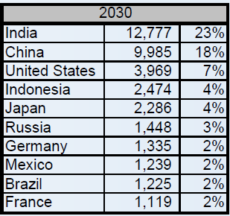
Developing countries are increasing global energy consumption per year by more than 90 %
Middle Class Consumption
Billions of 2005 PPP$ (purchasing-power-parity)
Top 10 Countries
(billions of 2005 PPP$ and global share)
H. Kharas, “The Emerging Middle Class in Developing Countries,” Brookings Institution, June 2011.

Slide 4
China’s 2030 CO2 Emission Will be 30% of the World Total’s
IEA “World Energy Outlook 2009”

Slide 5
Targeted Market of theULP Integrated System: BoP
Satisfying the needs of the Base of the Pyramid (BoP) is the only way for long-term sustainable growth of the world (S.L. Hart, “Capitalism at the Crossroads”)
▪ Export oriented policies targeting at the wealthy class of developed countries led to
excessive production and global deflation.
▪ The poor at the BoP live in high cost economies, with huge consumer surplus.
▪ BoP is often ideal markets for destructive technologies.
Purchasing Power Parity
Population
>$20,000
7.5million ~ 100 million
$1,500 ~ $20,000
1.5billion ~ 1.75billion
$1,500 >
Base of Pyramid (BoP)
4billion
World Income Pyramid
5
S. L. Hart, “Capitalism at the Crossroads –Aligning Business, Earth and Humanity,” Perason Education, 2007.
Notes:
5

Slide 6
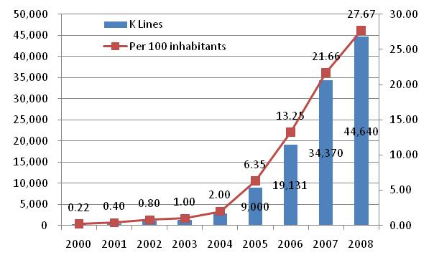
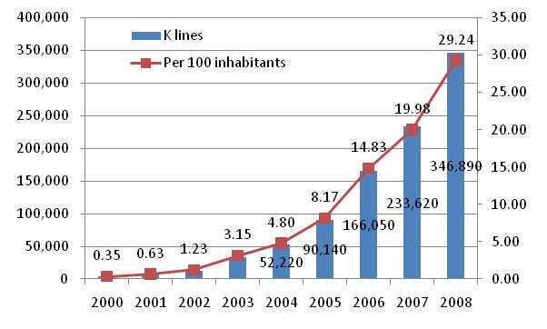
Mobile Phones Have Proved To Increase BoP Peoples’ Income
Bangladesh
10% increase in mobile penetration leads to a 1.2% increase in GDP in the long-run across developing countries.
(2006-2007, GSM Association)
India
H. Ogata, “Success Factors of Mobile Operators in BoP Markets, German-Japanese Symposium, Sept. 2010

Slide 7
ICT Innovations for BoP Rural Areas Key to Global Energy Efficiency
Developing countries are rapidly increasing global energy consumption by their industrialization and urbanization
  Innovations are needed to decrease energy consumption by industrialization and urbanization of developing countries.
  Economic growth by agriculture is more desirable than by secondary industries.
    Agriculture requires less energy than secondary industries.
Global energy efficiency and sustainability will be much improved by Innovations for people in rural areas of developing countries to improve the agricultural productivity and their living standards.
ICT infrastructures are indispensable for the innovations, but are missing in large part of BoP rural areas.

Slide 8
ICT system applied with Ultra low power (ULP) technologies

Slide 9
The Mission of ULP Integrated System Project
5 to 10 years after the completion of ULP Research Area
ULP components to which the results of ULP Research Area are applied
Reducing ICT electric power consumption
“Place & Play Informa-tion System”
ULP Integrated System
ULP components
ULP component
Resolving problems for humanity
ULP integration technology
ULP component
ULP component
Strengthening Japan’s industrial competitiveness
ULP integration technology
ULP component
ULP component
ULP component
Market?
Function?
9
Notes:
9

Slide 10
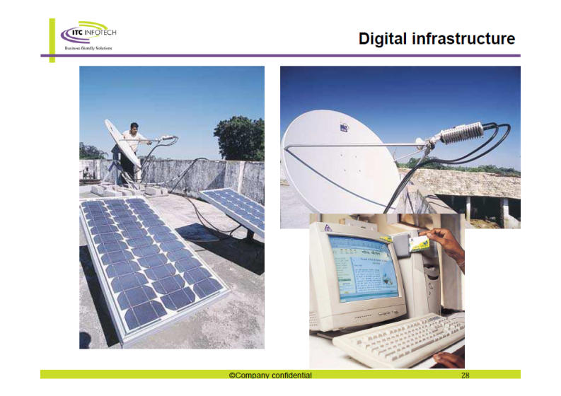

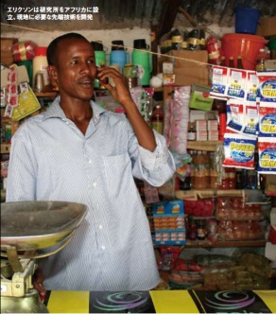
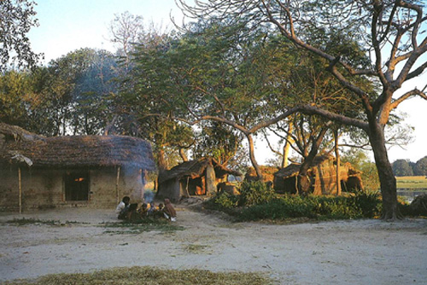
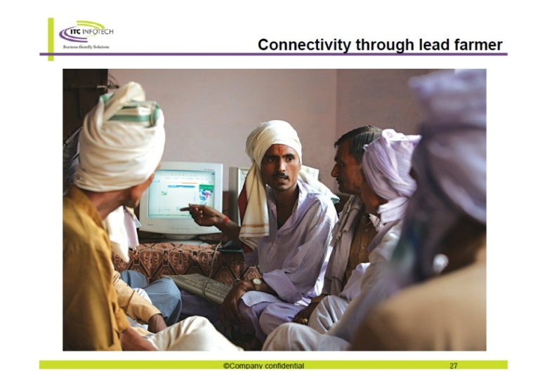
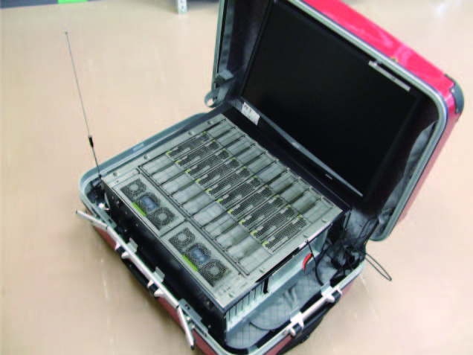

Place & Play-type Broadband Internet Systems with Poor Infrastructures
An example of the rural villages in India
(Sharing internet terminal in a village)
An image of P&P System providing broadband internet services to villagers
10
Notes:
10

Slide 11

Functional Concept of ULP Integrated System
Internet
Developed Countries
Network
Internet Users
Broadband Connectivity
Reliable Electrical Power Source
Developing Countries
Internet
Internet & Ubiquitous Network Users
ULP Integrated System
Internet Equivalent
Narrowband Connectivity
Broadband Connectivity
Electricity by Renewable Energy

Slide 12
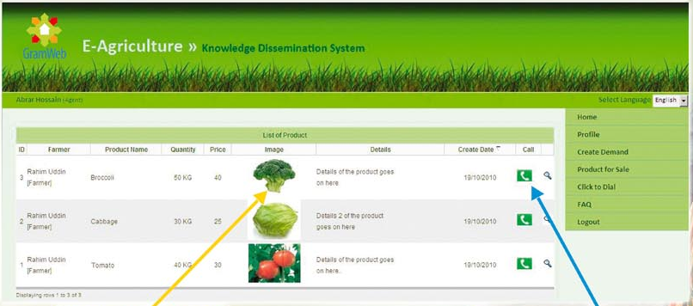
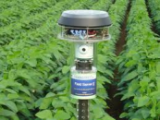
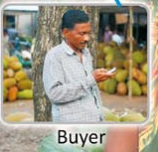
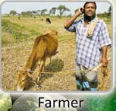
An Example of Agricultural Productivity Improvement
1. Soil temperature and moisture
Weather, etc.
5. Product selection and call
1. Agricultural work log
P&P Core System
4. Product Info Upload
2. Design the best agricultural work
3. Find the best timing to harvest
Volume of good product
Ref.1 http://igpf.gramweb.net/index.php
Ref. 2 T. Sugiyama, “Entrepreneurial Agriculture,” Tukiji-Shokan, 2005.
Average weight of product [g]

Slide 13





ULP Integrated System
Data Center
P&P back yard system
Servers
Power Supply
P&P backbone connected network
P&Pコアシステム
Indipendent Power Supply
P&P core system
P&P client system
P&P access network system
P&P ubiquitous terminal
電源
RFID and Sensors
ルータ
Suitcase-type P&P core system

Slide 14
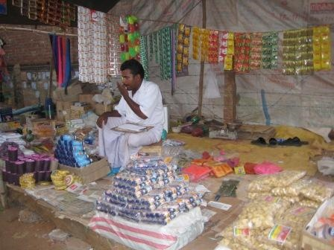
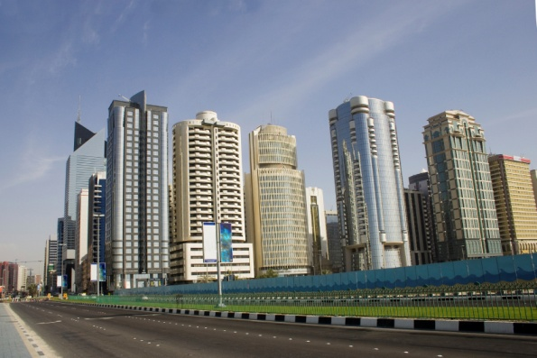

P&P Internet System
Provide broadband internet services with poor social infrastructures:
Store web contents in storage devices at places where broadband internet access is available.
Transport and mount the storage devices to the local P&P Core System for the local people usage via broadband WiFi networks.
Areas lacking infrastructures
Areas infrastructures prepared
Internet
Narrow band access line
Broadband access line
Transporting web content data
http://www.imtfi.uci.edu/imtfi_bopworkshop
Notes:
14

Slide 15
Challenges for P&P Internet System
Estimation and Download of Contents Needed by Users
Download as more contents including contents needed by users as possible
Download as more contents as possible within a given minutes
Total Web Contents in the World
Total Web Contents in the World
Downloaded Contents
Downloaded Contents
Contents Needed by Users
Contents Needed by Users

Slide 16
Are Smart grids for BoP the same as for developed countries?

Slide 17
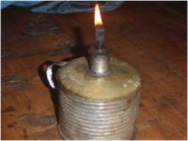
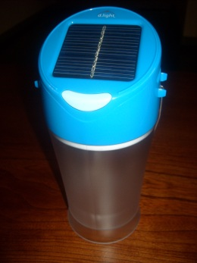
Smart Grid for BoP
Large Population Not Covered by Power Grid
  Ex) Percentages of households with electricity power supply in Bangladesh in 2008 (Ref. JETRO report, 2011)
    Average 41%, Urban Area 76%, Rural Area 28%
    Enhancement of the power grid has been stopped because of the demand-supply gap expansion
  Applications requiring electricity have different priorities, and acceptable energy costs are different
    Mobile phone > Lighting > TV, Radio> ..
Other Social Infrastructures Also Poor
  Infrastructures for Communications, Transportation, Water
  Integrated design of the infrastructures suitable for BoP?
    Ex) Infrastructure for power grid and transportation using electric vehicles
Application Oriented Power Grid
  Power sources suitable for applications
  Power grids suitable for applications
  Internetworking of power grids for applications rather than general power grid

Slide 18
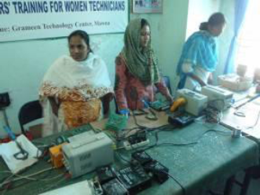
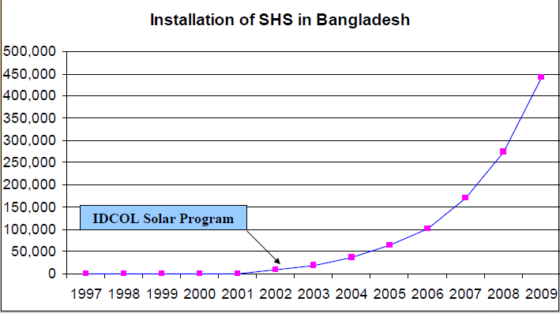
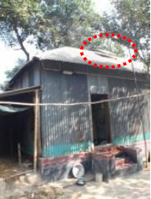
Installation of Solar Home System in Bangladesh
Female Workers Producing SHS Control Panels
50 Wp SHS costs $440.
A commercial-scale rooftop system could be reduced to $1.20 per Wp by 2020 from $2.90 per Wp ub 2012. (McKinsey estimation)
This will accelerate the SHS installation in BoP.
SHS Installed House
Ref. IDCOL, “IDCOL Solar Energy Program,” March 201.

Slide 19
Batteries for EV: Useful for Power Grid using Renewable Energy in Developed Countries
Cheap: Battery storing 30kWh for one household will cost less than 30,000 euro in 2020
Large Capacity: Tens of kWh
  Short term (min. to tens of min.) fluctuation of 100 kW solar batteries can be absorbed by 25 kWh battery of one EV
Large Output: Tens of kW
  Long term (hours) fluctuation of power generation by 4 kW solar battery for one to two households can be absorbed by 25kWh battery of one EV
    30% of surplus power generated by 4kW solar battery can be stored in 10kWh battery.
Ref.: Electricity Consumption by Typical Family
  295kWh / month
  30kWh / day
  Maximum power consumption: 5kW
30
20
10
0
Battery for EV
Nissan “LEAF”
Battery for home/professional use
Mitsubishi “i-MiEV”
Capacity (kWh)
MHI
GS YUASA
NEC
ELIIY POWER
BYD
SONY
0 20 40 60 80 100
Price (1000 euro) / kWh
Ref.: Automotive Technology 2011.11, p46

Slide 20
Summary
Reduction of Energy Consumption by Developing Countries Key to Global Energy Efficiency
R&D efforts including long-term R&D are required to enable developing countries
  To use energy efficiently for industrialization and urbanization
  To generate electric power efficiently for its application
  To improve the agricultural productivity and the living standards at rural areas
Developed countries would obtain enormous business opportunities by such R&D efforts

