Slide 1
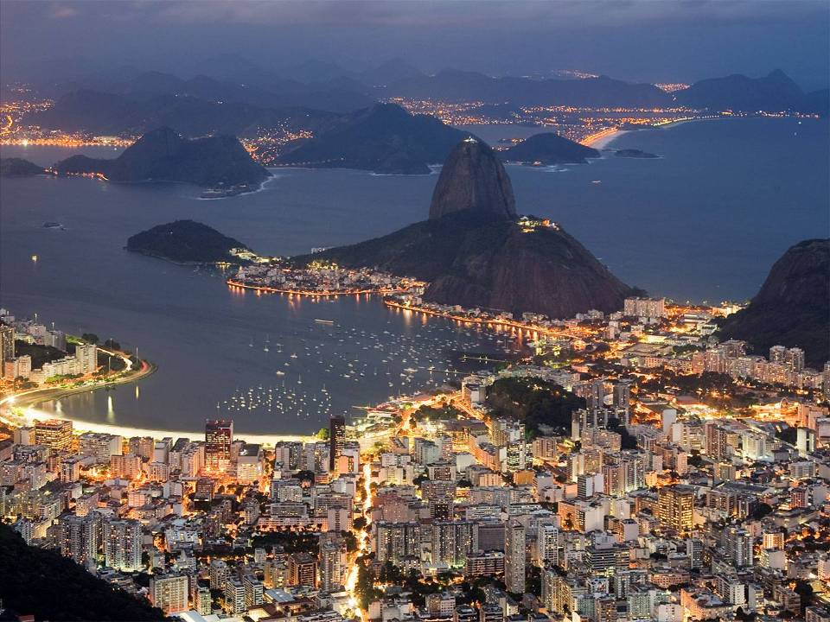
Picture of the Future
Rio de Janeiro 2030 + X
Corporate Technology
Energy Efficiency and Smart Cities
Dr. Wolfgang Heuring
November 21st, 2012
Notes:
1

Slide 2














Picture of the Future for cities:
Energy Efficiency and Smart Cities
ADMINISTRATION &
STRATEGIC PLANNING
ARCHITECTURE &
BUILDINGS
INFORMATION & COMUNICATION TECHNOLOGIES
EDUCATION
URBAN PLANNING &
CITY SHAPE
ECONOMY
HEALTHCARE & WELLBEING
IT/IC technologies
Metropol. alignment
Holistic urban planning
Decentralization
Retrofit
Energy efficiency
ICT as a backbone
TV platform as a standard
Dual education
Education as asset
Urban infrastructure
Sustainable urban environment
Increase of economical development in different areas
Decentralization
Prevention
~300 trends
14 Trend Clusters
RECYCLING / WASTE
MANAGEMENT
WATER / WASTE
WATER SUPPLY
AND DISTRIBUTION
MOBILITY OF
PEOPLE & GOODS
ENERGY SUPPLY
AND DISTRIBUTION
SAFETY & SECURITY
SOCIAL DIVIDE
WORK & LEISURE
No landfill
Waste as a resource
Water treatment
Closed loop for mass transportation
In feed lines
Centralized and decentralized energy generation
Pacification
Emergency mgmt.
Social inclusion
Increasing middle class
Flexibility of work processes
Elderly people employed
Notes:
2

Slide 3
The goal: improvement of energy efficiency in cities
The main levers are
Technologies (e.g., energy conversion and storage)
Behavior of people (e.g. awareness, responsible actions)
Urban policies and regulations (e.g., incentive systems)
Infrastructure (e.g., properties and configuration of the installed base)
CT RTC

Slide 4
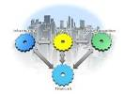
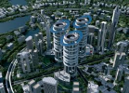

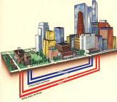

Systemic approach to realize energy efficiency in the city
Combination of
Business Intelligence
and
Innovative
Infrastructure
Solutions
Development of new
business models
Monitoring of
- Energy Consumption
- Installed Base
Multi-modal Energy Network
Smart Grid
CT RTC

Slide 5
Infrastructure for urban energy supply
CT RTC

Slide 6
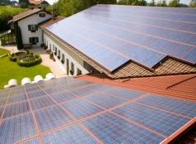
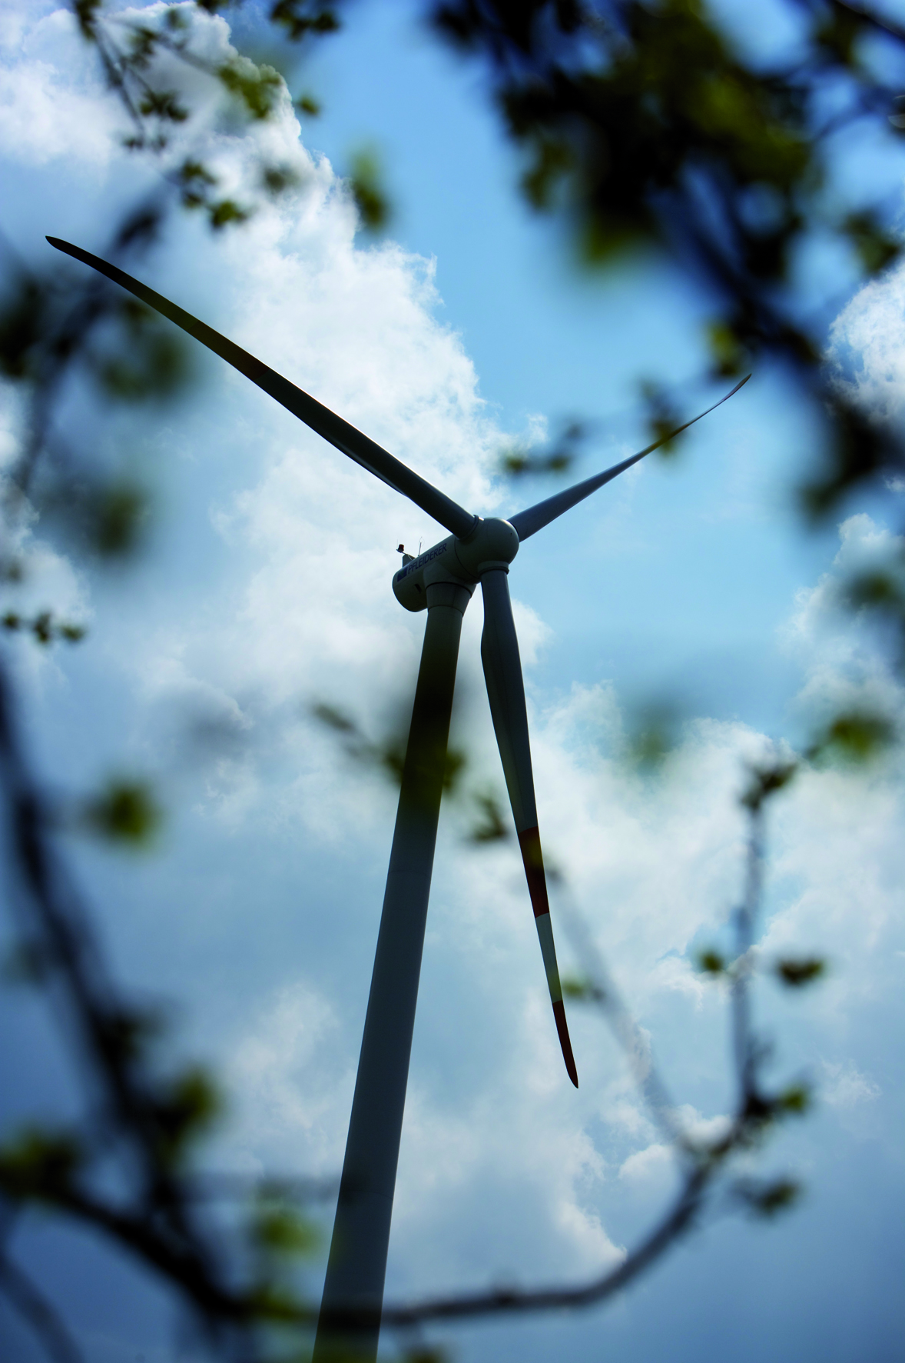
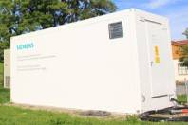
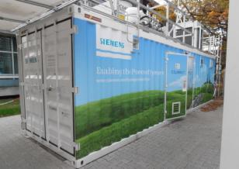
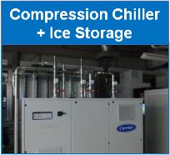
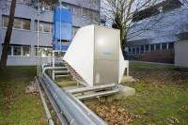
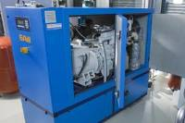
Upgrading Smart Grids to multi-modal energy networks enables high overall energy efficiency in cities
MULTI-MODAL ENERGY SYSTEMS
Renewable
Power Generation
Storage Systems
(Li-Ion Battery)
Storage Systems
(Elektrolyzer)
Key question:
How to network and operate the infrastructures for power generation, energy storage, heat/cold and water in a smart way?
Heat Pump +
Hot Water Storage
CHP¹⁾ Unit +
Hot Water Storage
¹⁾ Combined Heat and Power
CT RTC

Slide 7
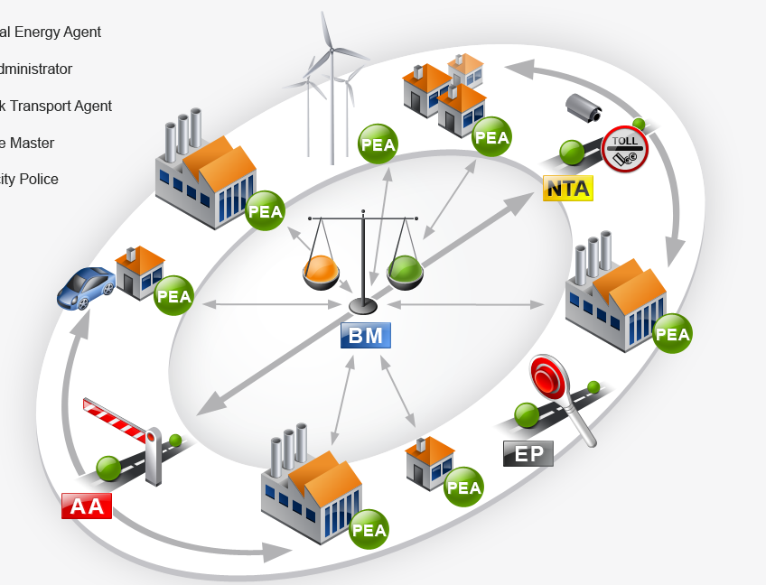





Self-Organizing Energy Automation Systems
(SO EASY) have shown their potential for smart power networks
SO EASY ARCHITECTURE FOR POWER GRIDS
(SCHEMATIC)
*)
*)
*)
Customer Benefit:
Significant
reduction of CAPEX
Design Principles:
Keep as much
functionality as
possible on lower
layers.
Use plug and play
for engineering.
*)
Network
Transport
Agent
Personal
Energy
Agent
Balance
Master
*)
Area
Administrator
*)
Electricity
Police
*)
*) Personal Energy Agent
CT RTC

Slide 8



Self-Organizing Energy Automation Systems can be upgraded to multi-modal energy networks
MULTI-MODAL ENERGY NETWORKS
(SCHEMATIC)
*)
Extensions:
District cooling & heating, water networks, Power to Gas (H₂)
Coupling via conversion units (e.g. compression chiller).
Energy agents
(PEA) provide
interface to the
new sub-systems too.
*)
*)
Network
Transport
Agent
Personal
Energy
Agent
Balance
Master
*)
Area
Administrator
*)
Electricity
Police
*)
*) Personal Energy Agent
CT RTC

Slide 9
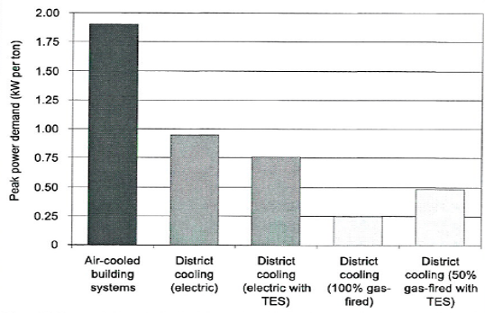
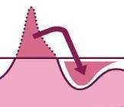
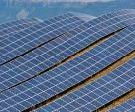
District cooling offers a potential to reduce power demand by 50 % compared to local A/C
54
BENEFITS OF URBAN MULTI-MODAL ENERGY SYTEMS
EXAMPLE: DISTRICT COOLING
Benefit
Facts and figures
Comfortable and reliable cooling for communities
High efficiency and peak load reduction using thermal storage
Targeting zero CO₂ emission by implementing renewable power plants
TES Thermal Energy Storage
Sources: International District Energy Association (IDEA)
CT RTC
Notes:
9

Slide 10
Urban multi-modal energy systems: Combined Heat and Power Plants optimize production of heat and electricity
CONTROL STRATEGY FOR OPTIMIZATION OF HEAT AND POWER GENERATION
CHP¹⁾ Unit +
Hot Water Storage
Biogas Plant supplying
5 CHP¹⁾ units
Siemens Lab
Smart Grid field test IRENE
electricity tariff
heat demand
Control Strategy
Gas motor
+ Generator
Heat
Thermal Storage and
District Heating
Power Grid
Power
Objectives
maximum revenue and profit
by selling optimized mix of heat and power
minimum operation and maintenance costs
minimum CO2 emissions
¹⁾ Combined Heat and Power
Notes:
10

Slide 11
Service for the City
Enhancement of the urban Energy Efficiency as a new
Business Opportunity

Slide 12


Service for the City
From the data to new business opportunities
Technology
Business
Customer
Installed Base ⇒
tied Capital
Preventive Maintenance (Cost reduction)
Design of Tariff models
(Generation of Revenue)
Support for the extension of the infrastructure
Segmentation of the customer base
(focused offerings)
Optimization of the configuration of the
infrastructure
Optimization of urban services by improved
coordination between domains
Benchmarking of energy concepts in the field
Interpretation of the data and derivation of business opportunities
Value Chains
/Processes
Data
Data
Analytics
Properties of the
Equipment
Load flow
Power consumption
Service-Data
Business
Intelligence
Business
Innovation
ICT
Data Mining
Internet of Things
Development of suitable business models
Development of new
Business Opportunities
Source: Leverage Service @ Siemens

Slide 13
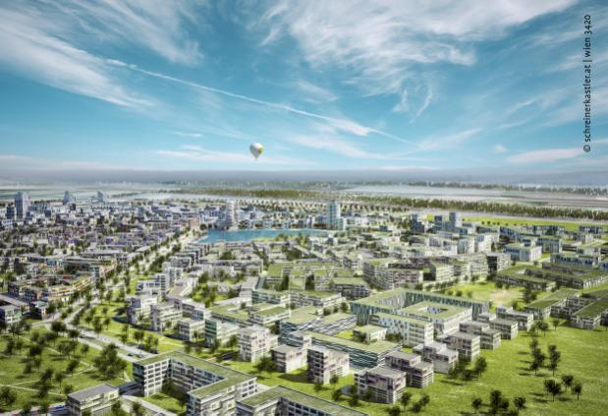
Implementation in a City
Project Vienna‘s Urban Lakeside - Aspern

Slide 14
Vienna‘s Urban Lakeside - Aspern
Aspern – one of the most important city extension programs in Europe
Area: 240 ha
Residential area for 20.000 inhabitants and 20.000 work places
4 principles:
Public space and micro climate (to investigate the relations between building and outdoor amenity)
Cross-building energy distribution (to investigate the options of inter-building energy exchange)
Demonstration buildings for residential, office and production
Monitoring (evaluation of the achievement of goals)
Source: http://www.hausderzukunft.at/results.html/id6793

Slide 15
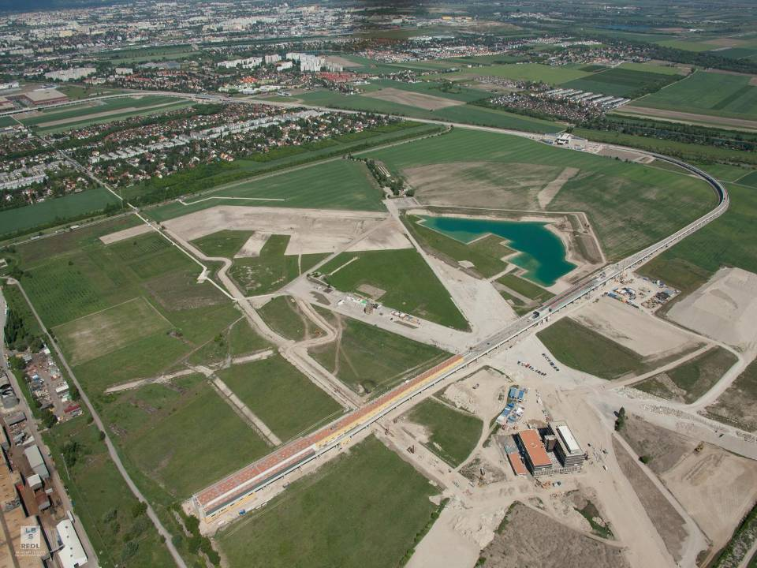
Bird‘s view on the status of the development of the district
Artificial lake
Track of the subway
Innovation quarter
(recently opened)
Source: http://www.aspern-seestadt.at/downloads/

Slide 16
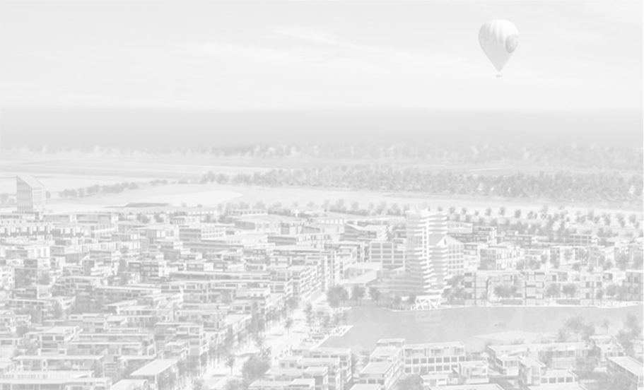



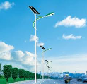


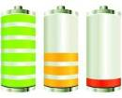





Area of research planned for the Living Lab in
Urban Lakeside - Aspern
Decentralized
Renewable Energy
Photovoltaics
Solar thermal
Micro Wind
Urban Data Center
LED Street Lighting
Mobility Services
SMART INTEGRATION
Life, Home and Work
Smart Grid
Network & Control
Control Heat pumps
Charging Infrastructure
Energy Storage
electrical & thermal
User Interaction
„Consumer to Grid“
Home-Automation

