Slide 1
From Smart Metering to Smart Grid An International Perspective

Slide 2
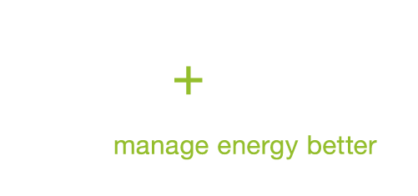
From Smart Metering …
A
Group Company
Turnover 2011 1.6 bn USD - Americas 47% - EMEA 35% - AsiaPacific 17%
R&D 7% of sales
Customers Over 8000
Employees >5,000
R&D resources 850 in 17 R&D centers
Manufacturing sites 16
Operating entities In 31 countries
Sales offices
73
More then a century of expertise in metering - 300 million installed electricity meters - 25+ years experience in Smart Metering

Slide 3
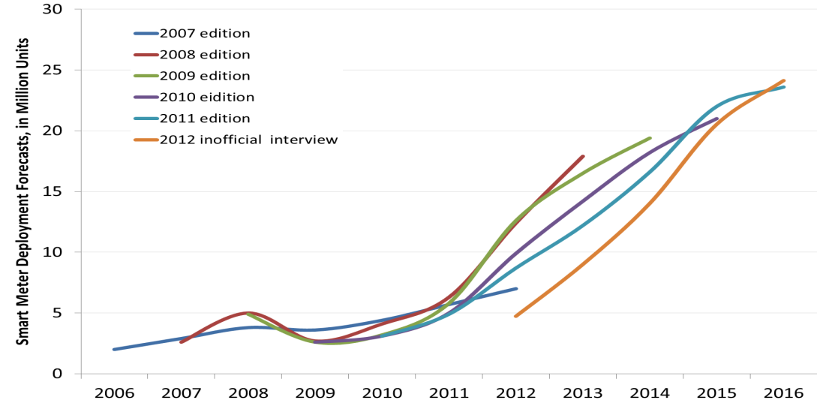
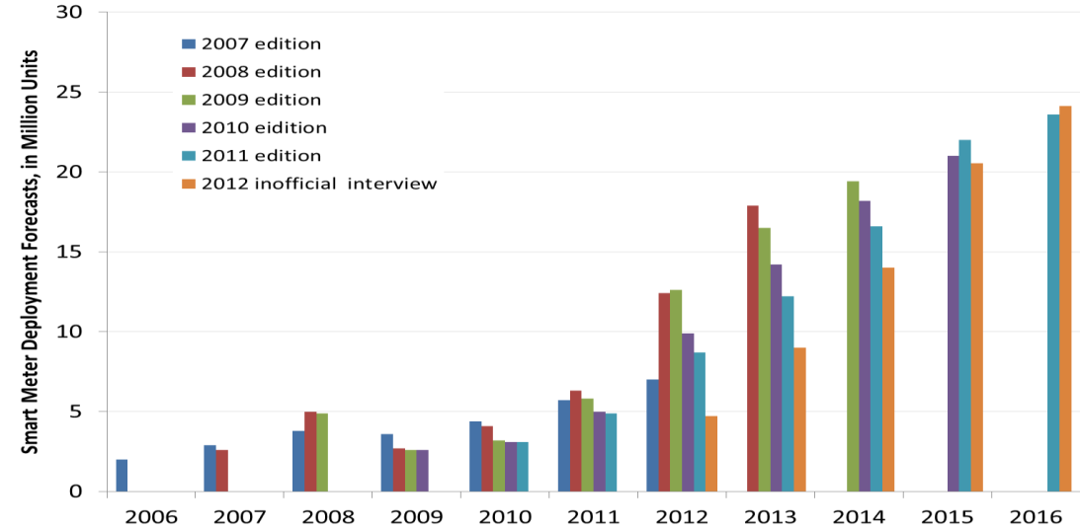
The European Smart Metering Market Forecast is shifting Year-on-Year (whilst the EU 3rd energy package targets remains)
Berg Insight market view 2012
Examples:
UK: Delay to finalization of market model + definition of standard
France: Postponement of next Linky (ERDF, France) tender by > 1 year
Spain: Push out of Iberdrola (Spain) / GNF (Gas Natural Fenosa) plans, economic slow down
Germany: In transition to a secure smart metering concept

Slide 4
Smart Metering in Europe – Current Roadmaps
Estimates
By Country
2013
2014
2015
2016
2017
2018
2019
2012
UK
29m EP’s
Foundation Stage
Full smart meter rollout timeline
France
34m EP’s
Pilots
Full smart meter rollout timeline
Spain
26m EP’s
Full smart meter rollout timeline
MA & Support
Germany
44m EP’s
Pilots
Full smart meter rollout timeline
Finland
Full smart meter rollout timeline
MA & Support
Denmark
Full smart meter rollout timeline
Maintenance & Support
Norway
Pilots
Full smart meter rollout timeline
MA & Support
Netherlands
Small Scale Roll-out
Full smart meter rollout timeline (Large Scale Roll-out)
Switzerland
Pilots
Full smart meter rollout timeline

Slide 5
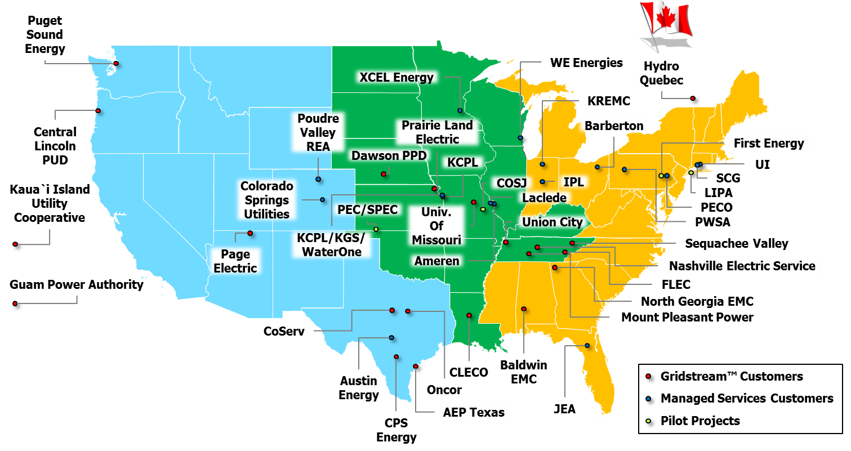
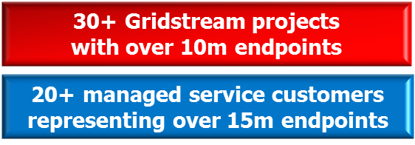
L+G’s Systems & Services Customer Base in North America

Slide 6
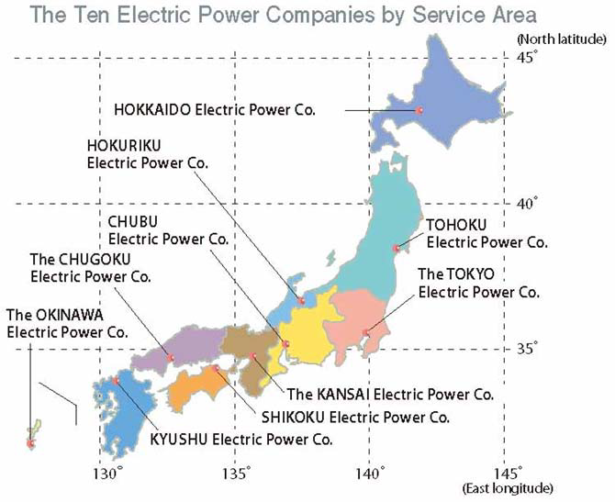
And Japan?

Slide 7
… to Smart Grid
A smart grid is an electrical grid that uses information and communications technology to gather and act on information, such as information about the behaviors of suppliers and consumers, in an automated fashion to improve the efficiency, reliability, economics, and sustainability of the production and distribution of electricity.
Source: Wikipedia

Slide 8
The Past

Slide 9
The Future

Slide 10
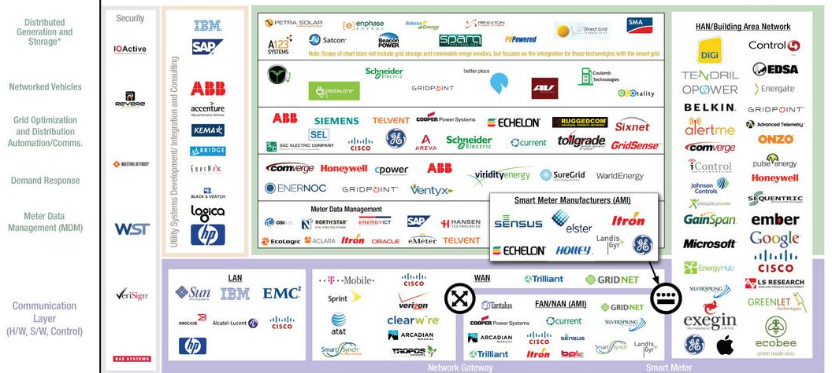
The Smart Grid Ecosystem Today
Utility Infrastructure Consumer

Slide 11
2H12: As Investment Activity Declines … Partnerships Flourish

Slide 12
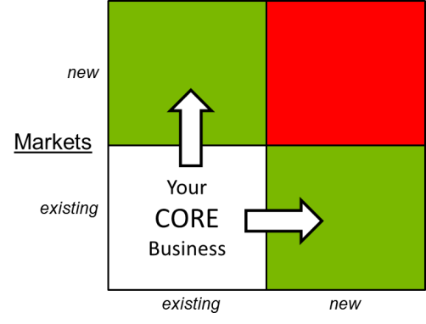
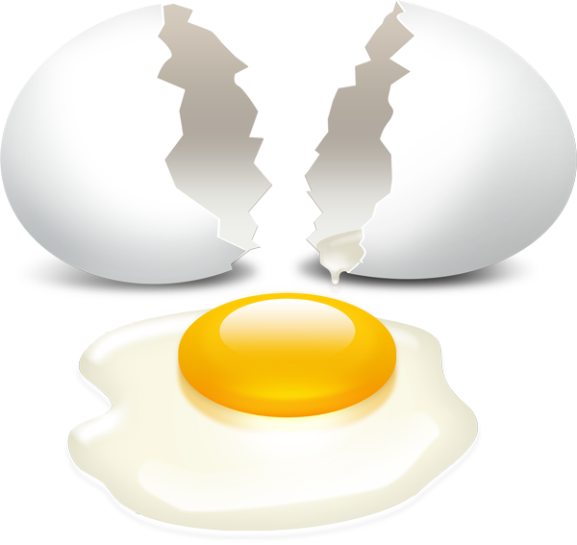
The Way Forward …
When should I start deploying SG tech?
Deploy asap: basis for new business
Challenge #1
What SG spec’s should I use?
Apply standards, build in flexibility
Challenge #2
How to develop my SG business?
As an incumbent, evolve from core
Challenge #3
Advice #1
Advice #2
Advice #3

