Slide 1
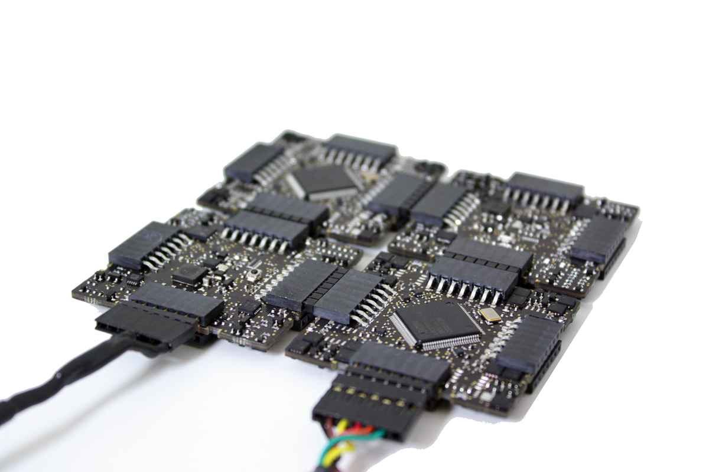
Embedded Electronic Systems
A success story for the German
job market
Michael Römer
Münchner Kreis, November 17th, 2010

Slide 2
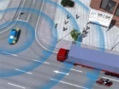


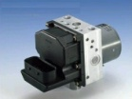

Embedded Electronic Systems (EES) stand for a wide variety of devices and services
t
Characteristics of embedded electronic systems (EES)
Innovation / Added-Value
Examples
Embedded Electronic Systems
Self-controlling/ autonomous systems
Car2 X
Commu-
nication
… value add via differentiation or productivity increase
… system that is part of a larger heterogeneous system
… add-on designed for a particular function
Software as a product (SaaP)
Drive
Assistant
Brake
Assistant
Mechanical component +
Value Added Service (VAS)
Mechanical comp. + electronic Add-on (Mechatronic)
ABS
Mechanical component
Conventional Brake
1960
1970
1980
1990
2000
2010
2020
2030
Source: A.T. Kearney Embedded Systems Study 2010

Slide 3






The growth potential across all sectors is above 10%
M
Share of EES in the cost of the final product or service
European share in the electronic market and market growth of electronic compared with growth of ES
40%
30%
20%
10%
0%
10%
20%
30%
60%
Automotive
50%
40%
Avionics/
Aerospace
30%
Industrial
Automation
20%
10%
Telecom
0%
Consume
Electronic
Automotive
Avionics/
Aerospace
Industrial
Automation
Telecom
Consumer
Electronics
Health and
Medical
Health and
Medical
ES-Growth
Electronic Growth
EU Share of ES &
Electronics Market
A high share of the final products’ price is represented by the costs of Embedded Systems’ development and implementation.
Source: FAST-TUM; A.T. Kearney Embedded Systems Study 2010

Slide 4
In Automotive EES functions increase in share of value add per vehicle to 60% in 2025
6
Development of share in EES cost of the final product
for automotive
Automotive
Case Example
Software instead of hardware
Software offerings will enable new revenue streams (e.g. pay per use, product add-on via remote update)
8%
15%
30%
Software
27%
EES
functions
32%
Electric & Electronic (E&E) components as essential precondition for software components and -mobility
Currently ~€ 150 bn of E&E components are build each year with a prospect growth of 6% p.a.
32%
Electric/
Electronic
65%
53%
38%
Mechanic
Not anymore the key differentiator
Will be sourced as commodity
1995
2010
2025
Source: A.T. Kearney Embedded Systems Study 2010

Slide 5


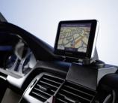


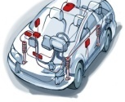
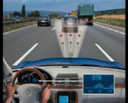
Especially high performing cars are characterized through a strong growth of EES components
5
Embedded systems development in Automotive
Efficiency control systems
# of ECUs
% of software errors
Amount of softwarecode
Car Multimedia (Navigation system, …)
Control units (Throttle & break control, …)
Drive assistance systems (Lane assist, ACC, …)
…
1990
1995
2000
2005
2010
More than 80% of innovation, and therefore of added value, will be obtained thanks to Embedded Electronic Systems
Source: A.T. Kearney Embedded Systems Study 2010

Slide 6


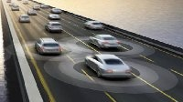

The need for system integration, new car services and sustained mobility will drive further growth
Growth drivers for Embedded Electronic Systems
New Consumer Services
Convergence between personal and mobility service
Growing importance for young consumer
Example: Convergence of Telco, Utility and Auto Services
Sustainability
Services & Mobility Concepts
Conservation of natural resources. Sustained mobility.
Growing demand for individual mobility - smaller city cars
Example: E-Mobility, Hybrid Cars, Fuel Cell, energy efficiency
New Car Services
Car efficiency and security is product differentiating
Growing number of innovative product offerings
Example: park assistance, Car2x, autonomous vehicles
Integration Service
10-15% growth within a car software code each year
80% supplier issues are software and hardware related
Example: System modularization, “0”-Bug-Development- Processes
Source: A.T. Kearney Embedded Systems Study 2010

Slide 7



We expect that this growth can create ~40,000 new jobs in the German Auto industry by 2025
5
Development of jobs related to Embedded Electronic Systems in Germany
(in ‘000)
New jobs for consumer oriented services
New jobs for sustainability services & mobility concepts
CAGR +4%
87
New Consumer Services
New jobs for car oriented services
4¹⁾
New jobs for system integration services
Sustain. Serv. & Mobility Concepts
Current ES workplaces in Germany since 1965
38
(44%)
+345%
New Car Services
Integration Service
78%
49
1965
1980
1995
2010
2025
1) New jobs for “New customer services” may not only be created in automotive industry but also industries with access to customers
Source: A.T. Kearney Embedded Systems Study 2010, Bitkom

Slide 8
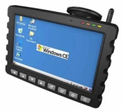
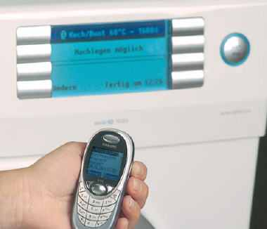
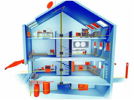

Across industries we estimate a potential in Germany of ~110,000 new jobs
0
Expected cross-industry job development through Embedded Systems
(in ‘000)
Exemplary growth fields
159
Medical appli-cations
Strong growth in new diagnostic tools or telemedicine
Cross-
Industry
growth
White goods
Intelligent programs in washing machines, etc.
Network access for selected appliances
110
Facility manage-ment
Intelligent facility mgt.
Energy management through smart metering
Automotive
growth
49
Home entertain-ment
Strong growth in functionality (e.g. Internet via TV)
2010
2025
Source: A.T. Kearney Embedded Systems Study 2010

Slide 9
Healthcare is leading and investing significantly in new diagnostic tools and telemedicine systems
0
Example growth in medical applications
Embedded Systems R&D related jobs in German Medical Technology
Importance of EES has significantly increased over the last years: 48% of R&D activities in Medical Technology
Various application areas and services could be primary enabled by EES:
  New diagnostic tools
  High-frequency surgery
  Ambient assisted living
  Health insurance cards
Revolutionary shift to Embedded Systems has initiated job boost of highly skilled personnel
CAGR +6%
14,700
11,000
2010
2015
Source: A.T. Kearney Embedded Systems Study 2010, ZVEI, SafeTrans

Slide 10
However there are still barriers that delay the breakthrough
Major EES growth barriers
A
Consumer Perspective
Example
Unclear use cases, complex services
Security of data
Only for premium products
Many functionalities are confusing/not needed, usability not intuitive
Storage of personal data especially with access to internet
B
Company Perspective
Example
Lack of architecture standards and product modularization
Limited number of experienced architects and developers with industry know-how
Products consumer are willing to pay for?
R&D budget for Embedded Systems not adequate
Lack of architecture standards leads to not manageable complexity
Source: A.T. Kearney Embedded Systems Study 2010

Slide 11
Consumer mainly perceive the EES offerings as to complex and to expensive
%
A
Consumer perspective on Embedded Electronic Systems
Willingness to pay an
extra fee per service?
How could consumer oriented
services be improved?
Yes
Useability
52.0%
Indifferent
Better service offer
35.0%
42%
Data security
27.0%
Personal device integrated
38.0%
No
High price
68.2%
0%
25%
50%
75%
100%
There is a lack of consumer awareness on what’s possible
Source: A.T. Kearney Embedded Systems Study 2010

Slide 12
Embedded systems are on the CXO agenda, however R&D priorities are still not under the Top 3
%
B
Company perspective on Embedded Electronic Systems
How do you rank the Embedded Systems’ role in your strategy?
What prevents OEMs to invest more in Embedded systems?
Marketing purposes only
Integrated part of the strategy
Lack of expertise
55.0%
2%
10%
Missing modules
35.0%
Missing standards
30.0%
Lack of business models
60.0%
Relevant,
but not prio 1
Other R&D Priorities
(i.e. powertain in Auto)
85.0%
Managing
the complexity
0%
25%
50%
75%
100%
There is still a lack of awareness, as the business case is not clear
Source: A.T. Kearney Embedded Systems Study 2010

Slide 13

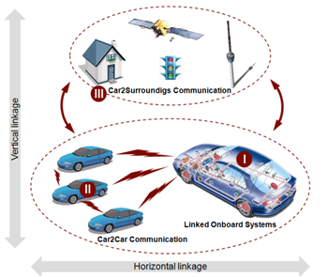
Additionally, job growth requires the right skill set starting with a strong academic and practical industry background
Status quo: Training the right resources
Some graduate programs in Germany offer special courses or whole master studies for EES with a limited number of places
  HS Aschaffenburg
  OFFIS e.V.- Oldenburger Institut für Informatik
  Fraunhofer FIRST – Berlin
However, only a few graduate schools offer a full study program for EES, e.g. HS Mittweida
Besides hard- and software design the programs also focus on getting practical industry background
Source: A.T. Kearney Embedded Systems Study 2010

Slide 14
The German industry should leverage it‘s starting position and participate from strong growth of Embedded Systems
Call for action
Focus
  Drive customer-centric innovation and develop new products and services in two areas
    Integration services
    New product/consumer related services
  Focus on value add of the customer
Collaborate
  Develop innovative business models and position correctly within the value chain
  Collaboratively develop applications even outside from the industry i.e. automotive
Education
  Industries and Universities should collaborate closer to improve the relevant academic and practical industry background of students
  Go further and start image campains at schools
Source: A.T. Kearney Embedded Systems Study 2010

Slide 15
Backup

Slide 16
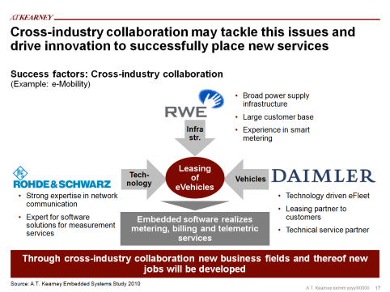
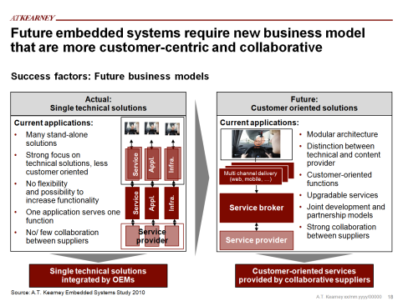
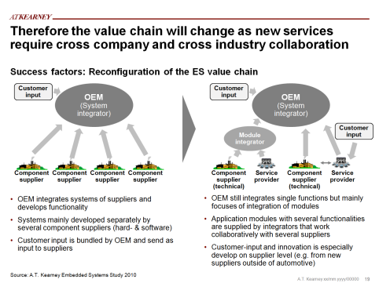
To tackle these issues an innovative and collaborative industry set-up should be targeted
Success factors for future growth
Cross industry collaboration
New business models
Right value chain
Development of innovative services through cross industry expertise
Development of new business models/ players with strong focus on consumer needs
Define whats core and foster cross company and cross industry collaboration
Strong focus innovation and consumer-centric development is key
Source: A.T. Kearney Embedded Systems Study 2010

Slide 17


Therefore the value chain will change as new services require cross company and cross industry collaboration
Success factors: Reconfiguration of the ES value chain
Customer input
OEM
(System integrator)
Customer input
OEM
(System integrator)
Module integrator
Customer input
Component supplier
Component supplier
Componentsupplier
Componentsupplier
Component supplier (technical)
Service provider
Component supplier
(technical)
Service provider
OEM integrates systems of suppliers and develops functionality
Systems mainly developed separately by several component suppliers (hard- & software)
Customer input is bundled by OEM and send as input to suppliers
OEM still integrates single functions but mainly focuses of integration of modules
Application modules with several functionalities are supplied by integrators that work collaboratively with several suppliers
Customer-input and innovation is especially develop on supplier level (e.g. from new suppliers outside of automotive)
Source: A.T. Kearney Embedded Systems Study 2010

Slide 18
The notion of Embedded Systems is rather diverse – This study focuses on interactive- and autonomous systems
58.0
Scope and Definition
Development of Embedded Systems
Characteristics of Embedded Systems
Focus
Embedded systems are designed to do some specific task, rather than be a general-purpose computer for multiple tasks.
Some also have real-time performance constraints that must be met, for reasons such as safety and usability;
Others may have low or no performance requirements, allowing the system hardware to be simplified to reduce costs.
Embedded systems are often part of a complete device including software, hardware and mechanical components
Example: Braking systems
Value Add
C2C comm.
Drive assistant
Brake assistant
Autonomous system
ABS
Interactive system
Control system
Connected system
ES as self-controlling system
ES as Add-on
ES as VAS
ES as SaaP
t
What are the opportunities for the German job market?
Source: BITKOM; A.T. Kearney Embedded Systems Study 2010

Slide 19

The notion of Embedded Systems is rather diverse and stands for a very wide variety of devices and systems
58.0
Characteristics of Embedded Systems
Embedded systems are some combination of computer hardware, software and mechanical components, either fixed in capability or programmable.
It is a dedicated system that is often an important part of a larger heterogeneous system.
Embedded systems are designed for a particular function, rather than being a general-purpose computer for multiple tasks.
Some also have real-time performance constraints that must be met, for reasons such as safety and usability;
Others may have low or no performance requirements, allowing the system hardware to be simplified to reduce costs.
As the word “Embedded” implies, these systems are “hidden” in a hosting system and their impact is therefore often not immediately measurable.
Source: BITKOM; A.T. Kearney Embedded Systems Study 2010

Slide 20
Related jobs will be created among the whole value chain especially at non-automotive 3rd party companies
15%
New Embedded Electronic Systems jobs in Germany until 2025
Illustrative
6000
11.000
3.000
18.000
Strategy
5%
5%
ES Development
ES Integration,
Tools & Testing
ES Operation &
Service Maintenance
Supplier
OEM
Dealer
3rd parties
About 40,000 new jobs related to ES development and
integration will be provided in Germany till 2025
Source: A.T. Kearney Embedded Systems Study 2010

Slide 21









The study considers CXOs’ views as well as external expert experiences and covers multiple industries and countries.
r
Scope of the Study
Method
>40 interviews with Embedded Systems management representatives from business units and IT
and based on a detailed questionnaire (45 – 60 minutes)
Interviewees from top (80%) – and middle (20%) management
60 consumer feedbacks
Enhanced by research of relevant press releases and studies
Geographic scope
Industry scope
Selected participants
Trans-
portation
Other
Communication
/ High-Tech
12%
74%
Automotive
Source: A.T. Kearney Embedded Systems Study 2010

Slide 22
The notion of Embedded Systems is rather diverse and stands for a very wide variety of devices and systems
58.0
Characteristics of Embedded Systems
Embedded systems are some combination of computer hardware, software and mechanical components, either fixed in capability or programmable.
It is a dedicated system that is often an important part of a larger heterogeneous system.
Embedded systems are designed for a particular function, rather than being a general-purpose computer for multiple tasks.
Some also have real-time performance constraints that must be met, for reasons such as safety and usability;
Others may have low or no performance requirements, allowing the system hardware to be simplified to reduce costs.
As the word “Embedded” implies, these systems are “hidden” in a hosting system and their impact is therefore often not immediately measurable.
Source: BITKOM; A.T. Kearney Embedded Systems Study 2010

Slide 23
Through the strong growth in automotive and other industries, the market for Embedded Systems will double
0
ALL: Zahlen plausibilisieren (€ 19bn kommen von BITKOM)
Development of ES demand of the German Automotive industry
Expected turnover development of Embedded System in Germany
(in € bn)
Today, a turnover of ~€ 19bn is generated through development of embedded systems in Germany
Besides automotive (~€ 6bn) embedded system are heavily used in the engineering industry, facility management, home appliances and others
Automotive will strongly grow the demand for embedded systems through Integration Services, New Car Services, Sustainability Services & Mobility Concepts and New Consumer Services
Also in other industries, embedded systems will experience significant growth such as in
  Engineering, e.g. increased connectivity of machines
  Utilities, e.g. smart energy networks
43
+126%
Other
industries
19
Automotive
2010
2025
Source: A.T. Kearney Embedded Systems Study 2010, BITKOM

Slide 24
To overcome barriers all four growth areas must develop clear business cases to increase the value add per vehicle
0
Role of embedded services in future vehicles
IV
Value add per car
New Consumer Services
Jobs in “Embedded Systems”
Software
III
Electronics
Sustainab.
& Mobility
Mechanics
II
New Car Services
2010
2025
I
Integration Service
Source: A.T. Kearney Embedded Systems Study 2010
Software value add per car

Slide 25
The continuously increasing number of ECU`s require expertise in system standardization and modularization
4
I
Integration Service
Example of increasing application of Embedded Electronic Systems (e.g. control units)
# of control units
Example: ECU development
Today, about 90% of all innovations in a vehicle are based on software and electronics
The total number of ECU’s is continuously increasing. Nowadays, more than 100 ECU’s are build into an advanced car
Nowadays, ECUs form a complex communication networking within a car
The complex functions, integrated in the ECU’s, require the usage of highly efficient development- and testing tools to ensure a zero bug quality
Model 8
Model 7
Model 5
Model 6
Model 1
Model 4
Model 3
Model 2
1996
1997
1998
1999
2000
2001
2002
2003
2004
2005
The increasing number of complex functions, integrated in the ECU’s, are leading to an ES job growth for OEMs, suppliers and 3rd parties
Source: A.T. Kearney Embedded Systems Study 2010, car2car, Siemens

Slide 26
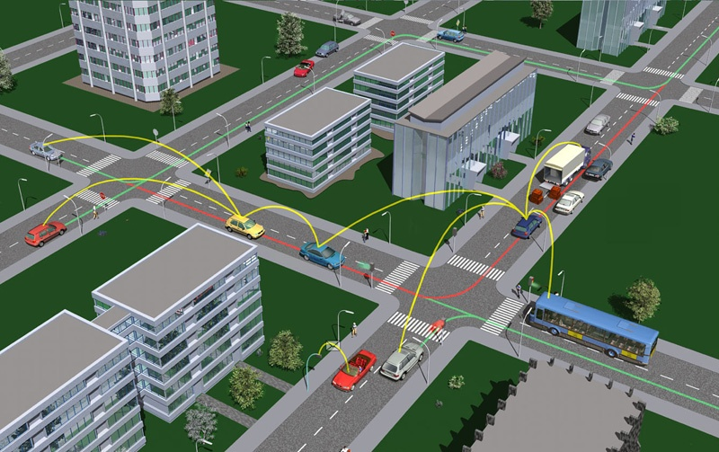
New innovative car services for more security, comfort and energy efficiency will generate additional demand
II
New Car Services
Example: Car2x communication
In future car-to-car and car-to-infrastructure commincation is a leading trend that will lead to safer and more efficient road traffic
2025 is expected as the break-through year in which more than 50% of all new cars are able to communicate
This ability is allows the traffic to flow more fluently it will be particularly interesting for optimal energy management in electric cars
New car services require a communication infrastructure and new standards , leading to an ES job growth for OEMs, suppliers and 3rd parties
Source: A.T. Kearney Embedded Systems Study 2010, car2car, Siemens

Slide 27




For automotive OEMs, the electric vehicle market will dramatically grow until 2030
0
III
A.T. Kearney study
"Powertrain of the Future"
Sustainab.
& Mobility
Projection of fleet (installed base)
(in mil. EV and PHEV)
Change
enforce-
ment
5)
Number of EV
and
PHEV
1)
4)
Moderate
drive for
change
2)
Limited drive
for change
Year
Fleet of 1 to 3.7 mil. electric vehicles in 2020
€ 20,000 per small electric vehicle⁶⁾
€ 20 to 74 bn. cumulated
electric vehicle sales till 2020
EV = electric vehicle; PHEV = plug-in hybrid electric vehicle
1) Ca. 3.5 mil. EV and PHEV in 2020, Deutsche Bank
2) 1 mil. EVs not earlier than 2020, Wuppertaler Institut für Klima, Umwelt, Energie GmbH
3) 1 to 2 mil. EVs and PHEVs in 2020, Fraunhofer ISI 4) 2 to 13 mil. EVs in 2030 (best guess: 10 mil.), Vattenfall
5) 8 to 13 mil. EVs and PHEVs in 2030, Fraunhofer ISI 6) Price for small car (Smart-class) today (Welt Online, article: march 11th 2008)
A.T. Kearney
scenario

Slide 28
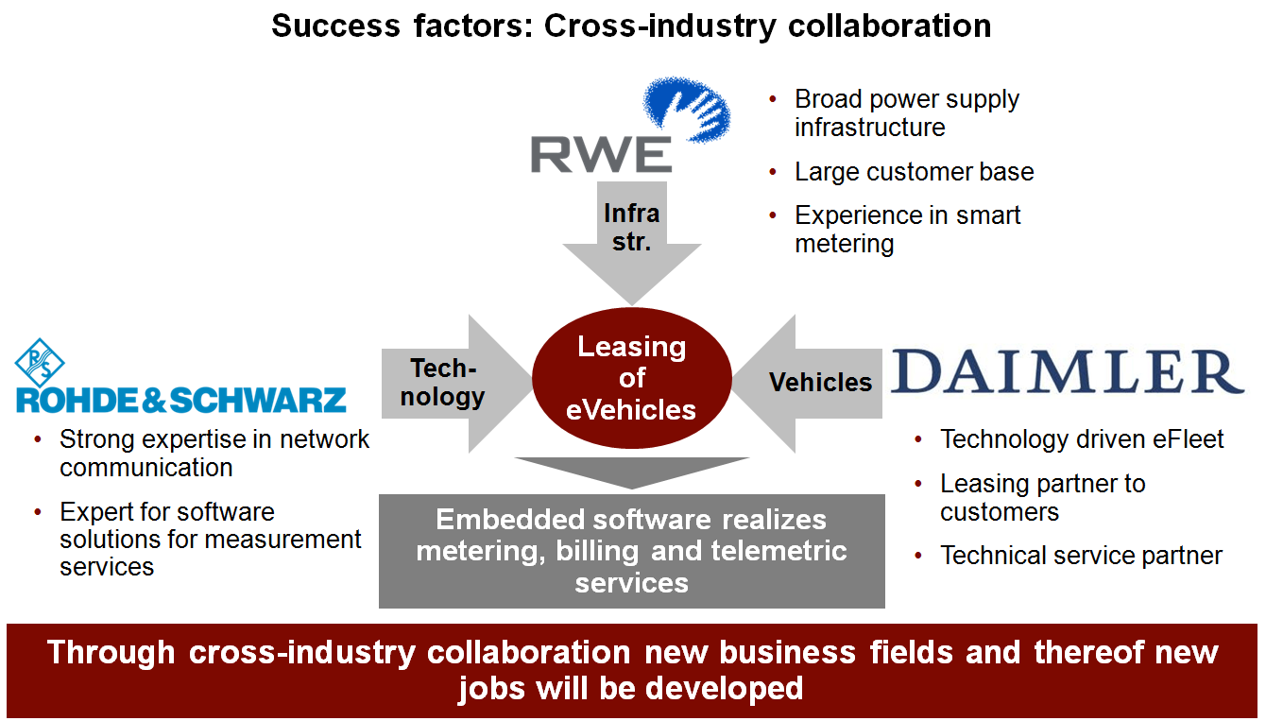
In addition to existing services further growth can be generated by consumer oriented service offerings
IV
New Consumer Services
Case example
Example: City Mobility Concepts
Collaboration of companies of various industries enable new product offerings and innovative services
Publicly available cars can be used by citizens
Registration, car spotting, reservation and payment via mobile phone, internet, etc.
Pay-per-minute/use model for providing mobility services
To offer new consumer oriented services systems integration for existing vehicles, devices and infrastructure is required
New consumer oriented services require an additional effort of collaboration leading to an ES job growth for OEMs, suppliers and 3rd parties
Source: A.T. Kearney Embedded Systems Study 2010, car2go, Daimler

Slide 29
Embedded services may not only be driven by the automotive industry but inherited from other industries
%
Drivers of Embedded Electronic Systems
Selection
Transport,
Utility
Comment
CAGR: 5%
Growers
Professional
services
As embedded systems also play a major role in various other industries such as Telco/ Media and Utilities those industries also have strong innovation potential for new customer services
Services developed in other industries might also be applied in the automotive industry, e.g. smart metering
The successful application of new services thereof requires innovative ideas across different industries
New
Consumer
Services
Input
New Car
Services.
Telecom,
Media
Input
Growth
(until 2025)
Integration
Service
Retail,
Wholesale
CAGR:
0%
moderate
Importance of embedded systems
high
Gross profit 2009, Germany
Automotive
Source: A.T. Kearney Embedded Systems Study 2010, car2go, Daimler

Slide 30

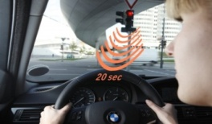
New services require strong cross-company collaboration, which will lead to more customer-centric business models
Success factors: Future business models
Actual:
Single technical solutions
Future:
Customer oriented solutions
Current applications:
Many stand-alone
solutions
Strong focus on
technical solutions, less
customer oriented
No flexibility
and possibility to
increase functionality
One application serves one
function
No/ few collaboration
between suppliers
Current applications:
Modular architecture
Distinction between technical and content provider
Customer-oriented functions
Upgradable services
Joint development and partnership models
Strong collaboration between suppliers
Multi channel delivery (web, mobile, …)
Service
Infra.
Appl.
Service broker
Service
Infra.
Appl.
Service provider
Service provider
Single technical solutions integrated by OEMs
Customer-oriented services provided by collaborative suppliers
Source: A.T. Kearney Embedded Systems Study 2010

Slide 31




German industry has a good starting position to play a major role in embedded systems
Value proposition for Germany
Strong economics
Strong economic growth in almost all industries
Strong demand for automotive vehicles
Strong know-how in IT
Large portfolio of innovative IT companies across Germany
Leading automotive OEMs
Footprint of technology leading automotive OEMs (e.g. VW) with strong focus on innovation
Well trained resources
Strong network of universities and well-trained IT and automotive professionals
Innovative supplier business
Strong technology driven suppliers with strong R&D capabilities
Source: A.T. Kearney Embedded Systems Study 2010

Slide 32



Cross-industry collaboration may tackle this issues and drive innovation to successfully place new services
Success factors: Cross-industry collaboration
(Example: e-Mobility)
Broad power supply infrastructure
Large customer base
Experience in smart metering
Infrastr.
Tech-nology
Leasing of eVehicles
Vehicles
Strong expertise in network communication
Expert for software solutions for measurement services
Technology driven eFleet
Leasing partner to customers
Technical service partner
Embedded software realizes metering, billing and telemetric services
Through cross-industry collaboration new business fields and thereof new jobs will be developed
Source: A.T. Kearney Embedded Systems Study 2010

Slide 33
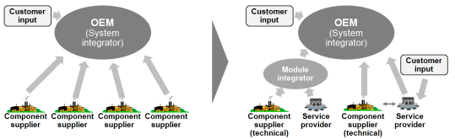
To make the growth of embedded systems a German success story, key questions need to be addressed
Key questions for success of embedded systems
1
2
3
Which future application and segments will drive growth?
How will future ES
change business models??
How can Germany
become the major player for embedded systems?
Where is the highest value add for ES?
Which market segments can be tapped with ES?
Which new developments in ES could facilitate a burst of growth?
Which are new requirements to the market?
Which roles will OEM play in future?
How will growth of embedded systems change business models?
What are the prerequisites for growth in Germany?
How can German industry leverage the good strating position?
In which areas will new jobs be created?

