Slide 1
Semantische Technologien und maschinelles Lernen zur Verwaltung und Nutzung von Big Data
Rudi Studer & Andreas Harth & Achim Rettinger & Thanh Tran
Institute AIFB & FZI Research Center for Information Technology

Slide 2
Agenda
Motivation
Semantic Data Integration
Semantic Search
Statistical Learning
Conclusions

Slide 3
Motivation

Slide 4
Motivation
With increased use of computers more and more data is being stored
Organisations rely on data to support research and business decisions
Data drives policy decisions in government
Individuals rely on data from the Web for information and communication
Data volumes explode
More and more data available on the Web is represented in Semantic Web standards
Linking Open Data (LOD) initiative provides a lot of structured linked data: Web of Data
Various approaches enable insights
Data integration on semantic level
Semantic interpretation of long-tail queries
Deriving new relationships

Slide 5
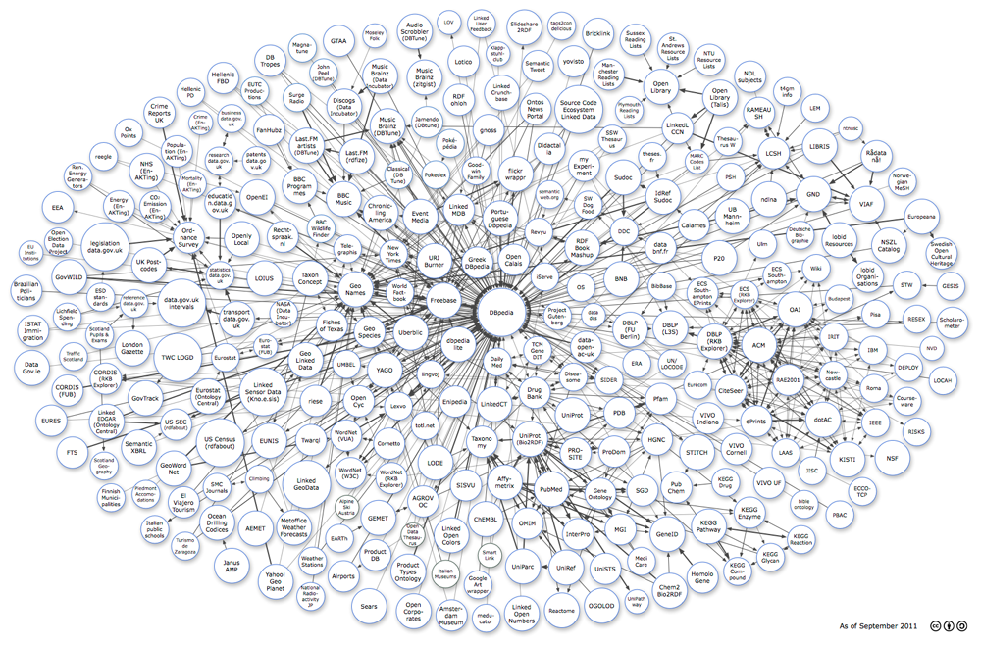
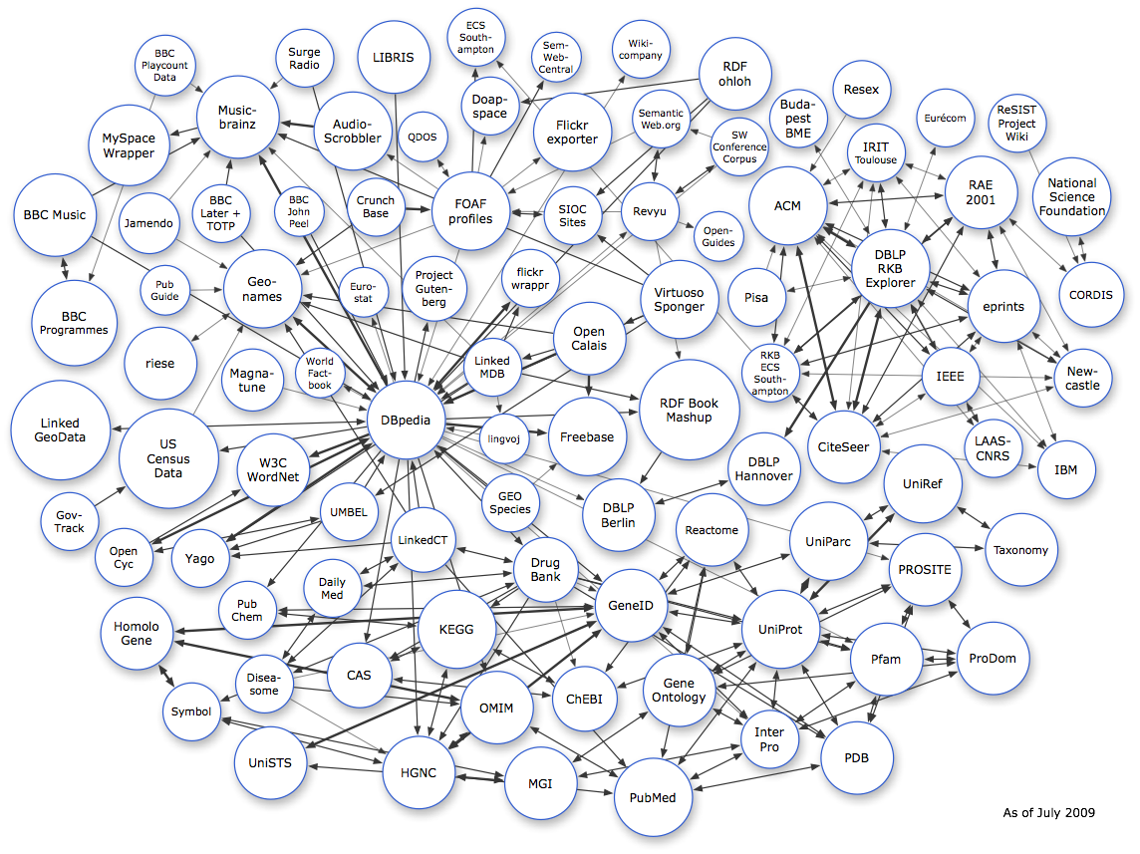
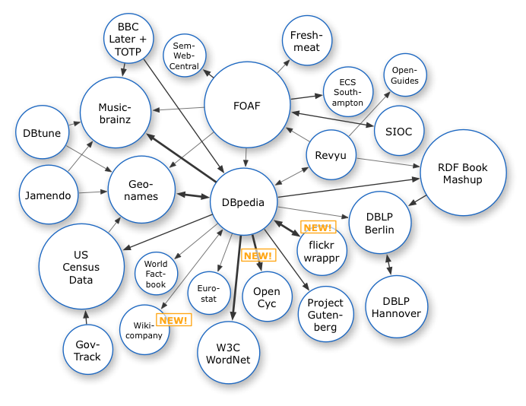
Linked Data on the Web

Slide 6
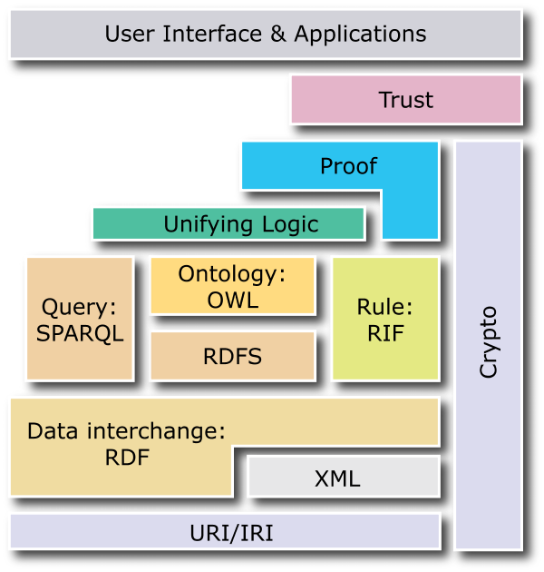
Semantic Technologies
Semantic Web technologies, standardised by the W3C, are mature:
RDF recommendation in 1999, update in 2004
RDFa (RDF in HTML) note in 2008
RDFS recommendation in 2004
SPARQL recommendation in 2008
OWL recommendation in 2004, update in 2009
RIF Core recommendation in 2010
Linked Data is a subset of the Semantic Web stack
Uniform use of URIs
Use of RDF and SPARQL

Slide 7
Semantic Data Integration

Slide 8
Motivation for Semantic Web Technologies
Semantic Web/Linked Data technologies are well-suited for data integration
Standard languages for representing mappings
Linked Data principles for linking data across datasets, and for publishing and accessing integrated Linked Data
Typical data integration scenario
We show
Novel data sets that are published as part of the Web of Data
An application showcasing the benefits of Linked Data to end-users
Novel generic mechanisms, approaches, and technologies for integration
?
!
Common Data Format
Data Integration
Interactive Data Exploration

Slide 9
Scenario: Integration of News with Linked Data
Semantic Search
(over Documents and Data)
Collaborative Filtering
Semantic Annotation
RSS/Atom Newsfeeds
mappings
reuse of identifiers

Slide 10
Common Data Format/Access Protocol
Access to networked data and ontologies is a first step
DBpedia, Freebase, NYTimes Topics, CrunchBase already exist as Linked Data and are interlinked
Next steps:
Perform entity matching in news feeds (identifying entities in text)
Semantic search to enable complex queries and collaborative filtering
Required: Principled way for integrating data from services providing data (e.g., via LinkedIn API) or functionality (e.g., entity matching)

Slide 11
Linked APIs Motivation
The Web today is not only about serving static data:
Data is often dynamically created as a result of some calculation carried out over input data (e.g., weather information)
Service endpoints, forms and APIs are used to trigger functionalities in the Web and the real world as well (e.g., ordering a pizza or solving a recaptcha)
Programmableweb.com lists ~4300 APIs¹
¹http://programmableweb.com

Slide 12
Linked APIs
Web APIs use heterogenous data formats, different architectural styles, and are mostly only textually described
Developers have to gain a deep understanding of every API and write individually tailored code to consume services in applications
The Linked APIs effort aims to promote a scalable and efficient style of services, by bringing together:
RESTful services (respecting Web architecture)
resource-oriented
manipulated with HTTP verbs
GET, PUT (, PATCH), POST, DELETE
Negotiate representations
Linked Data
Uniform use of URIs
Use of RDF and SPARQL
RDF in
Linked API
RDF out
match
match
Description (RDF+SPARQL)
Pattern
Pattern

Slide 13
Combinding Linked APIs
Increased value comes from combinations of services/APIs
6300 mashups on programmableweb.com
Manual effort is required for compositions (glue code)
Structured service/API descriptions ease the composition process considerably
Semantic descriptions allow to execute several tasks automatically (e.g., data matching, discovery, repair)
Structured
Semantic description
Structured
Semantic description
Manually crafted glue code
Structured
Semantic description

Slide 14
Integration and Interoperation Summary
Linked Data and Linked APIs as common abstraction for accessing data and functionality
Linked APIs provide means for publishing and reusing data services on the Web
Linked Data/Linked APIs can be used in
Data processing workflows
Query processing
http://linkedservices.org/ - community website (KIT, U Ghent, USC ISI, OntoText) with further information and links, reference to mailing list

Slide 15
Semantic Search

Slide 16
Motivation for Semantic Search
Common queries solved
navigational, entity search with unambiguous named entity mention
But long tail queries…
Several problematic cases (long tail queries)
Ambiguous / imprecise queries (entity queries)
“George Bush” the beer brewer from Germany
Complex queries (aggregated, relational queries)
“digital camera under 300 dollars produced by canon in 1992”
Use semantics captured by thesauri, ontologies, semantic meta(data) to obtain precise understanding, to aggregate information from different sources, and to retrieve relevant results!
Notes:
“We are at the beginning of search.“ (Marissa Mayer)
Heavy investment in computational power
Navigational queries: short queries target a specific page on the Web served as entry point, based on which the user further explore and find the actually relevant information
Topical queries: terms of the queries belong to some topics, which can be successfully determined using statistical techniques that exploit word-occurences
→ PSI, topic models
Long tail: Distributions of queries is made up of a few common queries and many more so-called long tail searches, i.e. very specific queries that may only occur once
Relatively small number of searches are made up of the most common queries, while the bulk of queries (up to 80 percent) however, are long-tail
Looking at long-tail reveal problematic cases: not solved yet
→ Remaining queries in the long tail of Web queries log are hard (complex questions)
Users have certain expectations as what search engines can provide → expand the capabilities to accommodate complex tasks that involve complex information needs
- Queries users cannot think of search engines being capable of solving
Or, some of these searches are so hard that the users don’t even try them anymore
Require deep understanding of the underlying information needs and data
data and queries specified as text → ambiguous, imprecise
deeper understanding = clear and precise semantics of data and queries
Requires retrieval / aggregation of precise information
Towards a Semantic Web
Large number of Web data vocabularies published in RDFS and OWL
Schema.org
Dbpedia ontology
Large amounts of structured/semantic data published in RDF / RDFa
Linked Data
Embedded metadata

Slide 17
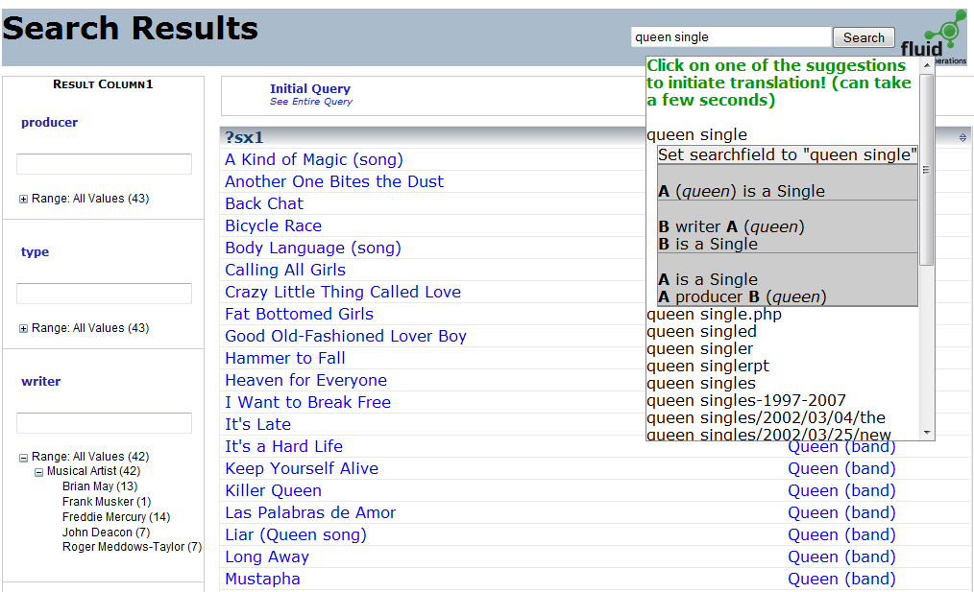
Semantic Search Solution Search Intent Interpretation, Refinement and Exploration
Keywords
Query Completions
Term
Completions
Facets
Notes:
To give an impression where we are towards accomplishing this goal: demo first
Our current system:
Support the process of addressing complex information needs:
starts with keyword search: intepreting the query intent
and then browsing / exploration / refinement of results set via faceted search

Slide 18
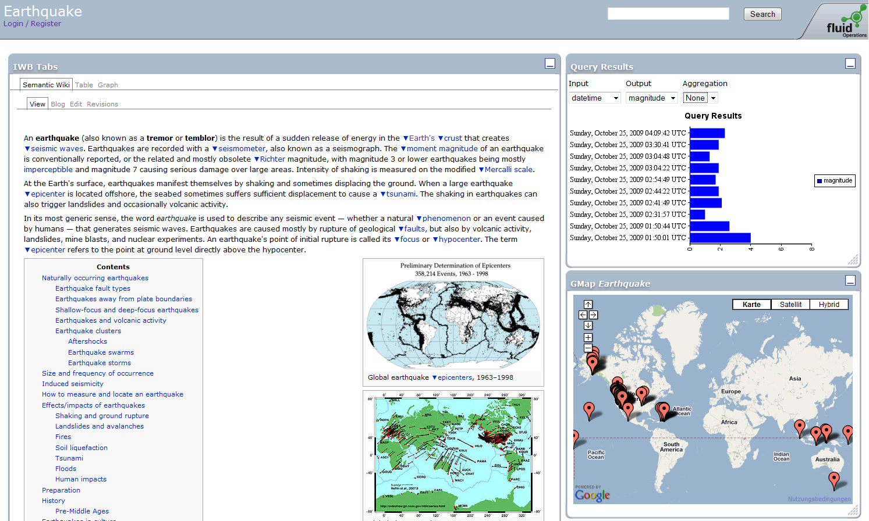
Semantic Search Solution Result Inspection, Analysis and Browsing
Notes:
- Upon selecting a specific result: resource-base navigation (instead of faceted based)

Slide 19
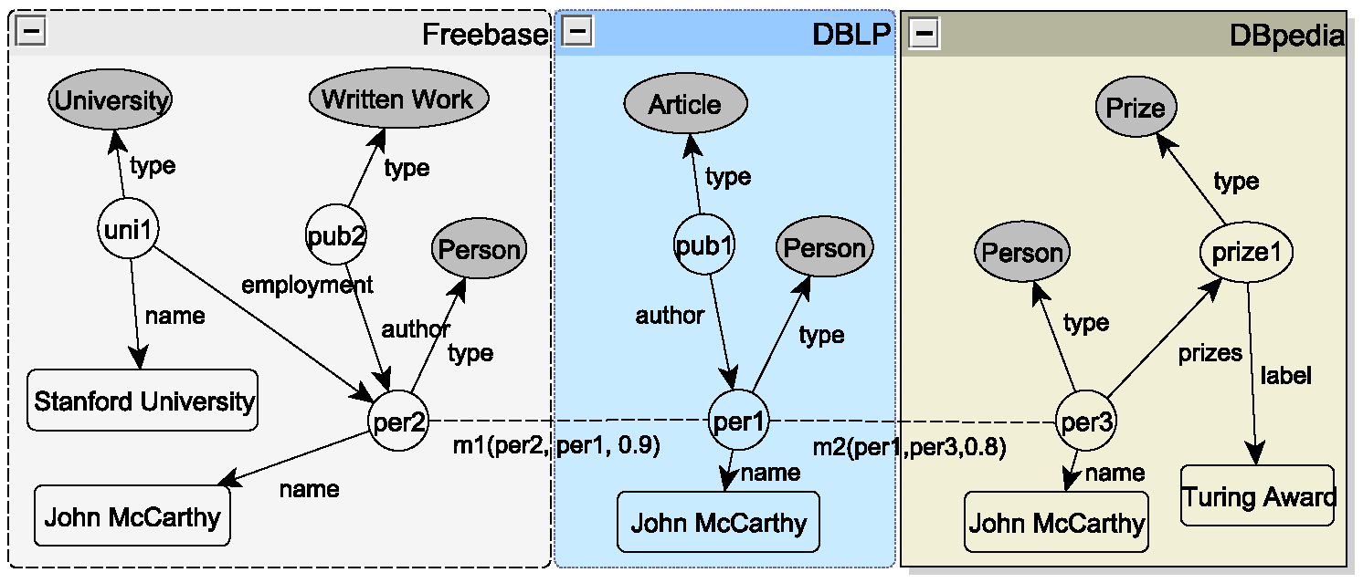
Keyword Query Processing: Problem
“Articles of researchers at Stanford with Turing Award”
„Stanford
Article
Turing Award“
Specification
Keywords might produce large number of matching elements in the data graph
The data graph might be large in size
Search complexity increases substantially with the size of the graph
Large number of results
Selection
Set of Queries
Set of Results
Query 1 1) Result 1
Query 2 2) Result 2
Notes:
- Keywords does not express sturcutural constraints, less constraints than structured queries
- Results might be not needed

Slide 20
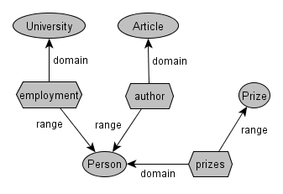
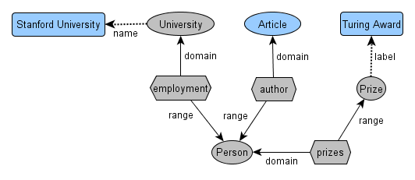
Ideas behind Solution: Top-k over Query Space
Schema graph
Query space
Main Idea
Query space: more compact representation of the data graph
Online construction of query space out of schema graph
Match keywords against labels of resources to find keyword elements
Connect keyword elements with elements of schema to obtain query space
Online top-k query graph exploration
Decreased complexity through exploration on much reduced summary model called query space
Top-k procedure for graph exploration to compute only top-k results
Principle approach for ranking based on language models for structured results
Notes:
Flexible matching methods

Slide 21
Benefits of Semantic Search
Solve queries in the long tail
Ambiguous queries
Complex queries
Addressing complex information needs of end-users
Complex results to intuitive keyword-based queries
Both documents and facts

Slide 22
…Selected Challenges
Hybrid content management
Indexing hybrid content (structured data & text)
Processing hybrid queries
Ranking hybrid results (facts combined with text)
Querying paradigm for complex retrieval tasks
Querying at once vs. iterative exploration
Combination of keywords, NL and facets?
Semantics for broader search context/process: from querying to browsing to intuitive presentation, supporting complex analysis of data / results
Notes:
Relational semantics in structured data is increasingly available
BUT QUALITY
Some also result from manual data collection effort
Automatic methods can help
But do not scale effectively to the large scale hetereogenous setting
Combine structure with content? Ad-hoc aggregeation No principled approaches! Different semantics!
Adding data after text is created, instead of subsequent enrichment; supporting creation, editing and maitaning hybrid content right at the start and throughout the process?

Slide 23
Statistical Learning

Slide 24
Motivation for Statistical Learning
Statistical learning is a method that can help to solve tasks for data integration, semantic search, e.g.:
Textmining:
Extract structure (facts) from unstructured sources (text)
Link extracted facts to knowledge bases
Statistical Analysis:
Cluster semantic data (find similar entities, facts, events,...)
Predict facts and events, analyze trends

Slide 25
1. Textmining: Solutions I
Unsupervised Semantic Parsing (USP):
Identify similar terms
Identify similar syntactical structures
Microsoft buys Powerset
Microsoft acquires semantic search engine Powerset
Powerset is acquired by Microsoft Corporation
The Redmond software giant buys Powerset
Microsoft’s purchase of Powerset, …
Automatically cluster synonymic expressions

Slide 26
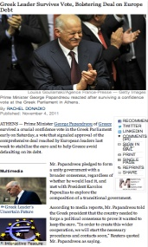
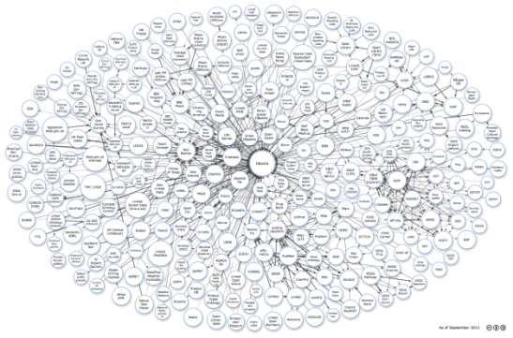
1. Textmining: Solutions II
Semantic Annotation:
Link text fragments to rich background knowledge (Wikipedia / Dbpedia)
Web Pages
LOD Cloud

Slide 27
1. Textmining: Challenges / Benefits
Benefits: Existing tools work well for
fixed set of entity types (Persons, Institutions,…)
popular domains (mainstream news, Wikipedia,…; cannot be directly applied to special domains: e.g. nanotechnology)
major languages (English, Spanish,…)
domains where annotated corpora are available
Challenges for current research
Cross-lingual (cover and bridge between many languages)
see EU project: X-LIKE
Non-standard language (cover e.g. twitter feeds)
Unsupervised approaches (Data driven, do not require extensive annotation efforts; but don’t scale, results are often hard to interpret by users)

Slide 28
2. Statistical Analysis: Solutions I
Find similar entities (clustering)
Find identical entities (entity resolution)
„Machine Learning“
skos:prefLabel
topic110
person100
foaf:knows
foaf:topic_interest
=?
foaf:gender
„Jane Doe“
person200
„female“
foaf:name

Slide 29
2. Statistical Analysis: Solutions II
Prediction (recommendation engines)
„Machine Learning“
skos:prefLabel
?
foaf:topic_interest
topic110
person100
foaf:knows
foaf:gender
foaf:topic_interest
„Jane Doe“
person200
„female“
foaf:name

Slide 30
2. Statistical Analysis: Challenges / Benefits
Research challenges
Big data analytics
Very sparse data sets (little information about a specific instance)
Rich contextual knowledge available (temporal, location)
Extract / Predict complex events
Provide anytime feedback for exploratory data analysis
Analyze data streams
Potential benefits of new approaches
Scale to huge data sizes
Can deal with high dimensional sparse data sets
Incorporate temporal information
Make personalized recommendations

Slide 31
Conclusion

Slide 32
Conclusion
Large and increasing amounts of semantic data
Semantic data / technologies provide added value
Data Integration: Linked Data / Linked APIs provide standards-based means for publishing and reusing data / data services on the Web
Semantic Search: Addressing complex information needs in the long tail, providing complex results to intuitive keyword-based queries
Statistical Analysis/Learning: Extract and predict complex events and links over high-dimensional sparse Big Semantic Data
Combine ML with intelligent complex event processing
Integrate methods for building up proactive infrastructures
Notes:
Linked Data and Linked APIs as common abstraction for accessing data and functionality
Linked APIs provide means for publishing and reusing data services on the web
Linked Data/Linked APIs can be used in
Data processing workflows
Query processing
http://linkedservices.org/ - community website (KIT, U Ghent, USC ISI, OntoText) with further information and links, reference to mailing list
Solve queries in the long tail
Ambiguous queries
Complex queries
Addressing complex information needs of end-users
Complex results to intuitive keyword-based queries
Both documents and facts
Research challenges
Big data analytics
Very sparse data sets (little information about a specific instance)
Rich contextual knowledge available (temporal, location)
Extract / Predict complex events
Provide anytime feedback for exploratory data analysis
Analyze Datastreams
Potential benefits of new approaches
Scale to huge data sizes
Can deal with high dimensional sparse data sets
Incorporate temporal information
Make personalized recommendations

Slide 33
Questions / Comments?
http://www.aifb.kit.edu
http://www.ksri.kit.edu
http://www.fzi.de

