Slide 1
Innovative Anwendungsfälle für die Datenanalyse „Von Datenflut zu neuem Wissen – Neue Geschäftsmodelle in einer digitalen Welt“ Münchner Kreis - Fachkonferenz 2012
Dr. Volker Rieger
24.05.2012

Slide 2
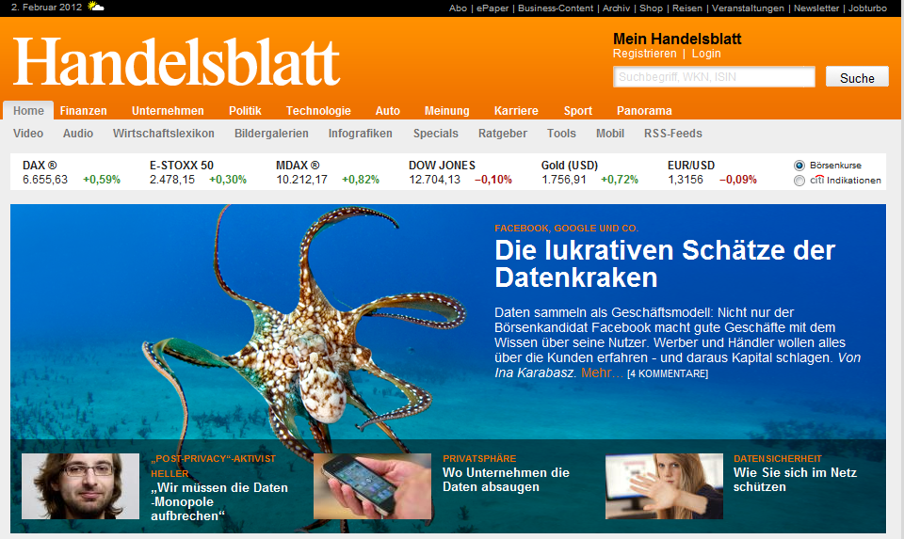
The public discussion on data analytics is frequently influenced by fear and lack of transparency for the users. A dialogue between all parties will help acceptance.
Guidelines
Introduction
Source: Handelsblatt Online, February 2012

Slide 3
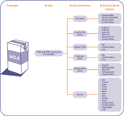
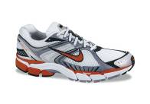
Provisioning of information – whether as pure-play service or as attachment to an existing product – takes an increasing part of value creation across many industries.
Frame Template
Data-Centric Business Models
GS1 – Data products along the Supply Chain
NIKE plus – Data as Part of the Consumer’s Benefit
Supply chain tracing
Participate in virtual challenges
Users track their runs through a micro chip
Share running routes online on a digital map
Global product classification standards
System of bar codes & identification
Mashup with other communities
Direct connection to Apple iTunes
System for global synchronization of product catalogues
Share music favorites
personal training schedules
Join teams & community, find running mates
Database Services/ Information Registry
Pure Data Services (“Pure-play”)
Products with a Data Sphere (“Hybrid”)

Slide 4
Data analytics has to cover and integrate both external and internal information sources. The results can be used internally or monetized in the external market.
Frame Template
Productization of Information
Social Media
Internet of Things
Intake
Output
Information as product
Presentation
Integration
transactions
Analysis
Information for decision support
Feasibility
New data sources
New technologies
Public acceptance
Opportunity
Information products
Customer intimacy
Real-time decisions
in memory
Information for operational support
hadoop
Enterprise

Slide 5
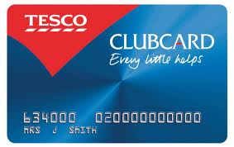
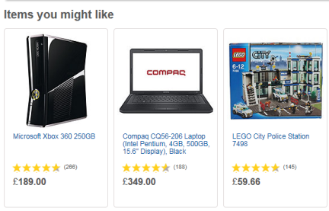
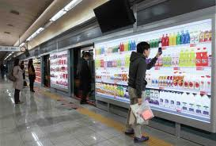
Analytics is one step in the overall information value chain. Linking all elements creates new business models, applications and value propositions.
Frame Template
Information Value Chain
Intake
Processing
Output
Generation & Acquisition
Storage & Archiving
Analytics
Presentation
DB
Loyalty card
Data bases and CRM systems
Personalized advertising & product recommendations
Virtual store in subway where commuters can buy groceries out of a virtual wall.
Example: Tesco Supermarkets

Slide 6
Most market participants perceive analytics as the key step of value contribution in information-driven services and business models.
Frame Template
Information Value Chain
Intake
Processing
Output
Generation & Acquisition
Storage & Archiving
Analytics
Presentation
66%
Percent of participants rating a step as highly important for the overall value contribution:
Source: Detecon Study
Notes:
Study details:
Question: “These web sites are valueable to me because they support the following steps of the information lifecycle” ➔ allowed answers: „extremely high“, „very high“, „high“, „medium“, „low“, „no value“, „N/A“
Steps of the information lifecycle (full list):
Data generation & acquisition, (2) storage & representation, (3) Aggregation & processing, (4) Integration, (5) Analytics, (6) Presentation & provisioning
➔ (3)-(5) have been merged into „Analytics“
Graph shows cumulated percentage of answers „extremely high“, „very high“, and „high“
Demographics
n = 101
Participants both from service provider as well as user side
Industries:
consulting (45%),
software & services (18%),
financial services (8%),
consumer services (4%),
telco (4%),
health care (4%),
other (17%)
Career level:
Student (7%)
Entry level (6%)
Experienced (26%)
Manager (18%)
Senior Manager (13%)
Executive level / SVP (28%)
Other (2%)

Slide 7
The transformation of business and social life towards digital IT-based processes leaves various data traces requiring new capabilities to handle and analyze data.
Frame Template
Digital Transformation
The future digital world
Required new data capabilities
Fully IT-based business processes in all industries
…huge
volumes
Web-based and mobile customer interaction
Social life via social media networks
…high
velocity
Handle data with…
…large variety
Ubiquitous Internet-of-Things
Closed-loop real-time decision making
The big data triangle

Slide 8
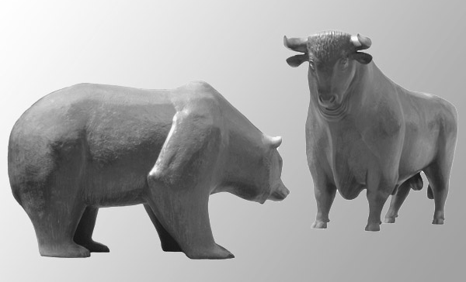
New big data analytics applications impacting core business processes can be found in all industry and services sectors.
Frame Template
Industry Use Cases
Analyze energy data to improve demand and supply forecasting
Perform customer analytics to retain existing customers
Analyze social media data for market research.
Make free-text analysis of claim reports.
Utilities
Telecommunication
Media
Insurance
Use event-processing for trading and risk management
Determine efficacy of pharmaceuticals by insurance data analysis
Analyze machine data from sensors for preemptive maintenance
Optimize logistics by analysis of location data from transport vehicles
Financial services
Health care
Manufacturing
Logistics

Slide 9
Customer data is perceived as being the most valuable data domain. A domain of growing interest is sensor data – representing the progress of the Internet of Things.
Frame Template
Data Domains
Internet of Things
72%
55%
52%
Customer
Financial
Geographic
Sensor Data
Product
Price
Data in domain X entails “very high” value contribution.
Source: Detecon Study
Notes:
Study details:
Question: “In your opinion, how much value/profit can be generated with the following types of data?” ➔ allowed answers: „extreme value“, „high value“, „medium“, „low value“, „no value“
Data domains (full list):
News, user behaviour, customer data, financial, product, review & rating, sports, travel, price, sensor, user generated, mobile
Graph shows cumulated percentage of answers „extreme value“ and „high value“
Demographics
n = 101
Participants both from service provider as well as user side
Industries:
consulting (45%),
software & services (18%),
financial services (8%),
consumer services (4%),
telco (4%),
health care (4%),
other (17%)
Career level:
Student (7%)
Entry level (6%)
Experienced (26%)
Manager (18%)
Senior Manager (13%)
Executive level / SVP (28%)
Other (2%)

Slide 10
Customer analytics has been the focus of many innovative start-ups. Both historic and real-time data is being used to support enterprise decision making and new services.
Customer Analytics Market Scan
‚Offline‘ (historic)
‚Realtime‘
Location enabler (pure providing of data)
Data manage-ment
Indirect actions / support decision making
Direct customized actions
Indirect actions / support decision making
Direct customized actions
Market seg-mentation
Marketing audit (reference data)
Customized pricing
Targeted advertising
Recommen-dation
Monitoring – dynamic data
Social network marketing
Realtime targeting
Status- / Context-aware-services
User refunding for advertising
Social network search analytics
Rich profiles of locations
Hybrid
Community vending machine
Service driven companies
Audio-based ad measurement
Customized phone bill
Interest-graph based recommendations
Data organizing API
45
Social textmining
Location API
43
44
23
Predictive behavior analytics
SW based loc. system
7
1
Twitter analytics
Behavioural data bank
Forecast web-usage paths
Risk-oriented pricing
Share location via a Web
55
54
Targeted advertising
Credit-card usage based ads
Door to door navigation
Real-time social media analytics
360° usage view
Pure-play
= Innovative CA-Applications
Source: Telekom Innovation Laboratories, Detecon Analysis

Slide 11
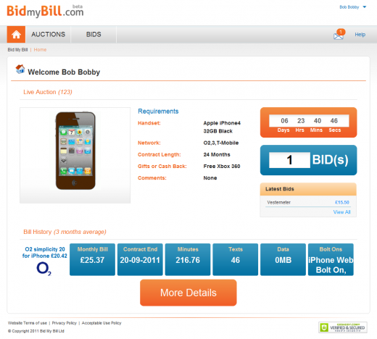
Bid my Bill establishes a new business model: it provides an exchange platform and acts as intermediary between mobile operators and potential customers.
Frame Template
Example 1: Customer Analytics
Customized mobile tariffs
Reversed mobile phone buying process: phone companies bid for the user’s contract based on historic billing data
Extensive analytics on historic minutes, text and data usage
User can add personal requirements (e.g. phone choice, network preferences, etc.)
Launch: October 2011

Slide 12
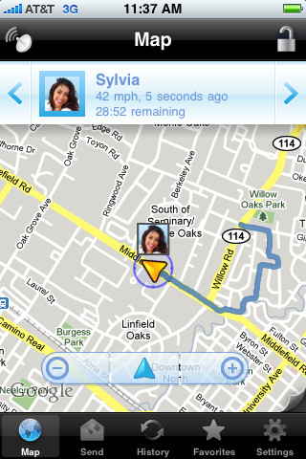
Glympse leverages the possibilities of retrieving location data. It addresses data privacy issues by leaving the decision – when to share his location and to whom – to the user.
Frame Template
Example 2: Customer Analytics
Share location data
Users can share their own location data with friends in real-time
Friends receive a link to a map where they can “follow” the current location, and see the estimated arrival time at a certain location
The location information can also be propagated to Facebook.
Launch: 2008

Slide 13
With big data technology highly granular and yet exhaustive data is analyzed to trouble-shoot IPTV networks. Hence, call-center volumes can be reduced by 30%-50%.
Frame Template
Example 3: Internal Processes and Technologies
Correlation analysis of IPTV-infrastructure
Trouble-shooting in IPTV-networks involves complex combinations of devices, protocols and environmental conditions.
Data from different device vendors and from different protocol levels have to be integrated, leading to a high variety of data sources and large data volumes.
With end-to-end correlation analysis of log-data Deutsche Telekom could significantly increase its trouble-shooting capabilities. Accordingly, IPTV call center volumes dropped by 30%-50% within one year and customer satisfaction increased.
STB
IPTV data stream
In-house
DSLAM
AGS1
AGS2
BBRAR
IP-Backbone
D-Server
A-Server

Slide 14
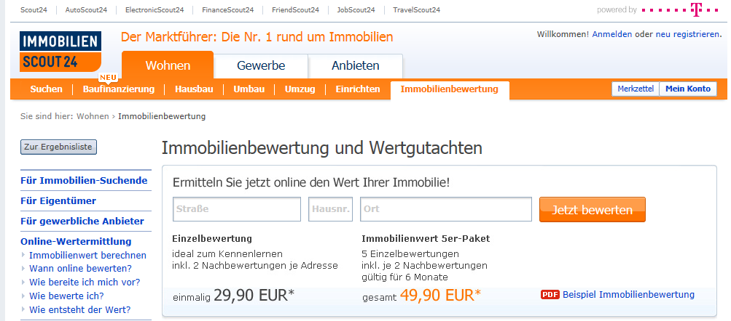
Immoscout24 uses its real-estate listings to derive market prices and offers these information as a paid service to home owners.
Frame Template
Example 4: Product & Price Information
Real estate
The real estate is a market known to its high degree of information asymmetry, giving rise to a high big data value potential
The Deutsche Telekom subsidiary Immoscout24 is market leader (67% of visitors in 2010) among real estate portals in Germany
Immoscout24 derives real-estate market prices based on its listings with a high level of granularity in regard to location, size, condition, features, etc.
For a fee, value estimation based on the market prices is offered to real-estate owners

Slide 15
Deutsche Telekom’s media portals (Musicload, Entertain, Videoload, …) use both product and customer-derived data to improve user experience and enhance sales.
Frame Template
Example 5: Personalized Media Recommendations (PMR)
A multi-tenancy and scalable recommender solution for the Deutsche Telekom portals.
Basic Knowledge and R&D from T-Labs. Integration and commercialization by CID and YOOCHOOSE
Patented stereotype algorithm developed at T-Labs
Semantic content based filtering and metadata enrichment is implemented for Entertain in Germany.
In use at Musicload, Gamesload and Entertain, future use at TV-Archive, Videoload and Erotic Lounge
1
Content
based
Filtering
„If product A is similar to product B, recommend product A.“
2
„Many customers who bought A also bought B. If customer X buys product A, recommend product B.“
Collaborative
Filtering
3
Rule
based
Filtering
Filter rules set by product manager.
•
Erfahrung
•
Umfragen
4
•
…
Rock
Song A
„If customer A has the behavioral pattern of stereotype X, recommend product B.“
Stereotype
Filtering
Song B
Pop
Song C
5
Song D
Automated optimal combination of various algorithms.
Source: Telekom Innovation Laboratories

Slide 16
Trust and value are key to data analytics. Openness and win-win situations create benefits and acceptance.
Guidelines
Summary
1
Data analytics covers numerous applications fields
Customer data is an important but only one of many fields
2
Only value for the customer is true business value
Use analytics to improve your product and customer service
3
Data has market value
All analytics initiatives should look to monetize data assets
4
Data likes to interact
The combination of internal and external data yields maximum benefits
5
Machine data from the Internet of things will grow significantly in the next years
Connecting remote assets and products to internal IT systems

Slide 17
Contact sheet
Contact
Dr. Volker Rieger
Detecon International GmbH
Managing Partner
Oberkasseler Str. 2
53227 Bonn (Germany)
Phone: +49 228 700 1920
Mobile: +49 160 7131031
E-Mail: volker.rieger@detecon.com

