Slide 1
Research, Innovation and Teaching in Big Data Analytics Challenges and Chances
Prof. Dr. Volker Markl
Chair of the Database Systems and Information Management Lab
Technische Universität Berlin
www.dima.tu-berlin.de

Slide 2
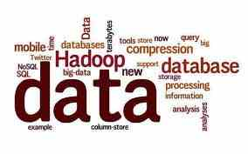
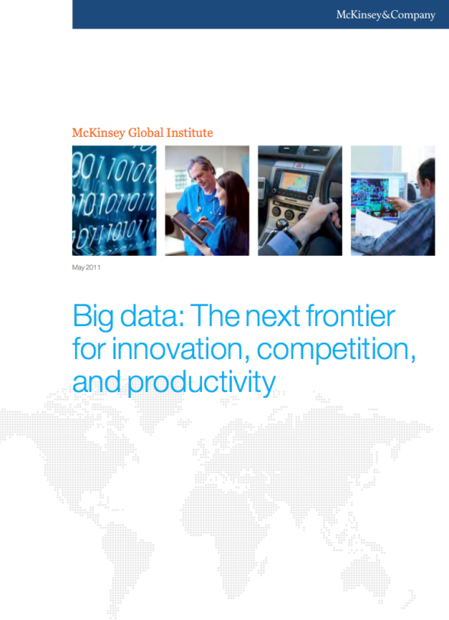
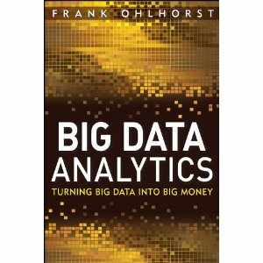
About Big Data Analytics
Source: McKinsey
Source: Information Week
Source: Amazon
Source: NCSU

Slide 3
Agenda
What is Big Data?
Examples
Parallel Data Processing and Other Enabling Technologies
Applications
Challenges
Call to Action

Slide 4
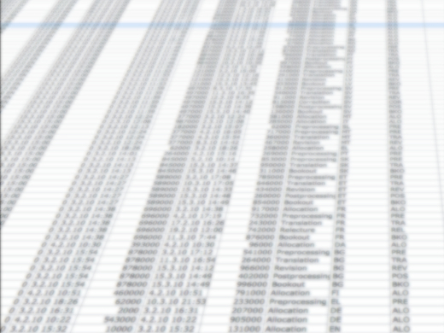
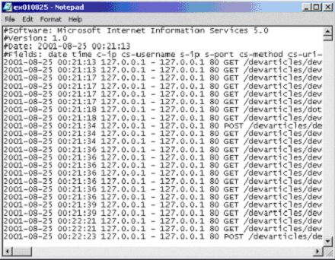
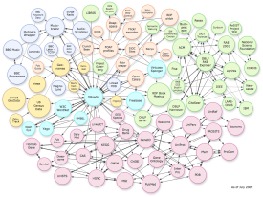
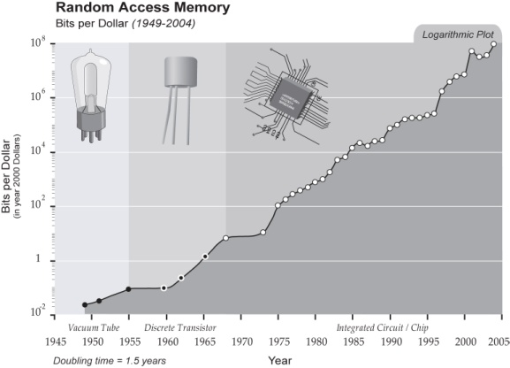
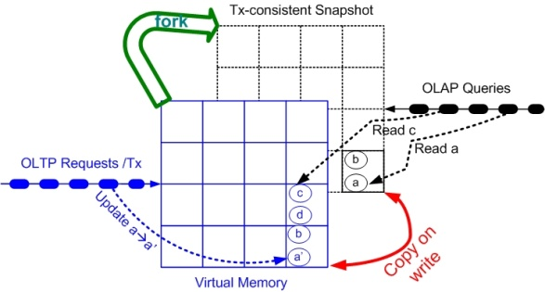
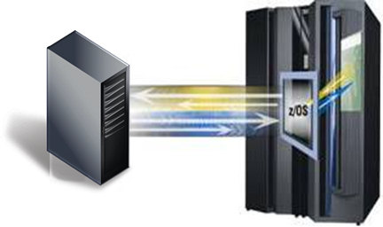
„Medium Data Analytics“
Transactional Data at „Webscale“
Web Logfiles
Linked Open Data and many other „human generated data sets“
These data sets will fit into main memory soon!
IBM ISAO
SAP HANA
TUM Hyper
Many standard data management solutions exist!

Slide 5
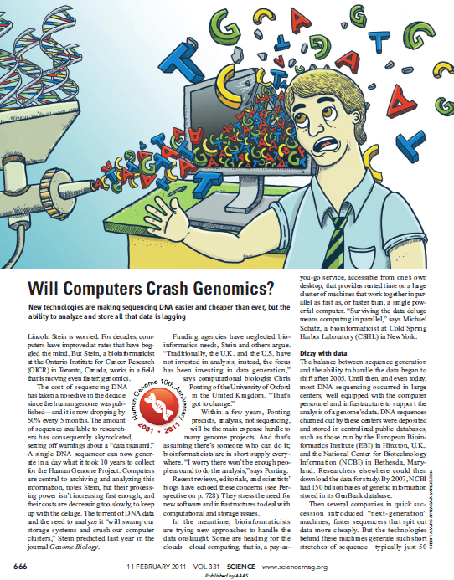
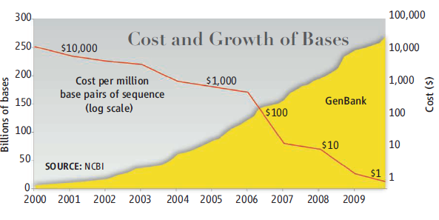
Big Data for Real
It is cheaper to resequence than to store genome data!
Science 11 FEBRUARY 2011 VOL 331, ISSUE 6018, PAGES 639-806

Slide 6
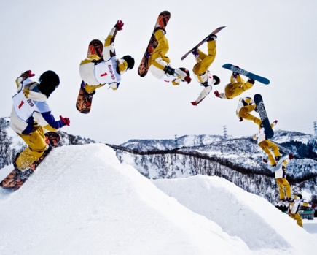
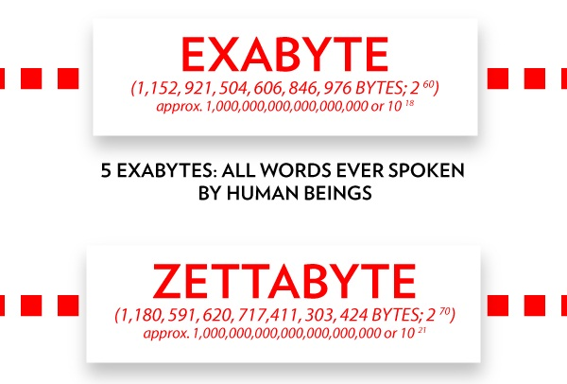
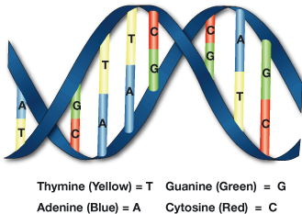
Other Examples of Really Big Data Sets
Smart Grids
Web Archive
Video Streams
Sensor Data
Audio Streams
Genome Data
mostly machine generated or collaborative on web-scale
RFID Data

Slide 7
Defining Big Data Analytics by Complexity
Size
Format/Media Type
Uncertainty/Quality Freshness
etc.
Selection/Grouping Relational Operators (Join)
Information Extraction & Integration
Data Mining
Predictive Models
etc.
Data
Query

Slide 8
A Popular Definition: The „V“s
Volume
Data size
Velocity
Data ingestion speed
Analysis time window
Variablity
Data formats
Media types
Veracity
Uncertainty
Inconsistency
challenging for complex analysis questions
solutions exist for structured data and text
challenging for graph or audio/video data
challenging for automatic reasoning
Popular „definition“, but misses some other aspects of complexity

Slide 9
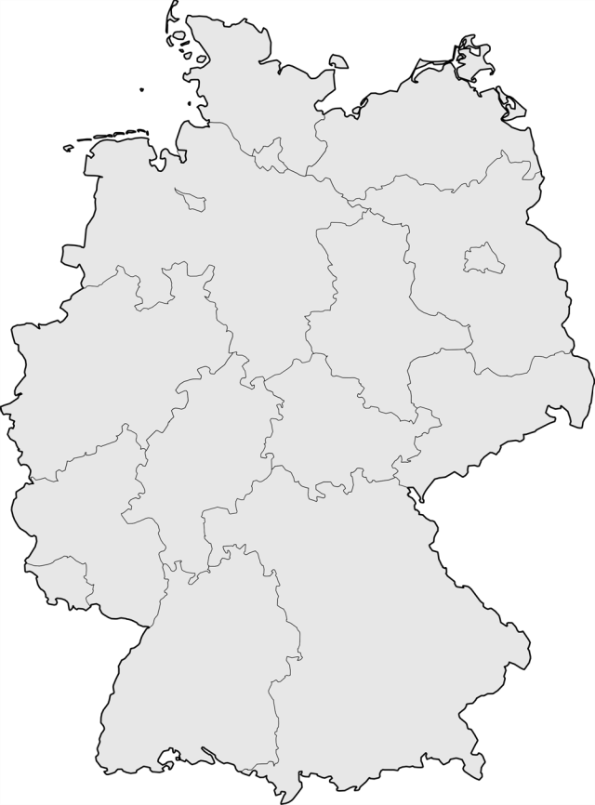
Big Data Analytics Example: Climate Data Analysis
PS,1,1,0,Pa, surface pressure
T_2M,11,105,0,K,air_temperature
TMAX_2M,15,105,2,K,2m maximum temperature
TMIN_2M,16,105,2,K,2m minimum temperature
U,33,110,0,ms-1,U-component of wind
V,34,110,0,ms-1,V-component of wind
QV_2M,51,105,0,kgkg-1,2m specific humidity
CLCT,71,1,0,1,total cloud cover
…
(Up to 200 parameters)
Analysis Tasks on Climate Data Sets
Validate climate models
Locate „hot-spots“ in climate models
Monsoon
Drought
Flooding
Compare climate models
Based on different parameter settings
Necessary Data Processing Operations
Filter
Aggregation (sliding window)
Join
Multi-dimensional sliding-window operations
Geospatial/Temporal joins
Uncertainty
10TB
1100km,
2km resolution
3 months,
1h resolution
950km, 2km resolution

Slide 10
Another Example: The Next Generation of Business Intelligence
Internet
Situational BI
Text
How did the sentiment towards my products change this year?
Text
Text
Intranet
Information Extraction
Semantic Integration Load/Refresh or Ad-hoc
Text
Text
BI over Text
XLS
Analysis Schema and Entities
How is the customer satisfaction per region?
Text
Text
XML
Who is leading in American Idol?
Text
Text
Text
Text
Text
Text
Data Warehouse Data Marts
BI over Media Types
The next generation of Business Intelligence (NGBI) will correlate data warehouses with text and other modalities from web services of information providers, corporate Intranets and the Internet

Slide 11
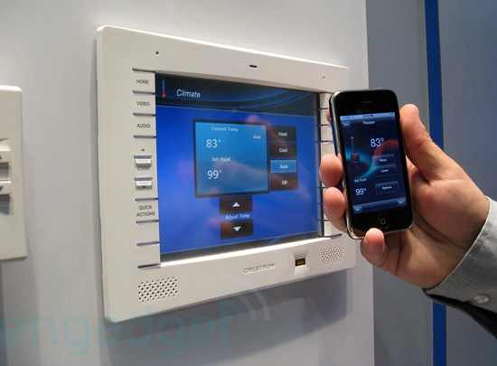
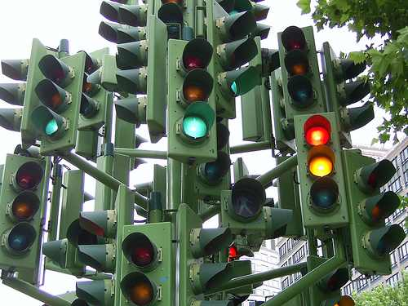
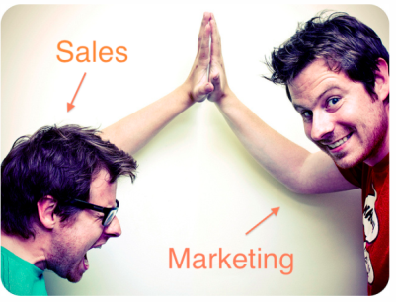
Further Applications
Healthcare
Home Automation
Water Management
Lifecycle Management
Energy Management
Traffic Management
Sales/Marketing

Slide 12
Parallel Data Processing
Need for data parallel processing
Increase of data complexity
Increase of query complexity
Moore’s Law: ManyCore and Cluster Computing
Scale-up no longer possible
Scale-out is the name of the game
Parallel programming is not easy
(Network) Communication
Concurrent programming: Divide & Conquer
Synchronization as bottleneck (Amdahl’s Law)
Fault tolerance
Data Programming models must ease parallel data processing
Abstractions hide the gory details
Automatic adaption to hardware
Parallelization and Optimization
Beware: Data flow and control flow dependencies!
Popular simple model: map/reduce (e.g., Hadoop)

Slide 13
The Information Economy
A major new trend in information processing will be the trading of original and enriched data, effectively creating an information economy.
„When hardware became commoditized, software was valuable. Now that software is being commoditized, data is valuable.“ (Tim O‘Reilly)
„The important question isn’t who owns the data. Ultimately, we all do. A better question is, who owns the means of analysis?“ (A. Croll, Mashable, 2011)
Information as a Service
MIA, Datamarket, …
End users
Data as a Service
MIA, Azure IMR, etc …
Corporations
SaaS
Salesforce.com, Office 2010 WebApps
Value increase
Analysts
PaaS
Microsoft Azure, Google App Engine
Application
Developers
IaaS
System administrators
Amazon Elastic Compute Cloud
Cloud-Computing Stack
The Market situation

Slide 14
MIA: A Marketplace Infrastructure for Analytics
Dataproviders
Algorithms
Users
Data &
Aggregation
Revenue Sharing
Technology
Licensing
Queries
Analytical
results
Marketplace
Social Media Monitoring
Media Publisher Services
SEO
Index
Trust
Massively Parallel Infrastructure
Distributed Data Storage
German Web
Infrastructure as a Service
http://www.trusted-cloud.de/de/778.php

Slide 15
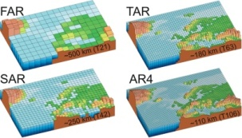
Stratosphere: Big Data Analytics Infrastructure for the Cloud
Use Cases
Explore the power of Cloud computing for complex analytical tasks
Database-inspired approach
Analyze, aggregate, and query
Textual and (semi-) structured data
Research and prototype a web-scale data analytics infrastructure
Scientific Data
Life Sciences
Linked Data
Parallel Analytics Query Processor
Infrastructure as a Service
...
Stratosphere is publically funded by DFG and EIT. Open Source at www.stratosphere.eu
Notes:
Researches “Information Management in the Cloud”
Joint project by 5 research groups from the Berlin area
Started in Oct. 2010
More than 10 PhD students and 16 master students involved

Slide 16
The „Big Data“ Space
Legal Dimension
Social Dimension
Economic Dimension
Technology Dimension
Application Dimension
Copyright
Privacy
Digital Preservation Decision Making
Verticals
User Behaviour
Societal Impact
Collaboration
Scalable Data Processing
Signal Processing
Statistics/ML
Linguistics
HCI/Visualization
Business Models
Benchmarking
Impact of Open Source
Deployment
Pricing

Slide 17
Call to Action
Educate Data Scientists to create the required talent
T-shaped students
Information „literacy“
Data Analytics Curriculun
Research Big Data Analytics Technologies
Data management (uncertainty, query processing under near real-time constraints, information extraction)
Programming models
Machine Learning and statistical methods
Systems architectures
Information Visualization
Innovate to maintain competetiveness
Demonstrate flagship use-cases to raise awareness
Promote startups in the area of data analytics
Transfer technologies to German enterprises, in particular SMEs
Determine legal frameworks and business models
We need to ensure a German technological leadership role in „Big Data“

Slide 18
Some Solutions
Parallel Data Processing
Parallel Data Managementb: ParStream et al.
Map/Reduce: Hadoop, Stratosphere et al.

Slide 19
Parallel Speedup

Slide 20
Parallel Speedup

Slide 21
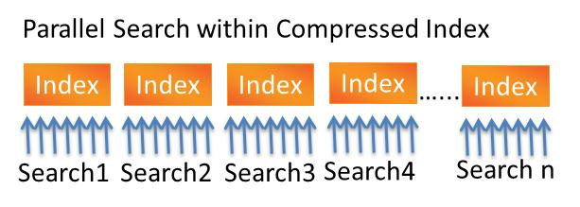
ParStream provides the unique combination of REAL-TIME – LOW-LATENCY – HIGH THROUGHPUT
ParStream Big Data Analytics Platform
ParStream’s key advantages:
Unique Highly compressed Bitmap Index which can be analyzed in compressed form (patent application filed)
Real-time analytics through Massively Parallel Processing (MPP)
Very high throughput due to massively reduced workload (no decompression, small index, efficient algorithms)
Low-Latency through continuous import of new data without slowing down analytics
Columnar data / index allows very flexible analytics (multi-column, multi-value)
Specialized data / index types and algorithms
Shared Nothing Architecture
PARSTREAM PARALLEL ARCHITECTURE
SQL API / JDBC / ODBC
C++
UDF - API
Real-Time Analytics Engine
In-Memory and
Disc Technology
High Performance
Compressed Index
(HPCI)
Multi-Dimensional
Partitioning
Massively Parallel
Processing (MPP)
Shared Nothing
Architecture
Fast Hybrid Storage (Columnar/ Row)
High Speed
Loader with Low Latency
PARSTREAM INDEX ARCHITECTURE
© Parstream GmbH, used with permission, www. parstream.com
21
Notes:
So lets have a look at the architecture of Parstream.
ParStream is a standalone analytical database which was designed and built by us in C++, without using any foreign programming code or modules.
The System combines state or the art architecture with unique ip.
Data in ParStream and can be queried using SQL and 3rd party Frontend Tools, that are conntected via JDBC or ODBC.
For running complex queries extremely fast, we provide a powerfull C++ API. By calling user defined functions we are able to execute complex algorithms like geo clustering directly within the database.
The Realtime Analytics engince processes the queries based on the indizes highly parallel within a multiprocessor environment.
ParStream is using an combined In-Memory and Disc technology to provide fast access to data. The data is also partitioned in multi dimensiones and distributed in a clustered shared nothing architecture.
By doing this we achieve ver good linear scalability and fault tolerance.
The heart of ParStream is our High Performance Compressed index, which we inventend and currently are in the patent filing process for it.
On the next slide, we will have a more detailed look at the index.
Data from different sources can be imported with a very high speed and a latency of just a few seconds. That assures that new data is available for querying immediately.
After importing the data is persisted using a vast hybrid storage, which is a configurable combination of a columnar and a row store
21

Slide 22
HUGE MARKET OPPORTUNITY
Big Data Analytics is a game changer in every industry
and is a huge market opportunity
All Industries
eCommerce
Services
Social
Networks
Telco
Finance
Energy
Oil and Gas
Many
More
Many Applications
Facetted Search
Web analytics
SEO- analytics
Online- Advertising
Ad serving
Profiling
Targeting
Customer attrition prevention
Network monitoring
Targeting
Prepaid account mgmt
Trend analysis
Fraud detection
Automatic trading
Risk analysis
Smart metering
Smart grids
Wind parks
Mining
Solar Panels
Production
Mining
M2M
Sensors
Genetics
Intelligence
Weather
© Parstream GmbH, used with permission
www. parstream.com
22

Slide 23
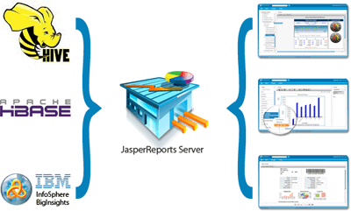
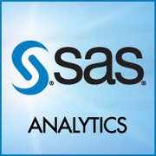
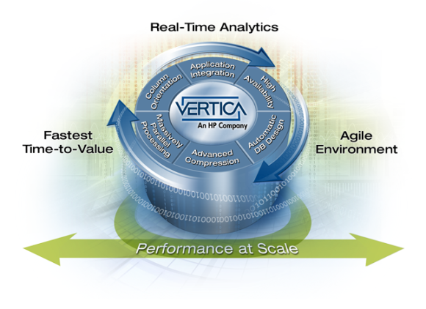
Further Players

Slide 24
What is Map/Reduce?
Programming model for data-intensive programming
well-suited for large scale parallel execution
automatic parallelization & distribution of data and computational logic
easy to extend with fault tolerance schemes
clean abstraction for programmers
Based on functional programming
treats computation as the evaluation of mathematical functions and avoids state and mutable data
no changes of states (no side effects)
output value of a function depends only on its arguments
Map and Reduce are higher-order functions
take user-defined functions as argument
return a function as result
to define a map/reduce job, the user implements the two functions m and r

Slide 25
Data Flow in Map/Reduce
(K _{m},V_{m})*
Framework
(K _{m},V_{m})
(K _{m},V_{m})
(K _{m},V_{m})
…
MAP(K _{m},V_{m})
MAP(K _{m},V_{m})
MAP(K _{m},V_{m})
…
(K _{r} ,V_{r})*
(K _{r} ,V_{r})*
(K _{r} ,V_{r})*
…
Framework
(K _{r} ,V_{r}*)
(K _{r} ,V_{r}*)
(K _{r} ,V_{r}*)
…
REDUCE(K _{r} ,V_{r}*)
REDUCE(K _{r} ,V_{r}*)
REDUCE(K _{r} ,V_{r}*)
…
(K _{r} ,V_{r})
(K _{r} ,V_{r})
(K _{r} ,V_{r})
…
Framework
(K _{r} ,V_{r})*

Slide 26
Map Reduce Illustrated (1)
Problem: Counting words in a parallel fashion
How many times different words appear in a set of files
juliet.txt: Romeo, Romeo, wherefore art thou Romeo?
benvolio.txt: What, art thou hurt?
Expected output: Romeo (3), art (2), thou (2), art (2), hurt (1), wherefore (1), what (1)
Solution: Map-Reduce Job
m (filename, line) {
foreach (word in line)
emit(word, 1);
}
r (word, numbers) {
int sum = 0;
foreach (value in numbers) {
sum += value;
}
emit(word, sum);
}

Slide 27
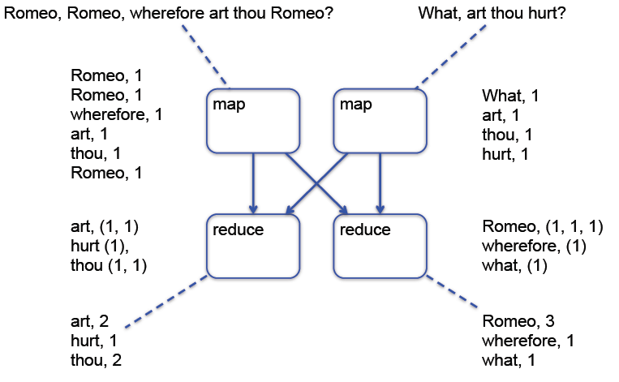
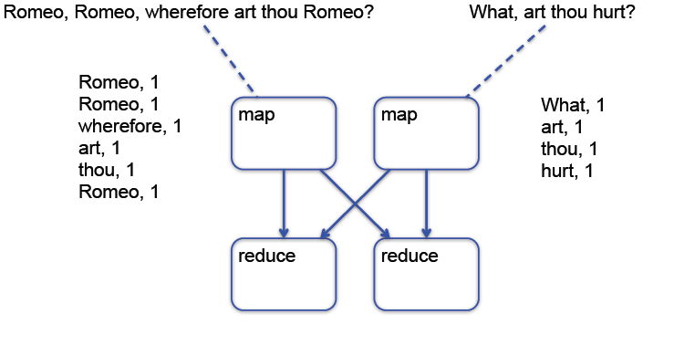
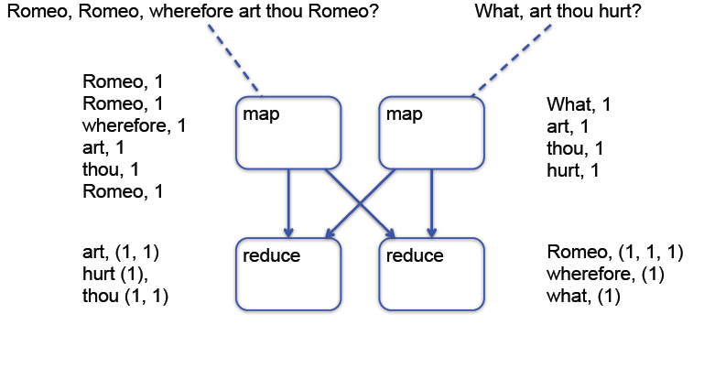
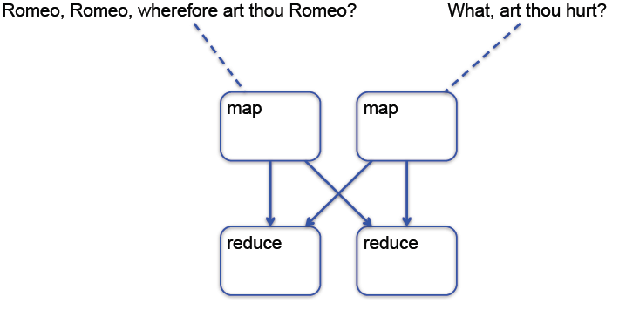
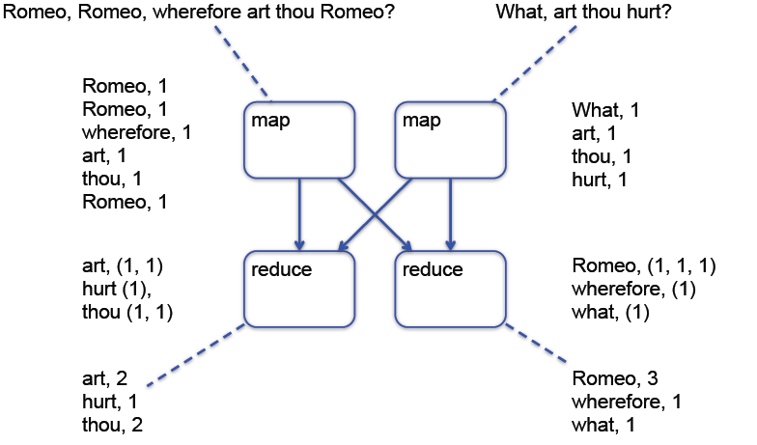
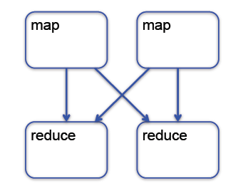
Map Reduce Illustrated (2)

Slide 28
Relational Operators as Map/Reduce jobs
Selection / projection / aggregation
SQL Query:
SELECT year, SUM(price) FROM sales WHERE area_code = “US” GROUP BY year
Map/Reduce job:
map(key, tuple) {
int year = YEAR(tuple.date);
if (tuple.area_code = “US”)
emit(year, {‘year’ => year, ‘price’ => tuple.price });
}
reduce(key, tuples) {
double sum_price = 0;
foreach (tuple in tuples) {
sum_price += tuple.price;
}
emit(key, sum_price);
}

Slide 29
Relational Operators as Map/Reduce jobs
Sorting
SQL Query:
SELECT * FROM sales ORDER BY year
Map/Reduce job:
map(key, tuple) {
emit(YEAR(tuple.date) DIV 10, tuple);
}
reduce(key, tuples) {
emit(key, sort(tuples));
}

Slide 30
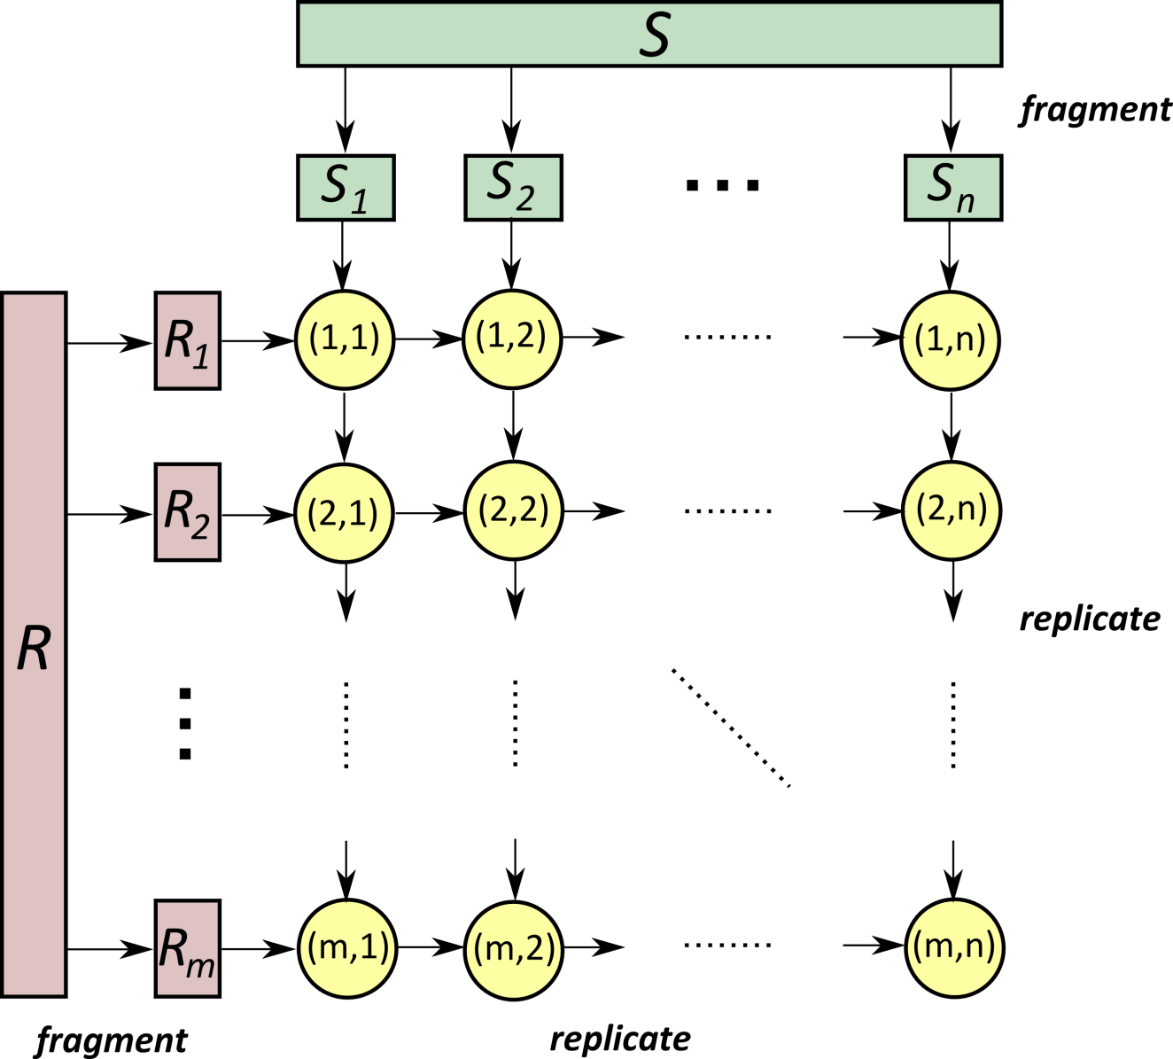
Symmetric Fragment-and-Replicate Join
Nodes in the Cluster
Requires Tricks in map/reduce
Programmer has to worry
about parallelization and/or handcode an optimizer
Important generic example. Specialized parallel joins may exploit data locality

Slide 31
Common Concepts of MapReduce and PACT
PACT is a generalization and extension of MapReduce
PACT inherits many concepts from MapReduce
Both are inspired by functional programming
Fundamental concept of programming model are 2nd-order functions
User writes 1st-order functions (user functions)
User code can be arbitrarily complex (albeit functional!)
2nd-order function calls 1st-order function with independent data subsets
No common state should be held between calls of user function
Input
1st-order function
(User Code)
2nd-order function

Slide 32
Common Concepts of MapReduce and PACT
Both use a common data format
Data is processed as pairs of keys and values
Keys and values can be arbitrary data structures
Key:
Used to build independent subsets
Must be comparable and hashable
Does not need to be unique
no Primary Key semantic!
Interpreted only by user code
Value:
Holds application data
Interpreted only by user code

Slide 33
MapReduce Programming Model Revisited
MapReduce provides two 2nd-order functions
MapReduce programs has fixed structure:
Map:
All pairs are independently processed
Reduce:
Pairs with identical key are grouped
Groups are independently processed
Key
Value
Input set
Independent subsets
Input
MAP
REDUCE
Output
1st-order map fnc
1st-order reduce fnc

Slide 34
PACT Programming Model
Generalization and Extension of MapReduce Programming Model
Based on Parallelization Contracts (PACTs)
Input Contract
2nd-order function; generalization of Map and Reduce
Generates independently processable subsets of data
User Code
1st-order function
For each subset independently called
Output Contract
Describes properties of the output of the 1st-order function
Optional but enables certain optimizations
Think: “interesting properties”
Data
Input
Output Contract
Data
User Code (1st-order function)
Input Contract (2nd-order function)

Slide 35
Input Contracts beyond Map and Reduce
Cross
Builds a Cartesian Product
Elements of CP are independently processed
Match
Performs an equi-join on the key
Join candidates are independently processed
CoGroup
Groups each input on key
Groups with identical keys are processed together

Slide 36
Output Contracts
Same-Key
User Function does not alter the key
Super-Key
Key generated by UF is a super-key of the input key
Unique-Key
Data source or UF produces unique keys
Same-Key
UF
Super-KEY
UF
Unique-KEY
UF

Slide 37
PACT Programming Model
PACT Programs effectively are data flow graphs
Data comes from sources and flows to sinks
PACTs process data in-between sources and sinks
Multiple sources and sinks allowed
Arbitrary complex directed acyclic data flows can be composed
Data Source 1
MAP
REDUCE
Data Sink 1
CROSS
MAP
MATCH
Data Sink 2
Data Source 2
COGROUP
MAP

