Slide 1



112 and eCall: The LifeService platform
Björn Steiger Foundation

Slide 2
Localisation Techniques LifeService.
running system in the German PSAPs
Planned Q4 2008
MAS
LBS
Cell-ID
GPS
Satellites
Three pilot tests were successfully completed in 2007
Possible with all normal mobile phones
Possible with GPS mobile phones + an application
Possible with all normal mobile phones + an application
LifeService. Localisation Platform

Slide 3
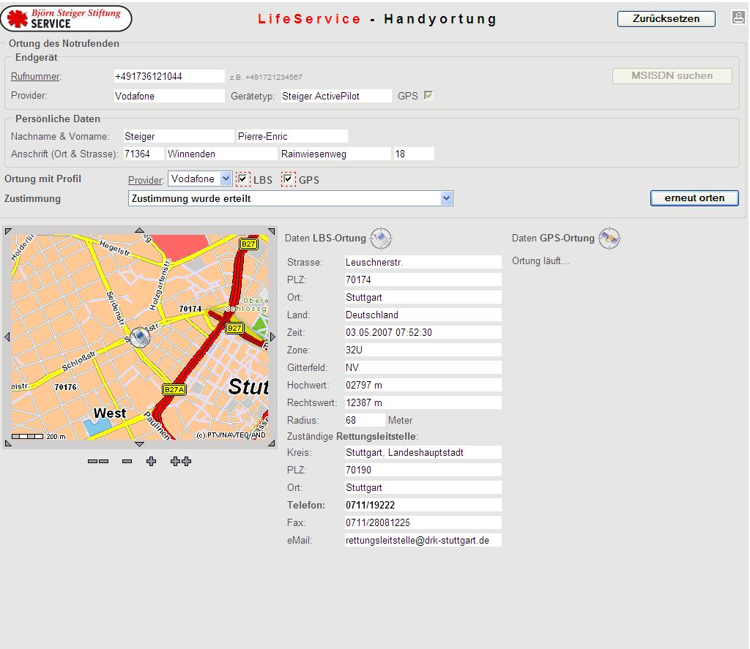
Only LBS
all mobile phones

Slide 4
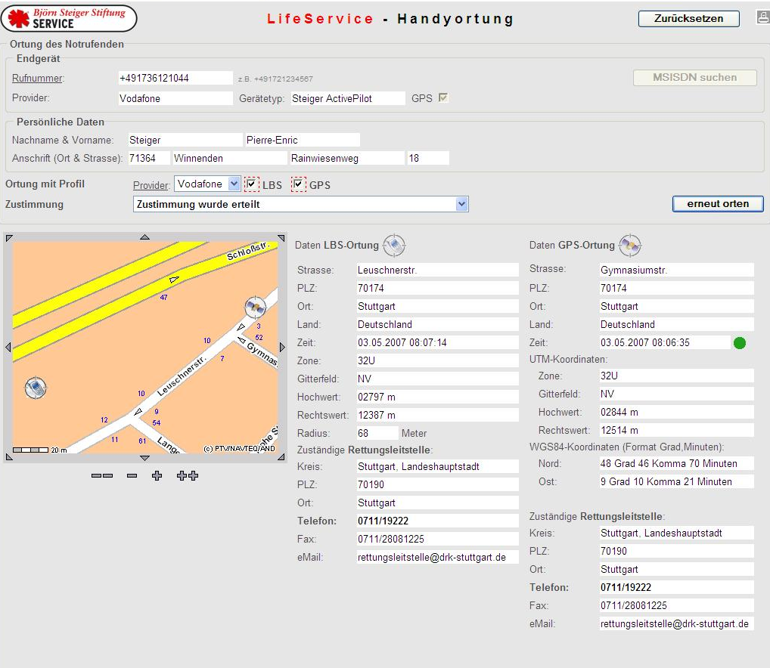
LBS and GPS
Examples of GPS Mobile Phones:
Nokia 6110
Nokia 6210
Nokia 6220
Nokia N78
Nokia N95
Nokia N96
Nokia Communicator
SonyEricsson C702
SonyEricsson Xperia X1
Samsung G810
LG KT610
Blackberry Cave 8300
Blackberry Cave 8310
Blackberry Cave 8320
Blackberry 8800
Blackberry 8820
Blackberry 8830
Blackberry Pearl 8110
Blackberry Pearl 8130
Blackberry 8800
HTC P3300
HTC P3600

Slide 5
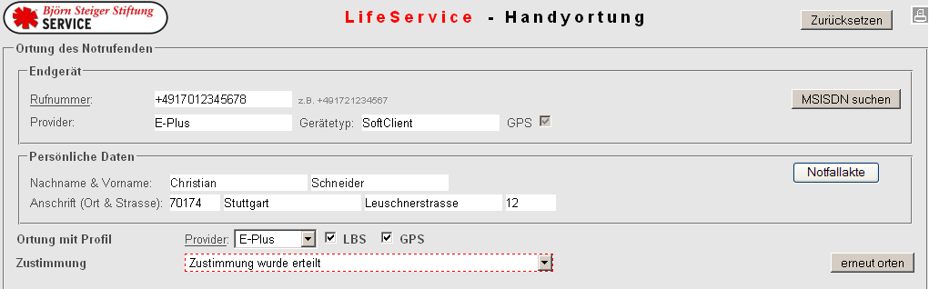
Emergency Record: LifeSensor
Information from emergency records available for all PSAPs over the LifeService. 112 platform:
Button: Emergency record

Slide 6
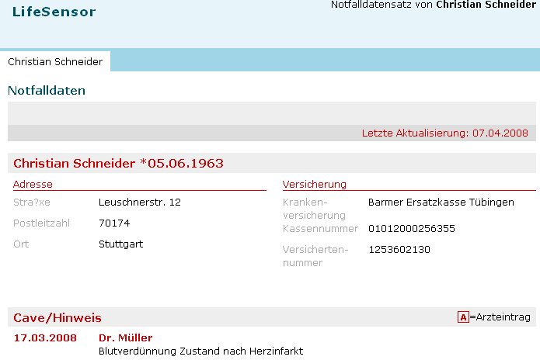
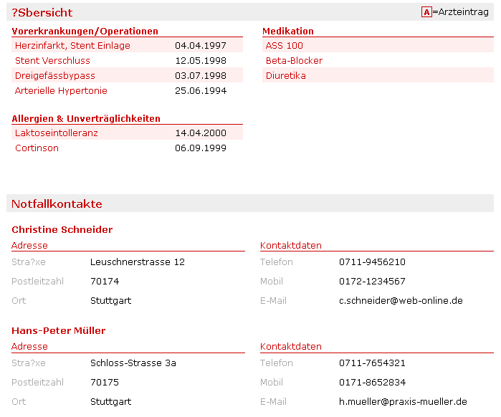


Slide 7

Localisation: LBS - GPS - MAS
Björn Steiger Foundation collaborates with the University of Duisburg/Essen for the development of a new localisation system, called MAS:
MAS – Mobile Assisted System
The coordinates of the mobile phone and the masts are familiar
The mobile device contains information from several mobile phone masts
The position of the mobile phone is requested through a special tool on the device over an SMS
Based on an algorithm, the familiar positions of the mobile phone masts and the signal strength the position of the mobile phone is calculated
Accuracy: a few metres

Slide 8
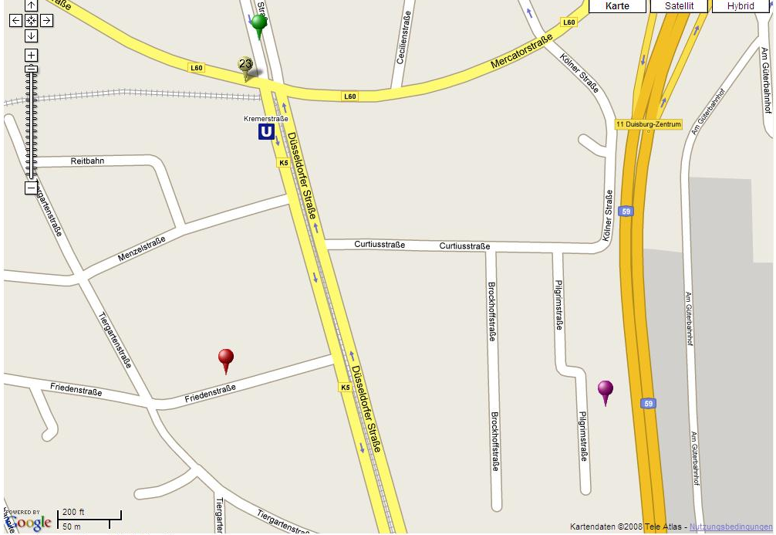
Localisation: via MAS in the City
MAS Position
GPS Position
LBS Position
Vodafone
LBS Position
T-Mobile

Slide 9
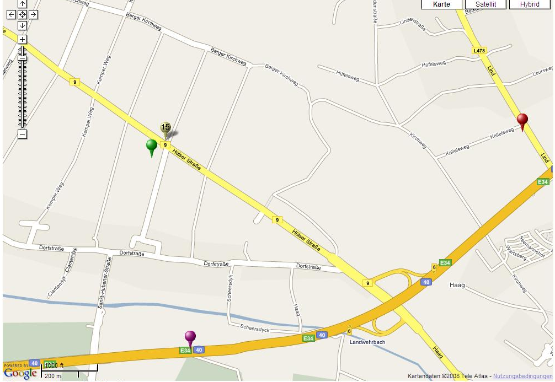
Localisation: via MAS in Rural Areas
LBS Position
Vodafone
GPS Position
MAS Position
LBS Position
T-Mobile

Slide 10
PSAP Structure

Slide 11
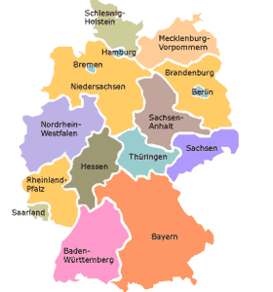
PSAP Environment
Germany as an example – Problem 1:
Federal eCall Responsibility: Federal Department of Transportation
PSAP - a
regional matter:
Ministry for Social Affairs
Ministry of Domestic Affairs
→ Hard to integrate the PSAPs in the eCall discussion
Germany as an example – Problem 2:
Huge technological differences in the PSAP equipment
→ Same problem in the whole EU, approx. 4500 PSAPs

Slide 12
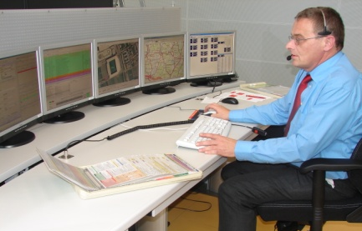
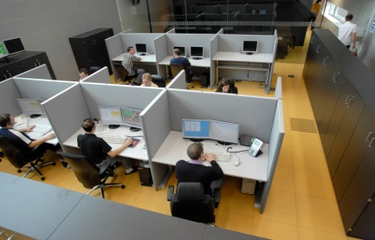
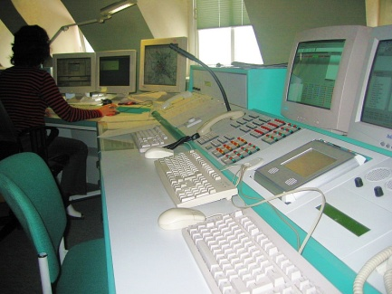
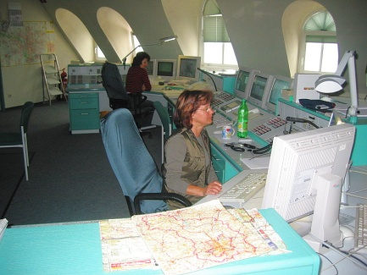
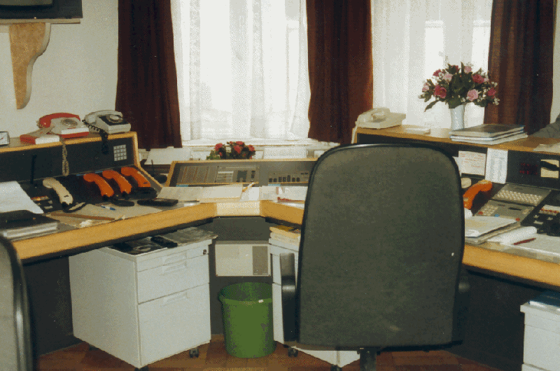
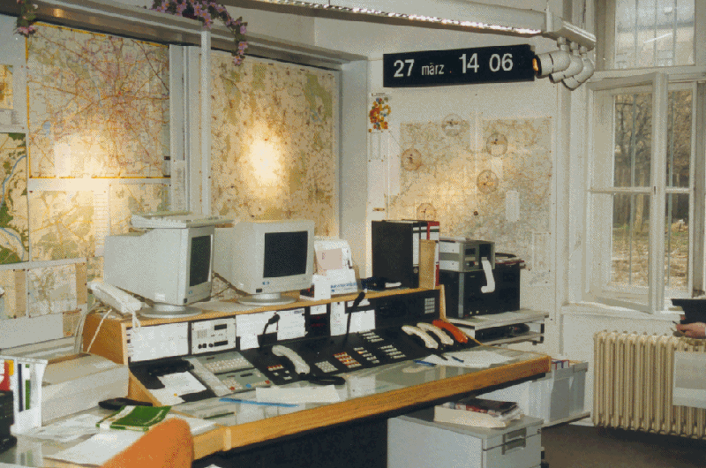
PSAP - State of Technology
10% of the German PSAPs are state-of-the-art and has a high technological standard on the communication system
60% of the German PSAPs have an acceptable standard. They have an ISDN system, Internet access on all computers and the possibility of displaying diagrams, maps etc. onscreen.
30% of the German PSAPs are equipped only with analogue telephone systems, sometimes without a telephone number display, no Internet connection and diagrams, maps etc. cannot be displayed on mono-screens either.
Important to have an eCall solution applicable for all 4.500 European PSAPs
independent on technological standard and financial situation

Slide 13
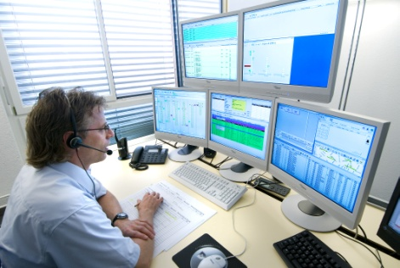
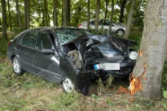

eCall and the German PSAPs
Figures from the German PSAPs for 2006:
36,5 million emergency calls
Less than 1 % of all
emergency calls to German
PSAPs are road accidents
with personal injury
21,9 million emergency calls
from mobile phones (60 %)
From the PSAP´s point of view it
is important to have a solution
with more services than eCall
since it is a small part of
their work
328.000 road accidents involving personal injury

Slide 14
e-Call Systems

Slide 15
eCall – InBand System
Voice and data in the same communication channel:
Voice connection
Responsible PSAP
:
Current communication standard: GSM
vehicle with inband modem
Data transfer (MSD)
Data and voice transfer possible also without SIM
High investments for upgrading the PSAP switchboards all over Europe
Main PSAP – special signalling in the GSM net – another emergency number
Service providers can make a profit out of eCall
Lack of alert redundancy
High investments for the OEMs
Disadvantages

Slide 16
eCall – Transfer to the LifeService. Platform over the BSSS System – Dual-System
Upgrading of the in Germany existing localisation system for mobile devices to include automotive functionalities
Roll-out in Europe
112
Vehicle recognizes crash, activation of cell phone or black box → emergency call and SMS-transfer.
1.
2.
3.
4.
Telematic solution opens voice call and sends 2 SMS with vehicle data to the central LifeService e-Call-Server
2.
1.
PSAP takes all necessary data via internet from the LifeService e-Call-Server
3.
2.
If no phone call is opened, an “event handler” informs the PSAP that vehicle data not has been processed
4.
4.

Slide 17
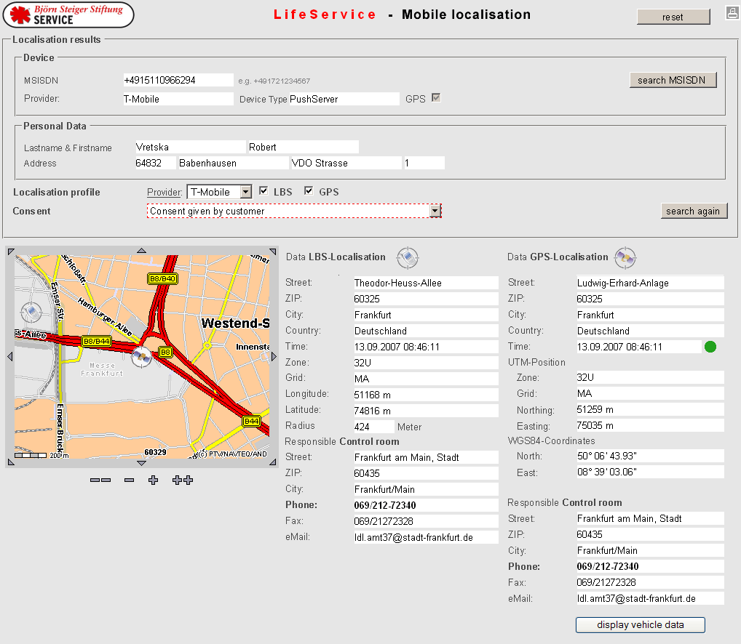
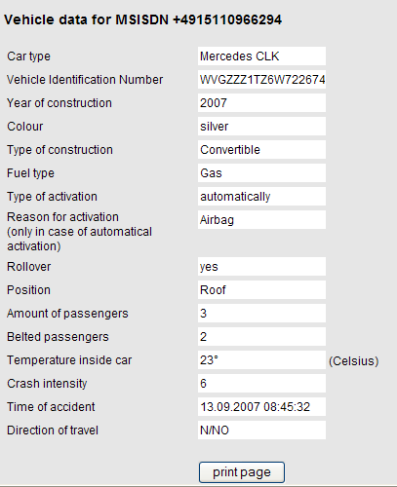
The LifeService. Platform eCall

Slide 18
Björn Steiger Stiftung
p.steiger@steiger-stiftung.de
www.steiger-stiftung.de

Slide 19
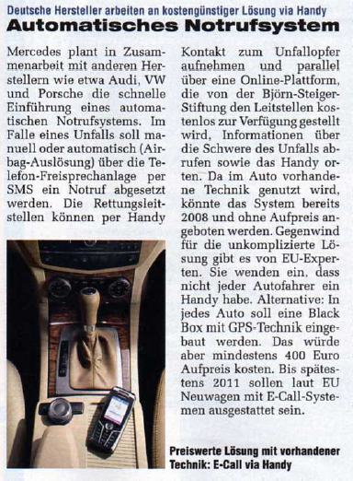

eCall Björn Steiger Foundation
The advantage of implementing eCall in the LifeService. 112 platform was first recognised by the development department at Mercedes-Benz in January 2007.
According to their theory is eCall an emergency mobile phone call, with or without a vehicle.
Continously, if we have a GSM-based solution with access availability for all PSAPs, no further technology needs to be implemented in the PSAPs.
Leading German automotive companies have in published articles declared their intent to collaborate with the Björn Steiger Foundation in the eCall project.
Auto Motor & Sport, 06.06.2007

Slide 20

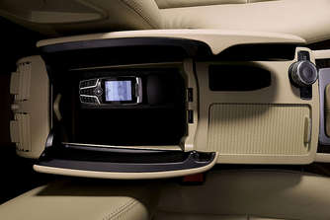
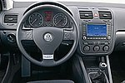
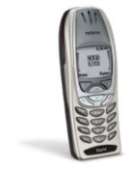

eCall – Automotive Solutions
highest safety Black box dual system
high safety SIM card placed in slot
high safety Mobile phone in charger device
+
cost optimized safety Mobile phone pairing with CAN
+
cost optimized safety Mobile phone pairing with airbag
20

Slide 21


e-Call Flag
Lokales PSAP
Call 112
without e-Call Flag
Call 112
with e-Call Flag
Nationales PSAP

