Slide 1
Embracing the Consumerization of IT!
Dr. Said Zahedani
Snr. Director Developer and Platform Strategy Group
Microsoft Deutschland GmbH

Slide 2
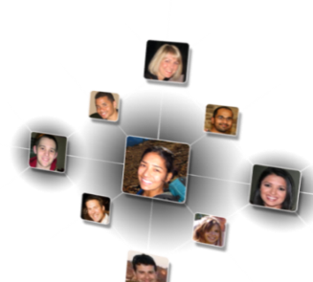
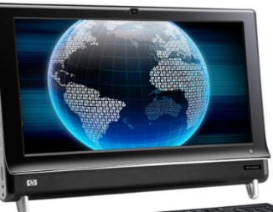
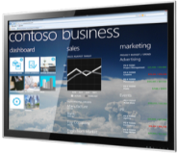
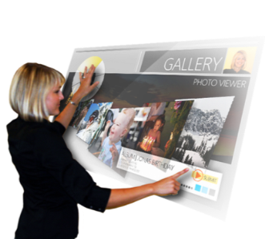
Microsoft Is Innovating Around Important IT Trends
Cloud computing
Data explosion
Social computing
Browser Based Apps
Ecosystem of computers
Personal devices in the workplace
Ubiquitous connectivity
Natural interaction

Slide 3
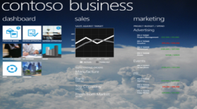
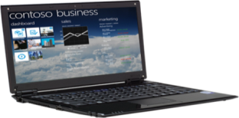
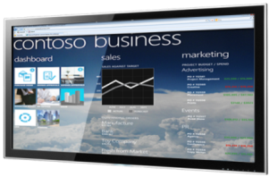
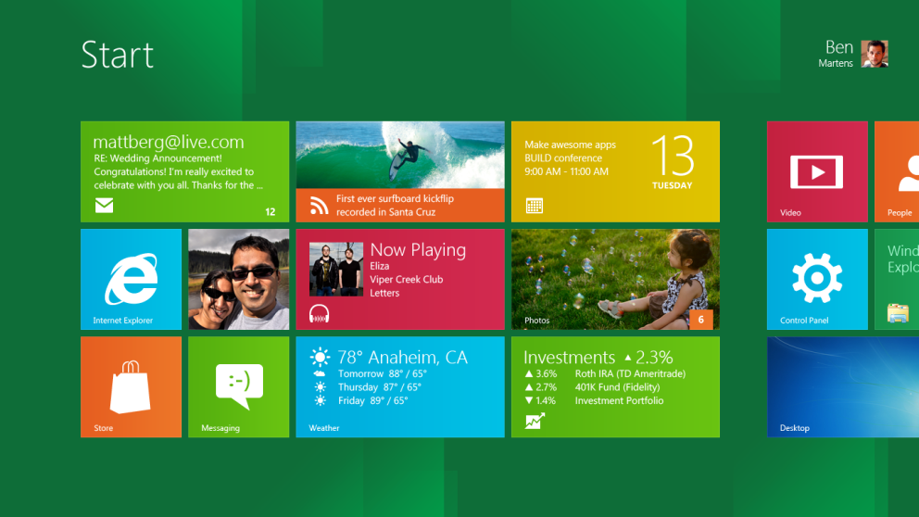
App Development Tools That Simplify and Enrich the Developer Experience
Consistent, connected experiences across the PC, Phone and browser
Unified application development
One development environment for all devices
Ability to enhance and extend apps with the cloud
A look ahead…

Slide 5
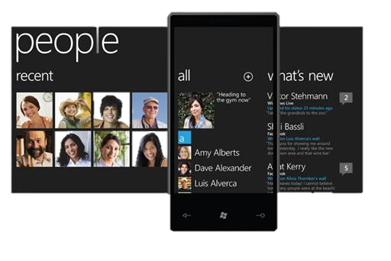
Metro Design Principles
Clean, Light, Open, Fast
Alive in Motion
Celebrate Typography
Content, Not Chrome
Authentically Digital

