Slide 1


Business Web –
The World is Changing
Dr. Uwe Kubach, Vice President
SAP Research, SAP AG, Walldorf, Germany

Slide 2

About SAP Research
The global technology research and innovation unit of SAP.
19 research locations worldwide with 700 employees.
Seven thematic research practices, a prototyping group and a business incubator.
A network of more than 800 partners from industry and academia

Slide 3

THE WORLD IS CHANGING
> 750 Million*
people are members of social networking sites

Slide 4

72%
say it is easier to locate
“knowledge” on the
web than on IT systems
THE WORLD IS CHANGING
Yankee Group – enterprise storage study – 2008

Slide 5

50%
of profits of large companies come from products launched
in the last 10 years.
THE WORLD IS CHANGING
Source: research conducted by Forbes, Ernst & Young, and the Wharton School of Business

Slide 6
Trends in Enterprise Computing
Business Network as
the Model
    Businesses are moving away from static supply chains towards adaptive and dynamic value networks formed through collaboration.
Everything as a Service
    Business activities from mainstream industries will move into the Internet of Services and will be presented as the next wave of consumable services.
Internet of Things
    Massive volumes of information from intelligent and connected things will change the way businesses and consumers interact.

Slide 7



Technology Disruption
Enterprise
Mobility
Cloud
Computing
In-Memory

Slide 8
The Application Market is Shifting
Traditional Apps
New Apps
    Need to Complement Existing Solutions
Number of Customers
    Fast Development
    Instant Use
    Real-time Data
    Exciting User Experience
    On any Device
Number of Apps

Slide 9
The Inflection in Enterprise Software
The Emergence of the Cloud indicates the need for new “Systems of Engagement”*
Emergent Needs
Mobility
Cloud Systems
Big Data
New User Experience
Elastic
GAP
Social
Current Enterprise Systems
Internet of Things
* Enterprises Shifting from ‘Systems of Record’ to ‘Systems of Engagement’. Geoffrey Moore, The Future of Enterprise IT, Innovation Conference, June 2011

Slide 10
Business Web: A True Business Cloud for the Enterprise
The Business Web is a cloud-based business environment that provides access to the necessary infrastructure, applications, content, and connectivity to deliver end-to-end business services optimized for mobility and ease of participation.
Service Center
App Store
Trusted Network of Business Service Providers
One-Stop Shop for Mobile Business
Business Web
Infrastructure
Content Center
Tools for Developing
and Operating Business Services on the Cloud
Globally Aggregated Business Intelligence for Real-Time Trading

Slide 11
Business Web: Marketplace and Business network
The Business Web is a cloud-based business environment that provides access to the necessary infrastructure, applications, content, and connectivity to deliver end-to-end business services optimized for mobility and ease of participation.
The Provider Side
The Consumer Side
Business Web Partners
Businesses/
Enterprises
Service Providers
Business Web
Connected Consumers
Enterprise, Web or Machine Data
Developer Community
Government
Businesses/
Enterprises
Connected Consumers
Government

Slide 12


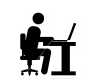

Demand & Supply on the Business Web
End Consumer
ENTERPRISE
e.g. Enterprise Users
BUSINESS WEB
Cloud Services
1
Request Business Service
(e.g. App to monitor vending machines in theme parks)
Enterprise Private Cloud
App
5
Deploy and Operate Business Service
Global Telco & Mediation Services
Creative, Development (ISV) & Content Services
4
Deploy and Operate Business Service
2
Build & Test Business Service
Device/IoT Makers
3
Build Device (e.g. tablet for emerging market/ sensor-equipped vending machine) for Business Service

Slide 13
Business Web Timeline & Structure
Strategy
Inception
Development
Board Decision
June 2011
Today
Dec 2011
Productization
Casino
Pilot A
Casino Pilot B
Unilever Pilot
June 2012: Version 0.9
Partners | SAP, HP, Intel, GlobalLogic, Ericsson, Deutsche Telekom
Adopters | Unilever, Casino

Slide 14
Business Web: Roadmap of Pilot Scenarios
Next-Phase
Scenarios (Initial)
Future Target
Scenarios
Pilot
Scenarios
    Collaborative Energy Management
    Connected Highways
    Smart Home
    Agrar/Crop Monitoring
    Distributed Education
    Mobile Banking
    Aging Services
    Mobile Vending
    eHealth: Remote Care
    Emerging Market Apps
    Connected Cars
    Aftermarket Product Services
    Hub service, predictive
    maintenance
    Mobile Workforce
    Management
    Public Safety (Food safety,
    recalls, …)
    Precision Retailing
    Retail Sales Execution
    Ice-Cream Container Tracking
    Mobile Money
    New Service Creation
    Automotive Logistics

Slide 15


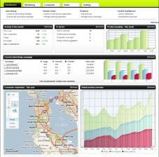
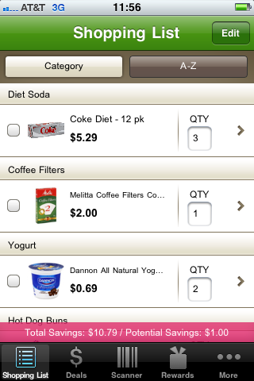

Precision Retailing
Consumer
Receives rich product info and special offers
Retailers & CP’s
Understand Consumer Shopping Context
Personal Shopping Assistant
Marketing Platform to Inform & Analyze
Personalized information in real-time
before a purchasing decision is made
    Find the right product and services
    Get better value for money
    Save time shopping
    Create real-time, 1-to-1 relationship with consumers
    Enable up-sell & cross-sell activities, digital couponing
    Collect rich information on consumer behavior
CRM
ERP
BI
POS
RTOM
PMR
Legacy Systems & New Services
  Access information needed to increase personalization level

Slide 16
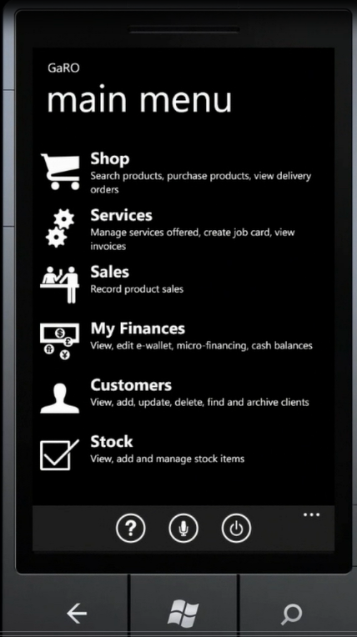
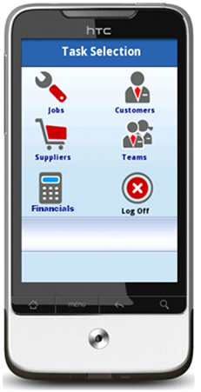
Supporting Very Small Businesses
    Millions of very small enterprises
    Such as a plumbers in South Africa, shop owners etc.
Huge Market
    Very cost sensitive
    Mobile device as only computer
    Business in your pocket
Requirements
    Manage jobs
    Manage customers
    Easily procure supplies
    Do simple invoicing and payments
    Do simple cash flow management
Adressed Needs

Slide 17







Product Services for Manufacturing Equipment
Global Predictive Maintenance
    Complex business networks
    Information hub for machine and business data (M2B, M2M)
    New cross-company business models
OEM
Component
Manufacturer
System
Integrator
Business Web
Maintenance Engineer
Operator
Service
Provider

Slide 18
Some Research Topics
Managing
Complexity
    Data sources & target platforms
    Platform independent development
    Management of embedded software
Security &
Trust
    Cross organization
    “Sticky Policies”
User
Interfaces
    From raw data to meaningful information
    Intelligent user support
    New interaction paradigms
    Service Description (USDL)
Interoperability
Business
Model
    Product-Service-Systems
    Network provisioning (MVNO)

Slide 19

63% of the world’s transaction revenue
touches a SAP system.

Slide 20

Thank You!
Contact information:
Dr. Uwe Kubach
SAP Research, SAP AG
uwe.kubach@sap.com

